Slide 1
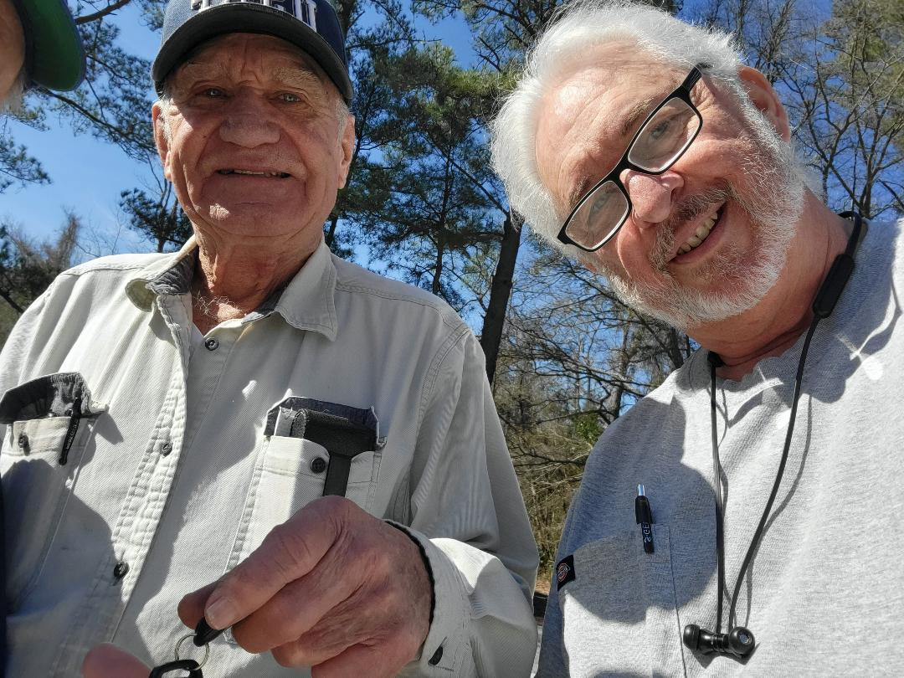
Thank You All

Slide 2
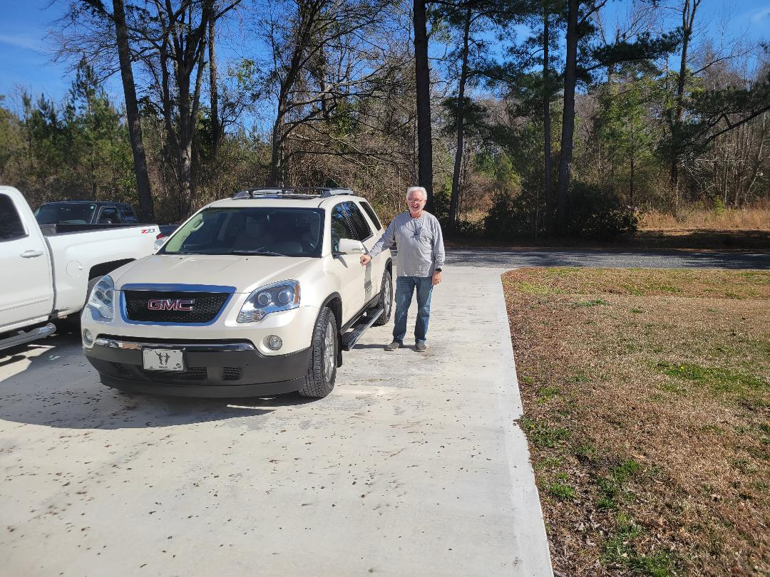
For this Very Generous Gift
I Can Never Thank You Enough!!

Slide 4

Worship Myths Pt 2
Edward Christian Church
February 26, 2023

Slide 5
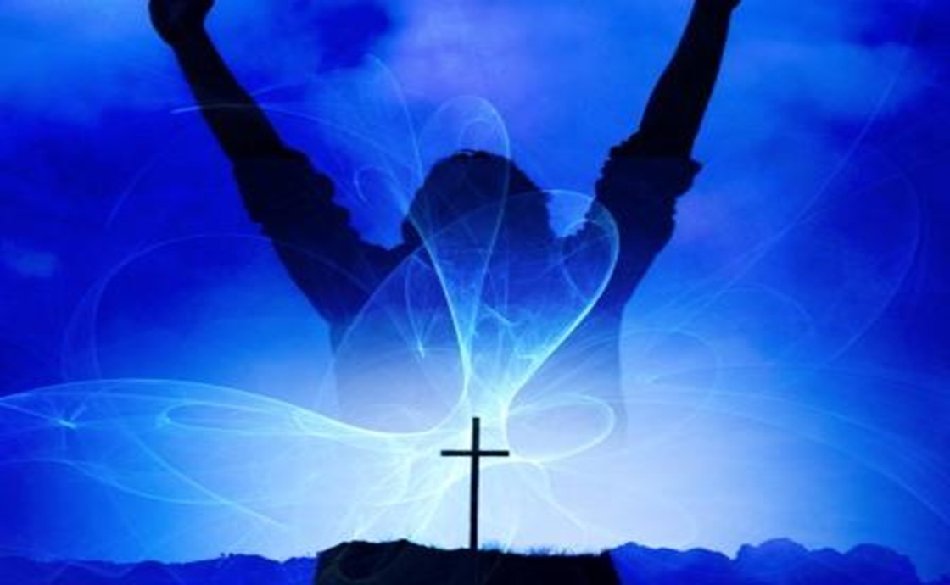

Praise and Worship
God Designed His Creation to Worship Him
Rom 1:20
“For the invisible things of him from the
Creation…. so that they are without excuse”
Rom 1:25
“changed the truth of God into a lie,
worshipped / served the creature > the Creator”
Isa 55:12
“The mountains and hills will burst into song,/ the trees of the field will clap their hands!”
Whenever God Communes With Us..
…We Respond With
Thanksgiving.. Praise ..Worship

Slide 6
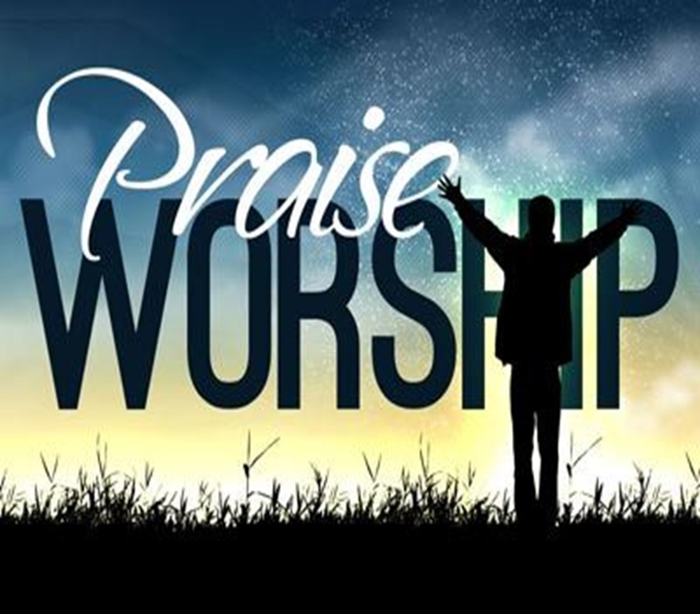
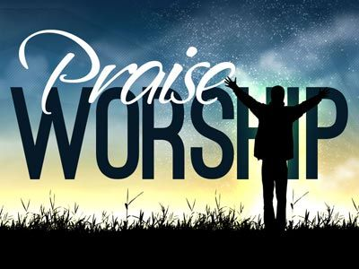
The Difference
Praise is…
Worship is…
About God
Opening Up
Boldly Declaring
Praise Applauds What...
…God Has Done
to God
Entering In
Humbly Bowing
Worship is Honoring…
…God for Who He Is

Slide 7

Our Purpose(goal) in Worship
Myth #1:
Worship is when we Talk about God
Truth #1:
Worship is when we Come into..
…the Presence of God
  True “God Encounter”
Psalm 22:3 (NASB77)
Yet Thou art holy,
O Thou who art enthroned upon the praises of Israel.

Slide 8
The Product(result) of Worship
Myth #2:
True Worship Leaves Me Feeling Pleased
Truth #2:
True Worship Leaves God Feeling Pleased
Eph 5:10 (AMP)
¹⁰ And try to learn [in your experience] what is pleasing to the Lord [let your lives be constant
proofs of what is most acceptable to Him].
Many Christians believe that they are the audience; in truth, God is the Audience (of One)

Slide 9
The Point of Focus in Worship
Myth #3:
In Worship, the Focus is on the Activity
(Performance Driven)
Truth #3:
In Worship, the Focus is on God
(Driven to Performance)
  Worship is an Inside Job!

Slide 10
The Pathway to Worship
Myth #4:
True Worship Happens when the Music
and Message are Good
  It Definitely Enhances but…
Truth #4:
True Worship Happens When We
Worship in Spirit / Truth
John 4:21-24

Slide 11
The Pathway to Worship
“The true worshipers will worship the Father in spirit / truth, for they are the kind of worshipers the Father seeks.” -John 4:23
Worship in Spirit= Attitude
...Beyond Surface
...Beyond Situation
Worship in Truth= Foundation
...Beyond Human Reasoning
...Beyond Human Reaction

Slide 12
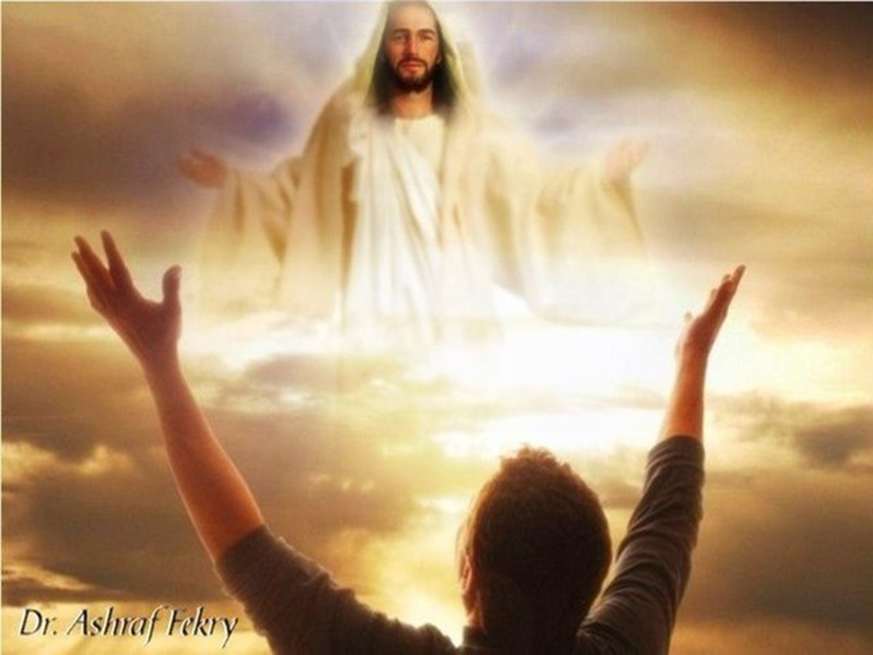

Our Preparation for Worship
Myth #5:
Worship Happens in Church –Only
Truth #5:
Worship is an Everyday Thing
Psalm 119:164 ,“Seven times a day do I praise thee because of thy righteous judgments”
Worship Can Happen Anytime We are Open to the Reality and Presence of God.

Slide 13
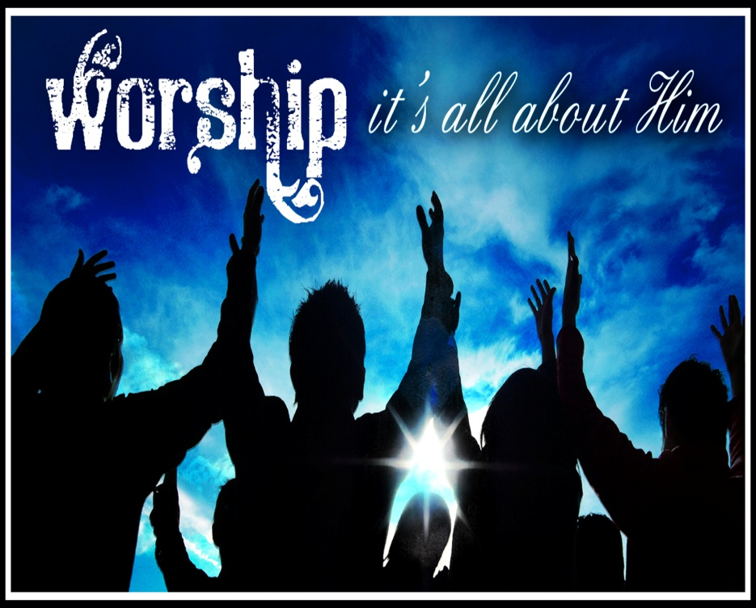
Our Passion for Worship
Myth #6:
I’m willing to Worship if We All Get Involved
Truth #6:
I’m willing to Worship if it’s Me Alone
Psalm 103:1, “Bless the LORD, O my soul: and all that is within me, bless his holy name”

Slide 14

Our Need for Worship
Myth #7:
Worship Does Not Affect my Life (not need it)
Truth #7:
Worship is a Life Altering Experience
(can’t live without it)
Psalm 27:4 (NASV)
One thing I have asked from the LORD, that I shall
seek: That I may dwell in the house of the LORD
all the days of my life, to behold the beauty of the LORD, And to meditate in His temple.”

Slide 15
Our Need for Worship
“In the year of King Uzziah’s death, I saw the Lord
Sitting on a throne, lofty and exalted, with the train
of His robe filling the temple .the foundations of the
thresholds trembled at the voice of him who called
out, while the temple was filling w- smoke. Then I said,
"Woe is me, for I am ruined! Because I am a man of
unclean lips, / I live among a people of unclean lips;
For my eyes have seen the King, the LORD of hosts“
Then one of the seraphim flew to me, w- a burning
coal in his hand which he had taken fr. the altar w-
tongs. /he touched my mouth w- it / said, "Behold, this
has touched your lips; /your iniquity is taken away,
and your sin is forgiven." -Isa 6:1-7 NASV

Slide 16
Our Style of Worship
Myth #8
Worship must be conducted in a Certain Style
Truth #8:
God Doesn’t Notice the How as much as the Why
True Worship is…
  Personal
  Corporate
  Never Limited
  Always Pleasing
  Draws us Closer –to God / each other

Slide 17
#8- Our Style of Worship
Worship is an…
“Inside Job”
Once it Starts it Moves…
“Out…
…and Up!”
God’s Heart is Touched…
…Ours is Lifted Up!

Slide 18
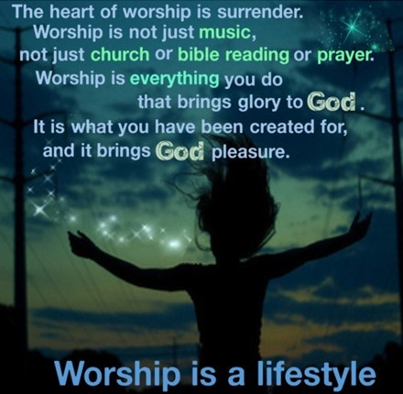
I need to worship because without it…
I can forget that I have a big God beside me-live in fear.
I can forget his calling /begin to live in a spirit of self-preoccupation.
I lose a sense of wonder/ gratitude/ plod through life with blinders on.
My natural tendency is toward self-reliance / stubborn independence.”

Slide 19
