Slide 1
Repeat
These are the 2 Most Important Hours of My Week – Help Me to Cherish Them
I Am Here Today to Worship
Not to Be Entertained
I Am Singing to An Audience of One
Accept My Worship Oh Lord!

Slide 2
Thank You God
For This NEW…
Year
Start
Opportunities
Challenges
Victories
Help Me to Take Advantage of These

Slide 3
AMAZING GRACE
Notes:
3

Slide 4
Amazing Grace how sweet the sound
That saves a wretch like me
I once was lost but now I’m found
Was blind but now I see
Notes:
4

Slide 5
I Get A Peaceful Easy Feeling
I Know You Won’t Let Me Down
Cause I’m All Ready Standing
On Solid Ground
Notes:
5

Slide 6
Through many dangers, toils and snares
I have already come,
'Tis grace has brought me safe thus far
And grace will lead me home.
Notes:
6

Slide 7
I get a peaceful easy feeling
I know you won’t let me down
Cause I’m all ready standing
On solid ground
Notes:
7

Slide 8
When we've been there ten thousand years
Bright shining as the sun,
We've no less days to sing God's praise
Than when we've first begun.
Notes:
8

Slide 9
I get a peaceful easy feeling
I know you won’t let me down
Cause I’m all ready standing
On solid ground
Notes:
9

Slide 10
I Surrender All

Slide 11
All to Jesus, I surrender;
All to Him I freely give;
I will ever love and trust Him,
In His presence daily live.
I surrender all, I surrender all,
All to Thee, my blessed Savior,
I surrender all.

Slide 12
Repeat
I Lift My Offering to You
Let It Please You Oh Lord
This is My Seed
Although It Leaves My Hand
It will Never Leave My Life
You Will Multiply It!
Accept My Seed Oh Lord!

Slide 13
Heart of Worship

Slide 14
When the music fades, all has slipped away and I simply come.
Longing just to be something that's of worth that will bless Your heart.

Slide 15
I'll bring You more than a song, for a song in itself is not what You have required.
You search much deeper within, through the way things appear,
You’r looking into my heart.

Slide 16
I'm coming back to the heart of worship and it’s all about You, it’s all about You, Jesus.
I'm sorry, Lord, for the thing I've made it when it’s all about You, it’s all about You, Jesus.

Slide 17
I was talking to someone at the Vets office last week…
We were talking about training our pets and teaching them tricks…
Guy : I taught my dog to play chess.
Me : He must be very smart?
Guy : Not really, I beat him two games out of three.

Slide 19

Edward Church
March 5, 2023

Slide 20

Praise Is..
Powerful-
  Never leaves situation the same
Positive-
  Hard to praise and pout at same time
Predictor-
  It effectively predicts the outcome
Productive-
  It can do what nothing else can…

Slide 21

…Gets Our Focus Off Ourselves… Back On God
  In “selfie” focused world, we need this reminder…
  …life is not all about us.
  When We Get Eyes on Self… “Hurt” is Magnified
  When Our Eyes are On Him … “Hope” is Magnified
He is Worthy of Our Praise…
…No Matter What We Face From Day to Day.
“Praise him for his mighty deeds; praise him according to his excellent greatness!” Psa. 150:2
"And my tongue shall speak of your righteousness and of your praise all the day long." Psa. 35:28

Slide 22

…Brings Us to a Place of Humility
We remember our dependency on God, as we acknowledge our need for Him.
As we praise Him as Creator/ King of this world…
…we recognize that we’re not in control, but He is!
“Let us come into his presence with thanksgiving; let us make a joyful noise to him with songs of praise! For the Lord is a great God, and a great King above all gods” Psa. 95:2-3
"I will give you thanks in the great congregation: I will praise you among much people" Psa. 35:18

Slide 23

…Makes the Enemy Flee
  It pushes back the darkness that surrounds
  Evil will not stick around if we’re praising our God…
…who will fight our battles for us.
Jehoshaphat, saw God miraculously defeat the enemy
“As they began to sing / praise, the Lord set ambushes against the men of Ammon / Moab / Mount Seir who were invading Judah, / they were defeated” 2 Chron. 20:22

Slide 24

…Leaves No Room For Complaining and Negativity
  Sometimes Problems Overwhelm Us
  Prayers Become Complaints
  Problems Become Set In
Praise Reminds Us Of…
  What He Has Already Done In Our Lives.
  He Can Do It Again
“Bless The Lord, O My Soul, And Forget Not All His Benefits, Who Forgives All Your Iniquity, Who Heals All Your Diseases, Who Redeems Your Life From The Pit, Who Crowns You With Steadfast Love And Mercy.” Psa. 103:2-4
"By Him Therefore Let Us Offer The Sacrifice Of Praise To God Continually, That Is, The Fruit Of Our Lips Giving Thanks To His Name." Heb. 13:15

Slide 25
..Leaves No Room For Complaining and Negativity
Luke 24:50-53
⁵¹ And it came to pass, while he blessed them, he was parted from them, and carried up into heaven. ⁵² And they worshipped him, and returned to Jerusalem with great joy: ⁵³ And were continually in the temple, praising and blessing God. Amen.
Acts 2:1-2
¹ And when the day of Pentecost was fully come, they were all with one accord in one place. ² And suddenly there came a sound from heaven as of a rushing mighty wind, and it filled all the house where they were sitting.

Slide 26
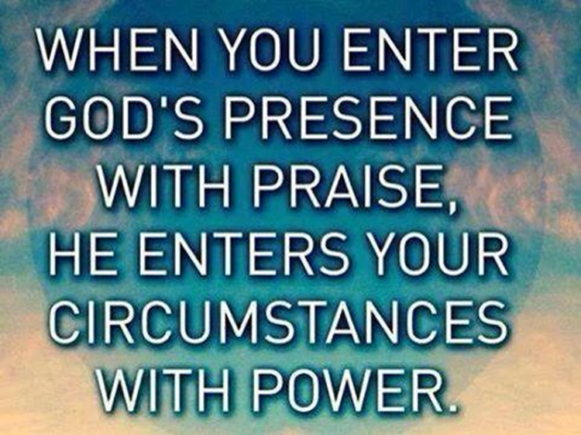
They Didn’t Focus on the Crucifixion
But their Focus was on the Resurrection

Slide 27
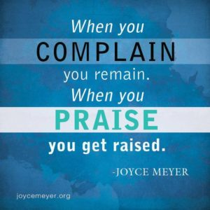




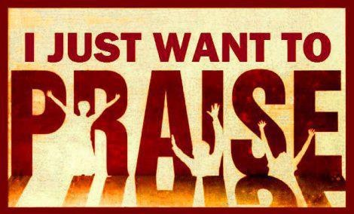

Slide 28

…Praise Invites His Presence
God dwells close to us when we praise Him
  He lives there
  He looks for it
“He inhabits the praises of His people.” Psa. 22:3
"But you are a chosen generation, a royal priesthood, an holy nation, a peculiar people; that you should show forth the praises of him who has called you out of darkness into his marvelous light;"
1 Pet. 2:9

Slide 30
Put your hand in the hand of the man who stilled the waters
Put your hand in the hand of the man who calmed the sea
Take a look at yourself / you can look at the others differently
By putting your hand in the hand of the man from Gal-ilee
Every time I look into the Holy Book I wanna tremble
When I read about the part where a carpenter cleared the temple
For the buyers and the sellers were no different
Fellers than what I profess to be
And it causes me shame to know I'm not the man that I should be

Slide 31
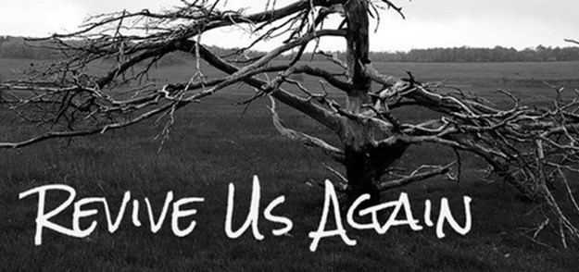
…Our Spirits are Refreshed and Renewed in His Presence
We're strengthened by His peace and refueled by His joy.
Through a Heart of Praise…
…We Realize that God Doesn’t Just Change Our Situations
…and Work Through Our Problems,
…He Changes Our Hearts.
“In His presence, there is fullness of joy.” Psa. 16:11
"Because your love is better than life, my lips will glorify you.
I will praise you as long as I live,
and in your name I will lift up my hands." Psa. 63:3-4

Slide 32
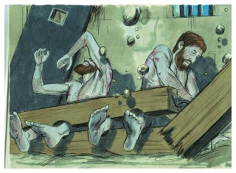
…It Paves the Way for God’s Power to be Displayed
People's lives are affected and changed.
God shakes things up through praise.
As Paul and Silas sat in prison, shackled, but praising God.
  Praise Moved God
  God Moved Heaven /Earth -God sent an earthquake
  Power Moved Hearts –jailer/ all his family saved-
“About midnight Paul/ Silas were praying/ singing hymns to God, and the prisoners were listening to them, and suddenly there was a great earthquake, so that the foundations of the prison were shaken. immediately all the doors were opened, and everyone's bonds were unfastened.” Acts 16:25-26

Slide 33
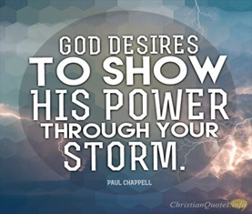
…It Paves the Way for God's Power to be Displayed
We have a choice every day in this life.
  live absorbed in worry and stress…
…focused only on what surrounds us
We can ask God to help us take our eyes off all the…
  problems and mess, or the voices of others…
  …look up...to the One who holds it all together
God desires our whole heart.
He longs for us to know the power of His presence
…He desires to bless us more than we could imagine
…His Spirit urges us onward, calling us closer

Slide 34
We praise you today with our hearts and songs, we praise you
for your faithfulness, we praise you for your great power and
love. We confess our need for you, our lives don't go so well
when we just spin around on our own. We struggle and worry,
get weary and worn. Yet you never leave us. Thank you for your
presence. Thank you for your care over us, thank you that you
breathe renewal right into our souls. We ask for your spirit to
fill us, to draw us close to yourself, and to work your purposes
through us, as we set our eyes on you.

Slide 35

Pt 2

Slide 36
We have so much to praise God for, there's great power in giving honor to Him. And many of you live that truth out, every single day of your lives. The Bible is filled with examples of praise when we see His power released - life-changing miracles, dramatic stories of the enemy being halted or defeated, hearts being changed and drawn closer to Him.
Yet reality is that way too often, daily struggles or constant life demands can crowd out our praise to God. We might check the worship box at church and somehow think we’re good for the week. And all the while, with souls distant and cold, we sing words, we listen to music, then we go home.
Sometimes it really is a sacrifice to offer praise. We may not feel like it. We’re struggling. We're weary. Or maybe, we feel like He let us down. We think God seems distant, like he's far away, or doesn't really care about what's troubling us. Painful life blows and losses might have recently sent us spiraling.
Here’s what can make a lasting difference. When we make that decision to fix our eyes on Him, and daily give Him praise, no matter what's staring us straight in the face, we suddenly realize that God has already begun to release the grip those struggles can have over us.
There’s power in our acknowledgement that He is worthy, above all else, of our worship and praise.
His Spirit urges us onward, to press in close to him. Doesn't matter how good or "not so good" we feel like we can sing, doesn't matter if we like upbeat worship, more reflective songs, or traditional hymns. Doesn't matter if we're alone, with a few, or in a big group. Doesn't even matter whether we "feel" like it or not. What matters is this - our hearts in tune with our Creator and King.

Slide 38

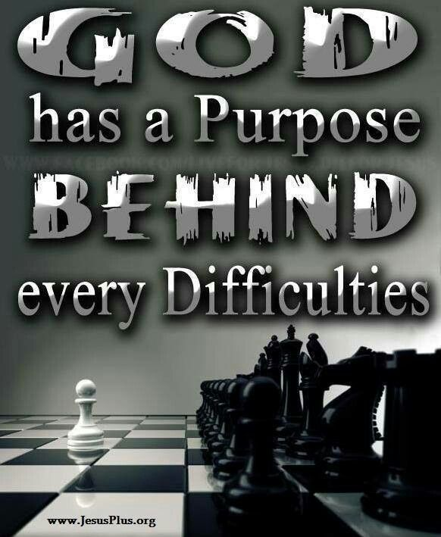

Slide 40
Floods

Slide 41
5. Praise makes room for God’s blessings over our lives. He will not hold back His goodness, praise opens the gateway of blessing as we come into the Presence of our King.
“Enter his gates with thanksgiving, and his courts with praise! Give thanks to him; bless his name!” Psa. 100:4
"Blessed be the God and Father of our Lord Jesus Christ, who has blessed us with all spiritual blessings in heavenly places in Christ:" Eph. 1:3

Slide 42
6. Praise invites His presence. God dwells close to us when we praise Him. He lives there. He looks for it.
“He inhabits the praises of His people.” Psa. 22:3
"But you are a chosen generation, a royal priesthood, an holy nation, a peculiar people; that you should show forth the praises of him who has called you out of darkness into his marvelous light;" 1 Pet. 2:9

Slide 43
7. Our spirits are refreshed and renewed in His presence. We're strengthened by His peace and refueled by His joy. Through a heart of praise, we realize that God doesn’t just change our situations and work through our problems, He changes our hearts.
“In His presence, there is fullness of joy.” Psa. 16:11
"Because your love is better than life, my lips will glorify you. I will praise you as long as I live, and in your name I will lift up my hands." Psa. 63:3-4

Slide 44
8. It paves the way for God's power to be displayed, miracles ​happen. People's lives are affected and changed. God shakes things up through praise. As Paul and Silas sat in prison, shackled, and chained, they kept right on praising God. And God sent an earthquake that shook the cells and broke the chains. The jailer and all his family came to know Christ that very night.
“About midnight Paul and Silas were praying and singing hymns to God, and the prisoners were listening to them, and suddenly there was a great earthquake, so that the foundations of the prison were shaken. And immediately all the doors were opened, and everyone's bonds were unfastened.” Acts 16:25-26
We have a choice every day in this life. To live absorbed in worry and stress, on the fast track of busy, focused only on what surrounds us, tuned into the roar of the world.
Or, we can ask God to help us take our eyes off all that may be swirling around, our problems and mess, or the voices of others. And we can look up...to Him, the One who holds it all together, and who holds us in his hands.
God desires our whole heart. He waits for us to return. He longs for us to know the power of His presence over our lives. He desires to bless us more than we could imagine. His Spirit urges us onward, calling us closer.
May He help us to look up...open our mouths...and sing.

Slide 45
Dear God,
We praise you today with our hearts and songs, we praise you for your faithfulness, we praise you for your great power and love. We confess our need for you, our lives don't go so well when we just spin around on our own. We struggle and worry, get weary and worn. Yet you never leave us. Thank you for your presence. Thank you for your care over us, thank you that you breathe renewal right into our souls. We ask for your spirit to fill us, to draw us close to yourself, and to work your purposes through us, as we set our eyes on you.
In Jesus' Name, Amen.

Slide 47
We have so much to praise God for, there's great power in giving honor to Him. And many of you live that truth out, every single day of your lives. The Bible is filled with examples of praise when we see His power released - life-changing miracles, dramatic stories of the enemy being halted or defeated, hearts being changed and drawn closer to Him.
Yet reality is that way too often, daily struggles or constant life demands can crowd out our praise to God. We might check the worship box at church and somehow think we’re good for the week. And all the while, with souls distant and cold, we sing words, we listen to music, then we go home.
Sometimes it really is a sacrifice to offer praise. We may not feel like it. We’re struggling. We're weary. Or maybe, we feel like He let us down. We think God seems distant, like he's far away, or doesn't really care about what's troubling us. Painful life blows and losses might have recently sent us spiraling.
Here’s what can make a lasting difference. When we make that decision to fix our eyes on Him, and daily give Him praise, no matter what's staring us straight in the face, we suddenly realize that God has already begun to release the grip those struggles can have over us.
There’s power in our acknowledgement that He is worthy, above all else, of our worship and praise.
His Spirit urges us onward, to press in close to him. Doesn't matter how good or "not so good" we feel like we can sing, doesn't matter if we like upbeat worship, more reflective songs, or traditional hymns. Doesn't matter if we're alone, with a few, or in a big group. Doesn't even matter whether we "feel" like it or not. What matters is this - our hearts in tune with our Creator and King.

Slide 48
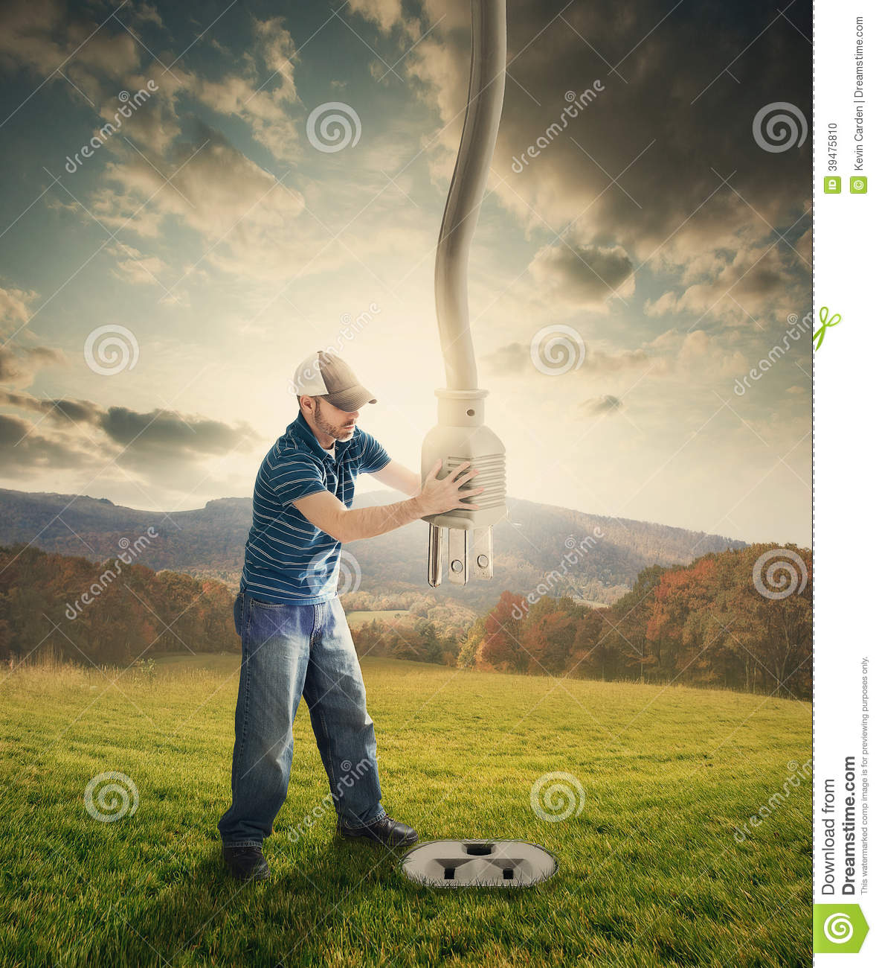

Slide 49
Keep On The Firing Line

