Slide 1
= too bad to lie about
= beyond repair
= recently washed
= if you use 90-weight oil
= needs an engine
= phone the junkyard
= it all leaks out
= cleaned the spark plugs
= I live on a hill
= within 10 miles
= no one wants it
= no one wanted it even when it was new
= in a farmer's field
= won't start
If the car ad claims these items, it really means:
rough condition
parts car
immaculate
engine quiet
needs minor overhaul
needs major overhaul
burns no oil
rebuilt engine
drive it away
drive it anywhere
desirable classic
rare classic
stored 20 years
ran when stored

Slide 3

Edward Church
March 5, 2023
Part 2

Slide 4

Praise Is..
Powerful-
Never leaves situation the same
Positive-
Hard to praise and pout at same time
Predictor-
It effectively predicts the outcome
Productive-
It can do what nothing else can…

Slide 5

…Gets Our Focus Off Ourselves… Back On God
In “selfie” focused world, we need this reminder…
…life is not all about us.
When We Get Eyes on Self… “Hurt” is Magnified
When Our Eyes are On Him … “Hope” is Magnified
He is Worthy of Our Praise…
…No Matter What We Face From Day to Day.
“Praise him for his mighty deeds; praise him according to his excellent greatness!” Psa. 150:2
"And my tongue shall speak of your righteousness and of your praise all the day long." Psa. 35:28

Slide 6

…Brings Us to a Place of Humility
We remember our dependency on God, as we acknowledge our need for Him.
As we praise Him as Creator/ King of this world…
…we recognize that we’re not in control, but He is!
“Let us come into his presence with thanksgiving; let us make a joyful noise to him with songs of praise! For the Lord is a great God, and a great King above all gods” Psa. 95:2-3
"I will give you thanks in the great congregation: I will praise you among much people" Psa. 35:18

Slide 7

…Makes the Enemy Flee
It pushes back the darkness that surrounds
Evil will not stick around if we’re praising our God…
…who will fight our battles for us.
Jehoshaphat, saw God miraculously defeat the enemy
“As they began to sing / praise, the Lord set ambushes against the men of Ammon / Moab / Mount Seir who were invading Judah, / they were defeated” 2 Chron. 20:22

Slide 8

..Leaves No Room For Complaining and Negativity
Luke 24:50-53 ⁵¹ And it came to pass, while he blessed them, he was parted from them, and carried up into heaven. ⁵² And they worshipped him, and returned to Jerusalem with great joy: ⁵³ And were continually in the temple, praising and blessing God. Amen.
Acts 2:1-2 ¹ And when the day of Pentecost was fully come, they were all with one accord in one place. ² And suddenly there came a sound from heaven as of a rushing mighty wind, and it filled all the house where they were sitting.

Slide 9
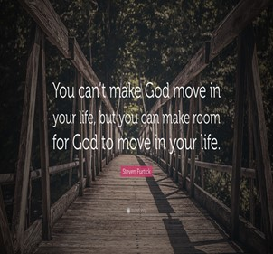
Praise Makes Room For God’s Blessings Over Our Lives
He Will Not Hold Back His Goodness,
Praise Opens the Gateway of Blessing…
…as we Come into His Presence
“Enter his gates with thanksgiving, and his courts with praise!
Give thanks to him; bless his name!” Psa. 100:4
"Blessed be the God and Father of our Lord Jesus Christ,
who has blessed us with all spiritual blessings in
heavenly places in Christ:" Eph. 1:3

Slide 10

…Praise Invites His Presence
God Dwells Close to Us When We Praise Him
He Lives There
He Looks For It
“He inhabits the praises of His people.” Psa. 22:3
"But you are a chosen generation, a royal priesthood, an holy nation, a peculiar people; that you should show forth the praises of him who has called you out of darkness into his marvelous light;"
1 Pet. 2:9

Slide 11

…Our Spirits are Refreshed and Renewed in His Presence
We're strengthened by His peace and refueled by His joy.
Through a Heart of Praise…
…We Realize that God Doesn’t Just Change Our Situations
…and Work Through Our Problems,
…He Changes Our Hearts.
“In His presence, there is fullness of joy.” Psa. 16:11
"Because your love is better than life, my lips will glorify you. I will praise you as long as I live, /in your name I will lift up my hands."
Psa. 63:3-4

Slide 12
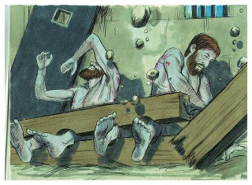
…It Paves the Way for God’s Power to be Displayed
People's lives are affected and changed.
God shakes things up through praise.
As Paul and Silas sat in prison, shackled, but praising God.
Praise Moved God
God Moved Heaven /Earth -God sent an earthquake
Power Moved Hearts –jailer/ all his family saved-
“About midnight Paul/ Silas were praying/ singing hymns to God, and the prisoners were listening to them, and suddenly there was a great earthquake, so that the foundations of the prison were shaken. immediately all the doors were opened, and everyone's bonds were unfastened.” Acts 16:25-26

Slide 13
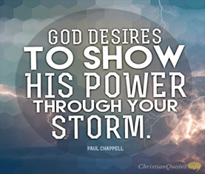
…It Paves the Way for God's Power to be Displayed
We have a choice every day in this life.
live absorbed in worry and stress…
…focused only on what surrounds us
We can ask God to help us take our eyes off all the…
problems and mess, or the voices of others…
…look up...to the One who holds it all together
God desires our whole heart.
He longs for us to know the power of His presence
…He desires to bless us more than we could imagine
…His Spirit urges us onward, calling us closer

Slide 14
We praise you today with our hearts and songs, we praise you
for your faithfulness, we praise you for your great power and
love. We confess our need for you, our lives don't go so well
when we just spin around on our own. We struggle and worry,
get weary and worn. Yet you never leave us. Thank you for your
presence. Thank you for your care over us, thank you that you
breathe renewal right into our souls. We ask for your spirit to
fill us, to draw us close to yourself, and to work your purposes
through us, as we set our eyes on you.

