Slide 1


Slide 3

The Battle Rages
But Satan Will Not Win!
Edward Christian Church
March 19. 2023
Matthew 16:18
Part 1

Slide 4
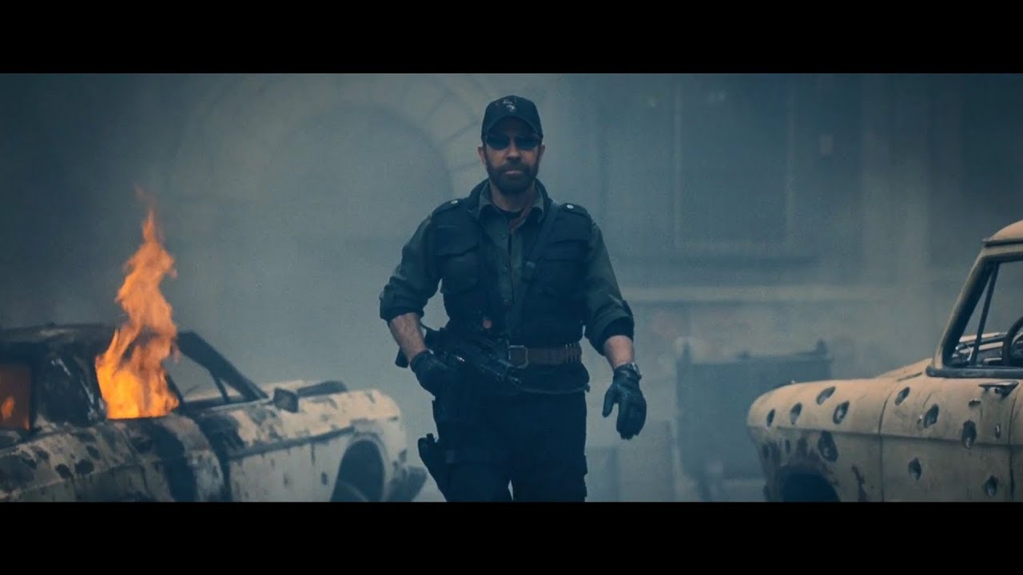
Have You Noticed…
Satanic Activity
Risen to All-Time High
Between God Being Snubbed
And the New Feel Good Agenda
He Has Stepped Up
And Gained Momentum

Slide 5
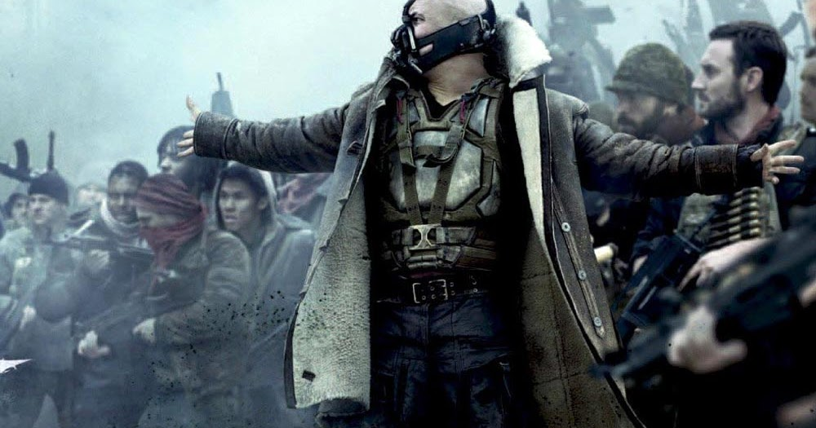
The Battle is Real
Lines Drawn
Sides Taken
Territories Lost
As Time Goes On…
It Seems Satan is…
Picking Up Steam
Running Roughshod
The Devil Will Not Win!

Slide 6

God
Satan
Creator
Good
Giver of life
Love
Truth/ Cannot Lie
Greatest Advocate
Destroyer
Evil
Murderer fr beginning
Hatred/ Malice
Father of Lies
Greatest Adversary
Satan Opposes Everything God Is…
…and Everything God Does

Slide 7
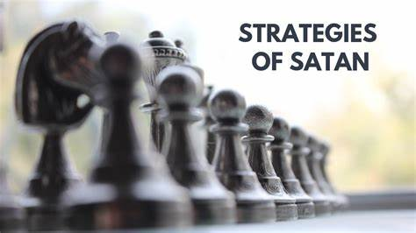
  Isa 14 / Ezk 28-
    Personal “Pride”
  Genesis 3 –
    Personal “Attack”
    Thru Pride and Misinformation
    Destroyed Mission - 1st Adam
  Wilderness –
    Personal “Attack”
    Thru Pride and Misinformation
    Tried to Destroy Mission - Last Adam

Slide 8

  Today – Personal Attack
    Thru Any Means Possible
    Destroy Mission of Church
Satan Desires to…
Affect Your Thinking, Life, Relationships
In Order to…
Infect Your Thinking, Life, Relationships

Slide 9

Seven Things The Devil Cannot Do
The Devil Cannot:
  Stop the Building of God’s Church
Matthew 16:18 (AMP)
¹⁸ And I tell you, you are Peter [Greek, Petros—a large piece of rock], and on this rock [Greek, petra—a huge rock like Gibraltar] I will build My church, and the gates of Hades (the powers of the infernal region) shall not overpower it [or be strong to its detriment or hold out against it].

Slide 10
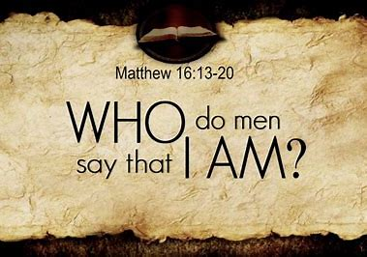
Jesus’ Strategy
Jesus Asks Who Do You Say I Am?
Jesus Never Asks Questions for His Benefit
…But Ours
      …Better Know Ourselves
Upon This Rock I Will Build My Church
        Person
          Jesus
        Profession
          He is the Christ
        Personal

Slide 11

Upon This Rock I Will Build My Church
Jesus is the…
  Architect -Rev 13:8
  Carpenter -Matt 16:18
  Cornerstone -Psa 118:22
  Foundation -I Cor 3:11
Built with 3 Rusty Nails
Old Rugged Cross
Satan is Defeated Foe ! -He Won’t Accept It!

Slide 12
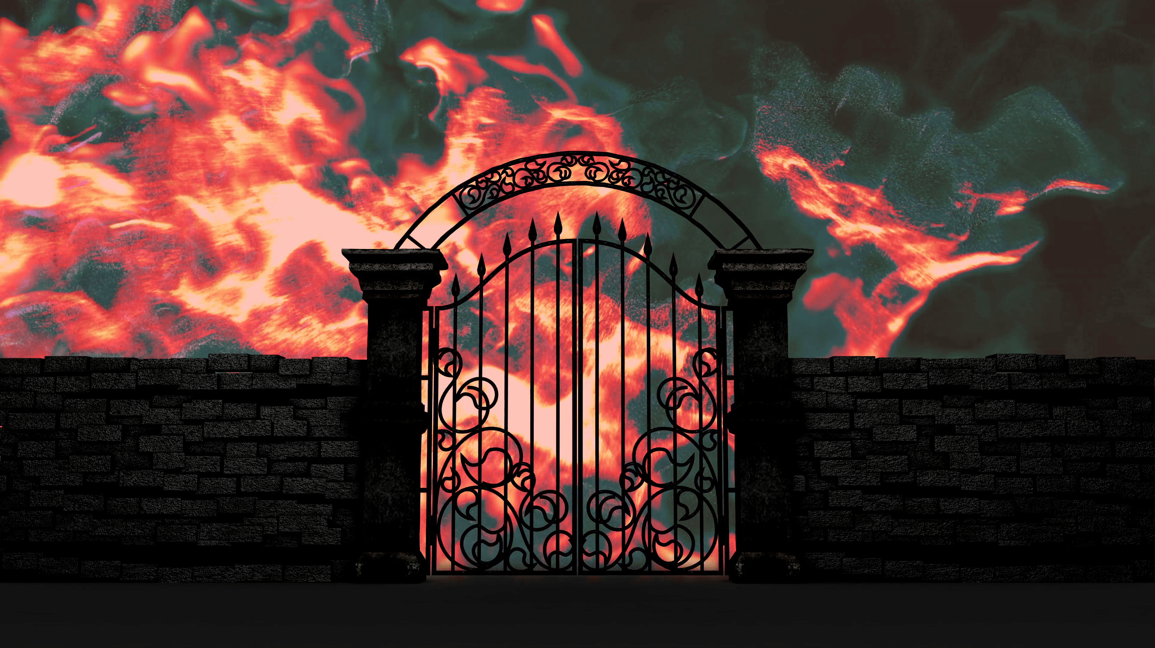
Jesus’ Strategy
The Gates of the City Represented:
      Wisdom
      Authority
      Power
      Entrance/ Activity
    Facts
      Gates Stationary
      Jesus Wants us on the Offensive

Slide 13
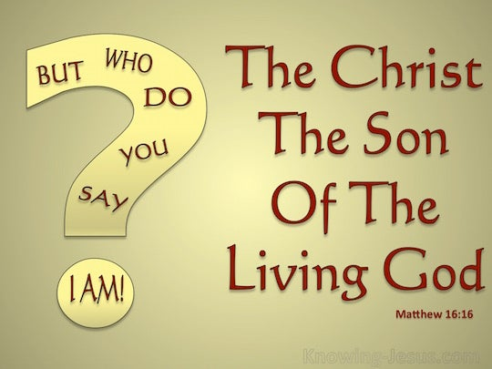
Satan’s Central Task and Desire is to…
…Prevent Jesus from being Glorified.
Glorify(to esteem glorious –magnify/ honor)
Acknowledge His…
Being…Attributes…Acts
Jesus said, “Glorify your son that I may glorify you!” -John 17:1
When Jesus is Glorified…
…Something Happens

Slide 14

Jesus’ Strategy
Gates of Hell Will Not Prevail…
Prevail -2 words
(opposition, intensity, struggle) +
(force of might)
Didn’t Say He Wouldn’t Try –But
…Not Prevail
More Spiritual Mature – More Intense Battle
Satan is Defeated Foe…
….He Wont Accept It!

Slide 15

John 16:33 –in World…
...You Will Have Tribulation(unusual pressure)
Cross Already Settled the Battle Issue
  Remember…
Satan is Defeated Foe !
Problem #1- He Won’t Accept It!
Problem #2- We Won’t Accept it Either!
The Devil Cannot:
  Stop the Building of God’s Church

Slide 16


