Slide 1


Slide 3

The Battle Rages
But Satan Will Not Win!
Edward Christian Church
March 26,2023
Matthew 16:18
Part 2

Slide 4
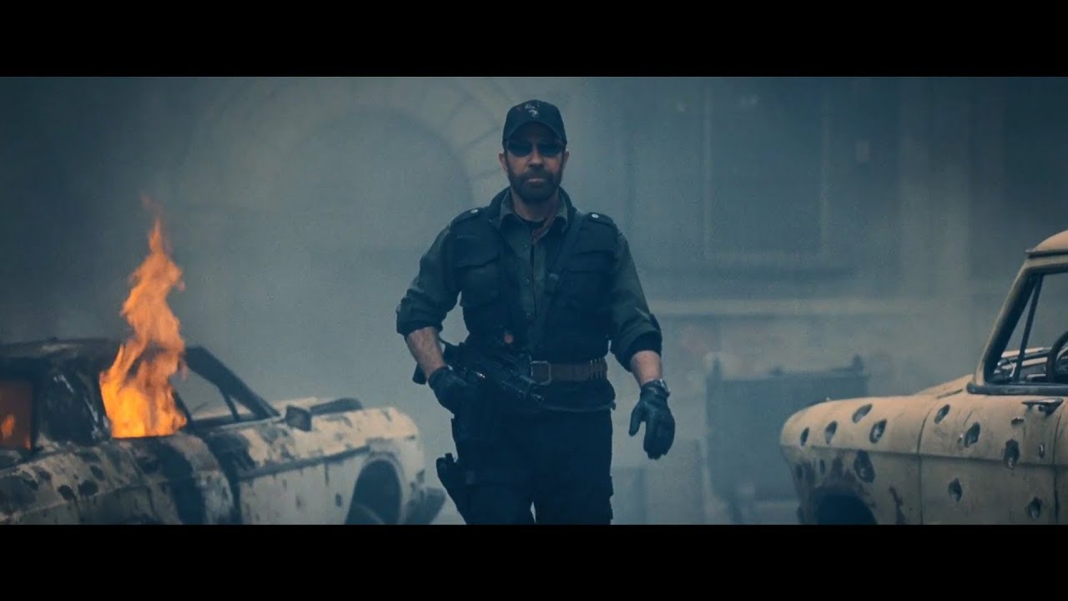
Have You Noticed…
Satanic Activity
Risen to All-Time High
Between God Being Snubbed
And the New Feel Good Agenda
He Has Stepped Up
And Gained Momentum

Slide 5
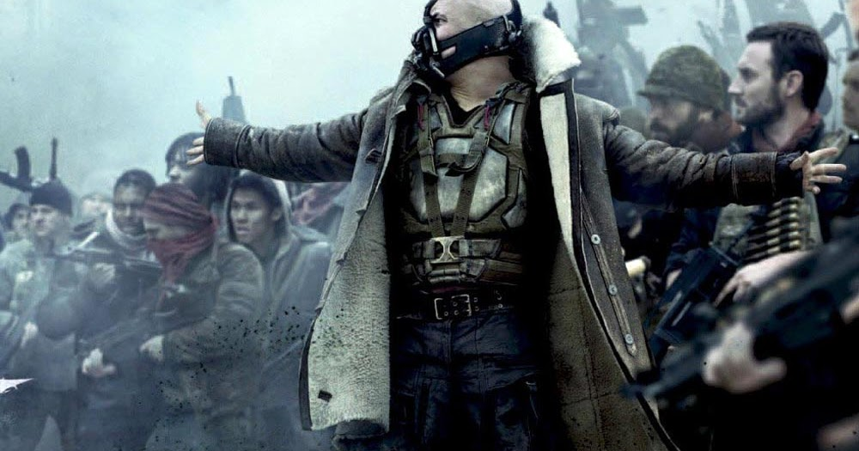
The Battle is Real
Lines Drawn
Sides Taken
Territories Lost
As Time Goes On…
It Seems Satan is…
Picking Up Steam
Running Roughshod
The Devil Will Not Win!

Slide 6

  Today – Personal Attack
    Thru Any Means Possible
    Destroy Mission of Church
Satan Desires to…
Affect Your Thinking, Life, Relationships
In Order to…
Infect Your Thinking, Life, Relationships

Slide 7

Seven Things The Devil Cannot Do
The Devil Cannot:
  Stop the Building of God’s Church
Matthew 16:18 (AMP)
¹⁸ And I tell you, you are Peter [Greek, Petros—a large piece of rock], and on this rock [Greek, petra—a huge rock like Gibraltar] I will build My church, and the gates of Hades (the powers of the infernal region) shall not overpower it [or be strong to its detriment or hold out against it].

Slide 8

Jesus’ Strategy
Jesus Asks Who Do You Say I Am?
Jesus Never Asks Questions for His Benefit
…But Ours
      …Better Know Ourselves
Upon This Rock I Will Build My Church
        Person
          Jesus
        Profession
          He is the Christ
        Personal

Slide 9

John 16:33 –in World…
...You Will Have Tribulation(unusual pressure)
Cross Already Settled the Battle Issue
“Cheer up, I have defeated the world”
He Reminds Us the War is Over/ the Winner / Loser Have Already Been Determined
  Remember…
Satan is Defeated Foe !
Problem #1- He Won’t Accept It!
Problem #2- We Won’t Accept it Either!

Slide 10

Stop the Building of God’s Church
  Next
  Confess Jesus IS Lord!

Slide 11
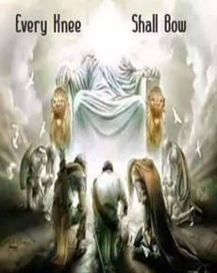
  There is a Day Coming But…
  He Will Not Currently Confess…
  …Because He Would Admit:
  Jesus IS God!!
and
He IS In Control!!
Jesus is My God!
Jesus is in Control of My Life!!

Slide 12

If He Confessed Jesus is Lord…
It Would…
Lesson His Claim –
  Prince Power Air -Eph 2:2
  He Desires Absolute Worship
Lesson His Power –
  Son of Perdition -2Thess 2:3-4
  He Desires Absolute Control
Lesson His Authority –
  God of World - 2Cor 4:4
  He Desires Absolute Domination

Slide 13

If He Confessed Jesus is Lord…
It Would Bring Revelation
  Satan is a Liar
    Master of Deception -John 8:44
  Satan is Limited
    Great Counterfeiter -I Peter 5:8
  Satan is a Loser
    He Cannot Win -Rev 20:10
  Jesus is Lord !!!!!
It Would Take Him ONE STEP Closer to Destruction -Phil 2:10

Slide 14

What It Means to Call Jesus Lord?
  “…No one can say that Jesus is Lord except by the Holy Spirit.”
  -1 Cor 12:3

Slide 15

We Can Confess Jesus is Lord
True Confession Is Done W- More Than Words
Confession “to Say Jesus is Lord”
…is to say He Died and Rose Again
Surrender to God -James 4:7
      The Devil Gets a Foothold in Any…
…UnSurrendered Area of Your Life
Offering Praise & Service
…the Only Thing We Can Give God

Slide 16



