Slide 1


Slide 3
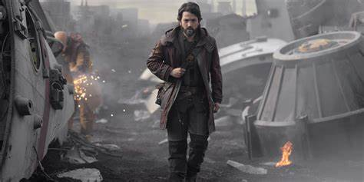
The Battle Rages But Satan Will Not Win!
Edward Christian Church
April 2,2023
Matthew 16:18
Part 3

Slide 4
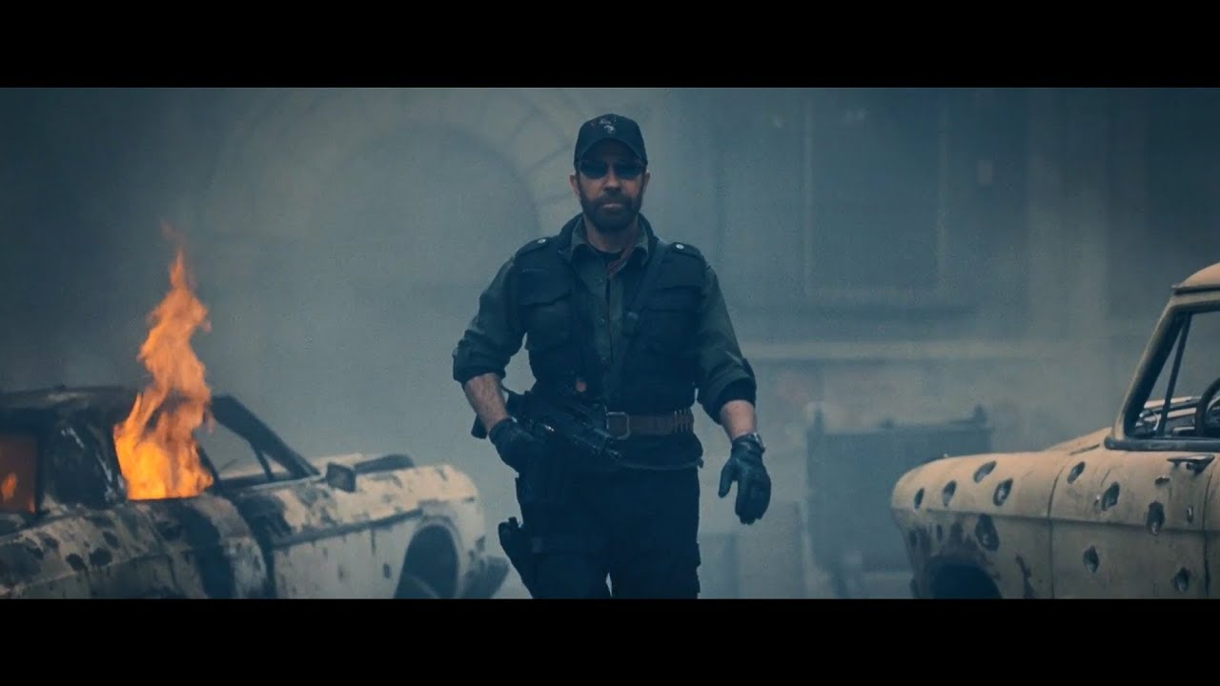
Have You Noticed…
Satanic Activity
Risen to All-Time High
Between God Being Snubbed
And the New Feel Good Agenda
He Has Stepped Up
And Gained Momentum

Slide 5

Today – Personal Attack
Thru Any Means Possible
Destroy Mission of Church
Satan Desires to…
Affect Your Thinking, Life, Relationships
In Order to…
Infect Your Thinking, Life, Relationships

Slide 6
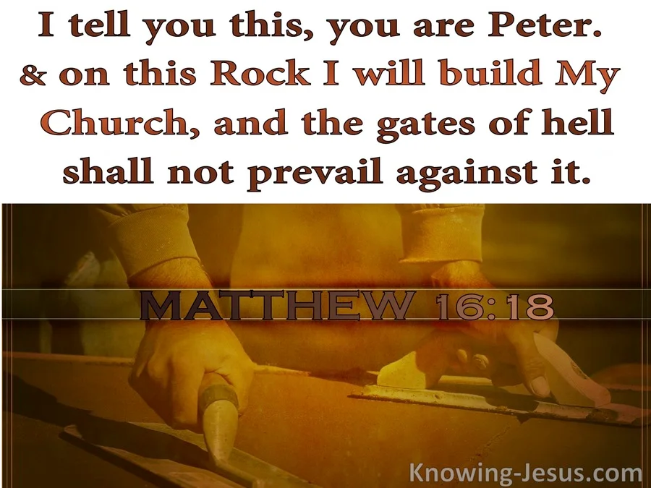
Seven Things The Devil Cannot Do
The Devil Cannot:
Stop the Building of God’s Church
Matthew 16:18 (AMP) ¹⁸ And I tell you, you are Peter [Greek, Petros—a large piece of rock], and on this rock [Greek, petra—a huge rock like Gibraltar] I will build My church, and the gates of Hades (the powers of the infernal region) shall not overpower it [or be strong to its detriment or hold out against it].

Slide 7
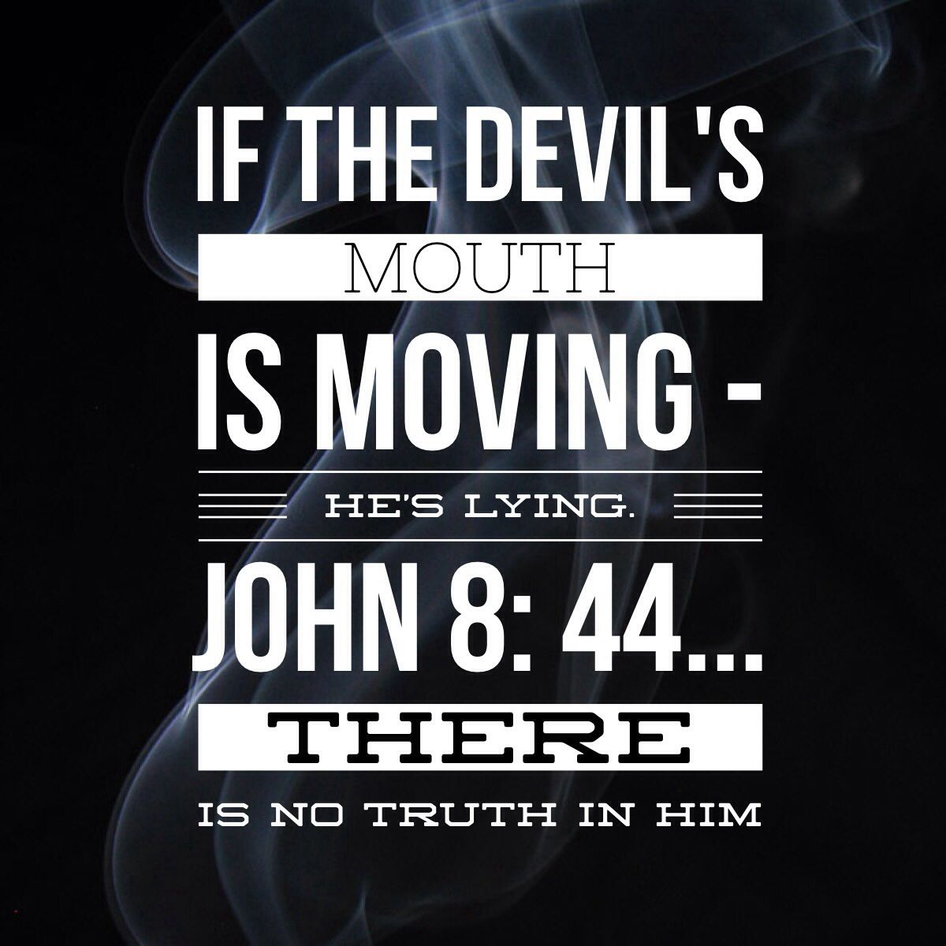
He Cannot Confess Jesus is Lord…
It Would Bring Revelation
Satan is a Liar
Master of Deception -John 8:44
Satan is Limited
Great Counterfeiter -I Peter 5:8
Satan is a Loser
He Cannot Win -Rev 20:10
Jesus is Lord !!!!!
It Would Take Him ONE STEP Closer to Destruction -Phil 2:10

Slide 8

Stop the Building of God’s Church
Confess Jesus IS Lord!
Overwhelm the Word of Jesus

Slide 9
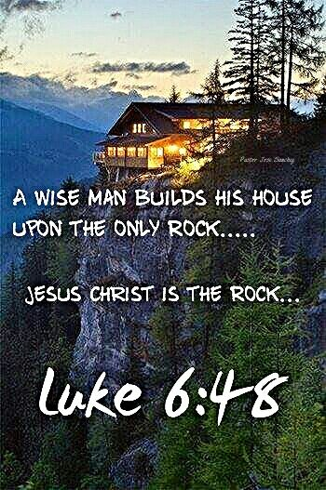
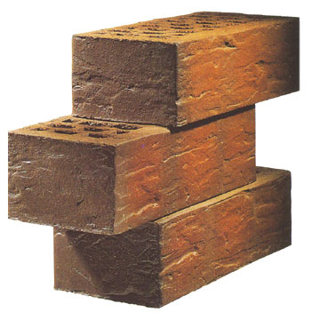
Overwhelm the Word of Jesus
Rock Solid Foundation
Luke 6:47-49 (KJV) ⁴⁷ Whosoever cometh to me, and heareth my sayings, and doeth them, I will shew you to whom he is like: ⁴⁸ He is like a man which built an house, and digged deep, and laid the foundation on a rock: and when the flood arose, the stream beat vehemently upon that house, and could not shake it: for it was founded upon a rock. ⁴⁹ But he that heareth, and doeth not, is like a man that without a foundation built an house upon the earth; against which the stream did beat vehemently, and immediately it fell; and the ruin of that house was great.

Slide 10
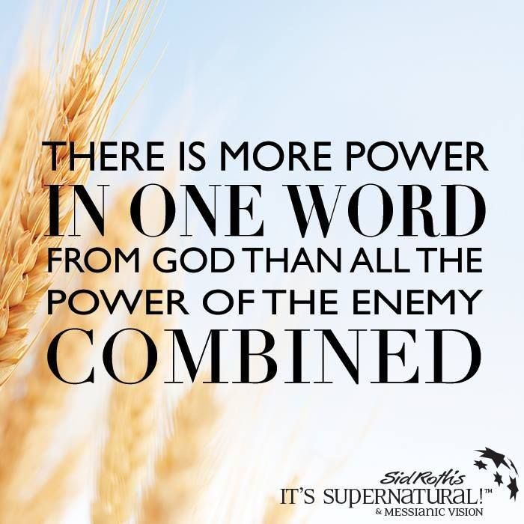
Powerful…
Foundation
Formation
Fortification
God’s Word is So Able to Do So Much…
It is Impossible to Describe with…
…Just One Word …
…So Let the Word Describe Itself

Slide 11
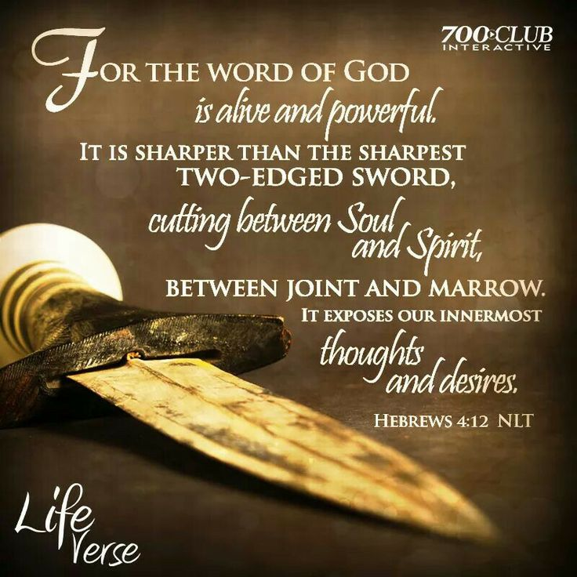
Sword that Pierces
For the word of God is living and active and sharper than any two-edged sword, and piercing as far as the division of soul and spirit, of both joints and marrow, and able to judge the thoughts and intentions of the heart. And there is no creature hidden from His sight, but all things are open and laid bare to the eyes of Him with whom we have to do. Hebrews 4:12-13
The Word is Divine
Sent Down from Above
It Originated from God Himself
It is a Book that is Alive

Slide 12
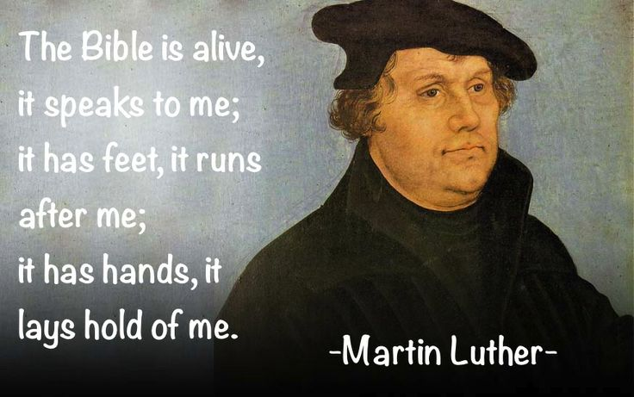
Hebrews 4:12 (AMP) ¹² For the Word that God speaks is alive and full of power [making it active, operative, energizing, and effective]; it is sharper than any two-edged sword, penetrating to the dividing line of the breath of life (soul) and [the immortal] spirit, and of joints and marrow [of the deepest parts of our nature], exposing and sifting and analyzing and judging the very thoughts and purposes of the heart.
Hebrews 4:12-13 (MSG) ¹² God means what he says. What he says goes. His powerful Word is sharp as a surgeon's scalpel, cutting through everything, whether doubt or defense, laying us open to listen and obey. ¹³ Nothing and no one is impervious to God's Word. We can't get away from it—no matter what.

Slide 13
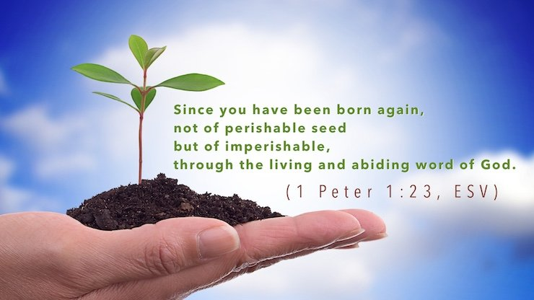
Seed that Reproduces
for you have been born again not of seed which is perishable but imperishable, that is, through the living and enduring word of God. – 1 Peter 1:23
Perishable Seed Can Only Reproduce a Life…
…After Its Own Kind
Fundamental Principle In Life..
“Like Produces Like”
A Supernatural Life Only Comes from a Seed that Is…
Living And Enduring

Slide 14
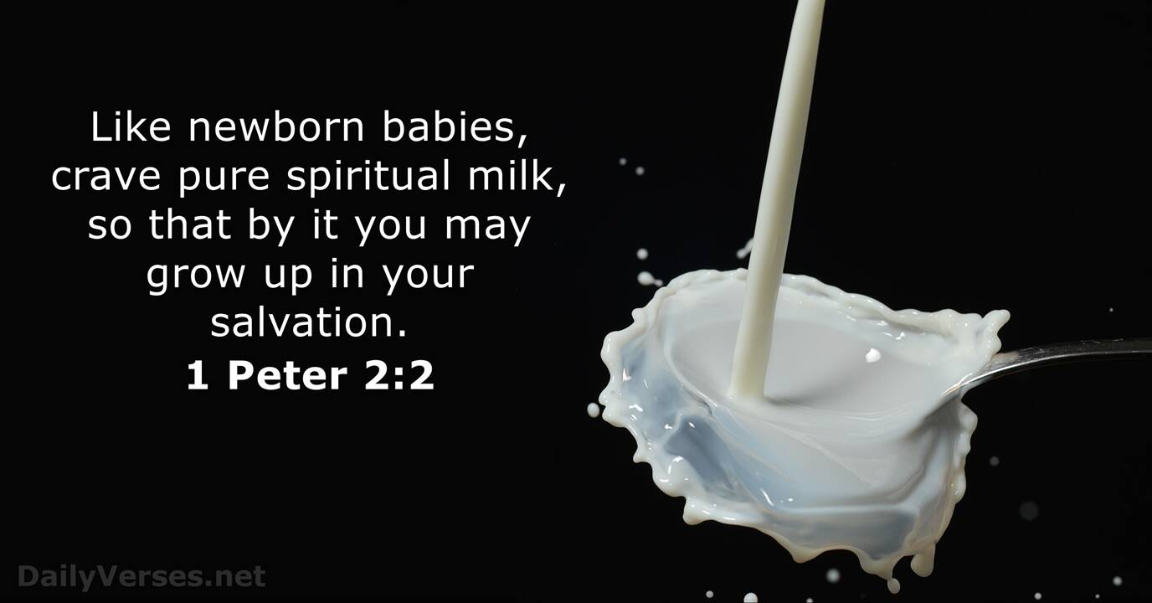
Milk that Nourishes
like newborn babies, long for the pure milk of the word, so that by it you may grow in respect to salvation. – 1 Peter 2:2
1 Peter 2:2 (NLT2) ² Like newborn babies, you must crave pure spiritual milk so that you will grow into a full experience of salvation. Cry out for this nourishment,
1 Peter 2:2 (AMP) ² Like newborn babies you should crave (thirst for, earnestly desire) the pure (unadulterated) spiritual milk, that by it you may be nurtured and grow unto [completed] salvation,

Slide 15
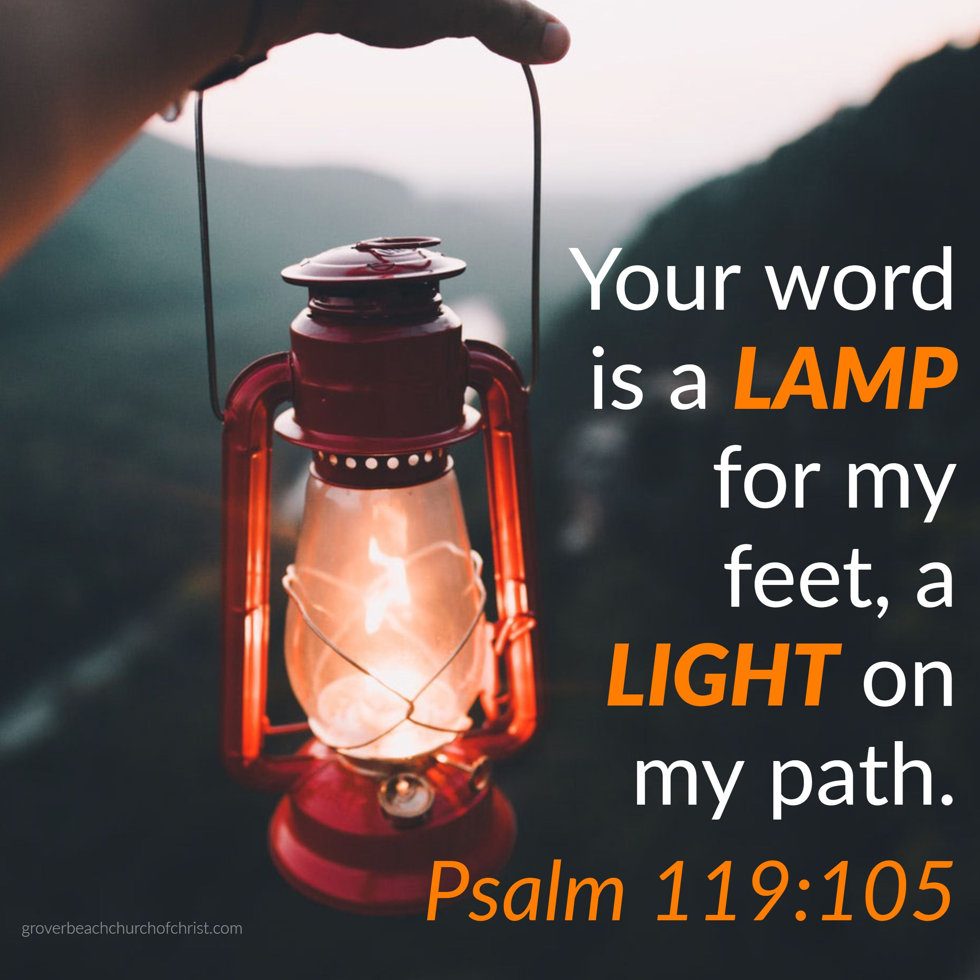
Lamp That Shines
Your word is a lamp to my feet, and a light to my path. Psalm 119:105
We live in a very dark world, and it is becoming darker by the moment.
There are many dangers that threaten Our safety
God’s Word is a lamp giving necessary light
Its not an option for a few of us, it is a necessity for every one of us
This light shines brightest in the darkest hours

Slide 16
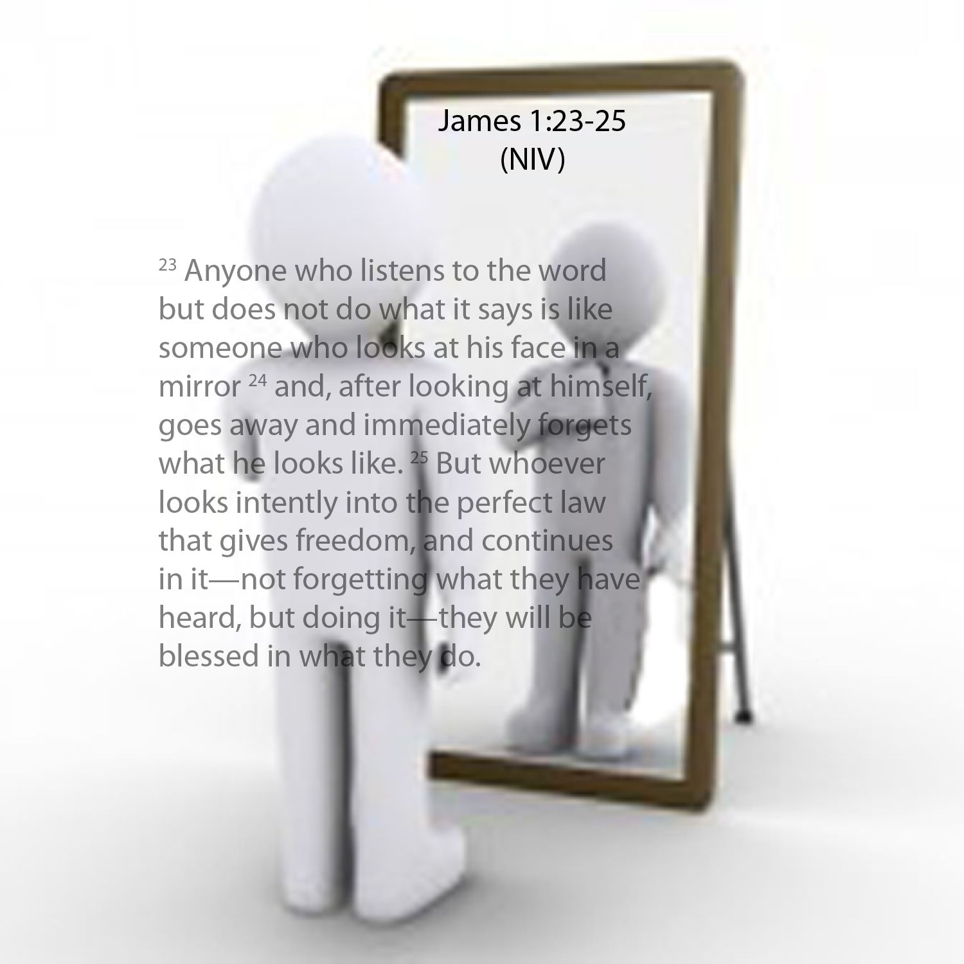
Mirror That Reveals
For if anyone is a hearer of the word and not a doer, he is like a man who looks at his natural face in a mirror – James 1:23
The Mirror Enables You to See Yourself as You Truly Are
A Mirror Tells It Like It Is
It Gives A True Reflection / Revelation Of What Is Inside
We Never Truly Know Ourselves Until…
…We Read The Word Of God

Slide 17
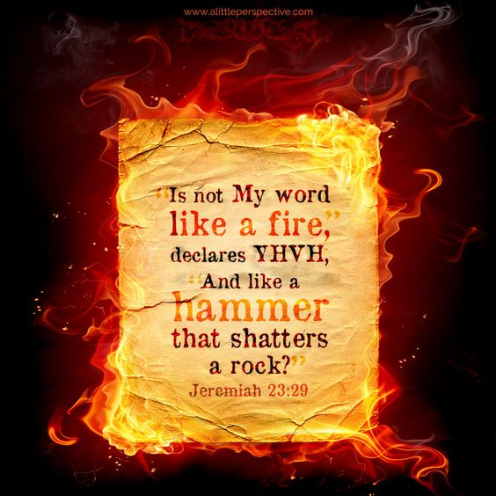
Fire that Consumes
“Is not My word like fire?” declares the Lord – Jer 23:29a
Jeremiah 20:7-9 (MSG) ⁷ You pushed me into this, GOD, and I let you do it. You were too much for me. And now I'm a public joke. They all poke fun at me. ⁸ Every time I open my mouth I'm shouting, "Murder!" or "Rape!" And all I get for my GOD-warnings are insults / contempt. ⁹ But if I say, "Forget it! No more GOD-Messages from me!" The words are fire in my belly, a burning in my bones. I'm worn out trying to hold it in. I can't do it any longer!

Slide 18
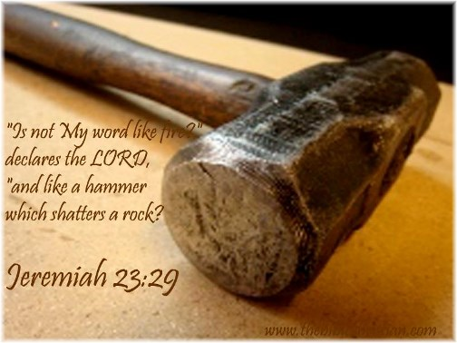
Hammer that Shatters
…like a sledge hammer which shatters a rock? – Jer 23:29b
Jeremiah 23:29 (AMP) ...like a hammer that breaks in pieces the rock [of most stubborn resistance]?
People are like a rock, hard-headed, hard-hearted w- a heart of stone that is resistant to the Truth of God.
How will they ever be brought to humility before the Throne of Grace?
It is by this invincible weapon, the Word of God

Slide 19
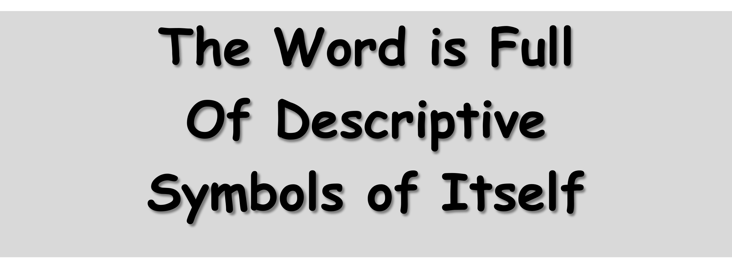
12 SYMBOLS OF THE WORD OF GOD
A sword to cut -Hebrews 4:12
A mirror to reflect -James 1:22-25
Seed to multiply -1 Peter 1:23-25
Milk to Nourish -1 Peter 2:2
lamp to guide -Psalms 119:105
fire to refine -Jeremiah 23:29
hammer to convict -Jeremiah 23:29
Laver to Cleanse -Ephesians 5:26-27
Rain & Snow to Refresh -Isaiah 55:10-11
Bow For Revenge -Habakkuk 3:9
Gold to Enrich -Psalms 19:7-11
Power to Create Faith & Eternal Life -Rom 10:17
Food To Nourish -1 Peter 2:2

Slide 20

R -Read It
Exposure /Examine
O -Operate It
Execute
C -Claim It
Embrace
K -Keep It
Engrain /Entertain

Slide 21
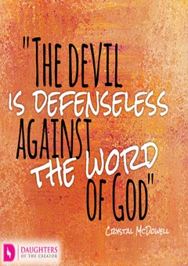
The Devil Cannot
Overwhelm
the Word of God

