Slide 1
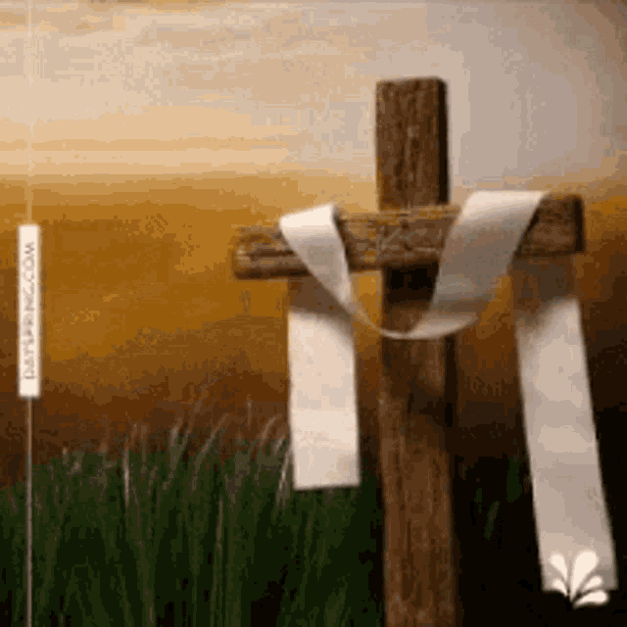
Welcome
Resurrection Sunday 2023

Slide 2
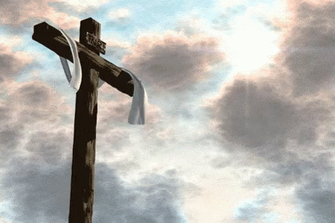
I'm forgiven,
Because You were forsaken
I'm accepted,
You were condemned
I'm alive and well…
…Your Spirit is within me
Because You died/ rose again

Slide 3
Amazing love, How can it be That You, my King, should die for me? Amazing love, I know it’s true. It’s my joy to honor You, In all I do,
I honor You.

Slide 4
You are my King You are my King Jesus, You are my King You are my King

Slide 5
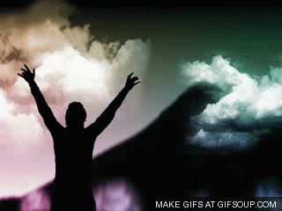
All To Jesus, I Surrender; All To Him I Freely Give; I Will Ever Love And Trust Him, In His Presence Daily Live. I Surrender All, I Surrender All, All To Thee, My Blessed Savior, I Surrender All.

Slide 6
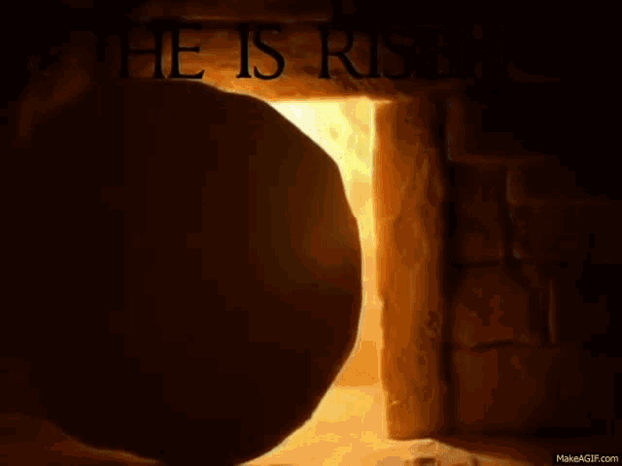
Because He Lives, I Can Face Tomorrow. Because He Lives. All Fear Is Gone. Because I Know, He Holds The Future. And Life Is Worth The Living, Just Because He Lives!

Slide 8
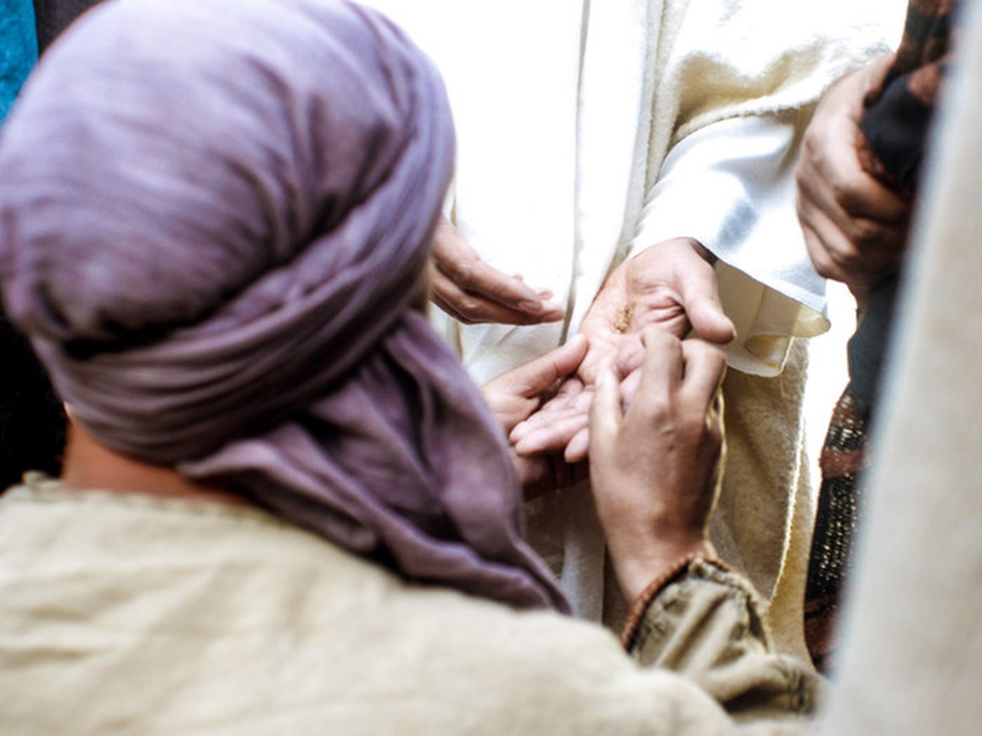

The Power of Our Wounds Part 1
Easter 2023
John 20:19-22
Edward Christian Church
April 9, 2023

Slide 9
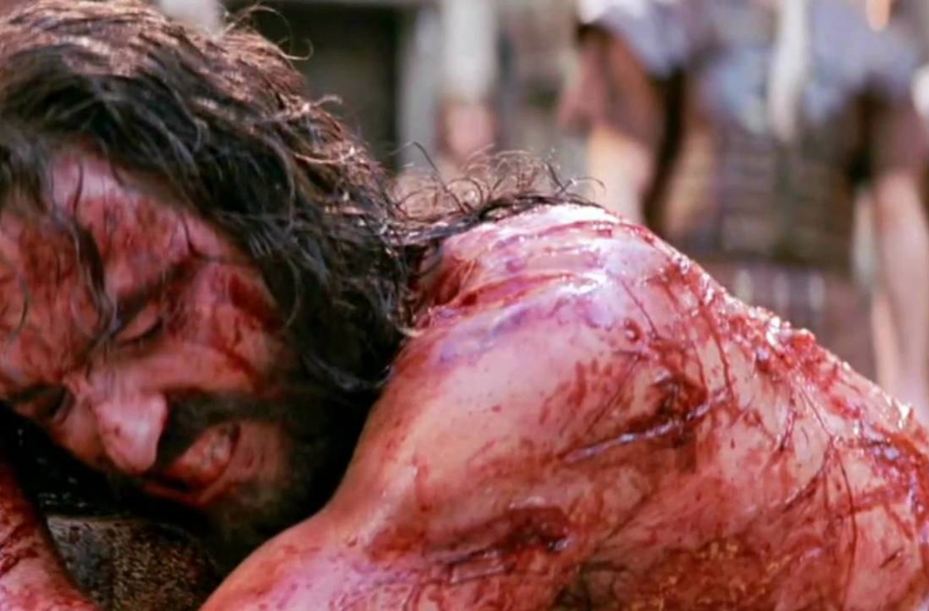
Time of Crisis
It Was Soon After the Cross …
the Crisis Was Still…
…Fresh In Their Minds
It Played Over / Over Again
The Terror Was Still Real
Their Hope Shattered
So Many Questions Left …
…Unanswered

Slide 10
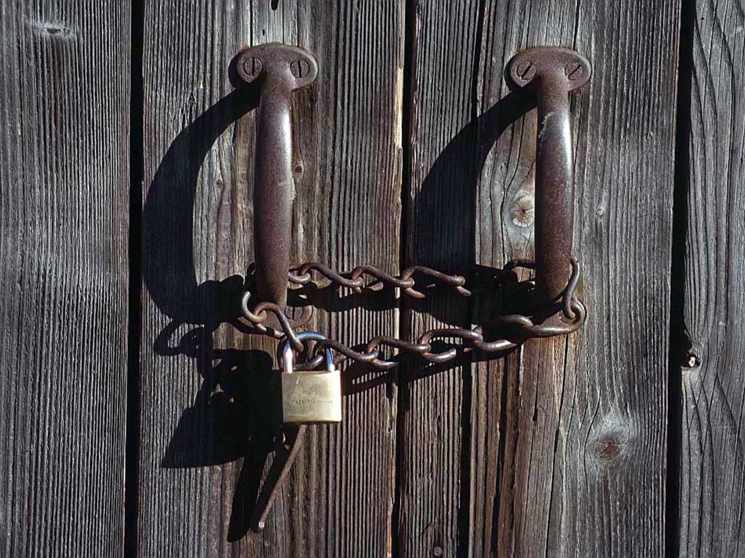
Hiding Behind Locked Doors
Their Motivating Factor…
…Fear – Phobia
Fear is Actually a Reaction…
…to What?
Confusion-
…Misunderstood His Words
Depression-
…Unmet Expectations
Desperation-
…Needed Answers

Slide 11
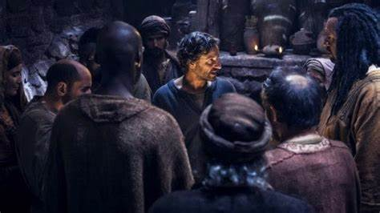
Hiding Behind Locked Doors
Faith Has to Be Active
in Order to Be Effective
They Moved from Faith…
…Attacking the Situation
…to the Situation
…Attacking Their Faith
Jesus Was About to Teach
“Valuable Lesson”

Slide 12
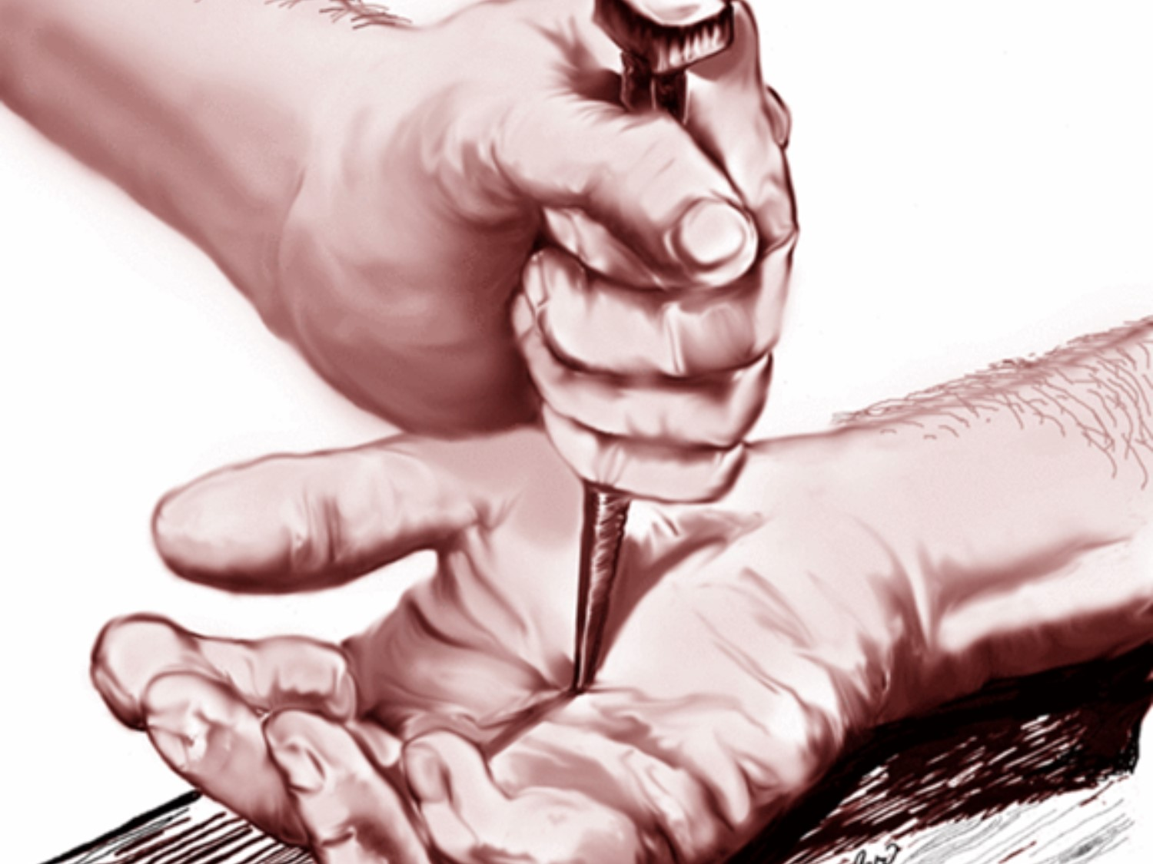
Our Wounds are Very Powerful
We Can Let Them Consume Us
And Be of Help to No One
Or
We Can Overcome…
Through the Power of God
And Help Many

Slide 13
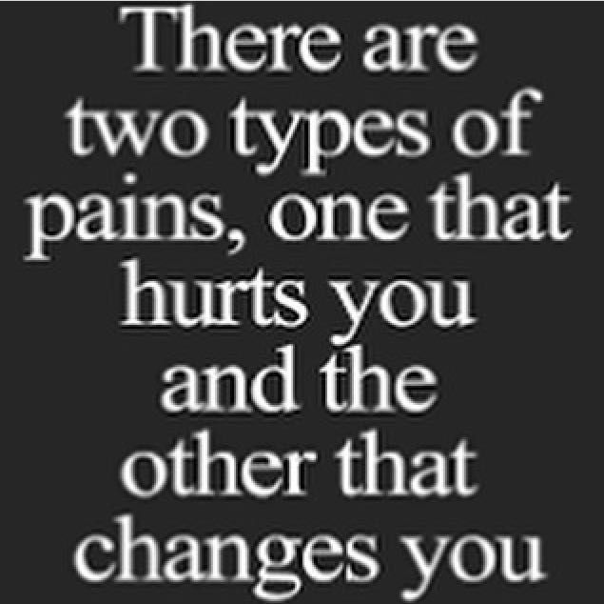
P= Powerful
A= All Experience it
I= Identify with Others
N= Never Wasted by God

Slide 14
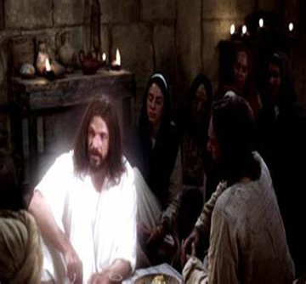
Our Wounds Propel Our Message (19)
No Peace
Limited Reach
“assembled together…”
Direction Unsure
Flee to Familiar
Limited Relationships
“…disciples..”
Dependence Unsure
Isolated
Limit Contacts

Slide 15
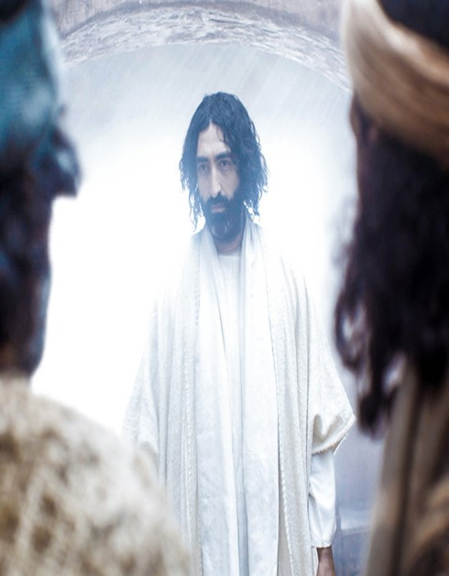

Our Wounds Propel Our Message (19)
No Peace
Limited Resources “Door shut..”
Remove Opportunity…
…to Happen Again
Power
Beyond Barriers
“locked doors”
Plan –let no one in
Power –not able to stop

Slide 16
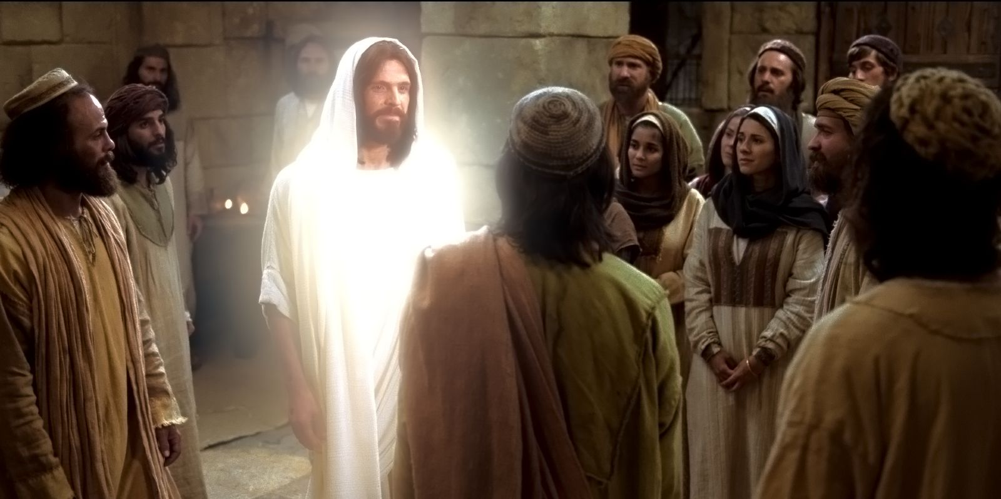
All the Walls We Build…
…All the Doors We Lock
…Can’t Lock Out the Pain
CANNOT KEEP JESUS OUT!

Slide 17

He Sympathized…
He Came Down From Heaven
He Emphasized…
He Carried a Cross
But He Gave Greatest Hope
He Arose

Slide 18


Slide 19
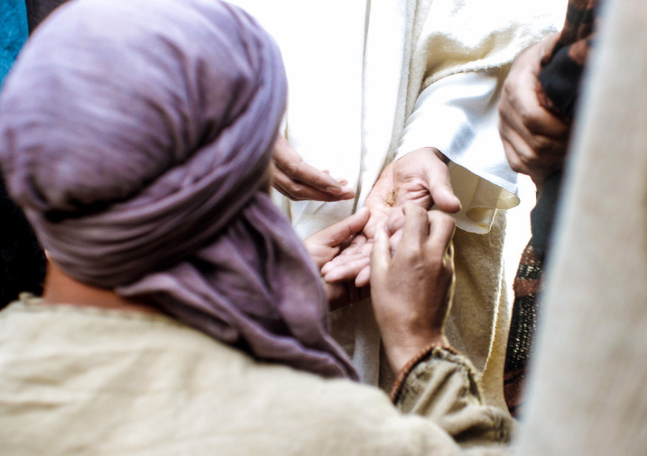
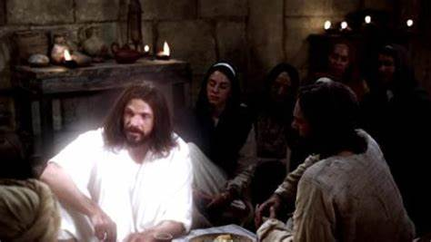


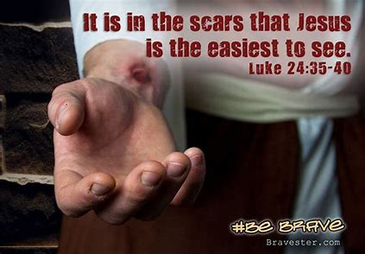
If He Can Defeat the Grave…
He Can Help You Defeat the Gravestones in You Life…

