Slide 1
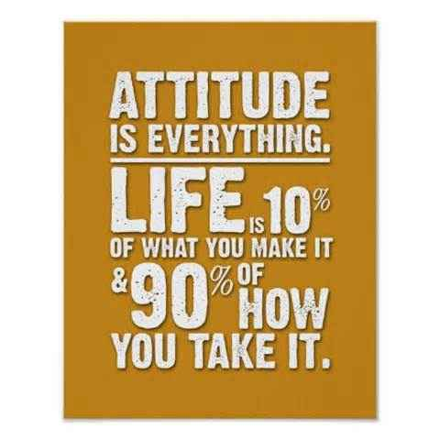

Slide 3
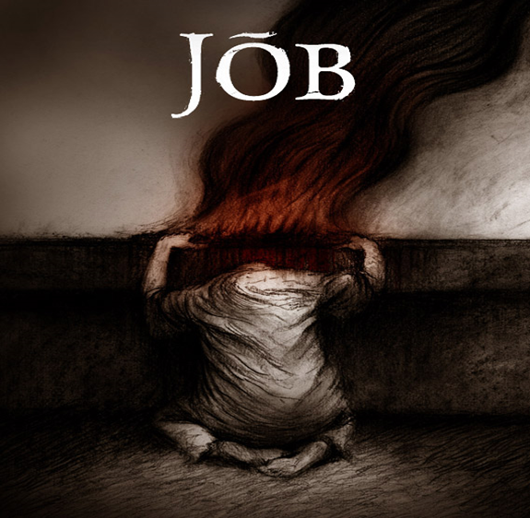
Handling Your Hurts pt1
Job 13:15
Edward Church
April 30, 2023

Slide 4
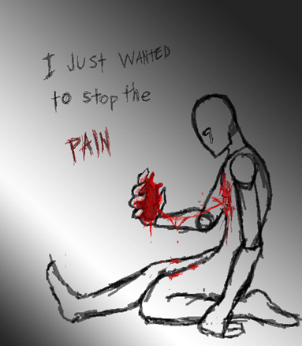
What Do You Do When…
Life Hurts
You Played By the Rules
Done What Is Expected
Lived in a Responsible Life
…Then the Bottom Falls Out

Slide 5

We Get Hurt in Many Ways…
Illness
Injustice
Criticism
Adversity
Loss
Stress
Suffering
We Feel Confused / Disappointed
Job Felt This Way…
…Yet He Kept His Faith Came
…Through Suffering With Victory
Though He slay me, I will trust him –Job 13:15

Slide 6
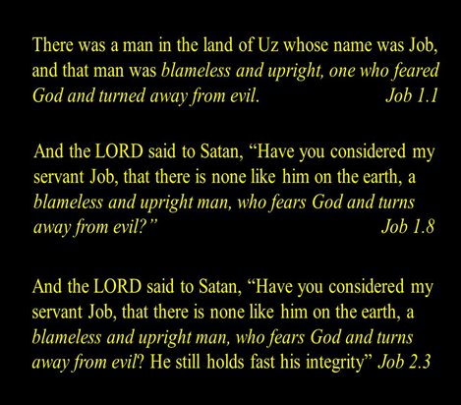
How Did Job Handle His Hurts?
What Can We Learn From Him?

Slide 7
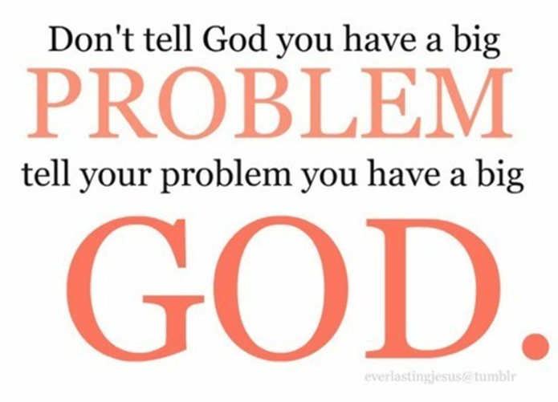
Reconnect to God (1:20-21)
First Thing He Did Was Worship
²⁰ Job got to his feet, ripped his robe, shaved his head, then fell to the ground and worshiped: ²¹ Naked I came from my mother’s womb, naked I’ll return to the womb of the earth. God gives, God takes. God’s name be ever blessed
He Got Up –He refused to Wallow in His Pain
Ripped Robe/ Shaved Head –Got Beyond Self
Fell to Ground and Worshipped – Got in Position to Receive

Slide 8
