Slide 2
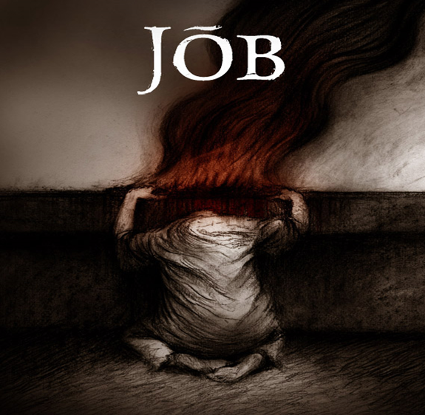
Handling Your Hurts pt2
Job 13:15
Edward Church
May 7, 2023

Slide 3
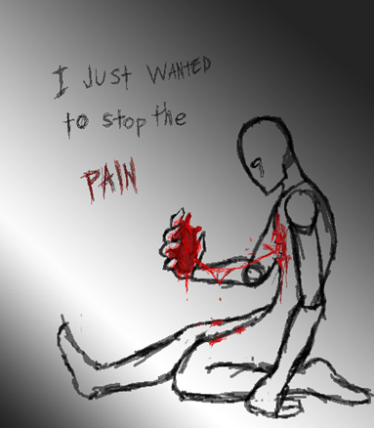
What Do You Do When…
Life Hurts
You Played By the Rules
Done What Is Expected
Lived in a Responsible Life
…Then the Bottom Falls Out

Slide 4
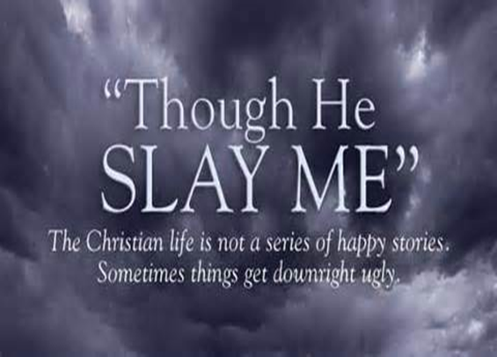
We Get Hurt in Many Ways…
Illness
Injustice
Criticism
Adversity
Loss
Stress
Suffering
We Feel Confused / Disappointed
Job Felt This Way…
…Yet He Kept His Faith Came
…Through Suffering With Victory
Though He slay me, I will trust him –Job 13:15

Slide 5
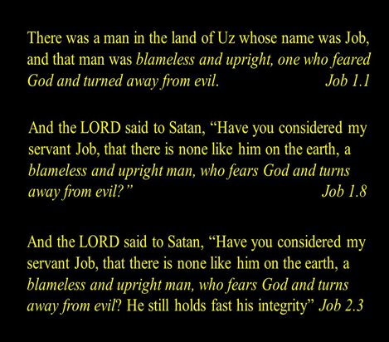
How Did Job Handle His Hurts?
What Can We Learn From Him?

Slide 6
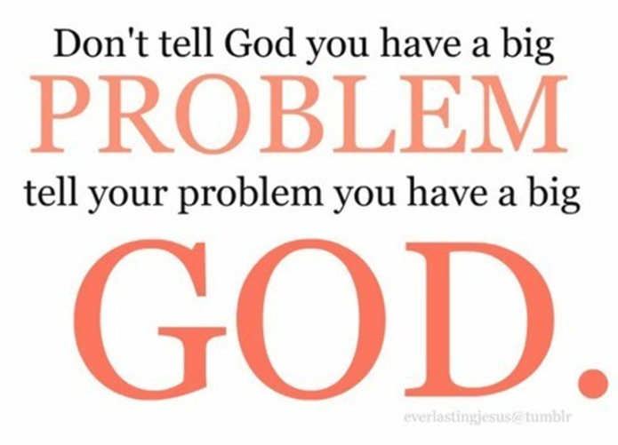
Reconnect to God (1:20-21)
First Thing He Did Was Worship
²⁰ Job got to his feet, ripped his robe, shaved his head, then fell to the ground and worshiped: ²¹ Naked I came from my mother’s womb, naked I’ll return to the womb of the earth. God gives, God takes. God’s name be ever blessed
He Got Up –He refused to Wallow in His Pain
Ripped Robe/ Shaved Head –Got Beyond Self
Fell to Ground and Worshipped – Got in Position to Receive

Slide 7
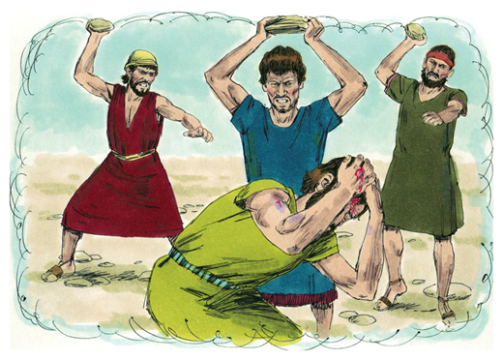
Find a Support Base
He was Visited by So-Called Comforters
But Not Very Good SUPPORT
Sat and Stared for 7 days
Then Ended Up Blaming Him
Our Judgement of Others is a Denial
…of the Possibility that We Could
…Go Through the Same Thing
There is a Difference in Lifting up…
…And Beating Up

Slide 9
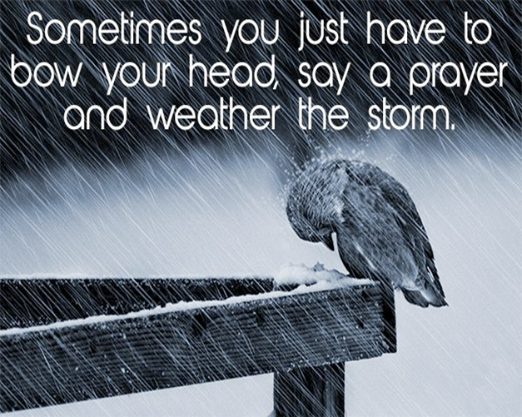
Trust God When You Don’t Understand
What Peace We Would Have If We Truly Believed That…
…God Works Out All Things For His Purpose/ In His Time
When Your Down to Nothing…
…God is Up to Something
When You Can’t See God’s Hand …
… You Can Trust His Heart

Slide 10
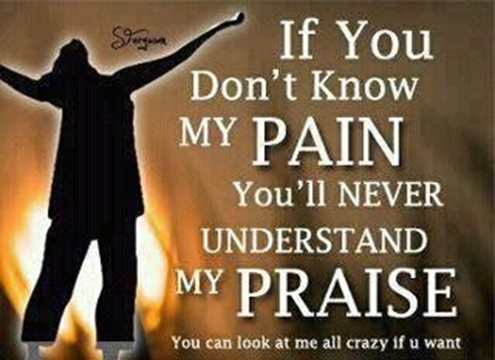
Learn From What You Experience
God Revealed Himself to Job During His Suffering (38-41)
Job Came To Know God Better Through His Experience
The Lord Answered Job Out of the Whirlwind…
…When Your in the Whirlwind God Will Speak
If You Position Yourself to Hear !
Job Repented…
…and Began to see God in a New Light!
⁵ I had only heard about you before, but now I have seen you with my own eyes. ⁶ I take back everything I said, / I sit in dust and ashes to show my repentance.” Job 42:5-6 (NLT)

Slide 11
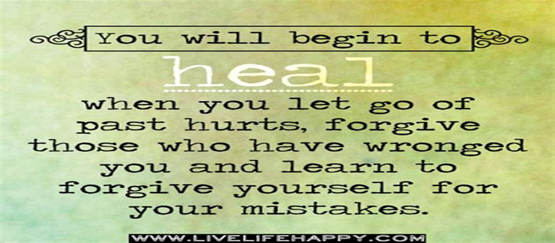
Learn to Forgive Others
We Need To Turn Things Loose…
…Not Hold On To Hurt Feelings
His Situation Turned Around When…
2 Parts
1st God’s –Timing
2nd Job’s - Trust
His Situation Turned Around After Job Prayed For His Friends
¹⁰ When Job prayed for his friends, the Lord restored his fortunes. In fact, the Lord gave him twice as much as before! Job 42:10 (NLT)

Slide 12
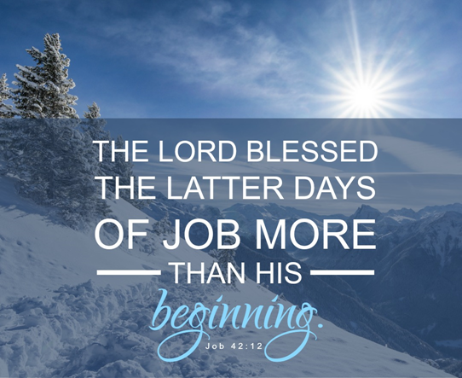
Expect a Turnaround (42:12)
The Story Starts SO Badly…
…But Ends with Recovery
Job 42:12-15 (NLT)
¹² So the Lord blessed Job in the second half of his life even more than in the beginning. For now he had 14,000 sheep, 6,000 camels, 1,000 teams of oxen, and 1,000 female donkeys. ¹³ He also gave Job seven more sons and three more daughters. ¹⁴ He named his first daughter Jemimah, the second Keziah, and the third Keren-happuch. ¹⁵ In all the land no women were as lovely as the daughters of Job. And their father put them into his will along with their brothers

Slide 13
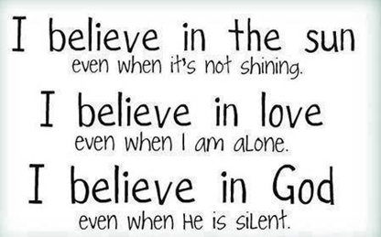
He Got Double for His Trouble
He Named His Daughters According to
…His Healing Process
1st Jemimah= day by day….dove(peace)
2nd Keziah= cassia= spice (perfume)
3rd Keren-happuch= make-up (to make beautiful)
It Didn’t Happen Overnight…
…Day By Day He Gave Him Peace
…God Began To Spice His Life Up – And
…Make Something Beautiful Out Of It
…Again!!!

Slide 14
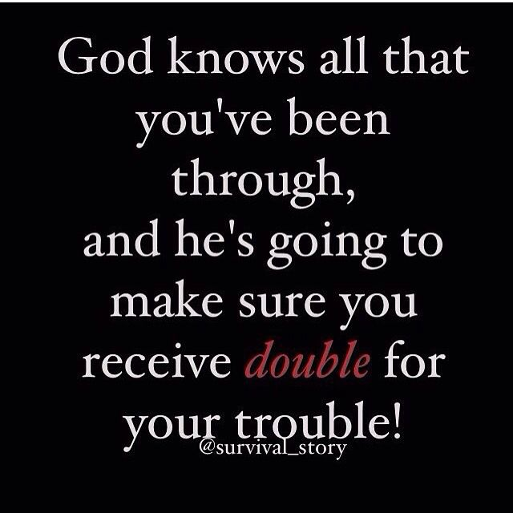
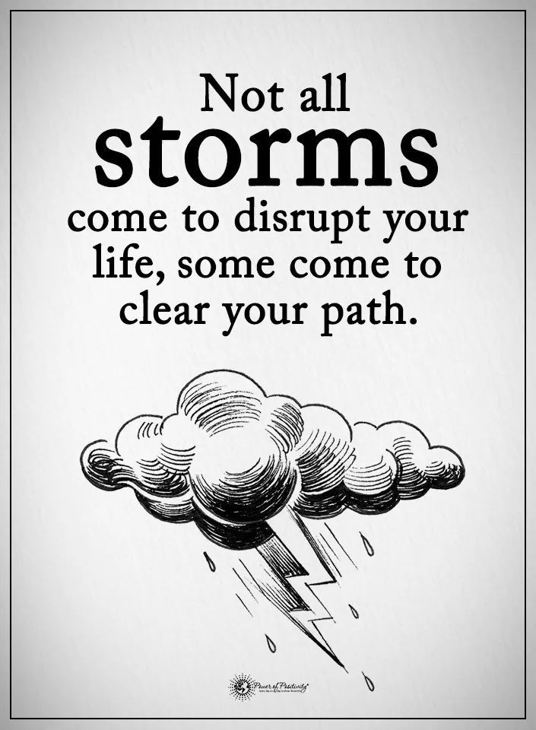
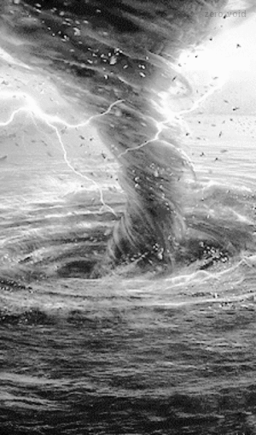
I Have Discovered Two Things About Storms

