Slide 1

Edward Church May 14, 2023

Slide 4
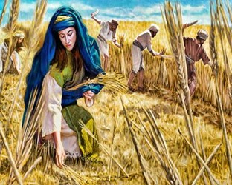
Mother’s Day 2023
Handfuls On Purpose
Book of Ruth
Edward Church
May 14, 2023

Slide 5
⁸ Then said Boaz unto Ruth, Hearest thou not, my daughter? Go not to glean in another field, neither go from hence, but abide here fast by my maidens: ⁹ Let thine eyes be on the field that they do reap, and go thou after them: have I not charged the young men that they shall not touch thee? and when thou art athirst, go unto the vessels, and drink of that which the young men have drawn. ¹⁰ Then she fell on her face, and bowed herself to the ground, and said unto him, Why have I found grace in thine eyes, that thou shouldest take knowledge of me, seeing I am a stranger? ¹¹ And Boaz answered and said unto her, It hath fully been shewed me, all that thou hast done unto thy mother in law since the death of thine husband: and how thou hast left thy father and thy mother, and the land of thy nativity, and art come unto a people which thou knewest not heretofore. ¹² The LORD recompense thy work, and a full reward be given thee of the LORD God of Israel, under whose wings thou art come to trust. ¹³ Then she said, Let me find favour in thy sight, my lord; for that thou hast comforted me, and for that thou hast spoken friendly unto thine handmaid, though I be not like unto one of thine handmaidens. ¹⁴ And Boaz said unto her, At mealtime come thou hither, and eat of the bread, and dip thy morsel in the vinegar. And she sat beside the reapers: and he reached her parched corn, and she did eat, and was sufficed, and left. ¹⁵ And when she was risen up to glean, Boaz commanded his young men, saying, Let her glean even among the sheaves, and reproach her not: ¹⁶ And let fall also some of the handfuls of purpose for her, and leave them, that she may glean them, and rebuke her not. Ruth 2:8-16 (KJV)

Slide 6

Handfuls on Purpose
God was About to Teach Ruth…
… a Valuable Lesson
And Every Mother Here Today
You Do What You Can Do…
Trust God to Do What You Can’t Do

Slide 7

Hey Mothers
Have You Ever Felted Overwhelmed By Life’s Challenges
Wrong Place At Wrong Time
Wrong Connections
Wrong Background
Your Life Questions Are Crowed with …
“What Ifs?” and “Shoulda Coulda Woulda’s”

Slide 8

Hold On
There is Always Hope
God is…
Still on the Throne
Still Working
Still Able to Meet Your Needs
Take the Pen Out of Your Hand…
Place It in God’s

Slide 9

Lessons From Ruth Encouragement for ALL MOTHERS

Slide 10

#1- Don’t Let Your Past Define You
Rough Start (1:4)
Moabite
Hope Came (1:4)
Married Godly Man
Hope Snatched (1:5)
Husband Died

Slide 11
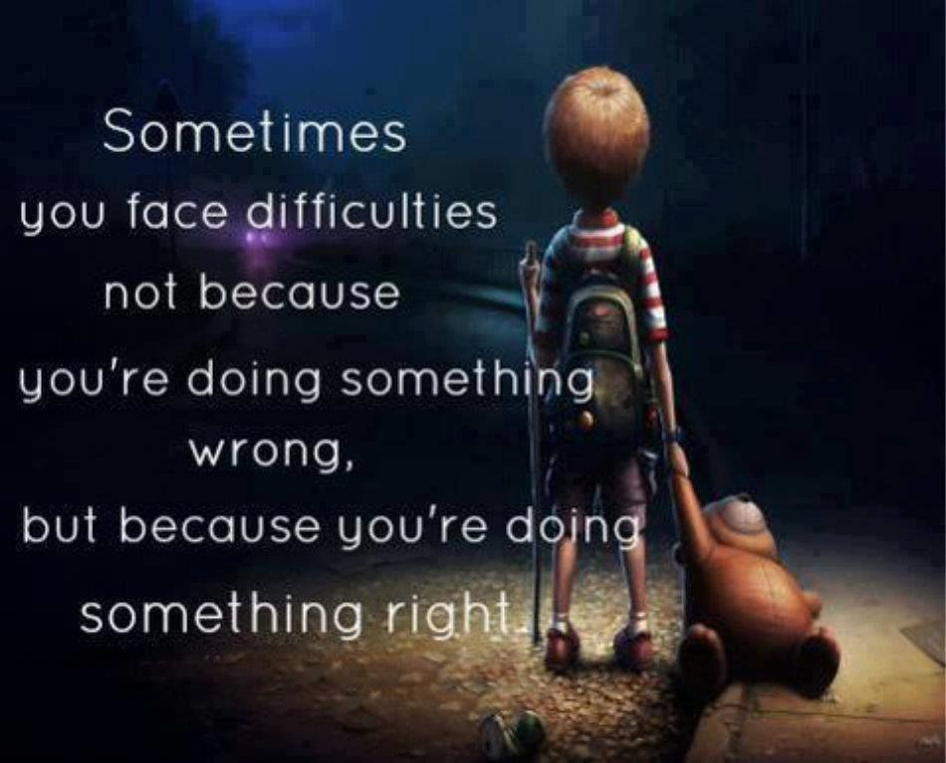
#1- Don’t Let Your Past Define You
#2- Do Let Your Present Difficulties’ Develop You
Bad Place (1:8-9)
Chose Not to Stay There (1:14-15)
Entreat Me Not to Leave You (1:16)
Ruth 1:16 (KJV) And Ruth said, Intreat me not to leave thee, or to return from following after thee: for whither thou goest, I will go; and where thou lodgest, I will lodge: thy people shall be my people, and thy God my God:

Slide 12

#1- Don’t Let Your Past Define You
#2- Do Let Your Present Difficulties’ Develop You
#3- Don’t Be Discouraged If Your Fresh Beginnings
Aren’t So Fresh (2:1-2)
Gleaned Fields
Takes Time (2:3-5)
Takes Trust (2:6-20)
There Was One Who Could Stop It All… (3:12)
But Legal Kinsman Didn’t Want to Redeem Her (4:1-7)

Slide 13

#1- Don’t Let Your Past Define You
#2- Do Let Your Present Difficulties’ Develop You
#3- Don’t Be Discouraged If Your Fresh Beginnings
The Legal Kinsman Didn’t Want to Redeem Her
#4- Do Trust God in the Process
Her Boaz Came
God Brought the Right One
Her Break Came
God Brought Him at Right Time
Her Baby Came
Her Hope Lasted Beyond Her
Jeremiah 29:11 (MSG) I know what I'm doing.
I have it all planned out —plans to take care of you, not abandon you, plans to give you the future you hope for.

Slide 14


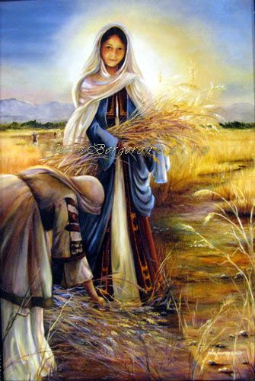


#4- Do Trust God in the Process
Her Boaz Came- God Brought the Right One
Her Break Came- God Brought Him at Right Time
Her Baby Came- Her Hope Lasted Beyond Her
Salmon Begat Boaz –(Rahab)
Boaz begat Obed –(Ruth)
Obed Begat Jesse
Jesse Begat David
Jesus Called the Son of David

Slide 15
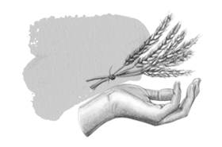

God Did NOT Give It All at Once…
But Handfuls on Purpose
Handful by Handful
Same Message to Mothers
Do Not
Give In..
Give Up
Handfuls Are On the Way!

