Slide 2
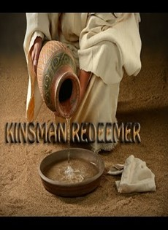
After Easter Special Pt 2
Edward Church
May 21, 2023
Book of Ruth

Slide 3
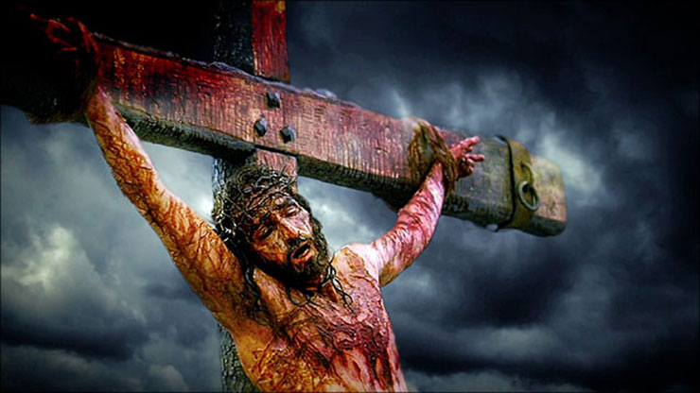
The Cross Was Real!
History Cannot Deny it!
Purpose
Price
Pain
It was the Price of Redemption

Slide 4
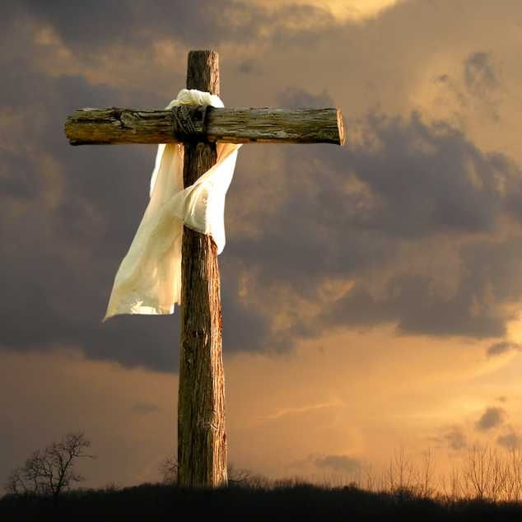
Redemption’s Price
1 Corinthians 6:20 (KJV)
For ye are bought with a price: therefore glorify God in your body, and in your spirit, which are God's.
John 8:36 (KJV)
If the Son therefore shall make you free,
ye shall be free indeed.
This Points to Powerful Picture
How God Made a Way

Slide 5

Redemption’s Picture
The Old Test Makes a Way of Redemption…
For Those Whose Family Line was Endangered Through…
Death
Destruction
Debt

Slide 6
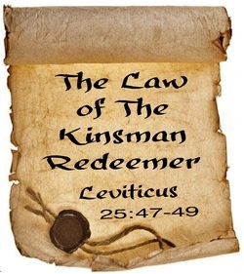
Deuteronomy 25:5-6 (KJV) ⁵ If brethren dwell together, and one of them die, and have no child, the wife of the dead shall not marry without unto a stranger: her husband's brother shall go in unto her, and take her to him to wife, and perform the duty of an husband's brother unto her. ⁶ And it shall be, that the firstborn which she beareth shall succeed in the name of his brother which is dead, that his name be not put out of Israel.
Leviticus 25:25
‘If a fellow countryman of yours becomes so poor he has to sell part of his property, ..his nearest kinsman is to come and buy back what his relative has sold.

Slide 7

Law of Kinsman - Lev 25:23, 48
Person
He must be a Kinsman
Power
He must be Free Himself
Price
He must have the Price
Pay
He must be Willing to Pay
Priority
He must Complete Process

Slide 8
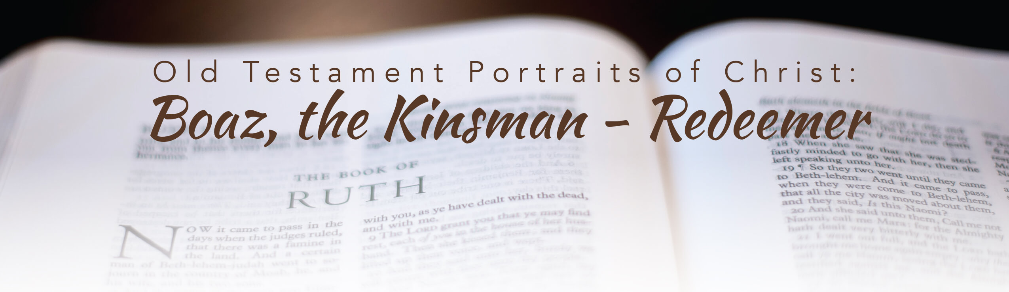
At the Beginning of the Book of Ruth,
Everything is Falling Apart
At the End
Life Has Been Put Back Together Again
It All Has to Do with the
Kinsman Redeemer

Slide 9
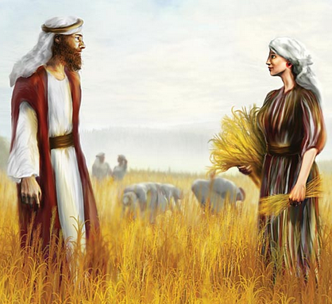
Boaz was that Man…
Person
He Was a Kinsman
Power
He Was Free Himself
Price
He Had the Price
Pay
He Was Willing to Pay
Priority
He Completed the Process
Boaz = Swiftness and Strength

Slide 10
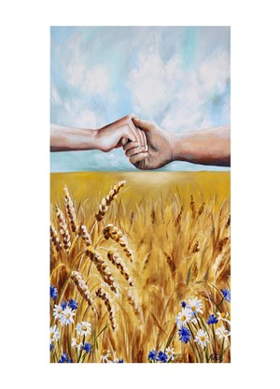
It May Be Easy to Look Down on Ruth
But We ALL are in the Same Boat
We Too Need of a Kinsman Redeemer
But Unlike Ruth
Ours Has a Much Heavier Role to Fulfill

Slide 11
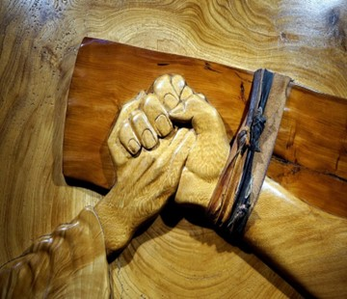
Jesus is Our Kinsman Redeemer
He Must Be Near Of Kin (Position)
Jesus Became Like Us
“The Word became flesh and made his dwelling among us. We have seen his glory, the glory of the one and only Son, who came from the Father, full of grace and truth” -John 1:14
Hebrews 2:17 (AMP)
¹⁷ So it is evident that it was essential that He be made like His brethren in every respect, in order that He might become a merciful (sympathetic) / faithful High Priest in the things related to God, to make atonement / propitiation for the people's sins.

Slide 12
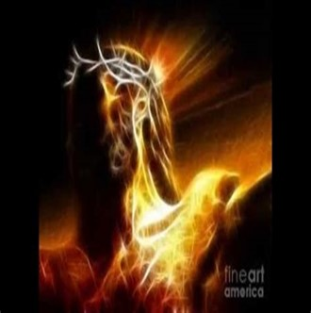
He Must Be Able To Redeem (Possession)
Jesus Was Able to Redeem
Hebrews 9:12 (AMP) ¹² He went once for all into the [Holy of] Holies [of heaven], not by virtue of the blood of goats and calves [by which to make reconciliation between God and man], but His own blood, having found and secured a complete redemption (an everlasting release for us).

Slide 13
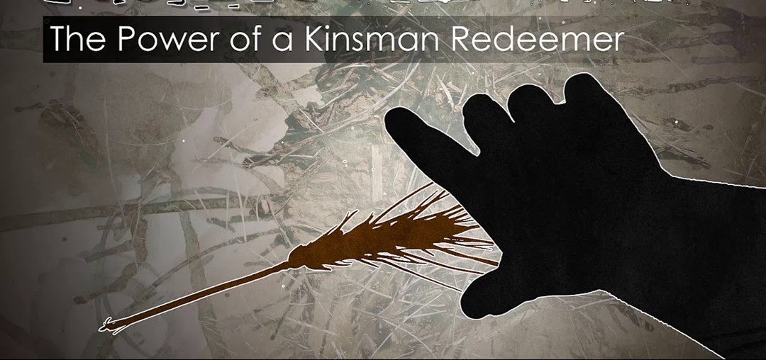
He Must Be Willing to Redeem (Passion)
Jesus Was Willing to Do It
Philippians 2:5-8 (NLT2) ⁵ You must have the same attitude that Christ Jesus had. ⁶ Though he was God, he did not think of equality with God as something to cling to. Instead, he gave up his divine privileges; he took the humble position of a slave/ was born as a human being. When he appeared in human form, ⁸ he humbled himself in obedience to God and died a criminal’s death on a cross.
“No one takes it from me, but I lay it down of my own accord. I have authority to lay it down and authority to take it up again. This command I received from my Father” -John 10:18

Slide 14
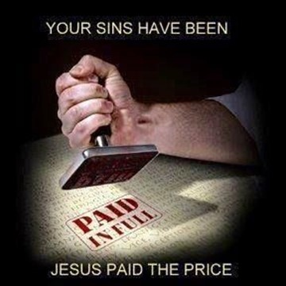
Redemption was Completed When…
…the Price was Completely Paid (Power)
Jesus Paid the Complete Price for Our Sin
John 19:30 (KJV) ³⁰ When Jesus therefore had received the vinegar, he said, It is finished: and he bowed his head, and gave up the ghost.
Our Redemption is a Complete Redemption.
When Our Kinsman Redeemer Paid the Price…
…He Completed What He Started!
There is Nothing Else Needed to Complete It
Or Bring It to Pass.
It Is Finished!

Slide 15
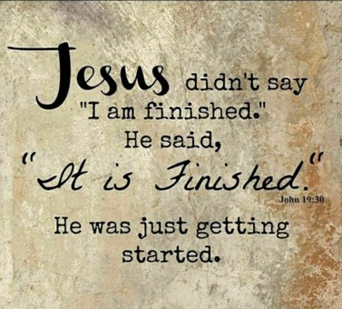
Jesus was Our Man…
Person
He Was a Kinsman
Power
He Was Free Himself
Price
He Had the Price
Pay
He Was Willing to Pay
Priority
He Completed the Process
Jesus = Jehovah + Redeems

