Slide 2


Slide 3
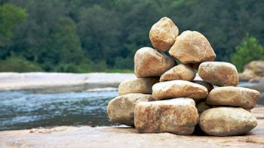
Edward Christian Church
May 28, 2023
Joshua 4
What Do
These
Stones
Mean?
Memorial Day 2023

Slide 4
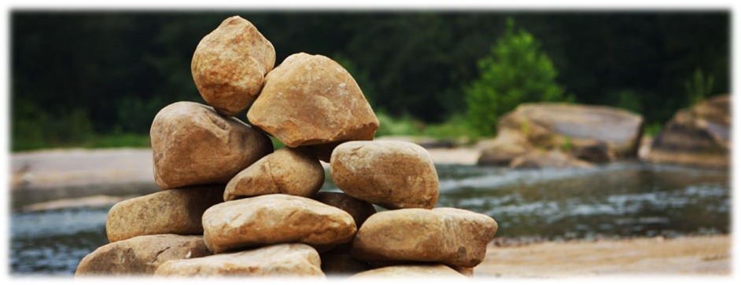
New Day Dawning
Behind them was 40 yrs of :
Wandering
What If’s
Could Have Beens
The Known
Today They Would Leave it all Behind!

Slide 5
New Day Dawning
In Front of Them Continuous:
Unknown
Challenges
Battles
Victories
Today They Would Need a Forward Look!

Slide 6
New Day Dawning
There was the…
Promise
Path of the Promise (swollen)
Power of the Promise (20 miles)
Picture of the Promise (12 stones)

Slide 7
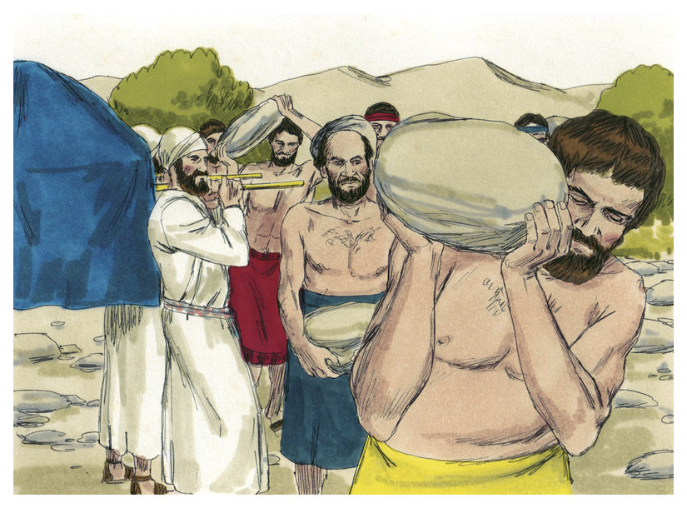
Picture of the Promise “Memorial”
Twelve Men Took 12 Stones:
from Jordan’s Floor
Piled Them Together
In the Promised Land
an Unmistakable Marker
At Place where God Demonstrated
His Power to Overcome Any Obstacle

Slide 8
What Do These Stones Mean?
There was…
There will be…
Struggle
Strength
Success
Struggle
Strength
Success

Slide 9
What Do These Stones Mean?
Spiritual Success Always Comes...
Through...
...Struggle

Slide 10
What Do These Stones Mean?
Remember Behind...
There will be Ahead…
Protection
Provision
Presence
Protection
Provision
Presence

Slide 11
What Do These Stones Mean?
God Always Helps us...
Through...
...the Struggle

Slide 12
God Left Giants in Promised Land On Purpose..to Produce Struggle
God Knows a Lack of Struggle Produces:
Spiritual Weakness
Loss of Spiritual Edge
Thanklessness
Spiritual Laziness

Slide 13
Struggle is a Sign…
#1- There is Still Life in You! - Potential
#2- Satan Does Not Have You Yet - Problem
#3- God Still Has Need of You - Purpose
#4- God is Defending You - Power
#5- Break Thru is On the Way - Promise
Psalms 34:19 (KJV) Many are the afflictions of the righteous: but the
LORD delivereth him out of them all.

Slide 14
What Do These Stones Mean?
What about the Monument in the River?
Unseen by All -would it make a difference?
Unseen by All -Except
God and the Ones that went through
After the Trial -Test -Battle -Struggle
There’s Something Inside..
Nobody Knows but You and God
Nobody Understands but You and God
Nobody even Satan Can Take It Away

Slide 15
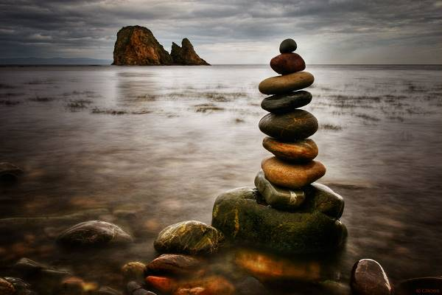
Memorial
The Visible One was a Testimony
…To Generations to the Faithfulness of God
The Invisible One was a Testimony
…To the Child of God Hid in Their Heart!

