Slide 2
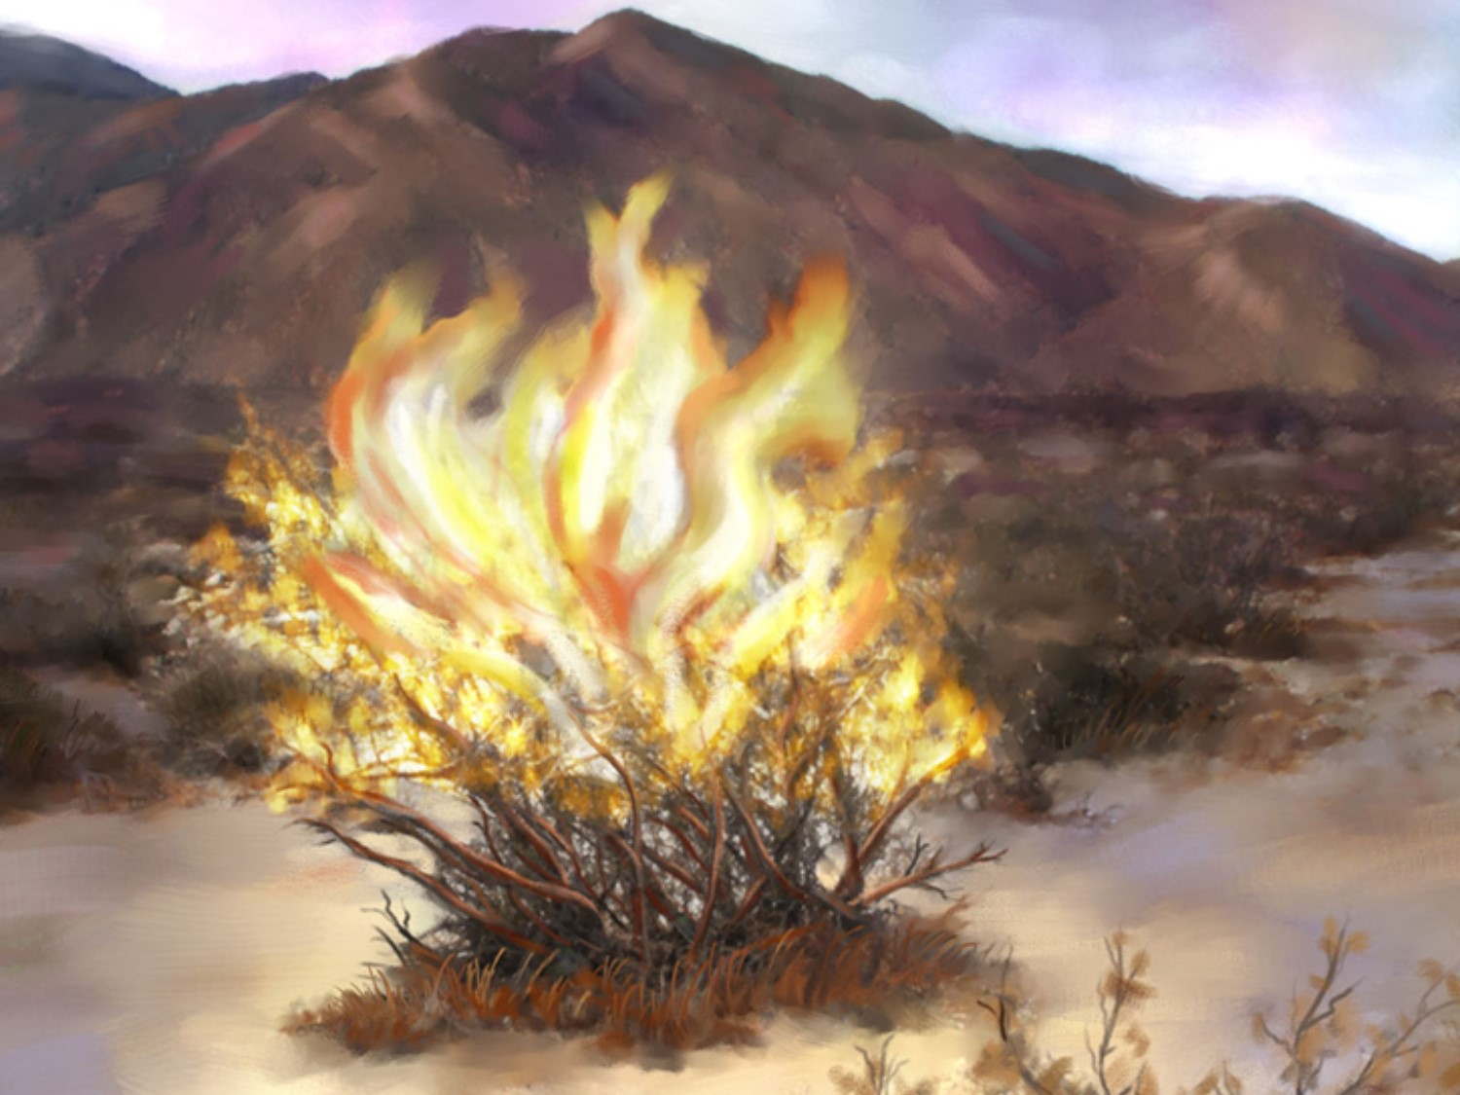
Going From Existing To Effective
…Four Keys –pt1
Hebrews 11:23-29
June 4, 2023
Edward Church

Slide 3
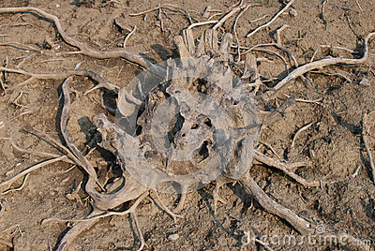
Do You Want to Stand Before…
…Burning Bushes
…Or Dried Roots ?

Slide 4

Hebrews 11
Is About Winners
It's God's Hall of Fame of Faith.
We Often Forget
These Were Ordinary People,
…Who Accomplished
…Extra-ordinary Achievements.

Slide 5

Hebrews 11
Several Things They Had In Common:
  Weren't Perfect
  Often Failed
  All Reached Their Goal
Why?
They Came To A Pivotal Point…
…In Their Faith Life.
They Made The Right Decisions

Slide 6

Moses Was No Exception
    He…
      Was Not Perfect
      Experienced Failure
      DID Reach His Goal
He Settled 4 Basic Life Questions

Slide 7

Basic Life Questions
Who Am I? (24)
What Are My Choices? (25)
What Is Really Important? (26)
What Are My Goals? (27)
Before We Can Be Truly…
ALL That We Can Be For God…
We Must Do the Same.

Slide 8
Basic Life Questions
The Answers to These 4 Questions Are…
4 Basic Principles
to Apply to Your Life…
...to Be Effective In God’s Kingdom

Slide 9

Who Am I? (24)
Be Yourself (24)
Refused =to reject; deny; totally disown
He Wanted to Do…
…What God Made Him to Do.

Slide 10

Be Yourself (24)
The Problem:
Moses had an Identity Crisis
  He Had to Decide "Who Am I?"
  We Come to Same Decision
The Purpose:
God Made You For A Purpose.
  He Made You to be a Part of a Plan.
  There's Nobody Who Can Be You
  Except You

Slide 11

Be Yourself (24)
The Power:
When He Gets to this Point,
  He Finds Inner Power
  Refused (to Reject, Deny,Totally Disown)
  He Wanted to Do…
  …What God Had Made Him to Do.

Slide 12
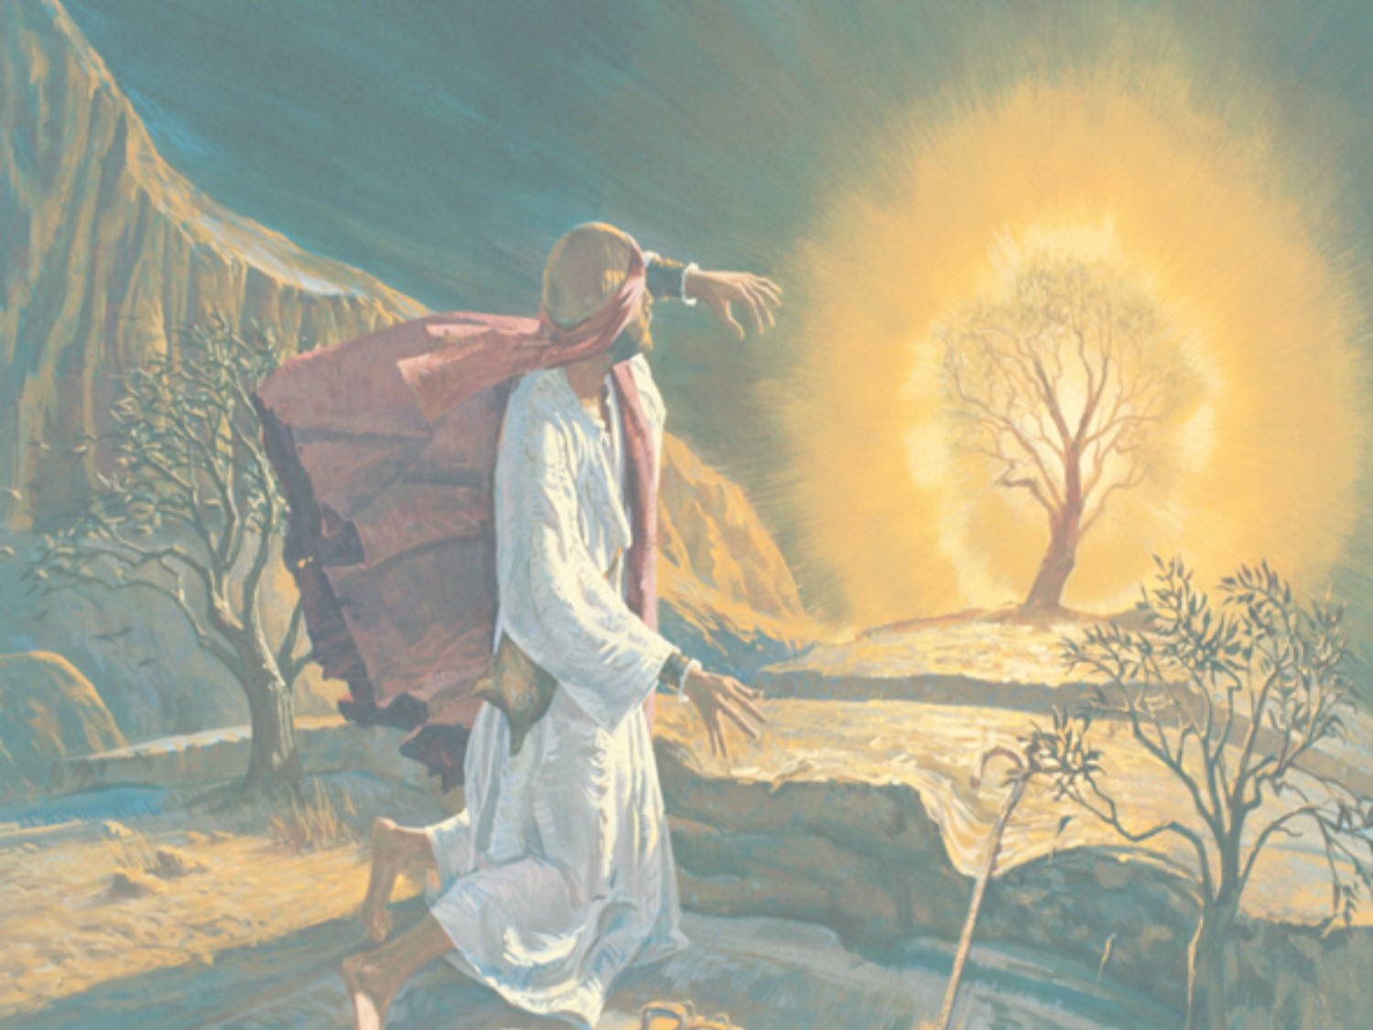
What Are My Choices? (25)
Accept Responsibility For Your Own Life
  Choosing=
to select, decide, deliberate choice
We Have a Choice:
  Place Blame or Accept Responsibility
  Don't Blame Somebody Else
  Do Something About It
  Decide to Change

Slide 13

Be Responsible (25)
Who (23)
  God Chose Moses as a Baby…
…But When Moses Grew Up
What (25)
  He had to Choose…
When (24)
  He Made His Choice?
    "When he was come to years."

Slide 14

Mark of Maturity
This Weeks Assignment…
Colossians 3:17 (AMP)
¹⁷ And whatever you do [no matter what it is] in word or deed, do everything in the name of the Lord Jesus and in [dependence upon] His Person, giving praise to God the Father through Him.
Colossians 3:23 (KJV)
²³ And whatsoever ye do, do it heartily,
as to the Lord, and not unto men;
Watch You Week Radically Change!
Physically, Mentally, Spiritually

