Slide 1

Last Weeks Assignment…
Colossians 3:17 (AMP) ¹⁷ And whatever you do [no matter what it is] in word or deed, do everything in the name of the Lord Jesus and in [dependence upon] His Person, giving praise to God the Father through Him.
Colossians 3:23 (KJV) ²³ And whatsoever ye do, do it heartily,
as to the Lord, and not unto men;
Did You Week Radically Change!
Physically, Mentally, Spiritually

Slide 2
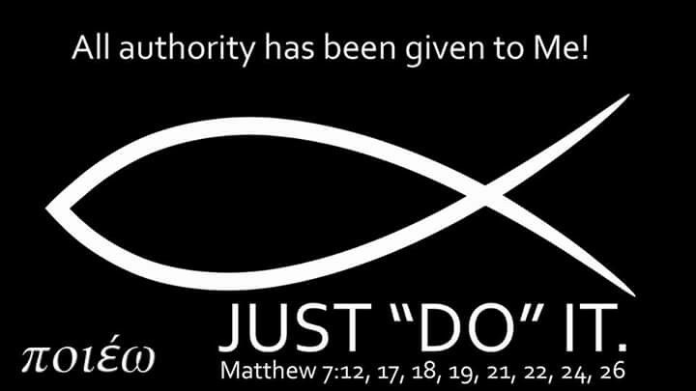
Colossians 3:16-17 (KJV) ¹⁷ And whatsoever ye do in word or deed,
do all in the name of the Lord Jesus, giving
thanks to God and the Father by him.
Word- (lego); something said (including the thought); reasoning (the mental faculty or motive) work.
Deed- ergo (to work); toil (as an effort or occupation); by implication an act :- deed, doing, labour, work.
In Name [authority, character]

Slide 3

New Living Translation whatever you do or say, do it as a representative
of the Lord Jesus, giving thanks through him to
God the Father.

Slide 5
A couple with three children waited in line at San Francisco's Pier 41 to purchase tickets for a boat trip to Alcatraz.
Others watched with varying degrees of sympathy and irritation as the young children fidgeted, whined, and punched one another. The frazzled parents reprimanded them to no avail.
Finally they reached the ticket window.
"Five tickets, please," the father said. "Two round trip, three one way.“
It is amazing how fast the kids calmed down

Slide 6
Japan Mission 2023

Slide 7
My time in Japan
I struggled to find what verse could sum up my time in such an extoic place.
The land was beautiful and peaceful but under that layer of projected perfection was a depression that could been seen.
I was also able to look back at the US and see a broken country and more importantly a broken church.
But acknowledging a problem allows allows to try and start to fix it.

Slide 8
Matthew 7:1-6
“Judge not, that you be not judged. 2 For with the judgment you pronounce you will be judged, and with the measure you use it will be measured to you. 3 Why do you see the speck that is in your brother's eye, but do not notice the log that is in your own eye? 4 Or how can you say to your brother, ‘Let me take the speck out of your eye,’ when there is the log in your own eye? 5 You hypocrite, first take the log out of your own eye, and then you will see clearly to take the speck out of your brother's eye.
6 “Do not give dogs what is holy, and do not throw your pearls before pigs, lest they trample them underfoot and turn to attack you.

Slide 9
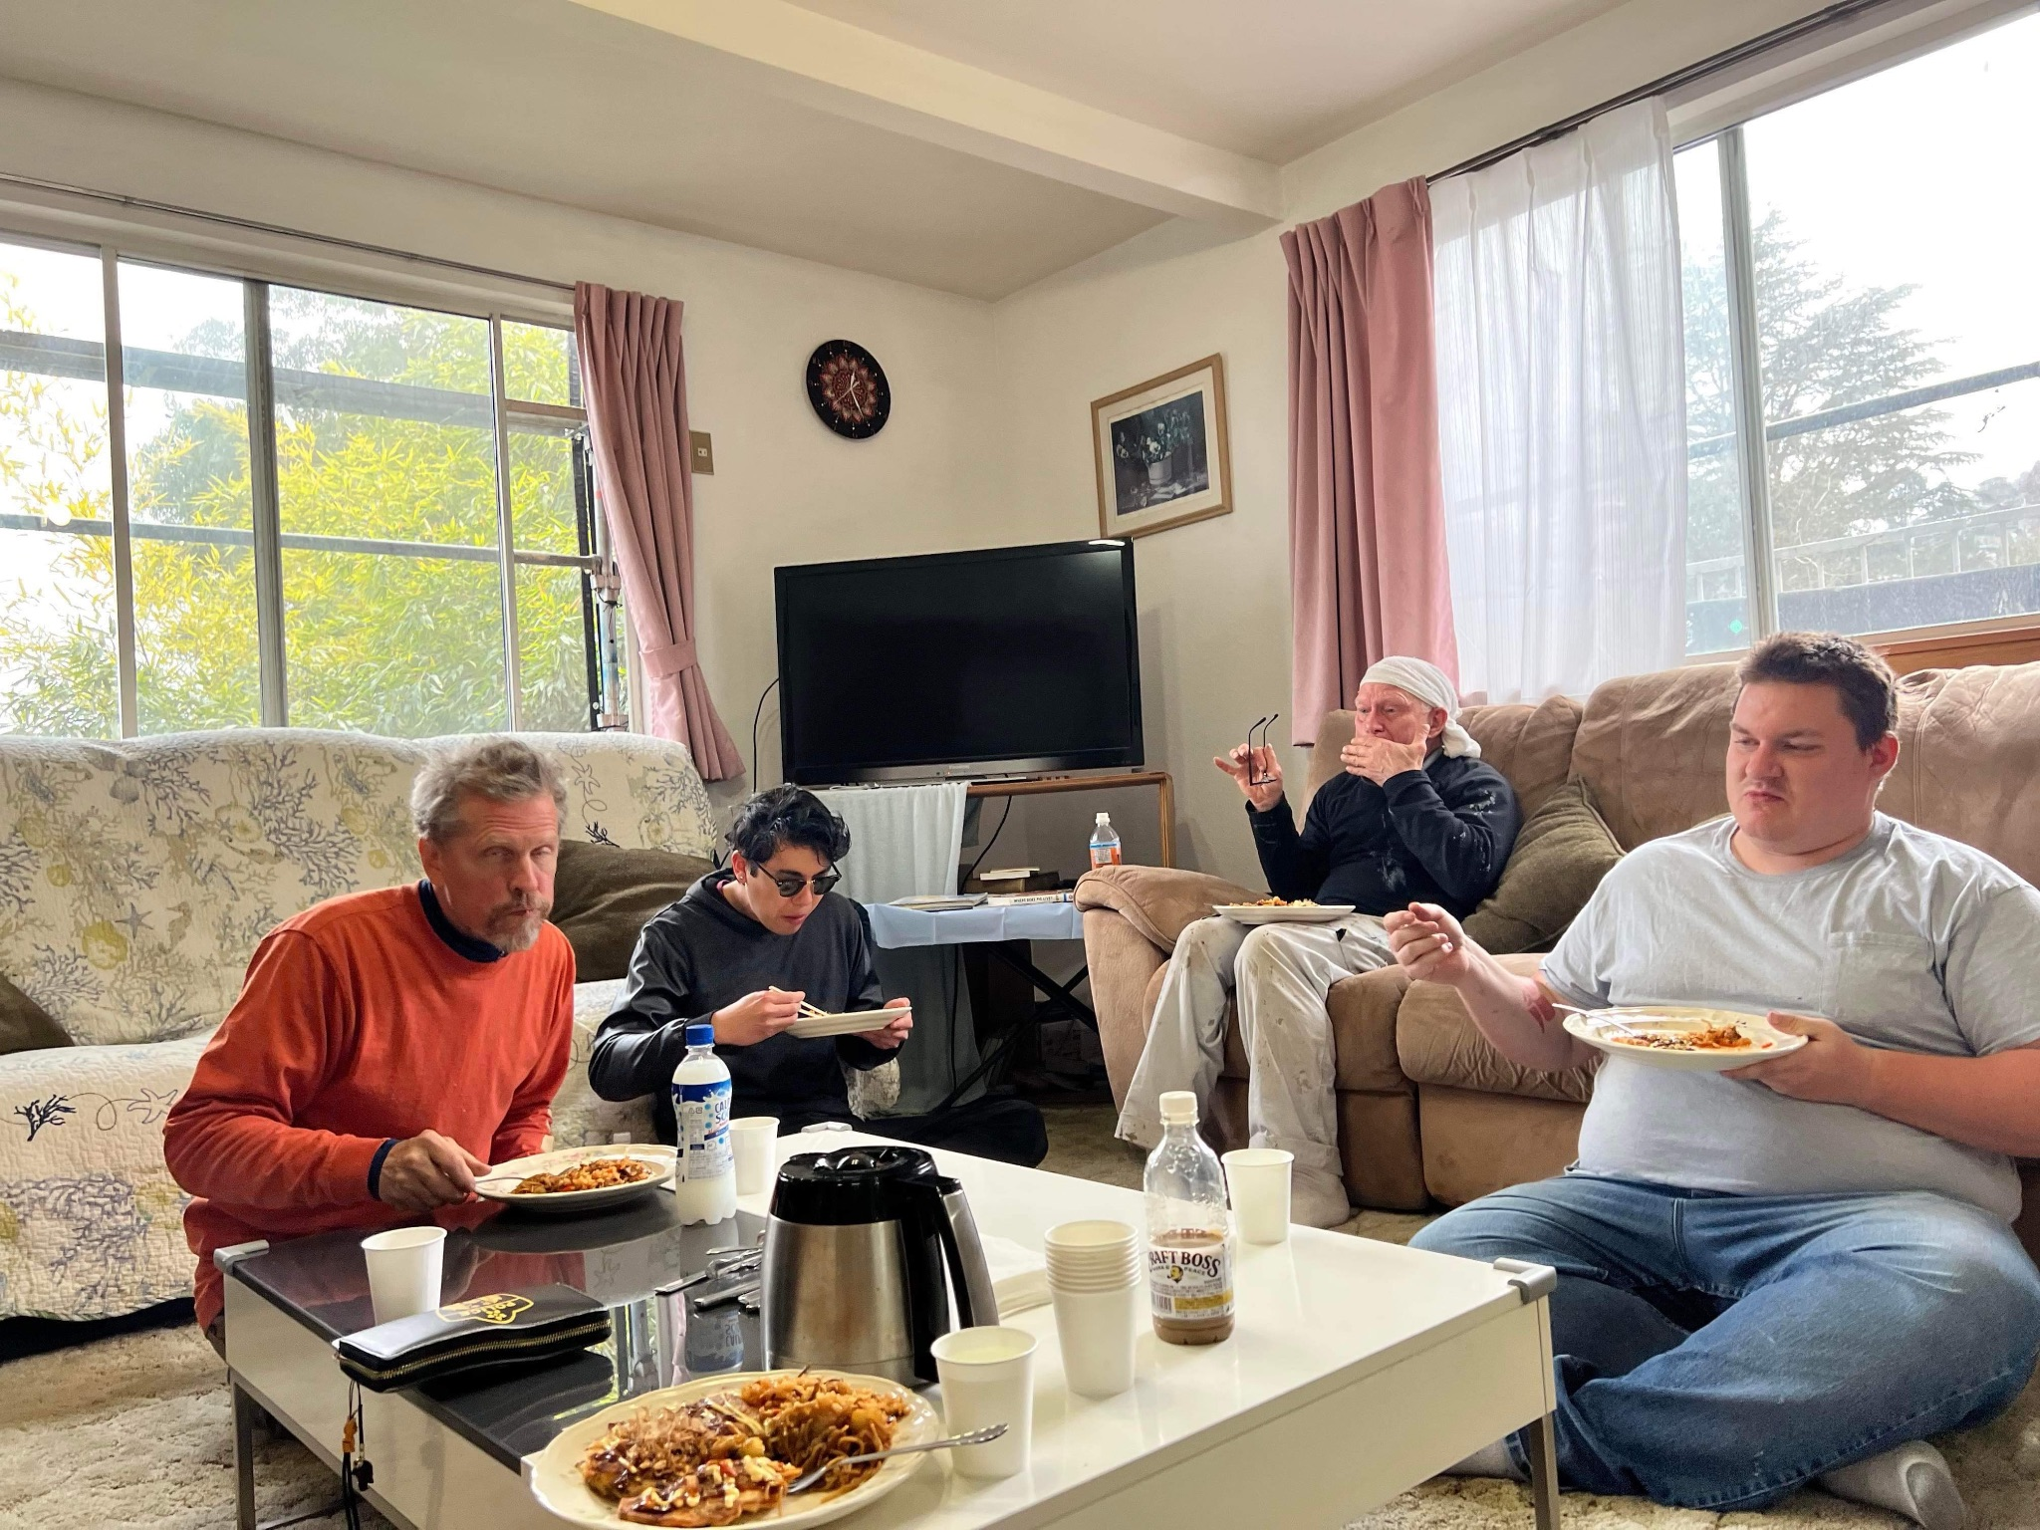

Slide 10
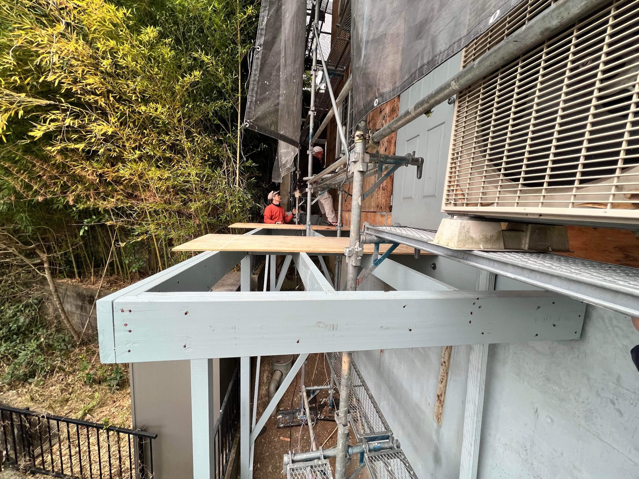

Slide 11
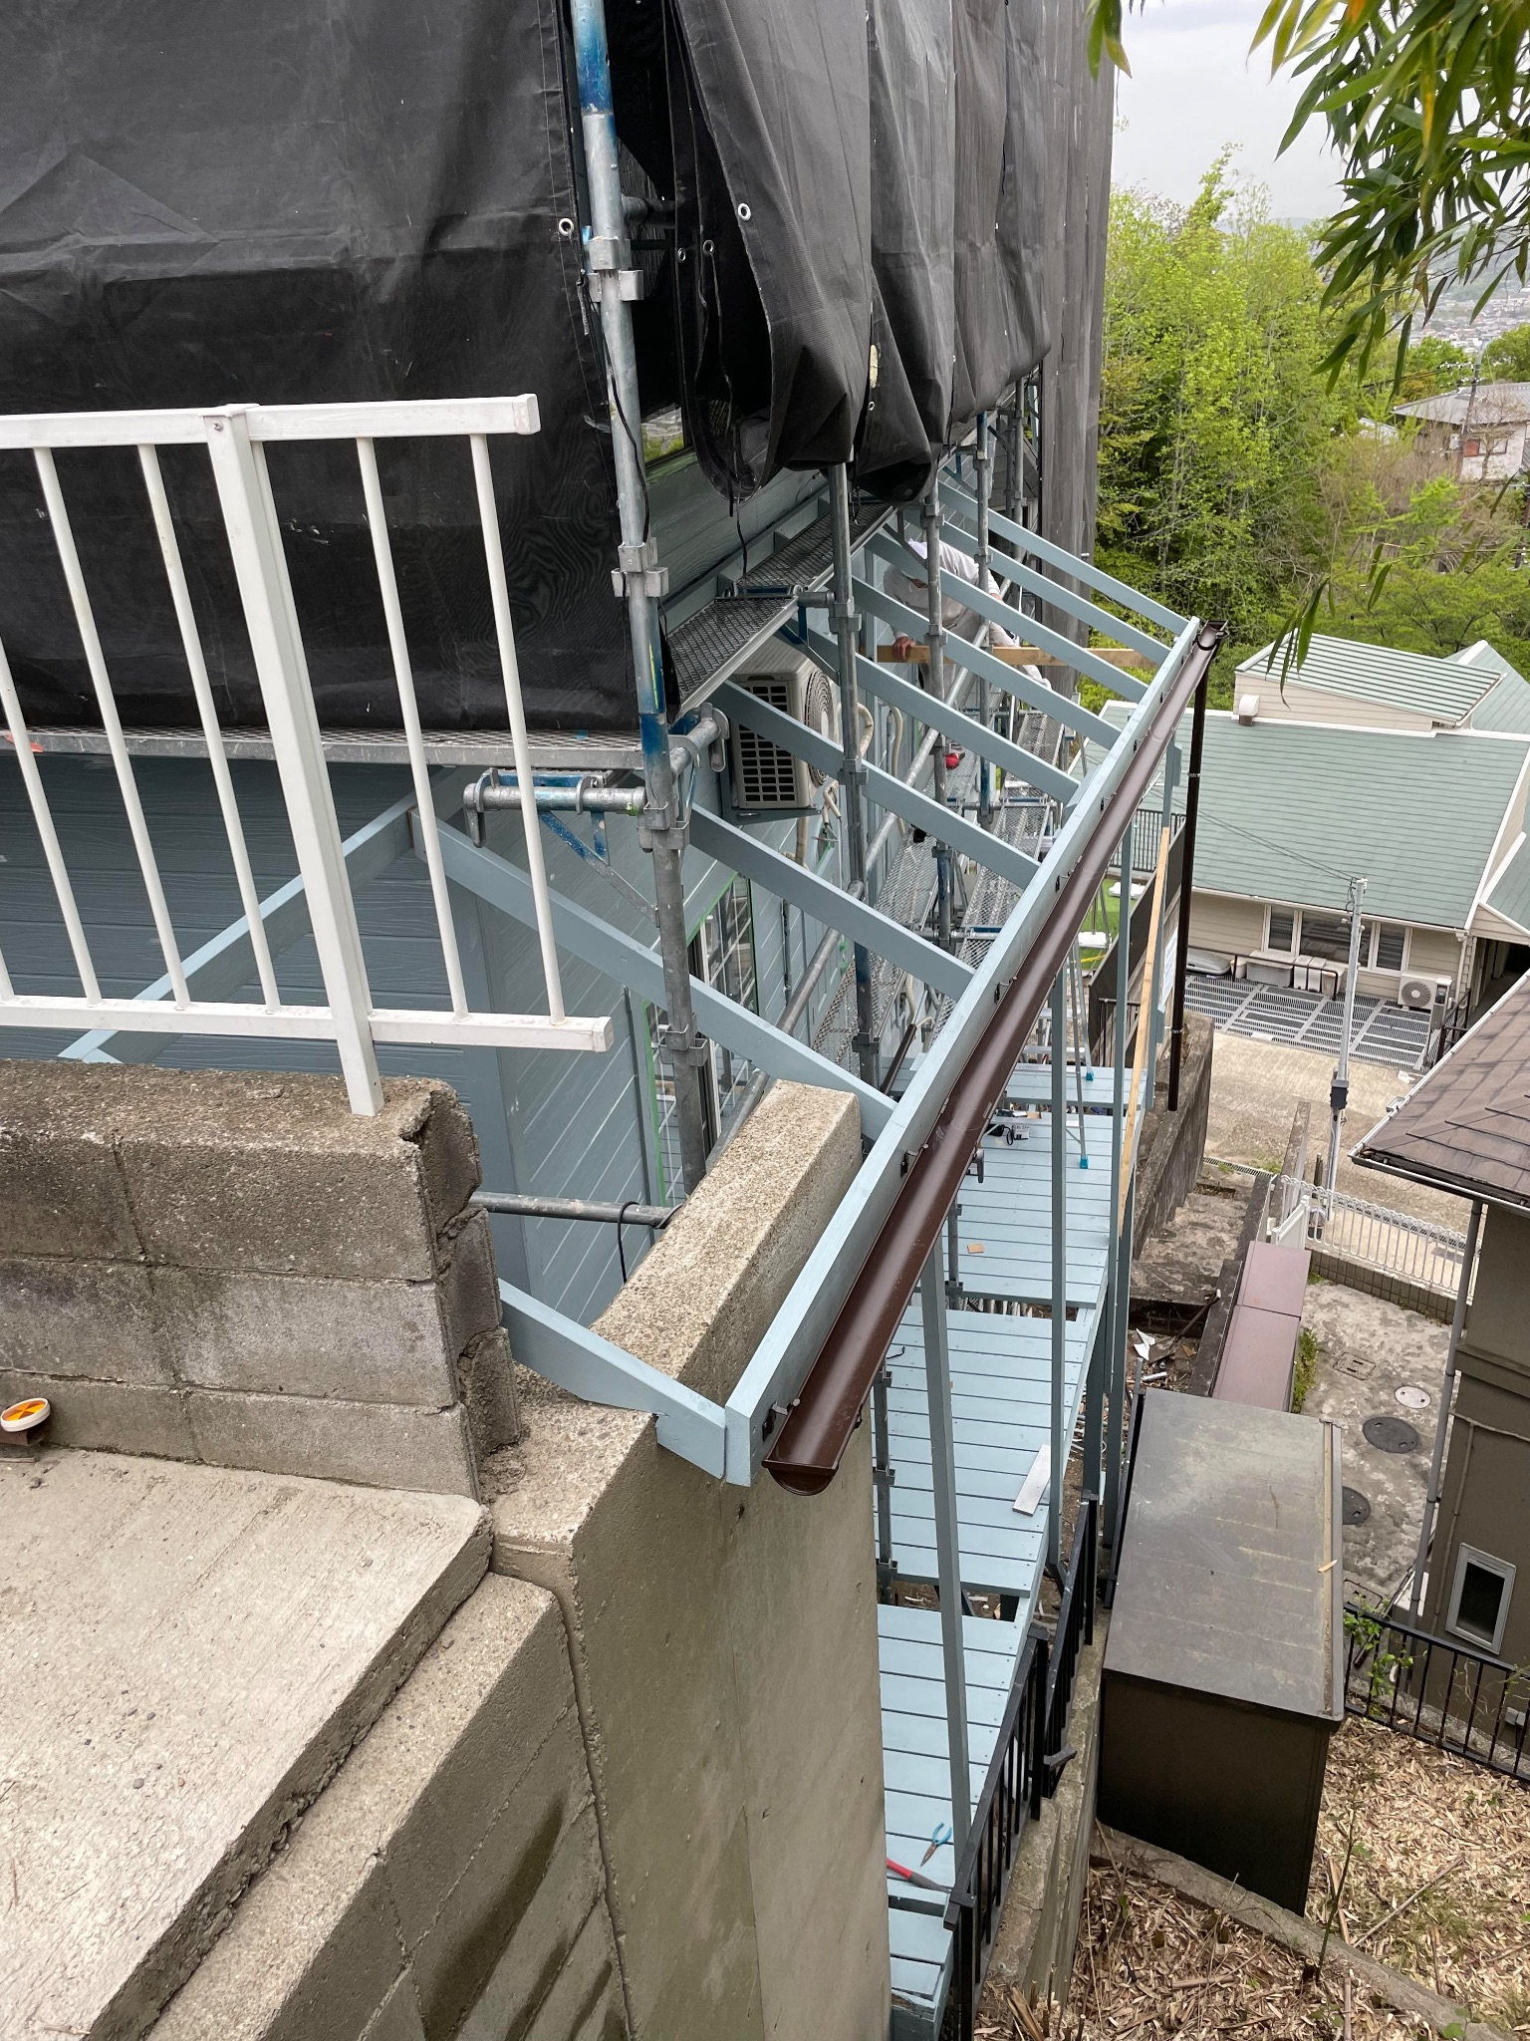

Slide 12
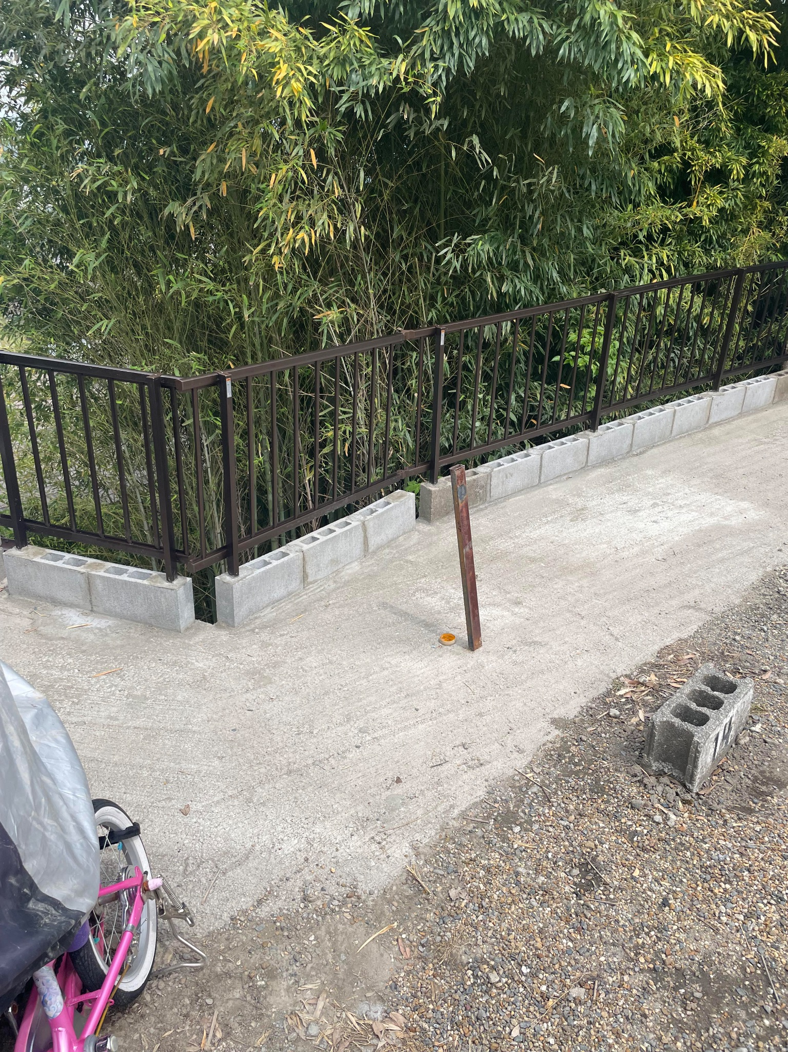

Slide 13
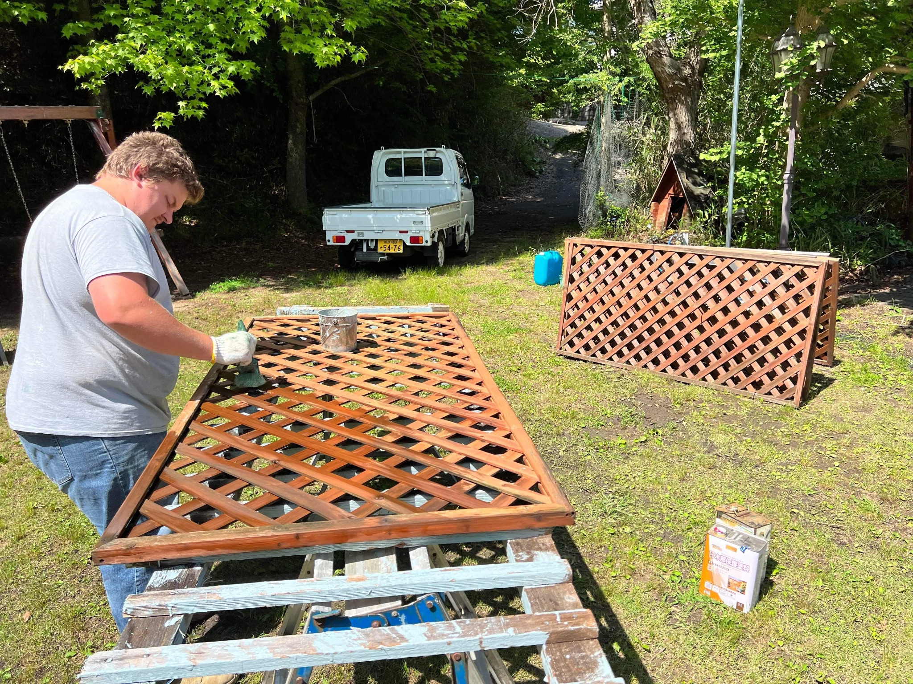

Slide 14
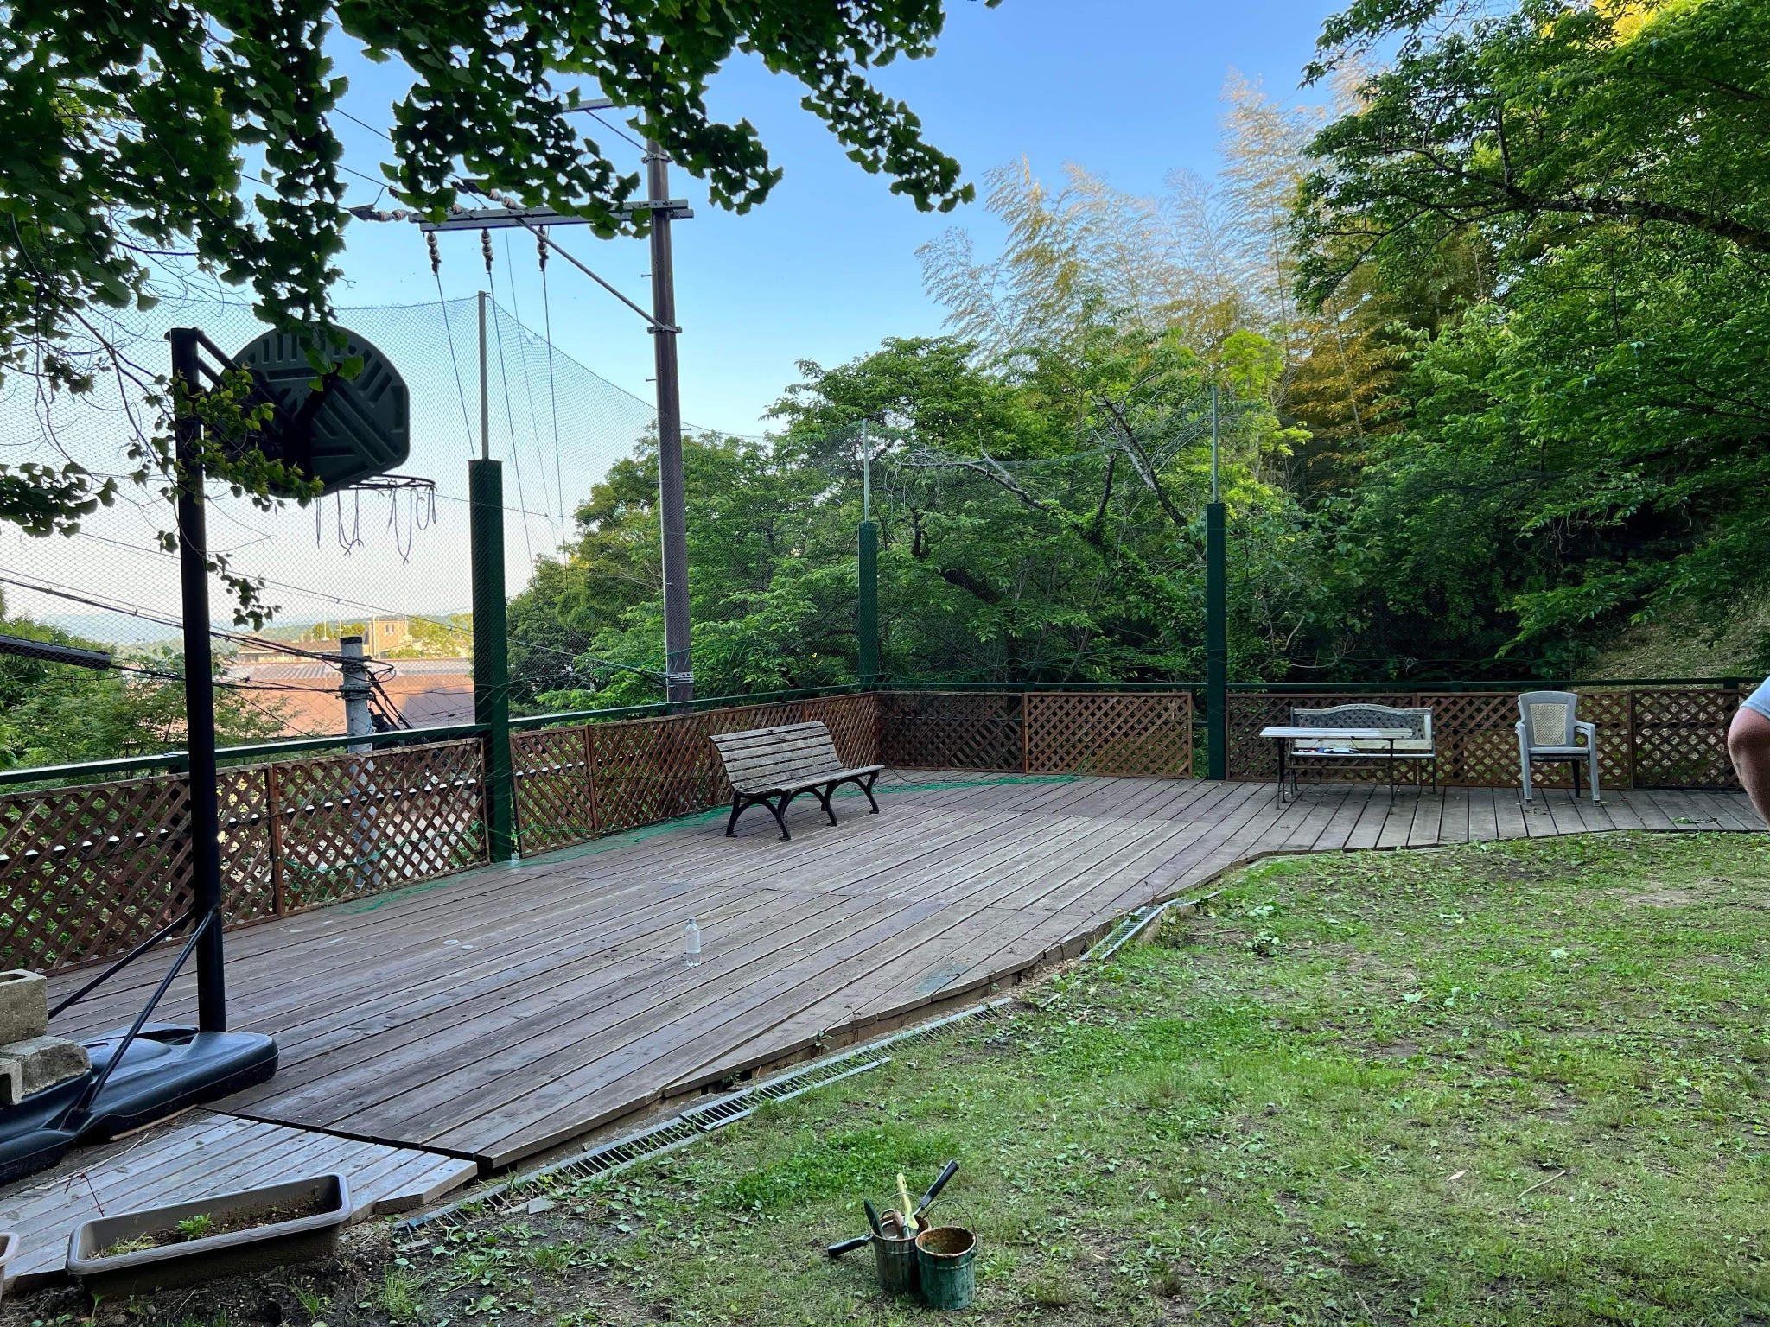

Slide 15
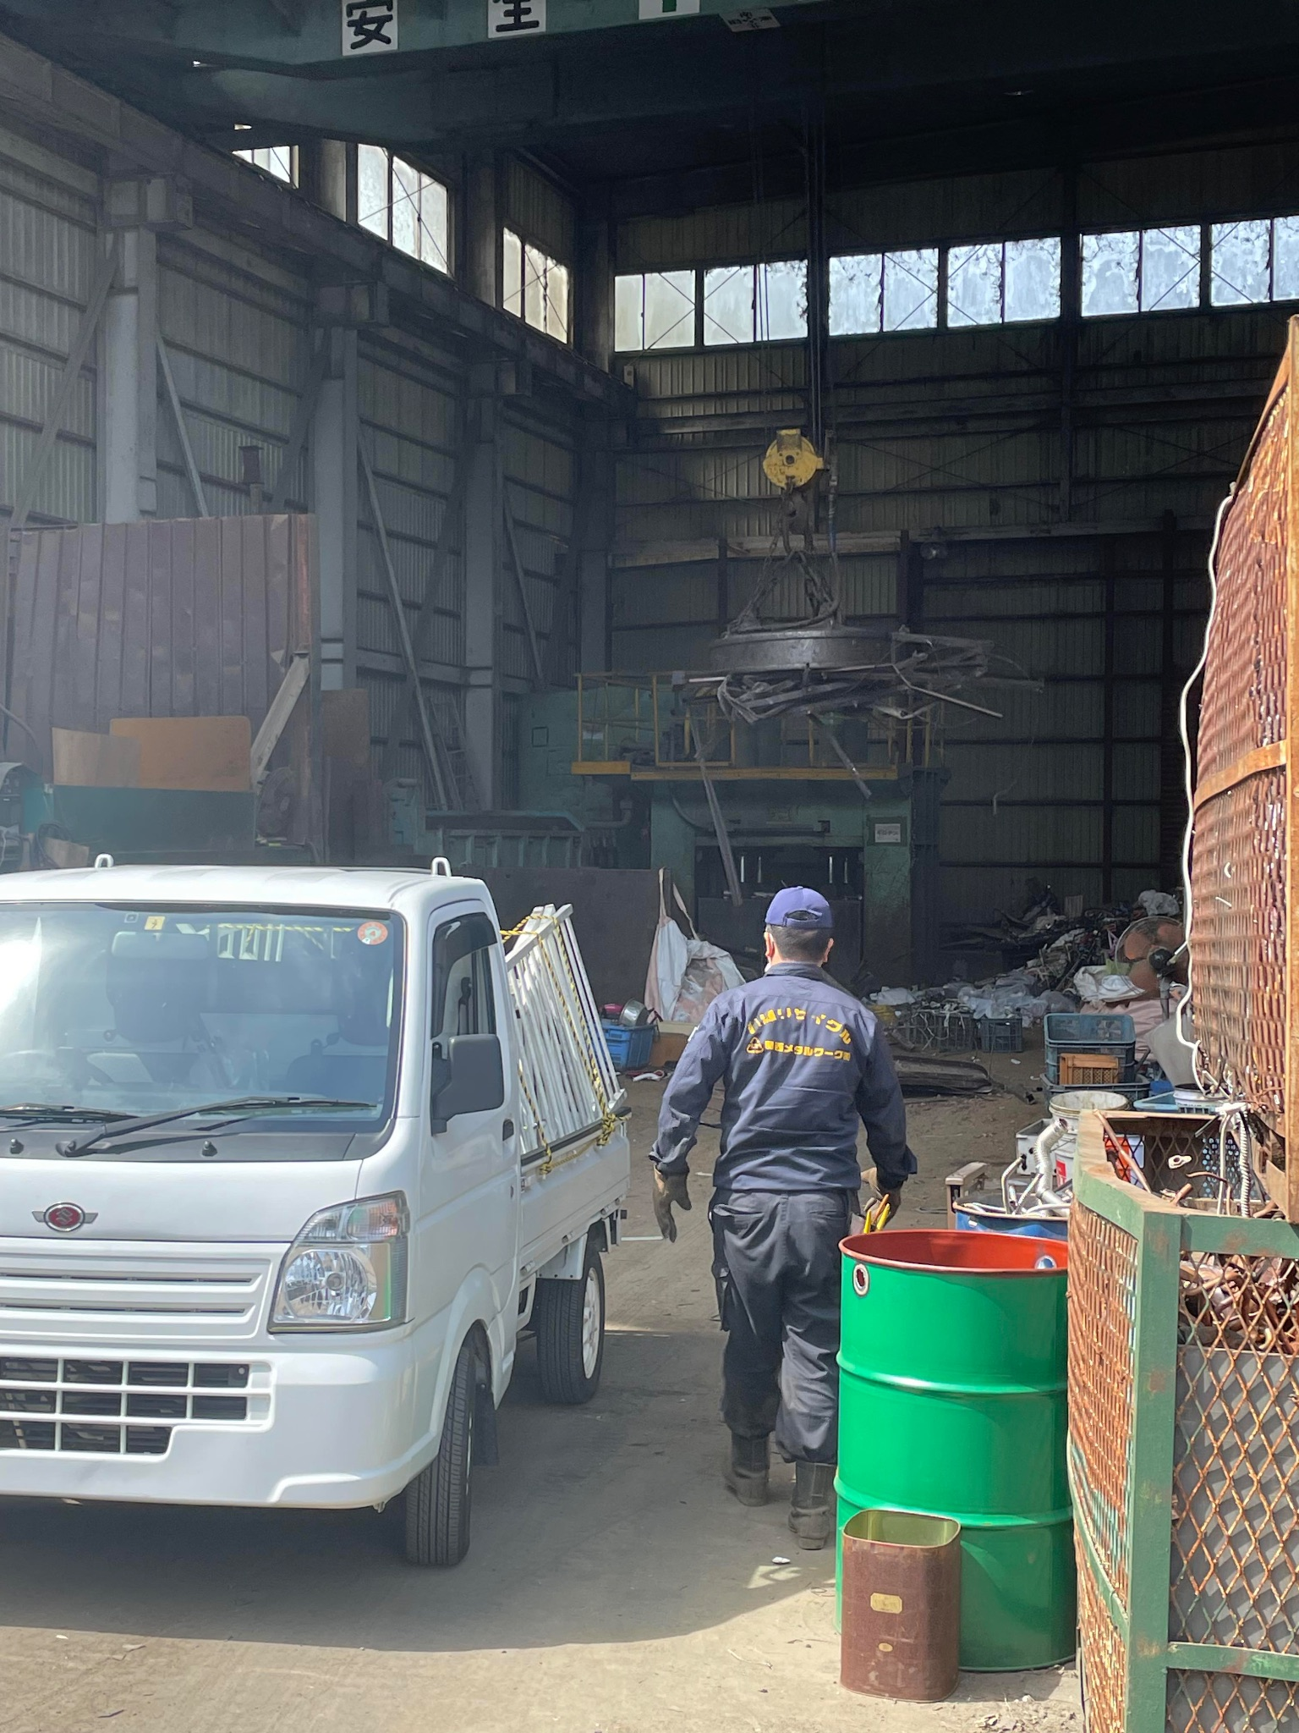

Slide 16
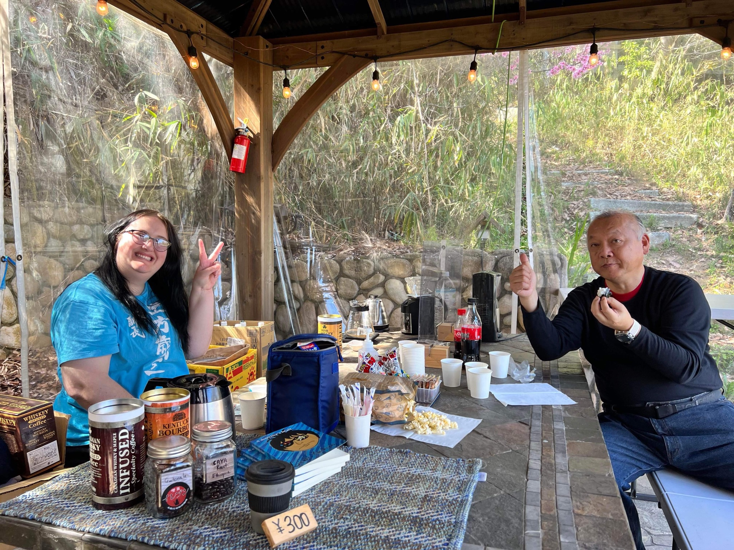

Slide 17
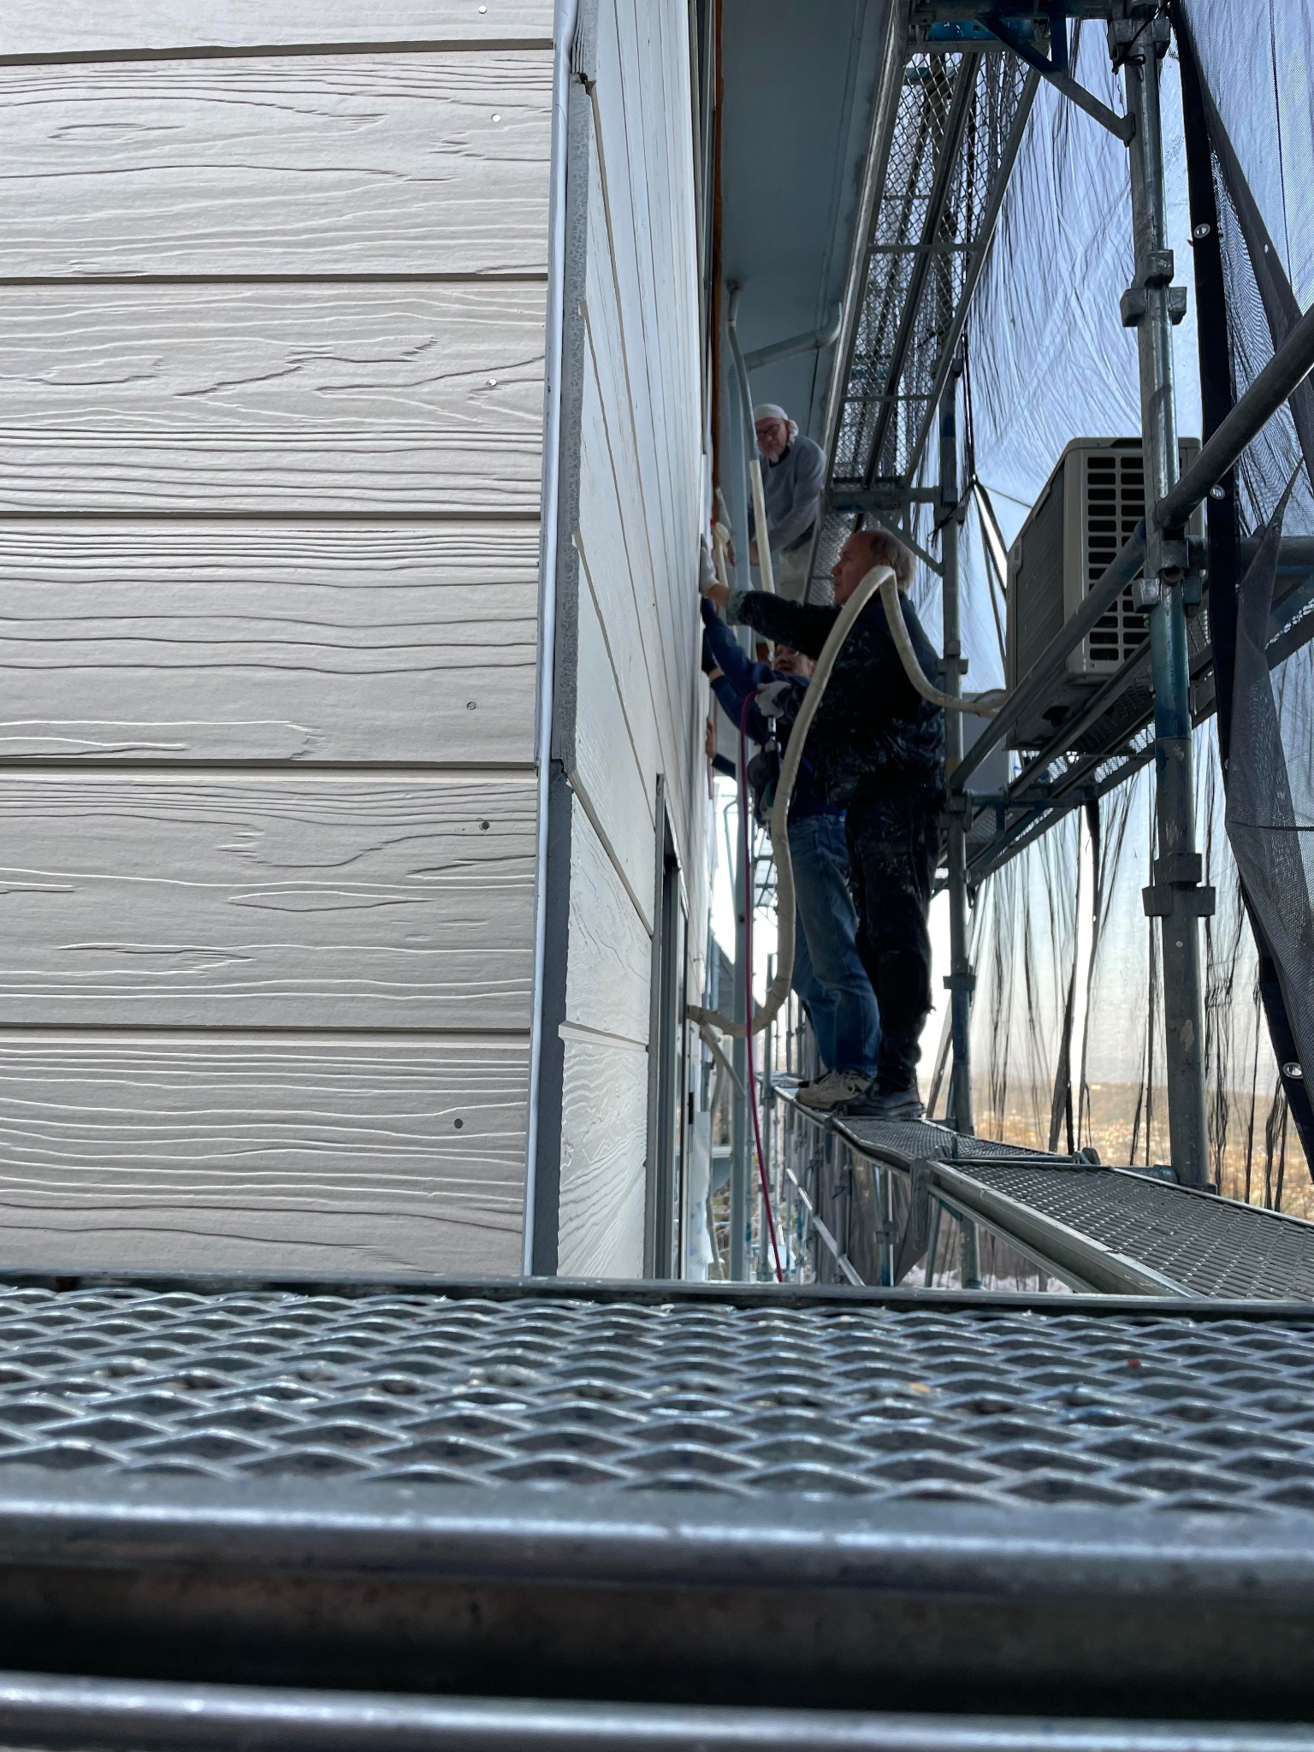

Slide 18
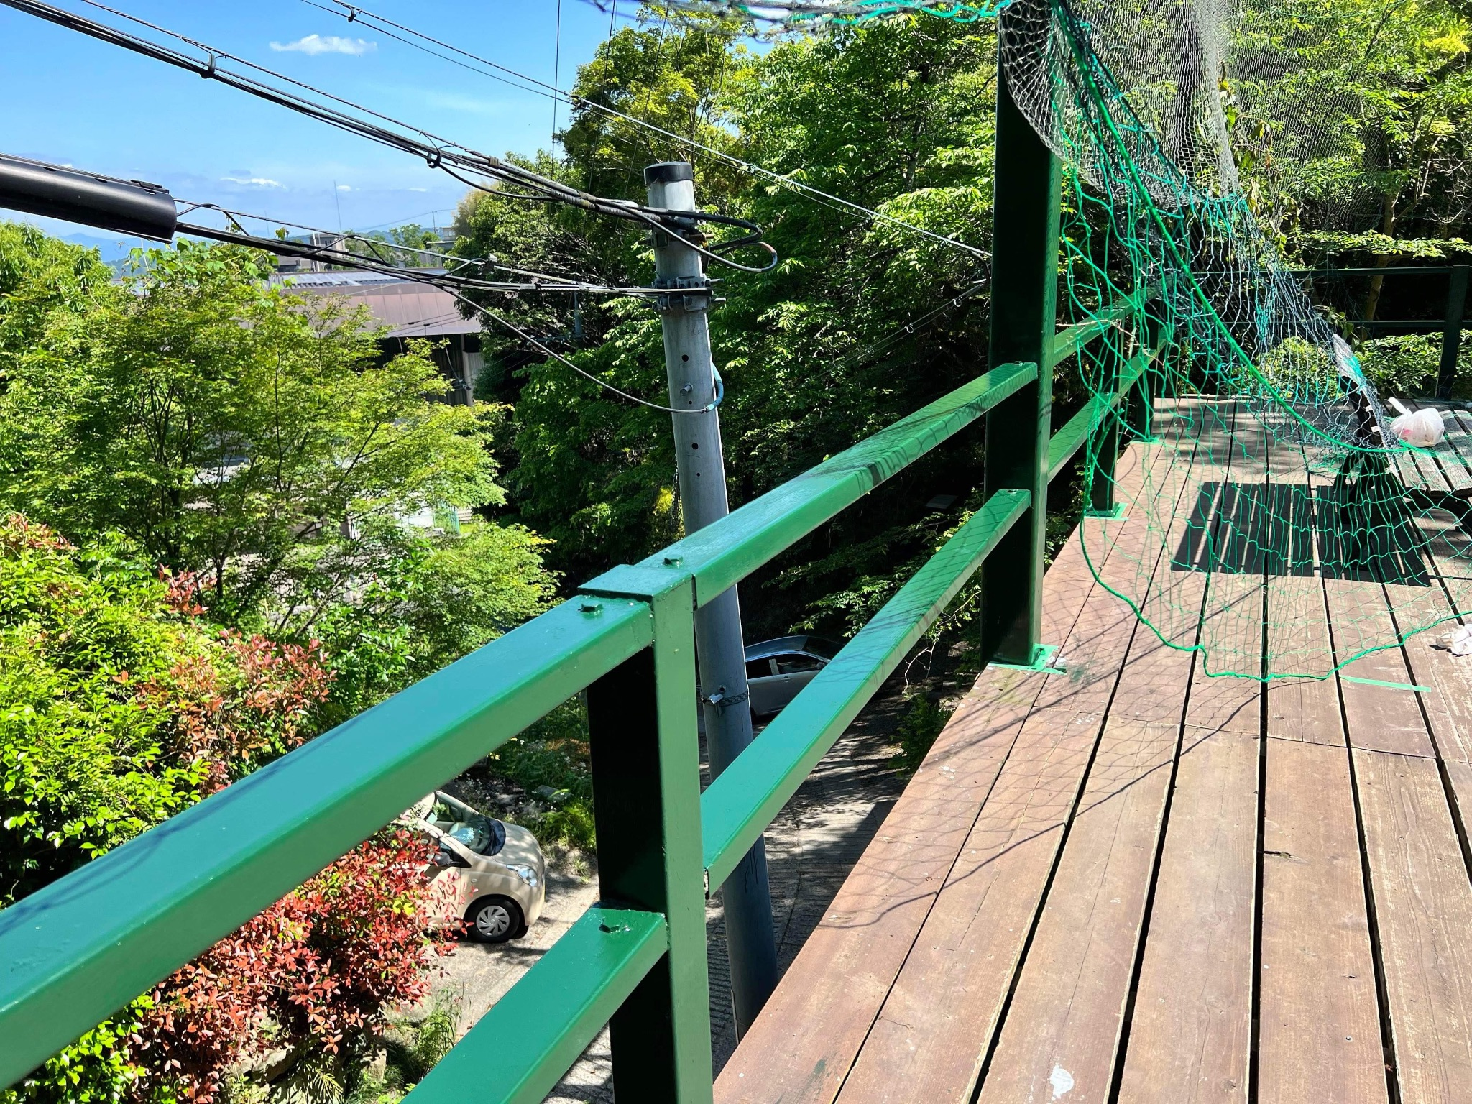

Slide 19


Slide 20
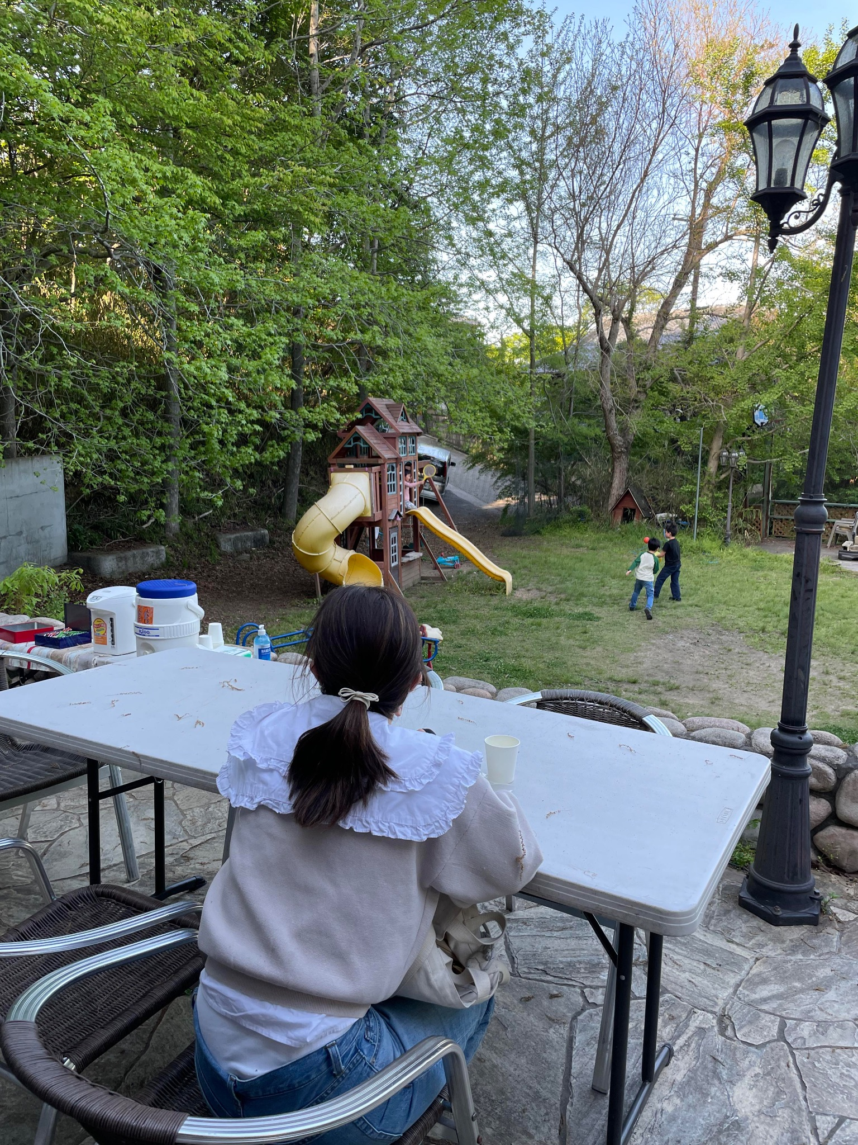

Slide 21
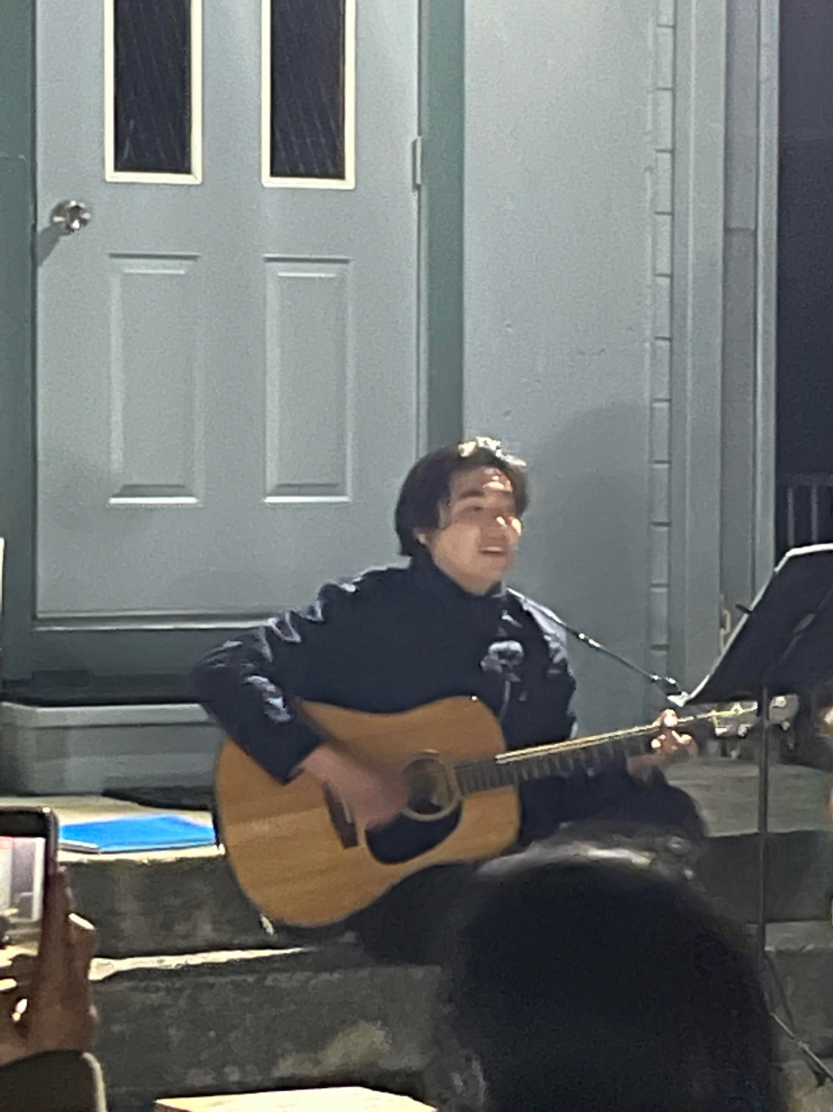

Slide 22
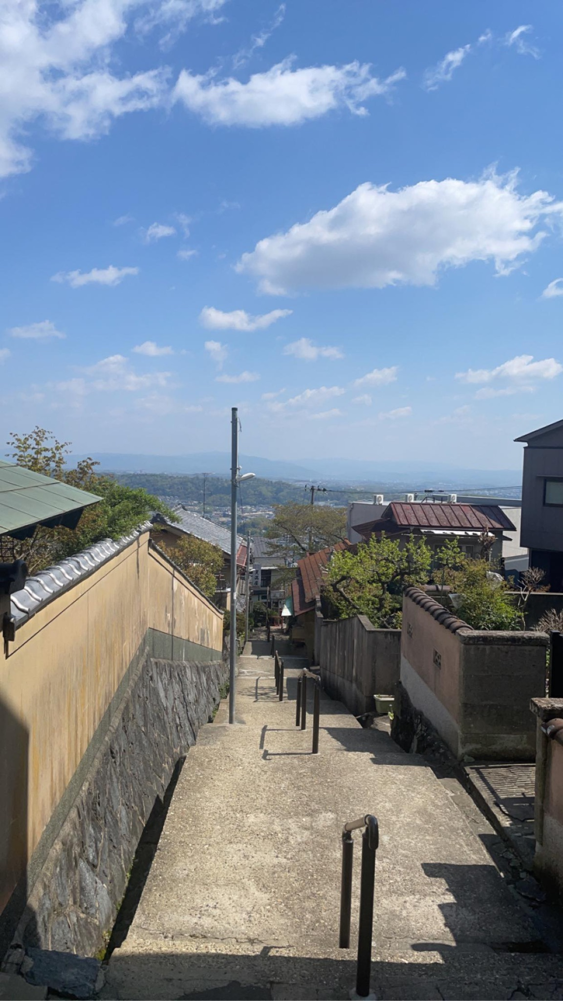

Slide 23


