Slide 1


Slide 2


Slide 3
Why Real Men Are Happier
#10- Men can wear shorts…
…no matter what their legs look like
#9- Men have one wallet and one pair of shoes…
…which are good for every season
#8- Men can choose whether or not to…
…grow a mustache
#7- Weddings take care of themselves
#6- Men only have to shave their faces…
and necks..
and backs?

Slide 4
Why Real Men Are Happier
#5- Men can do their Christmas shopping for 25 relatives…
… on Christmas Eve in 25 minutes
#4- Men don't have to stop and think which way…
…to turn a screw
#3- Men have one mood all the time…
Well Most of the Time…
…Ok Maybe Not
#2- A wedding dress cost $5000.
…A tuxedo rental - 100 bucks
#1- Men can open all their own jars

Slide 5

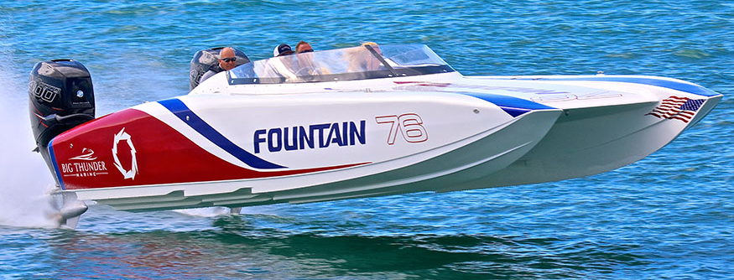
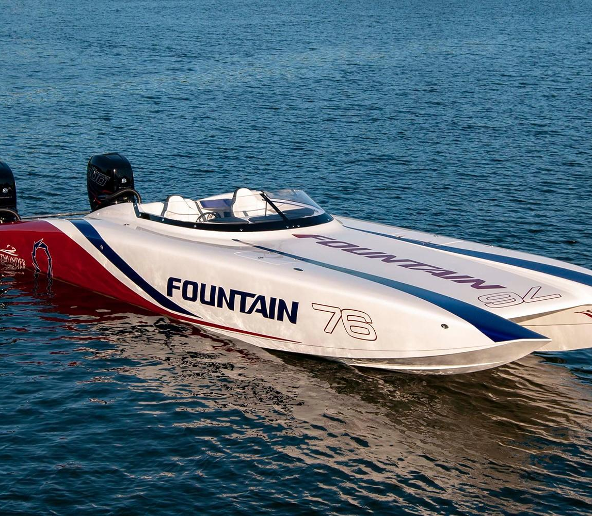

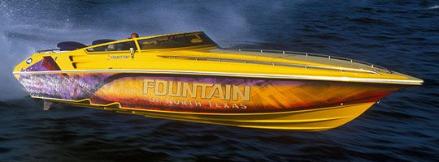
Fathers Day 2023 Lessons
from Fountain
Power Boats p1

Slide 6

Fountain Powerboats was an Awesome Place to Work
It was a Highly Competitive Environment
It was Easy to Go From Checkered Flag to Black Flag
There was so Many Variables and Procedures,
That If Not Handled Correctly It WILL COST in the Contest
Connect this to Spiritual Warfare
It is a Highly Competitive Environment
It is Easy to Go From Checkered Flag to Black Flag
There was so Many Variables and Procedures,
That If Not Handled Correctly It WILL COST in the Contest
Just as Reggie was the Leader…
…the Father is the Leader in Spt Warfare

Slide 7
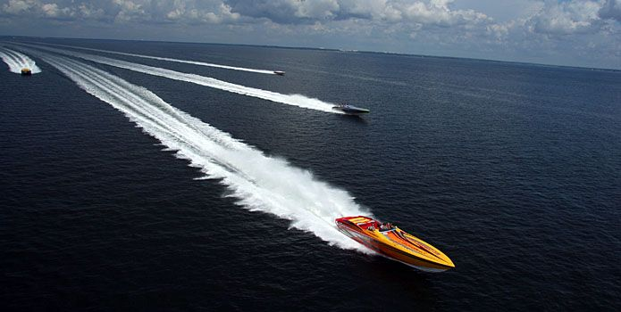
Lessons Learned From Fountain Powerboats
#1- If You Want to be the Man, You Have to Beat the Man
Aggressively Go After Your Competition
Never Play His Game- Force Him to Play Yours –Wooden

Slide 8

Spiritual Warfare
If You Want to be the Man, You Have to Beat the Man(Satan)
Aggressively Go After Your Satan / His Wiles –
Never Play His Game- Force Him to Play God’s
And I say also unto thee, That thou art Peter, and upon this rock I will build my church; / the gates of hell
shall not prevail against it. -Matthew 16:18
You are Not Helpless / Hopeless…You Are Called!
You Are the Patriarch / Priest of Your Home!
God has Called You and Annointed You for This!

Slide 9
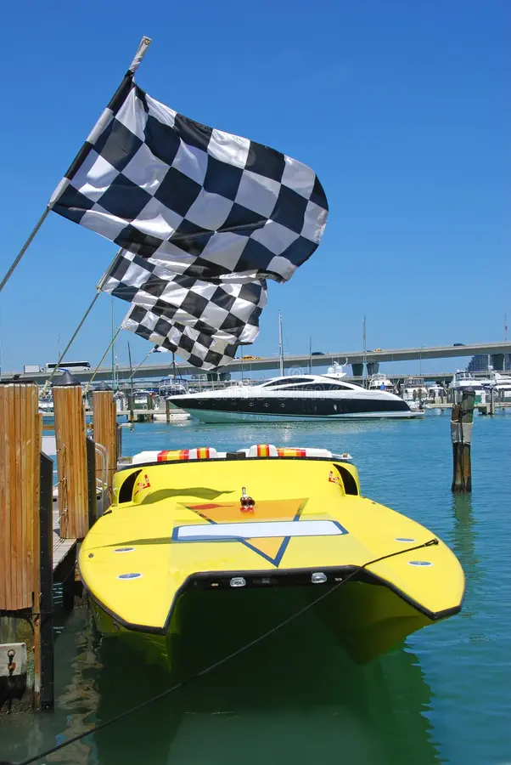
Lessons Learned From Fountain Powerboats
#2- Always Race to Win, esp. Guard Your Own Turf
How you Play the Game is Important…
…but also Winning
If Winning was not important..Why Keep Score?

Slide 10
Spiritual Warfare
Always Race to Win, esp. Guard Your Own Turf
How You Play the Game is Important –but also Winning
If Winning was not important..Why Keep Score?
Strive to Be Your Best
1 Corinthians 9:24 (KJV) Know ye not that they which run in a race run all, but one receiveth the prize? So run, that ye may obtain.
Your Family is Watching
Satan is Watching
Father’s You Can Be a Great Example…
Or a Great Warning!

Slide 11

Lessons Learned From Fountain Powerboats
#3- Never Too Old To Compete- Reggie 80+
What You May Not Have In Stamina..
…You Make Up For In Experience/ Knowledge

Slide 12
Spiritual Warfare
And Moses was an hundred and twenty years old when he
died: his eye was not dim, nor his natural force abated.
Deuteronomy 34:7 (KJV)
You Are Never Too Old!!
Your Kids May Be Grown
But
They Still Need You
Gbabies Still Need You
Others in Your Circle…

Slide 13
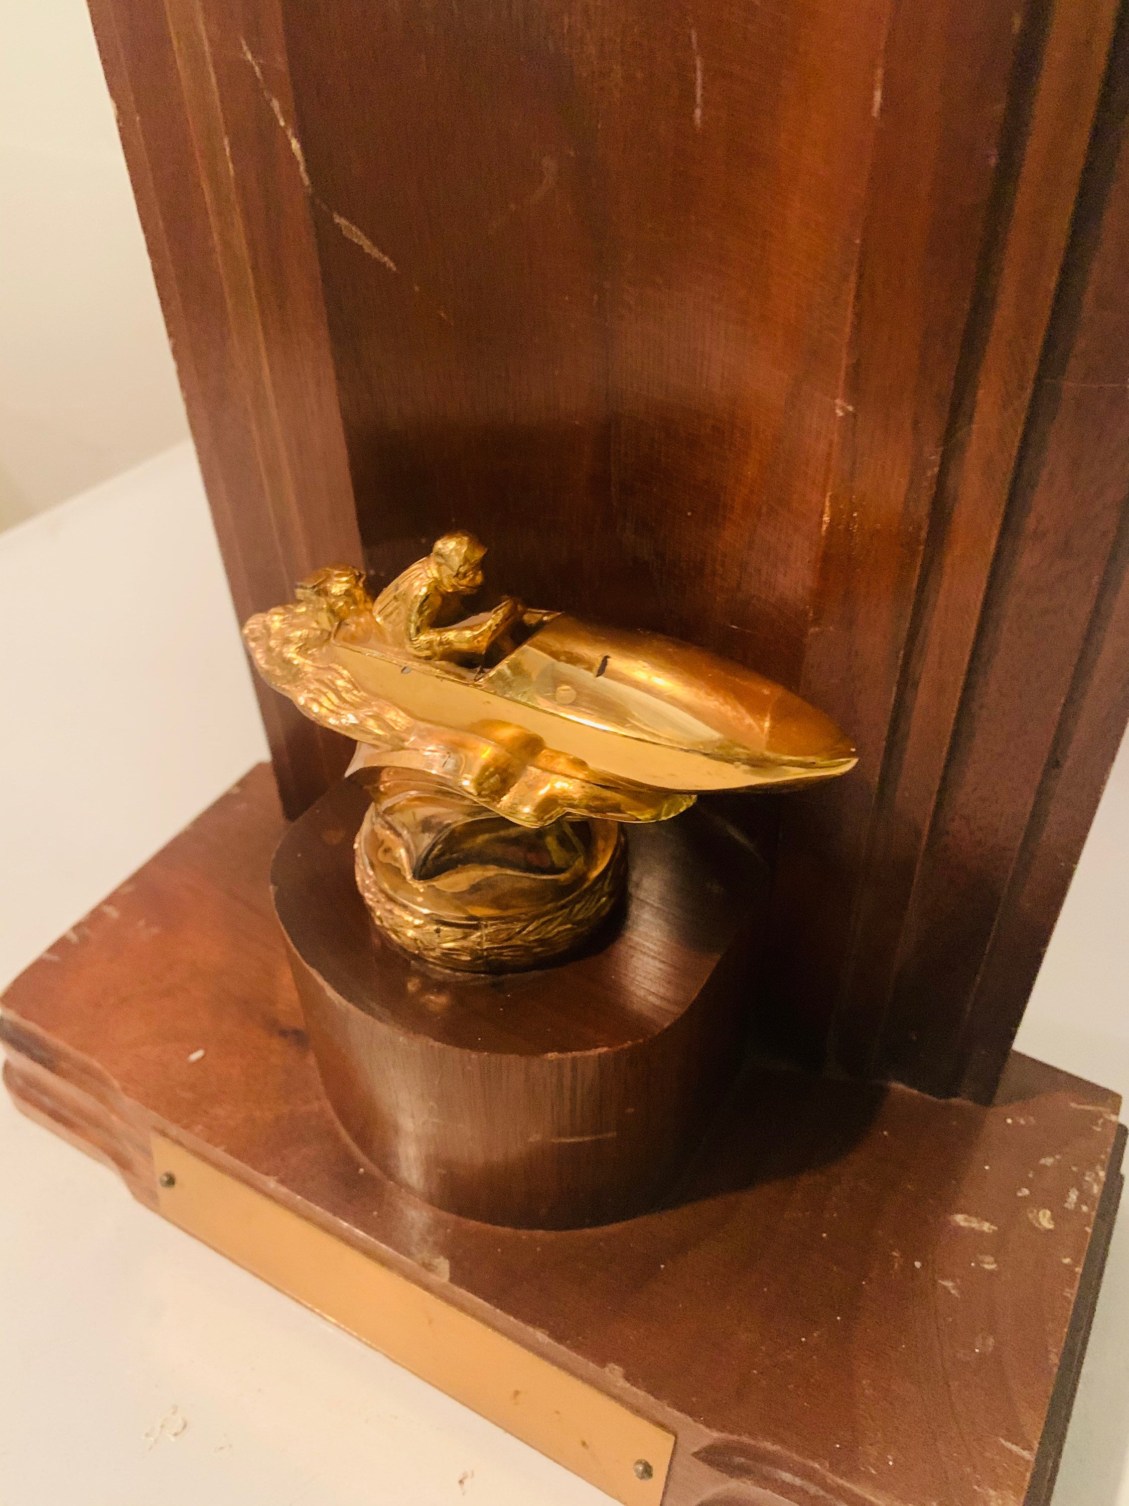
Lessons Learned From Fountain Powerboats
#4- People Follow Leaders (Winners)
People Don’t Want to Follow the Ineffective

Slide 14
Spiritual Warfare
The Father CANNOT Take a Back Row Seat…
…When It Comes to Spiritual Warfare
…We Need to Lead !!!
Know ye not that they which run in a race run all, but one receiveth the prize? So run, that ye may obtain. -1 Cor 9:24
We Cannot Afford to Sit Back/ Let Our Wives / or Children..
…Fight Alone!!!

Slide 15
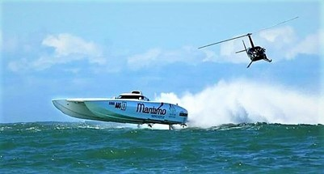
Lessons Learned From Fountain Powerboats
#5- Trust Your Guide –Helicopter/ SpottersYou Have to Trust Your Spotters to Find/ Signal Obstacles.

Slide 16
Spiritual Warfare
Trust Your Guide –Helicopter/ Spotters
You Have to Trust Your Spotters to Find and Signal Obstacles
And one of his servants said, None, my lord, O king: but Elisha, the prophet that is in Israel, telleth the king of Israel the words that thou speakest in thy bedchamber. 2 Kings 6:12
You Are Not Battling Alone !!!
You Have His..
Word
Spirit
Promise
.

Slide 17

Fathers Day 2023 Lessons from Fountain Power Boats pt1
For Many Years
Fountain Had Winning Seasons
Held Numerous Records
His Legacy is Still Going Strong

