Slide 1

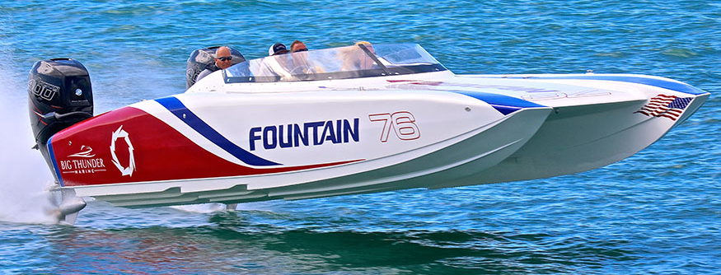
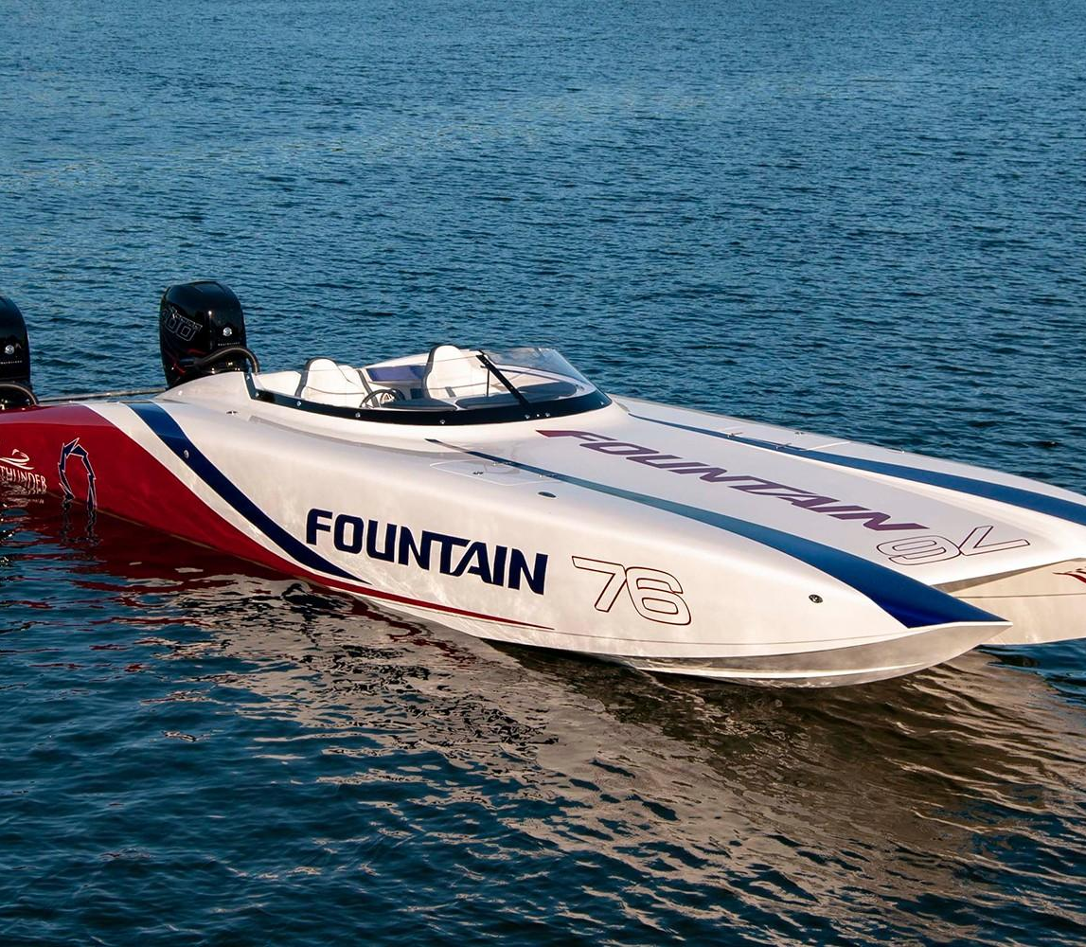

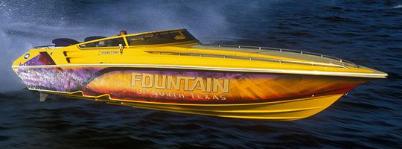
Fathers Day 2023
Lessons
from
Fountain
Power Boats p2

Slide 2

Fountain Powerboats was an Awesome Place to Work
It was a Highly Competitive Environment
It was Easy to Go From Checkered Flag to Black Flag
There was so Many Variables and Procedures,
That If Not Handled Correctly It WILL COST in the Contest
Connect this to Spiritual Warfare
It is a Highly Competitive Environment
It is Easy to Go From Checkered Flag to Black Flag
There was so Many Variables and Procedures,
That If Not Handled Correctly It WILL COST in the Contest
Just as Reggie was the Leader…
…the Father is the Leader in Spt Warfare

Slide 3
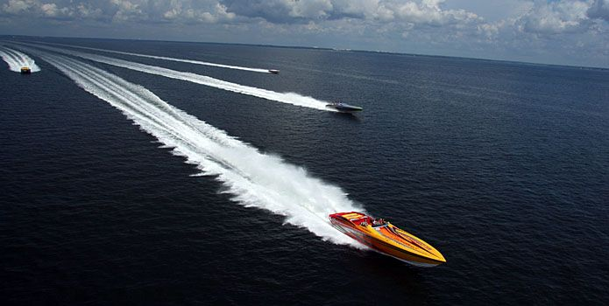
Lessons Learned From Fountain Powerboats
#1- If You Want to be the Man, You Have to Beat the Man
Aggressively Go After Your Competition
Spiritual Warfare
If You Want to be the Man, You Have to Beat the Man(Satan)
  Aggressively Go After Your Satan / His Wiles –
  Never Play His Game- Force Him to Play God’s
  And I say also unto thee, That thou art Peter, and upon this rock I will build my church; / the gates of hell
  shall not prevail against it. -Matthew 16:18

Slide 4
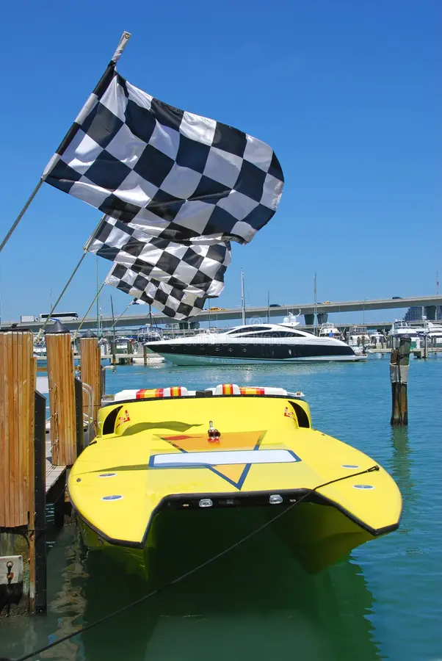
Lessons Learned From Fountain Powerboats
#2- Always Race to Win, esp. Guard Your Own Turf
  How you Play the Game is Important…
  …but also Winning
  If Winning was not important..Why Keep Score?
  Spiritual Warfare
Strive to Be Your Best
1 Corinthians 9:24 (KJV)
Know ye not that they which run in a race run all, but one receiveth the prize? So run, that ye may obtain.
Your Family is Watching
Satan is Watching
  Father’s You Can Be a Great Example…
  Or a Great Warning!

Slide 5

Lessons Learned From Fountain Powerboats
#3- Never Too Old To Compete- Reggie 80+
What You May Not Have In Stamina..
  …You Make Up For In Experience/ Knowledge
  Spiritual Warfare
  And Moses was an hundred and twenty years old when he
  died: his eye was not dim, nor his natural force abated.
  Deuteronomy 34:7 (KJV)
  You Are Never Too Old!!
  Your Kids May Be Grown
  But
  They Still Need You
  Gbabies Still Need You
  Others in Your Circle…

Slide 6
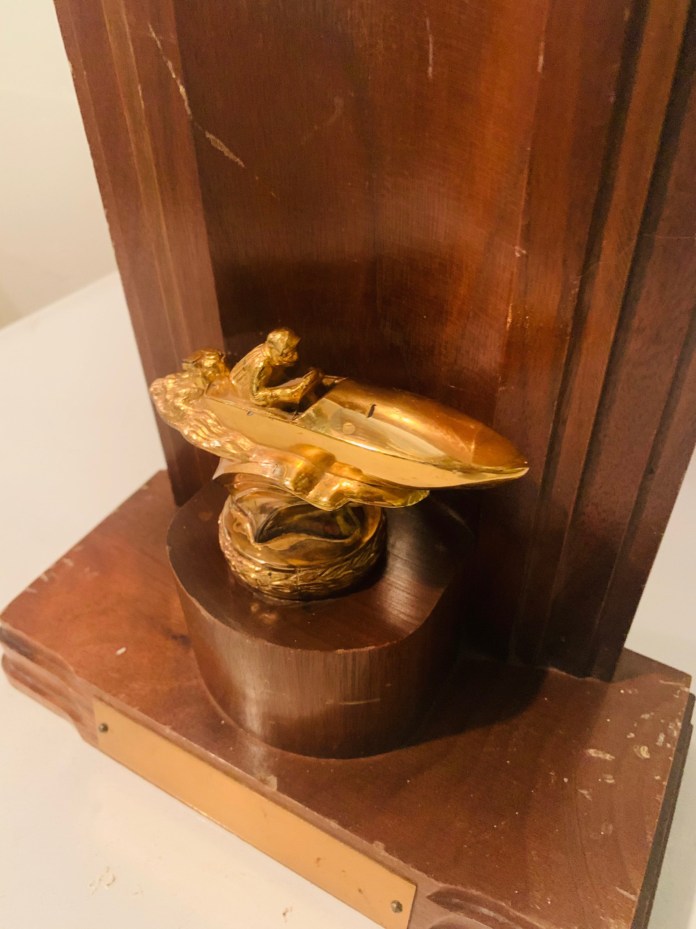
Lessons Learned From Fountain Powerboats
#4- People Follow Leaders (Winners)
  People Don’t Want to Follow the Ineffective
  Spiritual Warfare
  The Father CANNOT Take a Back Row Seat…
  …When It Comes to Spiritual Warfare
  …We Need to Lead !!!
Know ye not that they which run in a race run all, but one receiveth the prize? So run, that ye may obtain. -1 Cor 9:24
We Cannot Afford to Sit Back/ Let Our Wives / or Children..
…Fight Alone!!!

Slide 7
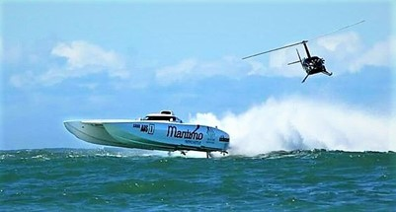
Lessons Learned From Fountain Powerboats
#5- Trust Your Guide –Helicopter/ SpottersYou Have to Trust Your Spotters to Find/ Signal Obstacles.
  Spiritual Warfare
Trust Your Guide
  You Have to Trust Your Spotters to Find and Signal Obstacles
  And one of his servants said, None, my lord, O king: but Elisha, the prophet that is in Israel, telleth the king of Israel the words that thou speakest in thy bedchamber. 2 Kings 6:12
  You Are Not Battling Alone !!!
  You Have His..
  Word
  Spirit
  Promise

Slide 9

Lessons Learned From Fountain Powerboats
Stay on Course
Don’t Do All that Work Just to Be Disqualified

Slide 10

Spiritual Warfare (Fathers)
Stay on Course
Don’t Do All that Work Just to Be Disqualified
  But I keep under my body, and bring it into subjection: lest that by any means, when I have preached to others,
  I myself should be a castaway. 1 Cor 9:27 (KJV)
  Increases Our…
  Power (inside)
  Influence (outside)
  Endurance (all around)

Slide 11
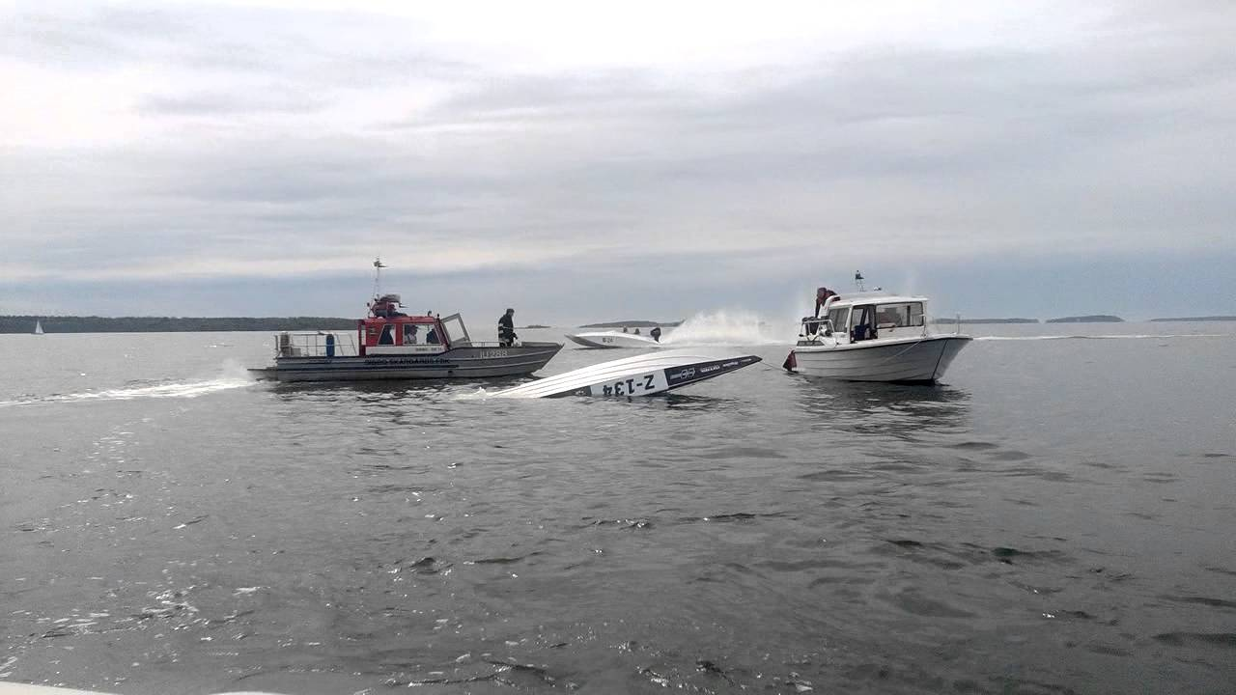
Lessons Learned From Fountain Powerboats
If You Capsize, Don’t Panic,
Help is Always Nearby/ on the Way

Slide 12
Spiritual Warfare (Fathers)
If You Capsize, Don’t Panic,
Help is Always Nearby/ on the Way
Psalm 145:14 (NLT2)
The LORD helps the fallen and
lifts those bent beneath their loads.
Psalm 145:14 (MSG)
¹⁴ GOD gives a hand to those down on their luck,
gives a fresh start to those ready to quit.
God Has a Heart for Fathers!

Slide 13
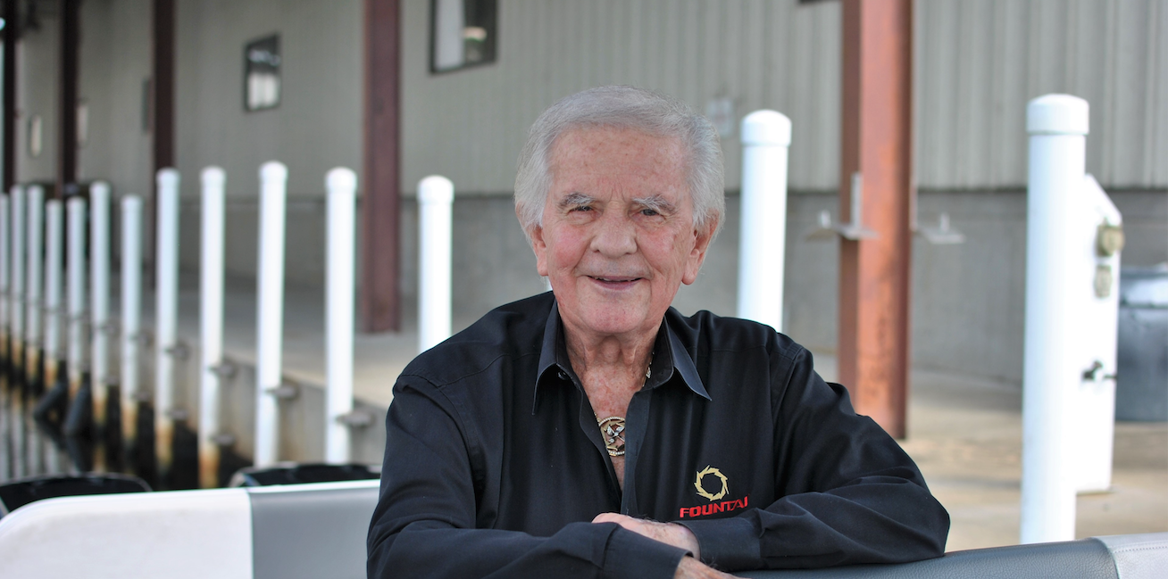
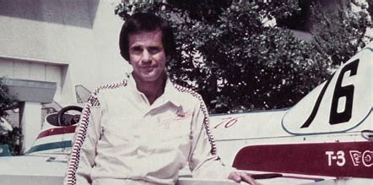
Lessons Learned From Fountain Boats
Always Keep in Shape
Although the Races Varied in Length
He Knew Personally He Had to Be Ready for a Marathon

Slide 14
Spiritual Warfare (Fathers)
Always Keep in Shape
Although the Races Varied in Length
Know that You Have to Be Ready for a Marathon
Your Fatherly Influence Will Last
Before the Birth of Our Family
During the Growth of Our Family
After Goes Beyond

Slide 15
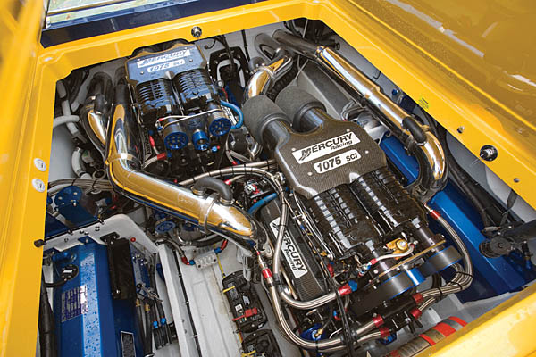
Lessons Learned From Fountain Powerboats
Keep Equip in Good Running Condition and Looking Good

Slide 16
Spiritual Warfare (Fathers)
Keep Equip in Good Running Condition/ Looking Good
Be alert and on your guard; stand firm in your faith (your conviction respecting man's relationship to God and divine things, keeping the trust and holy fervor born of faith and a part of it). Act like men / be courageous; grow in strength! -1 Cor 16:13 (AMP)
Its Hard to Exist Only on Yesterdays
Blessing
Power
Testimony
Lamentations 3:22-23 (KJV)
²² It is of the LORD'S mercies that we are not consumed, because his compassions fail not. ²³ They are new every morning: great is thy faithfulness.

Slide 17
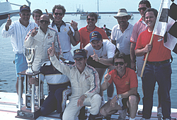
Lessons Learned From Fountain Powerboats
After Each Victory Always Thank Your Sponsor
You Could Not Have Done It Without Their Help / Resources

Slide 18
Spiritual Warfare (Fathers)
After Each Victory Always Thank Your Sponsor
You Could Not Have Done It Without Their Help / Resources
Deut. 20:4
For the LORD your God is the one who goes with you to fight for you against your enemies to give you victory.”
1 Corinthians 15:57 (AMP)
⁵⁷ But thanks be to God, Who gives us the victory [making us conquerors] through our Lord Jesus Christ.

Slide 19
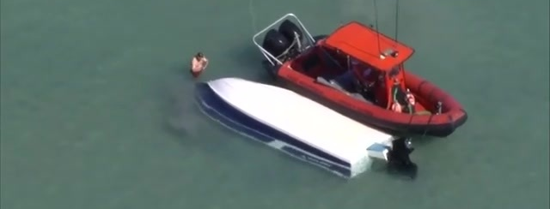

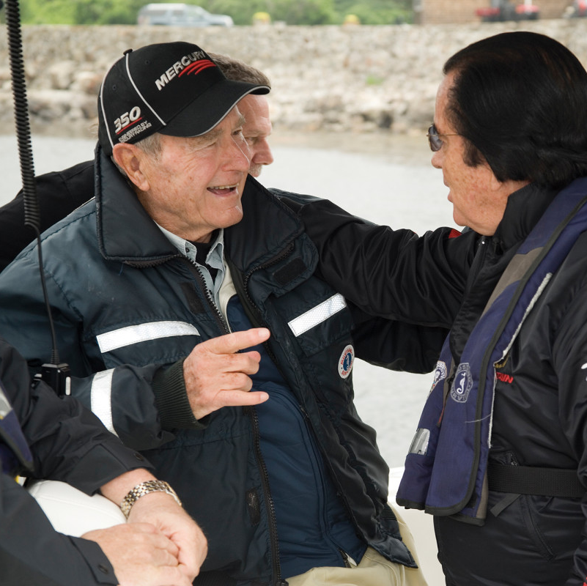

⁵⁷ But thanks be to God, Who gives us the victory [making us
conquerors] through our Lord Jesus Christ. ⁵⁸ Therefore, my beloved
brethren, be firm (steadfast), immovable, always abounding in the
work of the Lord [always being superior, excelling, doing more than
enough in the service of the Lord], knowing and being continually
aware that your labor in the Lord is not futile [it is never wasted or to
no purpose]. 1 Cor 15:57-58 (AMP)
Being a Father is Never Easy
Stressful
Lonely
But Satisfying when You Hear the Words - “Thanks, You Did Good..”
From Your Child
From Your God!

