Slide 1

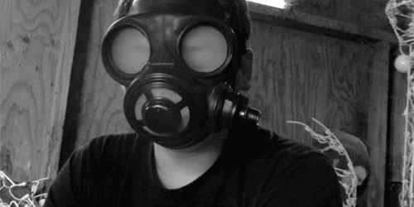
Somebody’s Feet Stink!
Stepped in What? –pt1
John 13 –Luke 22

Slide 2
Somebody’s Feet was Stinking
It was the Eve of the Passion
The Disciples had been with Jesus over 3 Years
Jesus Knew He didn’t Have Much Time Left
The Night Jesus Really Needed:
Support of His Friends
They were Arguing
Wrong Attitudes were Stinking Up the Room
He Knew that He Needed to Drive a Hard Lesson

Slide 3
Towel “Ultimate Lesson”
John 13:1-5 (AMP)
¹ [NOW] BEFORE the Passover Feast began, Jesus knew (was fully aware) that the time had come for Him to leave this world and return to the Father. And as He had loved those who were His own in the world, He loved them to the last and to the highest degree. ² So [it was] during supper, Satan having already put the thought of betraying Jesus in the heart of Judas Iscariot, Simon's son, ³ [That] Jesus, knowing (fully aware) that the Father had put everything into His hands, and that He had come from God and was [now] returning to God, ⁴ Got up from supper, took off His garments, and taking a [servant's] towel, He fastened it around His waist. ⁵ Then He poured water into the washbasin and began to wash the disciples' feet and to wipe them with the [servant's] towel with which He was girded.

Slide 4
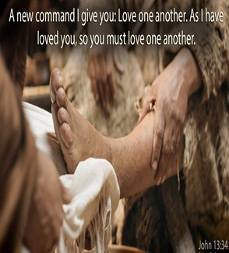
Towel “Fulness of Lessons” (1)
Fullness of…
Time
Destiny
Accomplishment
Example
The Full Example of Love is to Serve…
…Not to Be Served

Slide 5
Towel “Ultimate Lesson”
John 13:7-11 (AMP)
⁷ Jesus said to him, You do not understand now what I am doing, but you will understand later on. ⁸ Peter said to Him, You shall never wash my feet! Jesus answered him, Unless I wash you, you have no part with (in) Me [you have no share in companionship with Me]. ⁹ Simon Peter said to Him, Lord, [wash] not only my feet, but my hands and my head too! ¹⁰ Jesus said to him, Anyone who has bathed needs only to wash his feet, but is clean all over. And you [My disciples] are clean, but not all of you. ¹¹ For He knew who was going to betray Him; that was the reason He
said, Not all of you are clean.

Slide 6
Towel “Ultimate Lesson”
Bath Houses…
Come out Clean All Over
Walk to House
Pick Up Dirt and Debris
Only Needed to Wash Feet
Picture of Christian
Salvation is the Bath House
Come Out Clean
Walk Through World
Pick up Attitudes and Debris
Only Needs to Wash Attitude

Slide 7

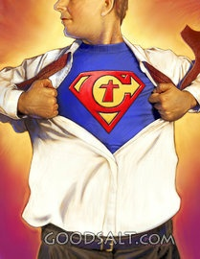
Stepped in “Pride”
1st- Luke 22:24 -accounted whose best
Keeping Count on Basis of Merit
2nd- Luke 22:31-34 I Will Not Deny You!
Comparing
Overconfident
Proverbs 16:18 (HCSB) ¹⁸ Pride comes before destruction, and an
arrogant spirit before a fall.

Slide 8
Stepped in “Anger”
Strife “quarrelsome”
Test of Quarrelsome Spirit
First Instinct is to Criticize.
Last Instinct is to Encourage
You Find Fault in Everything
Becomes a Critical Spirit

Slide 9

Pride
Jeremiah 9:23-24, “...Let not the mighty man boast of his might...but let him who boasts boast of this, that he understands and knows Me...”
Wrath
Romans 12:19, “Beloved, never avenge yourselves, but leave it to the wrath of God, for it is written, ‘Vengeance is mine, I will repay, says the Lord.’”

Slide 10
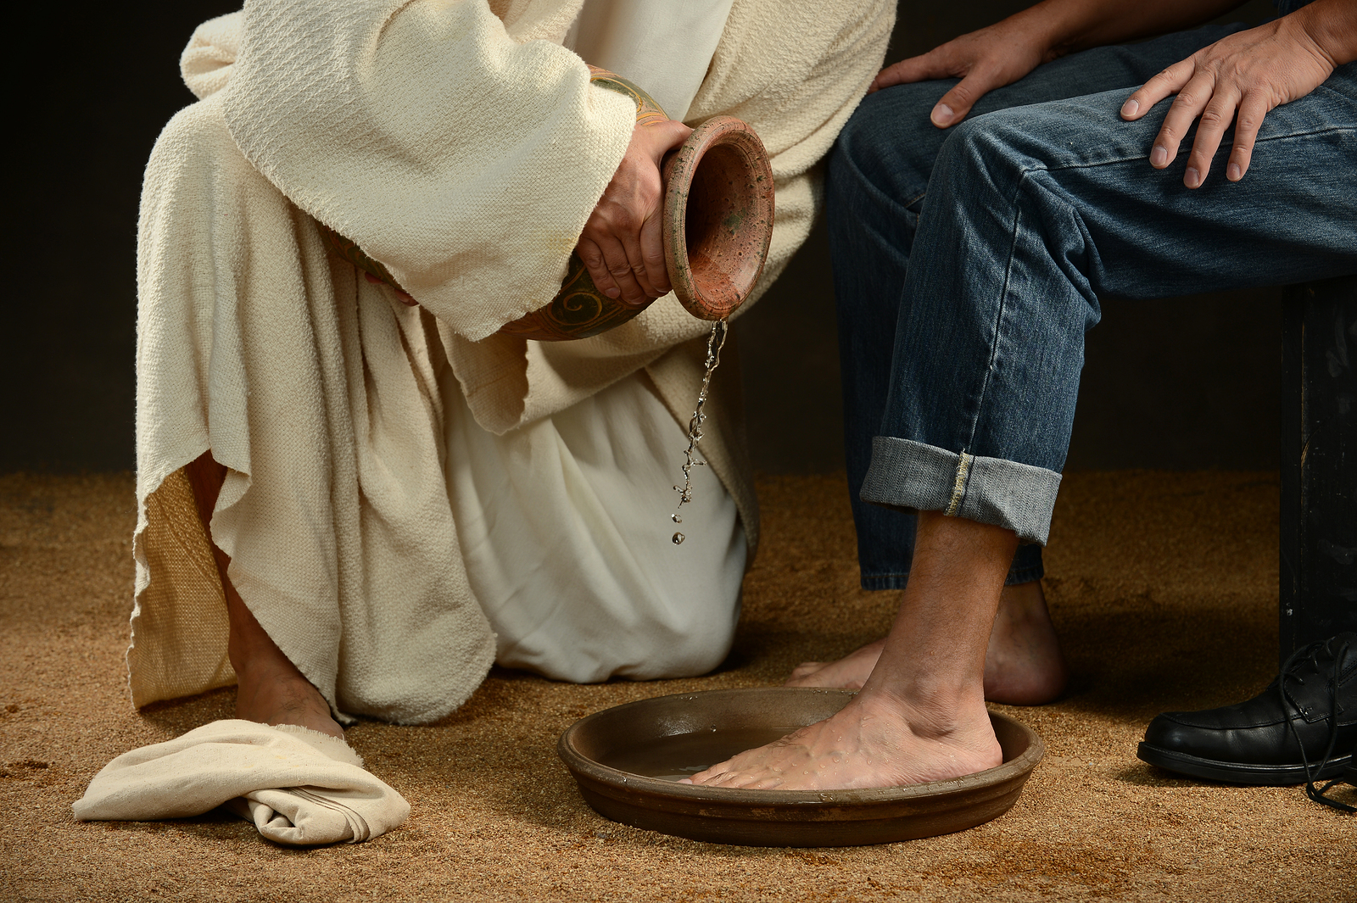
We Have a Choice
Choose Wisely

Slide 11
Somebodies-feet-stink_ whats-that-smell?
Stepped in What?
Notes follow:

Slide 12
George Washington that I felt was a strong example of servant leadership in practice. One rainy day during the American Revolutionary War, George Washington rode up to a group of soldiers attempting to raise a wooden beam to a high position. The corporal in charge was shouting encouragement, but the soldiers couldn’t get the beam in position. After watching their lack of success, Washington asked the corporal why he didn’t join in and help, to which the corporal replied, “don’t you realize that I am the corporal?” Very politely, General Washington replied ” I beg your pardon, Mr. Corporal, I did”. Washington dismounted his horse and went to work with the soldiers to get the oak beam in position. As they finished, General Washington was wiped perspiration from his face, and said “If you should need help again, call on Washington, your commander-in-chief, and I will come”

Slide 13
Seven Attitudes Developed Through Feetwashing and Communion 1 Corinthians 11:20-11:34 Seven attitudes that are developed through feetwashing and communion: 1. Feetwashing. (John 13:1-17) a. Service. (John 13:5; Matthew 20:25-28) b. Humility. (John 13:6-8; Philippians 2:1-11) c. Obedience. (John 13:12-17; Luke 5:1-11) 2. Communion. (1 Corinthians 11:20-34) a. Love. (1 Corinthians 11:20-22,33; 1 John 4:7-12,19-21) b. Thankfulness. (1 Corinthians 11:23-26; 2 Corinthians 9:15) c. Self-examination. (1 Corinthians 11:27,28; Lamentations 3:40) d. Authenticity. (1 Corinthians 11:29-32; James 1:21-27) Close: John 13:17

Slide 14
John 13:34-35
LOVE IS NOT AN OPTION, IT IS A REQUIREMENT (v. 34) A new command I give you: Love one another.
LOVE IS NOT AN ABSTRACT IDEA, IT IS A MATTER OF FOLLOWING HIS EXAMPLE (v. 34) As I have loved you, so you must love one another.
a. His love is sacrificial. Jesus was willing to lay down His life for us. In the same way, we must be willing to lay down our lives, not only for Him, but for His people.
b. His love is merciful. Even though He is perfect, He knows that we are not. When we fail He is faithful to forgive us our sins, even though we don't deserve His mercy. Therefore, we must be willing to forgive others even when we don't think they deserve it.
C.S. Lewis said, "He loved us not because we were lovable, but because He is Love."
c. His love is unconditional. Jesus never put conditions of His love for us. He said unequivocally, "As the Father has loved me, so have I loved you." (John 15:9) There is nothing we can do to change that love. We are commanded to love others in the very same way.
d. His love is full of positive expectations for us. Because Jesus loves us, He wants the best for us. The only way we can experience God's best is to love and follow Jesus Christ. So throughout the 13th, 14th, and 15th chapters of John, when Jesus reminds of His great love toward us, He also challenges to show our love for Him through obedience.
3. LOVE IS NOT INVISIBLE; IT TELLS THE WORLD WHO WE ARE
(v. 35) By this all men will know that you are my disciples, if you love one another.

Slide 15
We must take up the towel; the example of Jesus. (vv. 1-17)
( He dressed himself to serve.)
A. Fullness (v. 1)
1. The fullness of time.
2. The fullness of destiny.
The only way to get out of this world is to die.
3. The fullness of accomplishment.
4. The fullness of example.
The full extent of love is to serve.

Slide 16
End of Part 1

