Slide 2

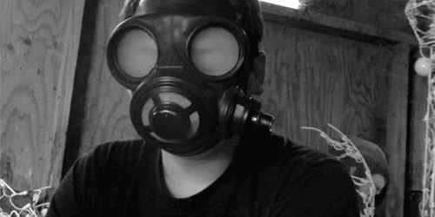
Somebody’s Feet Stink!
Stepped in What? –pt2
John 13 –Luke 22

Slide 3
Somebody’s Feet was Stinking
It was the Eve of the Passion
The Disciples had been with Jesus over 3 Years
Jesus Knew He didn’t Have Much Time Left
The Night Jesus Really Needed:
  Support of His Friends
  They were Arguing
  Wrong Attitudes were Stinking Up the Room
  He Knew that He Needed to Drive a Hard Lesson

Slide 4
Towel “Ultimate Lesson”
John 13:1-5 (AMP)
¹ [NOW] BEFORE the Passover Feast began, Jesus knew (was fully aware) that the time had come for Him to leave this world and return to the Father. And as He had loved those who were His own in the world, He loved them to the last and to the highest degree. ² So [it was] during supper, Satan having already put the thought of betraying Jesus in the heart of Judas Iscariot, Simon's son, ³ [That] Jesus, knowing (fully aware) that the Father had put everything into His hands, and that He had come from God and was [now] returning to God, ⁴ Got up from supper, took off His garments, and taking a [servant's] towel, He fastened it around His waist. ⁵ Then He poured water into the washbasin and began to wash the disciples' feet and to wipe them with the [servant's] towel with which He was girded.

Slide 5
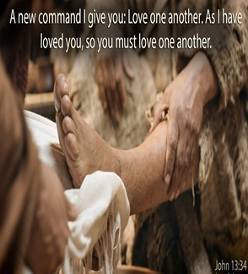
Towel “Fulness of Lessons” (1)
  Fullness of…
      Time
      Destiny
      Accomplishment
      Example
    The Full Example of Love is to Serve…
      …Not to Be Served

Slide 6
Towel “Ultimate Lesson”
John 13:7-11 (AMP)
⁷ Jesus said to him, You do not understand now what I am doing, but you will understand later on. ⁸ Peter said to Him, You shall never wash my feet! Jesus answered him, Unless I wash you, you have no part with (in) Me [you have no share in companionship with Me]. ⁹ Simon Peter said to Him, Lord, [wash] not only my feet, but my hands and my head too! ¹⁰ Jesus said to him, Anyone who has bathed needs only to wash his feet, but is clean all over. And you [My disciples] are clean, but not all of you. ¹¹ For He knew who was going to betray Him; that was the reason He
said, Not all of you are clean.

Slide 7
Towel “Ultimate Lesson”
Bath Houses…
  Come out Clean All Over
  Walk to House
  Pick Up Dirt and Debris
  Only Needed to Wash Feet
Picture of Christian
  Salvation is the Bath House
  Come Out Clean
  Walk Through World
  Pick up Attitudes and Debris
  Only Needs to Wash Attitude

Slide 8

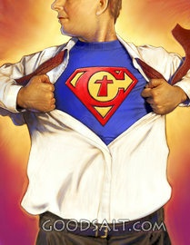
Stepped in “Pride”
1st- Luke 22:24 -accounted whose best
  Keeping Count on Basis of Merit
2nd- Luke 22:31-34 I Will Not Deny You!
  Comparing
  Overconfident
.

Slide 9
Stepped in “Pride”
1st- Luke 22:24 -accounted whose best
  Keeping Count on Basis of Merit
2nd- Luke 22:31-34 I Will Not Deny You!
  Comparing
  Overconfident
Proverbs 16:18 (HCSB)
¹⁸ Pride comes before destruction, and an
arrogant spirit before a fall.

Slide 10
Stepped in “Anger”
Strife “quarrelsome”
Test of Quarrelsome Spirit
  First Instinct is to Criticize.
  Last Instinct is to Encourage
  You Find Fault in Everything
  Becomes a Critical Spirit

Slide 11
Stepped in “Bitterness”
Bitterness –Strife = fond of strife
  Continual Strife Leads to Bitterness
  Bitterness= Anger Stretched Out
It Seems that The Disciples…
…Constantly Argued
…Bitterness Would Be a Problem
Even After Resurrection …
…When Jesus was Telling how Peter Will Die…
…What About John?

Slide 12
Stepped in “Selfishness”
Selfish – “Me First!” -the Common Thread with All Above
Then the mother of Zebedee's children came up to Him with her sons and, kneeling, worshiped Him and asked a favor of Him.
²¹ And He asked her, What do you wish? She answered Him, Give orders that these two sons of mine may sit, one at Your right hand and one at Your left in Your kingdom.
²² But Jesus replied, You do not realize what you are asking. Are you able to drink the cup that I am about to drink and to be baptized with the baptism with which I am baptized ? They answered, We are able.
²³ He said to them, You will drink My cup, but seats at My right hand and at My left are not Mine to give, but they are for those for whom they have been ordained and prepared by My Father.
²⁴ But when the ten [other disciples] heard this, they were indignant at the two brothers. Matt 20:22-24
Indignant= to be greatly afflicted, be much (sore) displeased, bitter

Slide 13
Stepped in “Callousness”
All of the Above Led to a Severe Case of…
…Callousness
Jesus Had…
  Informed
  Forewarned
But Their Callousness Blinded Them to…
…What He was Saying!
Too Calloused to Actually Sense…
…the Actual Need of the Hour

Slide 14
Stepped in What?
They Were So Caught Up in Themselves..
…That They Never Even Realized Until
    Garden
    Trial
    Scourging
    Cross
Jesus Needed Their Support…
…They Ran!

Slide 15
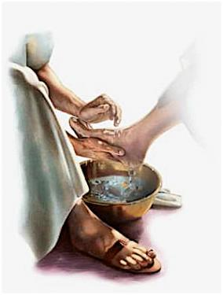
Phil 2:5-8 Steps to a Servant’s Heart
Let this Attitude Be in You…
Moved Beyond Position…
  (6) gave up Divine Form
  (7) gave up rights
  (7) became a Man –Gen 3:15
  (7) became a servant
  (8) obedient unto death
  (8) he died a terrible

Slide 16
Lessons from a Towel
He Could Take Up the Towel Because…
He was Secure in God -John 13:1-3
He Knew…
  Why He Came
  What He Had to Do
  Where He was Going
He was Secure in the Towel
Brings Joy –Happy -John 13:12-17
Brings Change

Slide 17
The Towel Challenge
The Next Time You Are Caught In
  Environment of Attitudes
  or
  Your Attitude Has Gone Astray
  Pull Out a Towel..

Slide 18
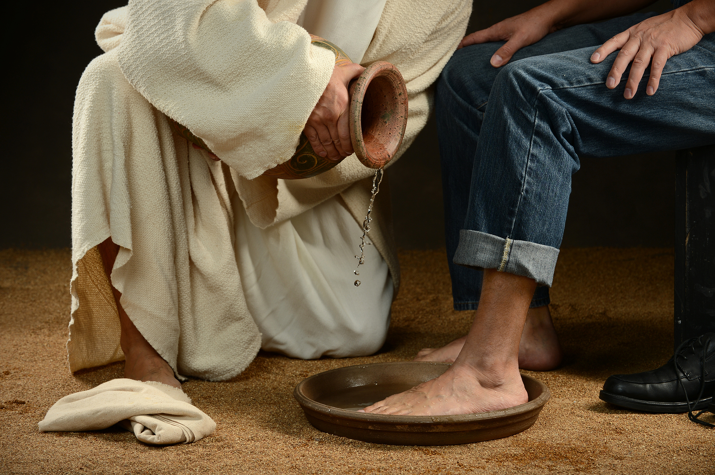
We Have a Choice
Choose Wisely

Slide 19
End of Part 2
Notes follow

Slide 20
Attorney: Is your appearance here this morning pursuant to a deposition notice which I sent to your attorney?
Witness: No, this is how I dress when I go to work.
Attorney: Do you recall the time when you examined the body?
Witness: The autopsy started around 8:30 PM
Attorney: And Mr. Denton was dead at that time?
Witness: If not, he was by the time I finished.
Attorney: The youngest son, the 20-year-old, how old is he?
Witness: He's 20, much like your IQ.
Attorney: Doctor, how many of your autopsies have you performed on dead people?
Witness: All of them… The live ones put up too much of a fight.
Attorney: Now, doctor, isn't it true that when a person dies in his sleep, he doesn't know about it until the next morning?
Witness: Did you actually pass the bar exam?
Attorney: How was your first marriage terminated?
Witness: By death.
Attorney: And by whose death was it terminated?
Witness: Take a guess.

Slide 21
We must take up the towel; the example of Jesus. (vv. 1-17)
( He dressed himself to serve.)
A. Fullness (v. 1)
1. The fullness of time.
2. The fullness of destiny.
The only way to get out of this world is to die.
3. The fullness of accomplishment.
4. The fullness of example.
The full extent of love is to serve.

Slide 22
George Washington that I felt was a strong example of servant leadership in practice. One rainy day during the American Revolutionary War, George Washington rode up to a group of soldiers attempting to raise a wooded beam to a high position. The corporal in charge was shouting encouragement, but the soldiers couldn’t get the beam in position. After watching their lack of success, Washington asked the corporal why he didn’t join in and help, to which the corporal replied, “don’t you realize that I am the corporal?” Very politely, General Washington replied ” I beg your pardon, Mr. Corporal, I did”. Washington dismounted his horse and went to work with the soldiers to get the oak beam in position. As they finished, General Washington was wiped perspiration from his face, and said “If you should need help again, call on Washington, your commander-in-chief, and I will come”

Slide 23
Seven Attitudes Developed Through Feetwashing and Communion
1 Corinthians 11:20-11:34
Seven attitudes that are developed through feetwashing and communion:
1. Feetwashing. (John 13:1-17)
a. Service. (John 13:5; Matthew 20:25-28)
b. Humility. (John 13:6-8; Philippians 2:1-11)
c. Obedience. (John 13:12-17; Luke 5:1-11)
2. Communion. (1 Corinthians 11:20-34)
a. Love. (1 Corinthians 11:20-22,33; 1 John 4:7-12,19-21)
b. Thankfulness. (1 Corinthians 11:23-26; 2 Corinthians 9:15)
c. Self-examination. (1 Corinthians 11:27,28; Lamentations 3:40)
d. Authenticity. (1 Corinthians 11:29-32; James 1:21-27)
Close: John 13:17

Slide 24
John 13:34-35
LOVE IS NOT AN OPTION, IT IS A REQUIREMENT
(v. 34) A new command I give you: Love one another.
LOVE IS NOT AN ABSTRACT IDEA, IT IS A MATTER OF FOLLOWING HIS EXAMPLE
(v. 34) As I have loved you, so you must love one another.
a. His love is sacrificial. Jesus was willing to lay down His life for us. In the same way, we must be willing to lay down our lives, not only for Him, but for His people.
b. His love is merciful. Even though He is perfect, He knows that we are not. When we fail He is faithful to forgive us our sins, even though we don't deserve His mercy. Therefore, we must be willing to forgive others even when we don't think they deserve it.
C.S. Lewis said, "He loved us not because we were lovable, but because He is Love."
c. His love is unconditional. Jesus never put conditions of His love for us. He said unequivocally, "As the Father has loved me, so have I loved you." (John 15:9) There is nothing we can do to change that love. We are commanded to love others in the very same way.
d. His love is full of positive expectations for us. Because Jesus loves us, He wants the best for us. The only way we can experience God's best is to love and follow Jesus Christ. So throughout the 13th, 14th, and 15th chapters of John, when Jesus reminds of His great love toward us, He also challenges to show our love for Him through obedience.
3. LOVE IS NOT INVISIBLE; IT TELLS THE WORLD WHO WE ARE
(v. 35) By this all men will know that you are my disciples, if you love one another.

Slide 25
John 13:1-3 (KJV)
¹ Now before the feast of the passover, when Jesus knew that his hour was come that he should depart out of this world unto the Father, having loved his own which were in the world, he loved them unto the end.
² And supper being ended, the devil having now put into the heart of Judas Iscariot, Simon's son, to betray him;
³ Jesus knowing that the Father had given all things into his hands, and that he was come from God, and went to God;

Slide 26
Jesus Took a Towel
He Gave the Ultimate Lesson
wiped those attitudes away

Slide 27
Philippians 2 – Patterns. Some patterns or examples are given. •Christ:
His servitude (lowly as a servant);
His submission (to God); His suffering (the cross);
His superiority (every knee shall bow to Him);
His saving (He is the Savior).

Slide 28
Luke 22:31-34 (KJV)
³¹ And the Lord said, Simon, Simon, behold, Satan hath desired to have you, that he may sift you as wheat:
³² But I have prayed for thee, that thy faith fail not: and when thou art converted, strengthen thy brethren.
³³ And he said unto him, Lord, I am ready to go with thee, both into prison, and to death.
³⁴ And he said, I tell thee, Peter, the cock shall not crow this day, before that thou shalt thrice deny that thou knowest me.

Slide 29
Cure for stinky feet
1- pride –accounted whose best
2- anger -strife
3- bitterness -strife
4- selfish - me 1st –let us sit on each side
5- calloused –didn’t even listen close enough to realize the cross
Philippians 2:3-11 (HCSB)
³ Do nothing out of rivalry or conceit, but in humility consider others as more important than yourselves.
⁴ Everyone should look out not ⌊only⌋ for his own interests, but also for the interests of others.
⁵ Make your own attitude that of Christ Jesus,
⁶ who, existing in the form of God, did not consider equality with God as something to be used for His own advantage.
⁷ Instead He emptied Himself by assuming the form of a slave, taking on the likeness of men. And when He had come as a man in His external form,
⁸ He humbled Himself by becoming obedient to the point of death— even to death on a cross.
⁹ For this reason God highly exalted Him and gave Him the name that is above every name,
¹⁰ so that at the name of Jesus every knee will bow— of those who are in heaven and on earth and under the earth—
¹¹ and every tongue should confess that Jesus Christ is Lord, to the glory of God the Father.

Slide 30
Problem: James and John or their mother asked about sitting in Heaven
Verses: Mark 10:35-37, Matthew 20:20-21; Status: Serious
In Mark's gospel, the brothers James and John asked to sit at the side of Jesus in Heaven. This is Mark 10:35-37:
And James and John, the sons of Zebedee, came up to him and said to him, "Teacher, we want you to do for us whatever we ask of you." And he said to them, "What do you want me to do for you?" And they said to him, "Grant us to sit, one at your right hand and one at your left, in your glory." (ESV)
On the other hand, Matthew 20:20-21 has it that the request came from their mother:
Then the mother of the sons of Zebedee came up to him with her sons, and kneeling before him she asked him for something. And he said to her, "What do you want?" She said to him, "Say that these two sons of mine are to sit, one at your right hand and one at your left, in your kingdom." (ESV)
These two passages are definitely about the same incident: in both Mark and Matthew, it comes right after Jesus foretells his death for the third time, and right before Jesus heals the blind. This is a problem. Inerrantists must reply like this:
Is it not plausible that all three came together and made inquiry of the Lord with regard to the positions on His right and left hand in the kingdom?
It's possible. Indeed, Matthew indicates that all three were present. But the question is not who was present, but rather, who spoke?
I suppose you can say that the sons and their mother all spoke, one after another. But this is one of several occasions in the gospels where inerrancy requires you to believe that two authors gave half the story and nobody gave the whole story. This is very irritating. The more reasonable response is that Matthew, who used Mark as a source, altered the story to make the disciples look less foolish, by having someone else make the silly request.

Slide 31
Matthew 20:18-24 (AMP)
¹⁸ Behold, we are going up to Jerusalem, and the Son of Man will be handed over to the chief priests and scribes; and they will sentence Him to death
¹⁹ And deliver Him over to the Gentiles to be mocked and whipped and crucified, and He will be raised [to life] on the third day.
²⁰ Then the mother of Zebedee's children came up to Him with her sons and, kneeling, worshiped Him and asked a favor of Him.
²¹ And He asked her, What do you wish? She answered Him, Give orders that these two sons of mine may sit, one at Your right hand and one at Your left in Your kingdom.
²² But Jesus replied, You do not realize what you are asking. Are you able to drink the cup that I am about to drink and to be baptized with the baptism with which I am baptized ? They answered, We are able.
²³ He said to them, You will drink My cup, but seats at My right hand and at My left are not Mine to give, but they are for those for whom they have been ordained and prepared by My Father.
²⁴ But when the ten [other disciples] heard this, they were indignant at the two brothers.

Slide 32
Philippians 2:3-11 (AMP)
³ Do nothing from factional motives [through contentiousness, strife, selfishness, or for unworthy ends] or prompted by conceit and empty arrogance. Instead, in the true spirit of humility (lowliness of mind) let each regard the others as better than and superior to himself [thinking more highly of one another than you do of yourselves].
⁴ Let each of you esteem and look upon and be concerned for not [merely] his own interests, but also each for the interests of others.
⁵ Let this same attitude and purpose and [humble] mind be in you which was in Christ Jesus: [Let Him be your example in humility:]
⁶ Who, although being essentially one with God and in the form of God [possessing the fullness of the attributes which make God God], did not think this equality with God was a thing to be eagerly grasped or retained,
⁷ But stripped Himself [of all privileges and rightful dignity], so as to assume the guise of a servant (slave), in that He became like men and was born a human being.
⁸ And after He had appeared in human form, He abased and humbled Himself [still further] and carried His obedience to the extreme of death, even the death of the cross!
⁹ Therefore [because He stooped so low] God has highly exalted Him and has freely bestowed on Him the name that is above every name,
¹⁰ That in (at) the name of Jesus every knee should (must) bow, in heaven and on earth and under the earth,
¹¹ And every tongue [frankly and openly] confess and acknowledge that Jesus Christ is Lord, to the glory of God the Father.

Slide 33
Luke 22:24-27 (AMP)
²⁴ Now an eager contention arose among them [as to] which of them was considered and reputed to be the greatest.
²⁵ But Jesus said to them, The kings of the Gentiles are deified by them and exercise lordship [ruling as emperor-gods] over them; and those in authority over them are called benefactors and well-doers.
²⁶ But this is not to be so with you; on the contrary, let him who is the greatest among you become like the youngest, and him who is the chief and leader like one who serves.
²⁷ For who is the greater, the one who reclines at table (the master), or the one who serves? Is it not the one who reclines at table? But I am in your midst as One Who serves.

Slide 34
Stepped in “Pride”
1- pride –accounted whose best
2- anger -strife
3- bitterness -strife
4- selfish - me 1st –let us sit on each side
5- calloused –didn’t even listen close enough to realize the cross

Slide 35
Cure – John
Towel
Phil 2:5

Slide 36
Find all the things going on in the Upper Room that night
Luke 22:24 (KJV)
²⁴ And there was also a strife among them, which of them should be accounted the greatest.
Pride –(false humility)-aggressive
Calloused – didn’t realize the Cross was coming
argumentative

Slide 37
John 13:1-20 (NASB77)
¹ Now before the Feast of the Passover, Jesus knowing that His hour had come that He should depart out of this world to the Father, having loved His own who were in the world, He loved them to the end.
² And during supper, the devil having already put into the heart of Judas Iscariot, the son of Simon, to betray Him,
³ Jesus, knowing that the Father had given all things into His hands, and that He had come forth from God, and was going back to God,
⁴ •rose from supper, and •laid aside His garments; and taking a towel, He girded Himself about.
⁵ Then He •poured water into the basin, and began to wash the disciples' feet, and to wipe them with the towel with which He was girded.
⁶ And so He •came to Simon Peter. He •said to Him, "Lord, do You wash my feet?"
⁷ Jesus answered and said to him, "What I do you do not realize now, but you shall understand hereafter."
⁸ Peter •said to Him, "Never shall You wash my feet!" Jesus answered him, " If I do not wash you, you have no part with Me."
⁹ Simon Peter •said to Him, "Lord, not my feet only, but also my hands and my head."
¹⁰ Jesus •said to him, "He who has bathed needs only to wash his feet, but is completely clean; and you are clean, but not all of you."
¹¹ For He knew the one who was betraying Him; for this reason He said, "Not all of you are clean."
¹² And so when He had washed their feet, and taken His garments, and reclined at the table again, He said to them, "Do you know what I have done to you?
¹³ "You call Me Teacher and Lord; and you are right, for so I am.
¹⁴ "If I then, the Lord and the Teacher, washed your feet, you also ought to wash one another's feet.
¹⁵ "For I gave you an example that you also should do as I did to you.
¹⁶ "Truly, truly, I say to you, a slave is not greater than his master; neither is one who is sent greater than the one who sent him.
¹⁷ "If you know these things, you are blessed if you do them.
¹⁸ " I do not speak of all of you. I know the ones I have chosen; but it is that the Scripture may be fulfilled, ' HE WHO EATS MY BREAD HAS LIFTED UP HIS HEEL AGAINST ME.'
¹⁹ "From now on I am telling you before it comes to pass, so that when it does occur, you may believe that I am He.
²⁰ "Truly, truly, I say to you, he who receives whomever I send receives Me; and he who receives Me receives Him who sent Me."

Slide 38
In their culture, service and humility were despised – as the attributes of good slaves. Humility was weakness. A man’s position in society was a reflection of his control and influence over others. For Jesus, their master, to perform the lowly job of foot washing completely reversed their value system. From Jesus’ action we perceive that humility and service is a requirement for salvation.
Philippians 2:3-4 Let nothing be done through strife or vainglory; but in lowliness of mind let each esteem other better than themselves. ⁴ Look not every man on his own things, but every man also on the things of others.
1John 3:16 Hereby perceive we the love of God, because he laid down his life for us: and we ought to lay down our lives for the brethren.
So we see that it’s not only service and humility, but also a willingness to give up our lives for our brethren as Christ did, and what his actions were foreshadowing in the conversation recorded in John 13:6-7.
Then cometh he to Simon Peter: and Peter saith unto him, Lord, dost thou wash my feet? ⁷ Jesus answered and said unto him, What I do thou knowest not now; but thou shalt know hereafter.

Slide 39
Mark 10:37 (KJV)
³⁷ They said unto him, Grant unto us that we may sit, one on thy right hand, and the other on thy left hand, in thy glory.
Self Promotion

Slide 40
Foot-washing was not primarily a ceremonial custom. It was practically important because people walked in sandals through dusty, muddy and manure-filled streets. Your feet got dirty and stinky.
Not surprisingly, washing someone else's feet was regarded as one of the most demeaning tasks anyone could perform. It was reserved for household slaves. But since there was evidently no household slave present at this secret meal, who would perform this task?
Jesus' disciples were not about to do it. Luke says they were in the midst of their favorite argument--"which one of them was regarded to be the greatest" (Lk. 22:24)--and I don't think that means Peter was insisting that John deserved that honor, etc. Anyone who washed feet in this setting would be admitting he was the low-life of the bunch!

Slide 41
“Jesus knew” – Knew what?
1. “that the Father had put all things under his power,
2. and that he had come from God
3. and was returning to God.”
he also knew the attitudes Present in the Room
And he was leaving soon so he needed to impact them NOW!

