Slide 2

Edward Church
Phil. 2:5
Pt 1
July 16, 2023

Slide 3
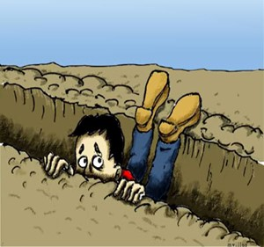
Ever Fall Into a Spiritual Rut?
Miserable = Uncomfortable
Obstructed = Hindered
Hopeless = No Way Out
What’s Left?
Lame
Blame
Nothing But the Same !

Slide 4
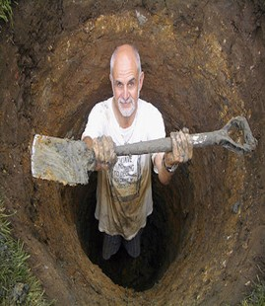
Building a New You
Realize…
We Have a Part to Play…
Attention
…What We See
Attitude
…How We Think About It
Actions
…How We Respond

Slide 5

Be a Better Person
“Let this mind be in you, which was also in Christ Jesus” -Phil. 2:5
Mind= Attitude
Be= Constant
You= Personal
Jesus Attitude Toward Others Was He Was A Servant…
…His Attitude Toward Self Was
…He Had No Problem With That

Slide 6

Quit Looking Out to Find Someone/ Something
…to Blame
But
Look In and
…Take Responsibility

Slide 7
From the Lost Book of the Bible – “Yeah But”
The Prophet “Yeah But” says:
Anything Before BUT…
Doesn’t Really Matter
Here is a New Challenge…
Take the Sentence….
“I Meant to BUT…”
…Out of Your Vocabulary

Slide 8

Think Better Thoughts
“Whatsoever things are of good report . . . think on these things” -Phil. 4:8
Philippians 4:8-9 (MSG)
⁸⁻⁹ Summing it all up, friends, I’d say you’ll do best by filling your minds and meditating on things true, noble, reputable, authentic, compelling, gracious—the best, not the worst; the beautiful, not the ugly; things to praise, not things to curse. Put into practice what you learned from me, what you heard and saw and realized. Do that, and God, who makes everything work together, will work you into his most excellent harmonies.

Slide 9
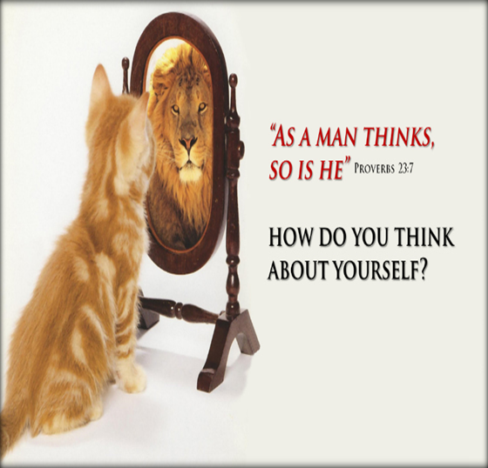
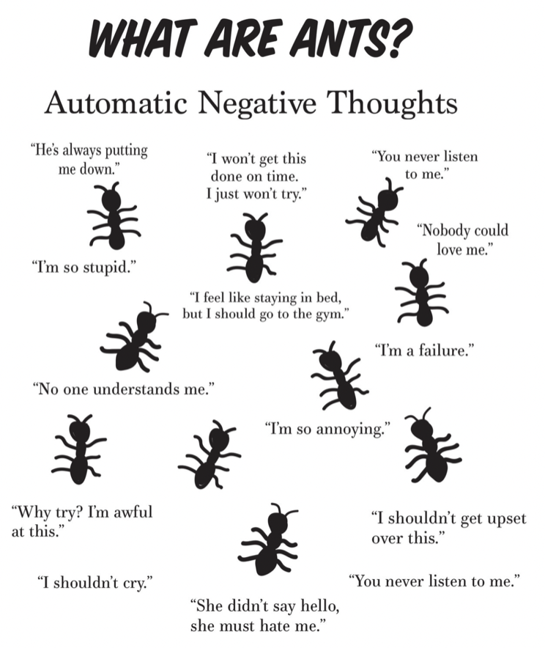
Discipline Our Thinking
Quit Allowing Negatives To Dominate Our Minds
ANTS
We Must Take Deliberate Action,
…Replacing Negative Thoughts With Positives
…And Keeping An Optimistic Outlook

Slide 10

Becoming a Better You
Hear Better Sounds
Romans 10:17-21 (NLT)
¹⁷ So faith comes from hearing, that is, hearing the Good News
about Christ
Quit Listening Negative, and Destruction
It Will Dwarf Your Spirit
We Must Listen to the Good, Resist the Bad.
We Must Hear From the Lord And Heed His Word.

Slide 11
Building a Better You…
…Will Build a Better
Marriage
Family
Church
Work Place

Slide 12


This Weeks Challenge
Whenever You Feel…
ANTS Attack
ATTACK Back!
RAID
R- Resist
A- Adjust
I- Inspect the Truth
D- Dwell on Truth Instead
Watch Your Life/ Attitude
Shift for the Better

Slide 13
End Part 1
Notes follow

Slide 14
ILLUST: Get ready to play the "Blame Game": You driving 100 mph in a 45 mph zone, you lose control, flip your car on a sharp curve, and critically injure yourself, who is at fault? No, not you, It’s the HIWAY Dept. for not making the degree of banking on the curve great enough to keep you on the road at 100 mph. You are wearing a shirt that¬ needs to be ironed. Instead of taking it off, you try to iron with it on and guess what? That’s right, you get burned. Shame on you right? No, it is the company who made the iron --they should have warned you that ironing clothes while they are on your body is dangerous. McDonalds for hotϖ coffee…trying to drive car, eat your Egg McMuffun, you spill hot, hot coffee all over yourself. You’re moron right? No, it is McDonalds fault for makingϖ that coffee too hot! OK, one more. You decide that you need to fix yourϖ TV. Without unplugging it, you begin your work. Uh Oh! You guessed it. You get fried! Dumb -- right? No, RCA should have told you that you were at risk for electric shock! B. Things happen you can’t control – but you can control your response. Let me say that again. Things happen you can’t control – but you can control your response. 1. I hear people say all the time, “He makes me so mad” or “She makes me so mad”. 2. Nobody can make you mad. You’re the only person who can make you mad. 3. People can do things that upset you, but you decide how you’re going to respond.

Slide 15
Becoming a Better You
Think Better Thoughts
Hear Better Sounds
“And it was revealed in mine ears by the LORD” (Isa. 22:14).
See Better/ Positive Sights
“Looking unto Jesus the author and finisher of our faith” -Heb. 12:2
Some Christians look for the bad in people and circumstances, seeing only the faults and negatives.
To be a positive person one must look for the good and look to Jesus.

Slide 16
Speak Better/ Positive Words
“Talk ye of all his wondrous works” (Ps. 105:2).
Many people talk mostly about evil and bad events. Some are harsh, unkind, and take God’s name in vain.
We should talk positively, seeking to glorify God by extolling his goodness, grace, and love.

Slide 17
Perform Better/ Positive Deeds
“And whatsoever ye do, do it heartily, as to the Lord, and not unto men” (Col. 3:23).
The deeds of many are negative.
They are selfishly motivated, dishonest, and displeasing to God.
We must be truthful, ready to lift those who are down, and witness for Christ.
Attend Better/ Positive Places
“I was glad when they said . . . Let us go into the house of the LORD” (Ps. 122:1).
Christians hurt their influence when they go to the wrong places in search of
Be a positive Christian.
Attend church faithfully.
Go with God and he will go with you

