Slide 2

Edward Church
Phil. 2:5
Pt 2
July 23, 2023

Slide 3
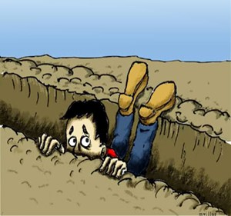
Ever Fall Into a Spiritual Rut?
Miserable = Uncomfortable
Obstructed = Hindered
Hopeless = No Way Out
What’s Left?
Lame
Blame
Nothing to But the Same !

Slide 4
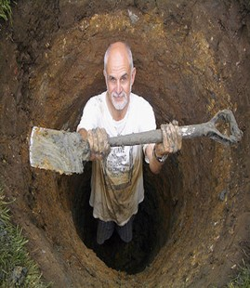
Building a New You
Realize…
We Have a Part to Play…
  Attention
    …What We See
  Attitude
  …How We Think About It
  Actions
    …How We Respond

Slide 5

Be a Better Person
“Let this mind be in you, which was also in Christ Jesus” -Phil. 2:5
  Mind= Attitude
  Be= Constant
  You= Personal
Jesus Attitude Toward Others Was He Was A Servant…
…His Attitude Toward Self Was
…He Had No Problem With That

Slide 6

Quit Looking Out to Find Someone/ Something
…to Blame
But
Look In and
…Take Responsibility

Slide 7

From the Lost Book of the Bible – “Yeah But”
The Prophet “Yeah But” says:
Anything Before BUT…
Doesn’t Really Matter
Here is a New Challenge…
Take the Sentence….
“I Meant to BUT…”
…Out of Your Vocabulary

Slide 8
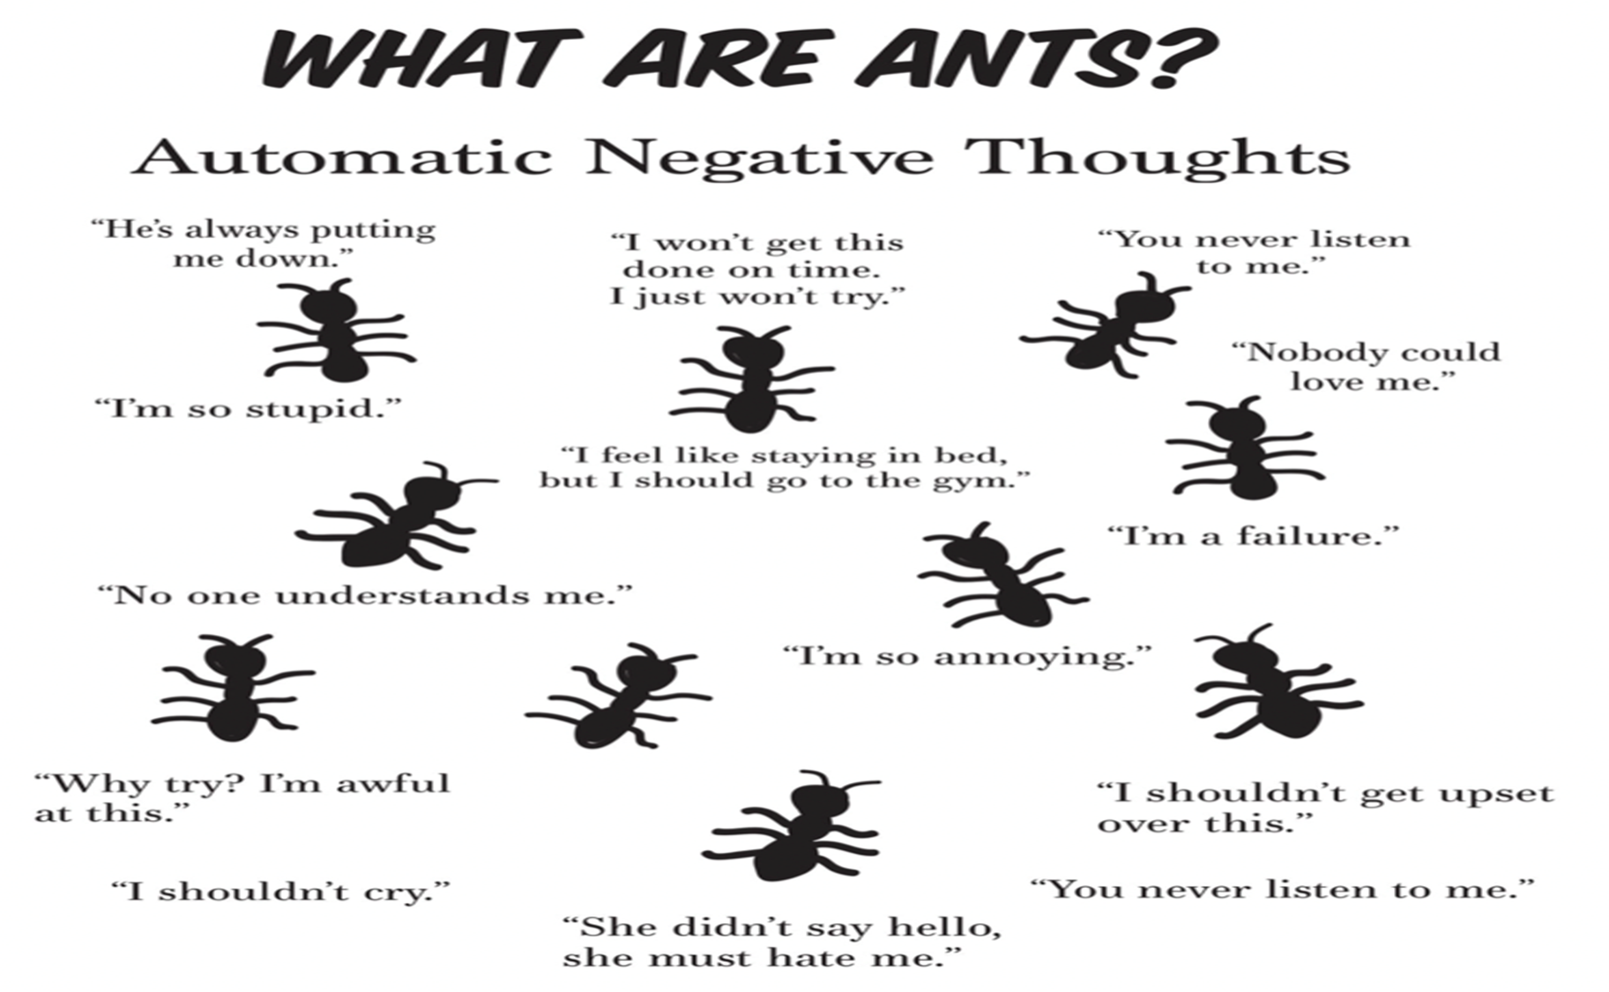
Think Better Thoughts
⁸⁻⁹ Summing it all up, friends, I’d say you’ll do best by filling your minds and meditating on things true, noble, reputable, authentic, compelling, gracious—the best, not the worst; the beautiful, not the ugly; things to praise, not things to curse. Put into practice what you learned from me, what you heard and saw and realized. Do that, and God, who makes everything work together, will work you into his most excellent harmonies. Philippians 4:8-9 (MSG)
Hear Better Sounds
Romans 10:17-21 (NLT)
¹⁷ So faith comes from hearing, that is, hearing the Good News
about Christ

Slide 9
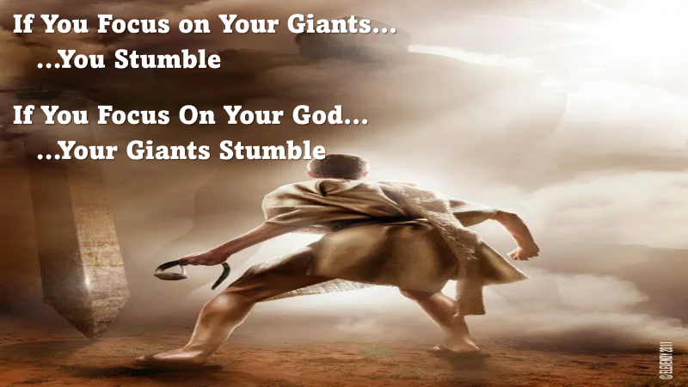
See Better Sights
“Looking unto Jesus the author and finisher of our faith” -Heb. 12:2
Many Look for the Bad In People and Circumstances…
…Seeing Only The Faults and Negatives
  In Order to Be a Better Person…
…Its Requires a Better…Positive…Perspective
Train Yourself to Look for the Good…
…and Look to Jesus in All Situations

Slide 10

[looking away from all that will distract us and] focusing our eyes on Jesus, who is the Author and Perfecter of faith [the first incentive for our belief and the One who brings our faith to maturity], who for the joy [of accomplishing the goal] set before Him endured the cross, ^{[a]}disregarding the shame, and sat down at the right hand of the throne of God -Heb 12:2 (AMP)
Keep your eyes on Jesus, who both began / finished this race we're in. Study how he did it. Because he never lost sight of where he was headed- that exhilarating finish in and with God- he could put up with anything along the way: cross, shame, whatever. And now he's there, in the place of honor, right alongside God. -Heb 12:2 (MSG)

Slide 11

Speak Better Words
“Talk ye of all his wondrous works” -Ps. 105:2
Many People Talk Mostly About Evil and Bad Events…
…Some are Harsh, Unkind, and Take God’s Name In Vain.
We Should Talk Positively, Seeking to Glorify God…
…Words of Encouragement, Healing Words
“Death and life are in the power of the tongue, and those who love it will eat its fruits.” – Proverbs 18:21, ESV
“Let the words of my mouth and the meditation of my heart be acceptable in your sight, O Lord, my rock and my redeemer.” (Amen!) – Psalm 19:14, ESV
“There is one whose rash words are like sword thrusts, but the tongue of the wise brings healing.” – Proverbs 12:18, ESV

Slide 12

Building a Better You…
  …Will Build a Better
    Marriage
    Family
    Church
    Work Place

Slide 13
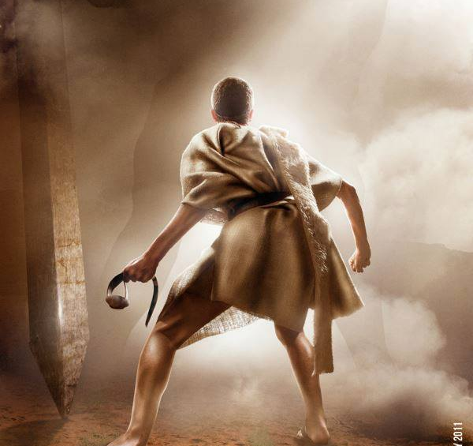
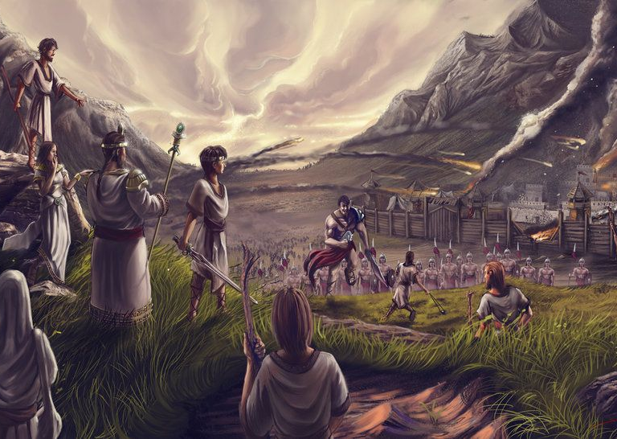
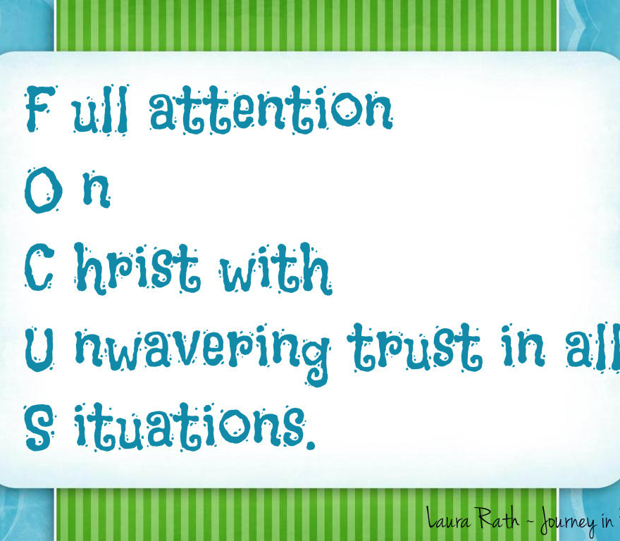

This Weeks Challenge
Whenever You Feel Your…
Focus is Off
Take Time to Align…
FOCUS
F- full attention
O- on
C- Christ with
U- unwavering trust in all
S- situations
This Will Shift Your Focus…
..to the Positive

Slide 14
End Part 2

Slide 15
Mrs. Pete Jones came into the newsroom to pay for her husband's obituary. She was told by the kindly newsman that it was a dollar a word and he remembered Pete and wasn't it too bad about him passing away.
She thanked him for his kind words and bemoaned the fact that she only had two dollars. But she wrote out the obituary, "Pete died."
The newsman said he thought Old Pete deserved more and he'd give her three more words.
Mrs. Pete Jones thanked him and rewrote the obituary: "Pete died. Boat for sale."

