Slide 2

Edward Church
Phil. 2:5
Pt 3
July 30, 2023

Slide 3
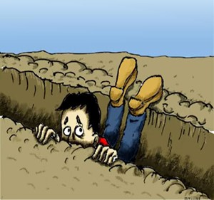
Ever Fall Into a Spiritual Rut?
Miserable = Uncomfortable
Obstructed = Hindered
Hopeless = No Way Out
What’s Left?
Lame
Blame
Nothing to But the Same !

Slide 4
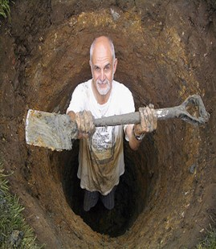
Building a New You
Realize…
We Have a Part to Play…
  Attention
    …What We See
  Attitude
  …How We Think About It
  Actions
    …How We Respond

Slide 5

Be a Better Person
“Let this mind be in you, which was also in Christ Jesus” -Phil. 2:5
  Mind= Attitude
  Be= Constant
  You= Personal
Jesus Attitude Toward Others Was He Was A Servant…
…His Attitude Toward Self Was
…He Had No Problem With That

Slide 6

Quit Looking Out to Find Someone/ Something
…to Blame
But
Look In and
…Take Responsibility

Slide 7

From the Lost Book of the Bible – “Yeah But”
The Prophet “Yeah But” says:
Anything Before BUT…
Doesn’t Really Matter
Here is a New Challenge…
Take the Sentence….
“I Meant to BUT…”
…Out of Your Vocabulary

Slide 8
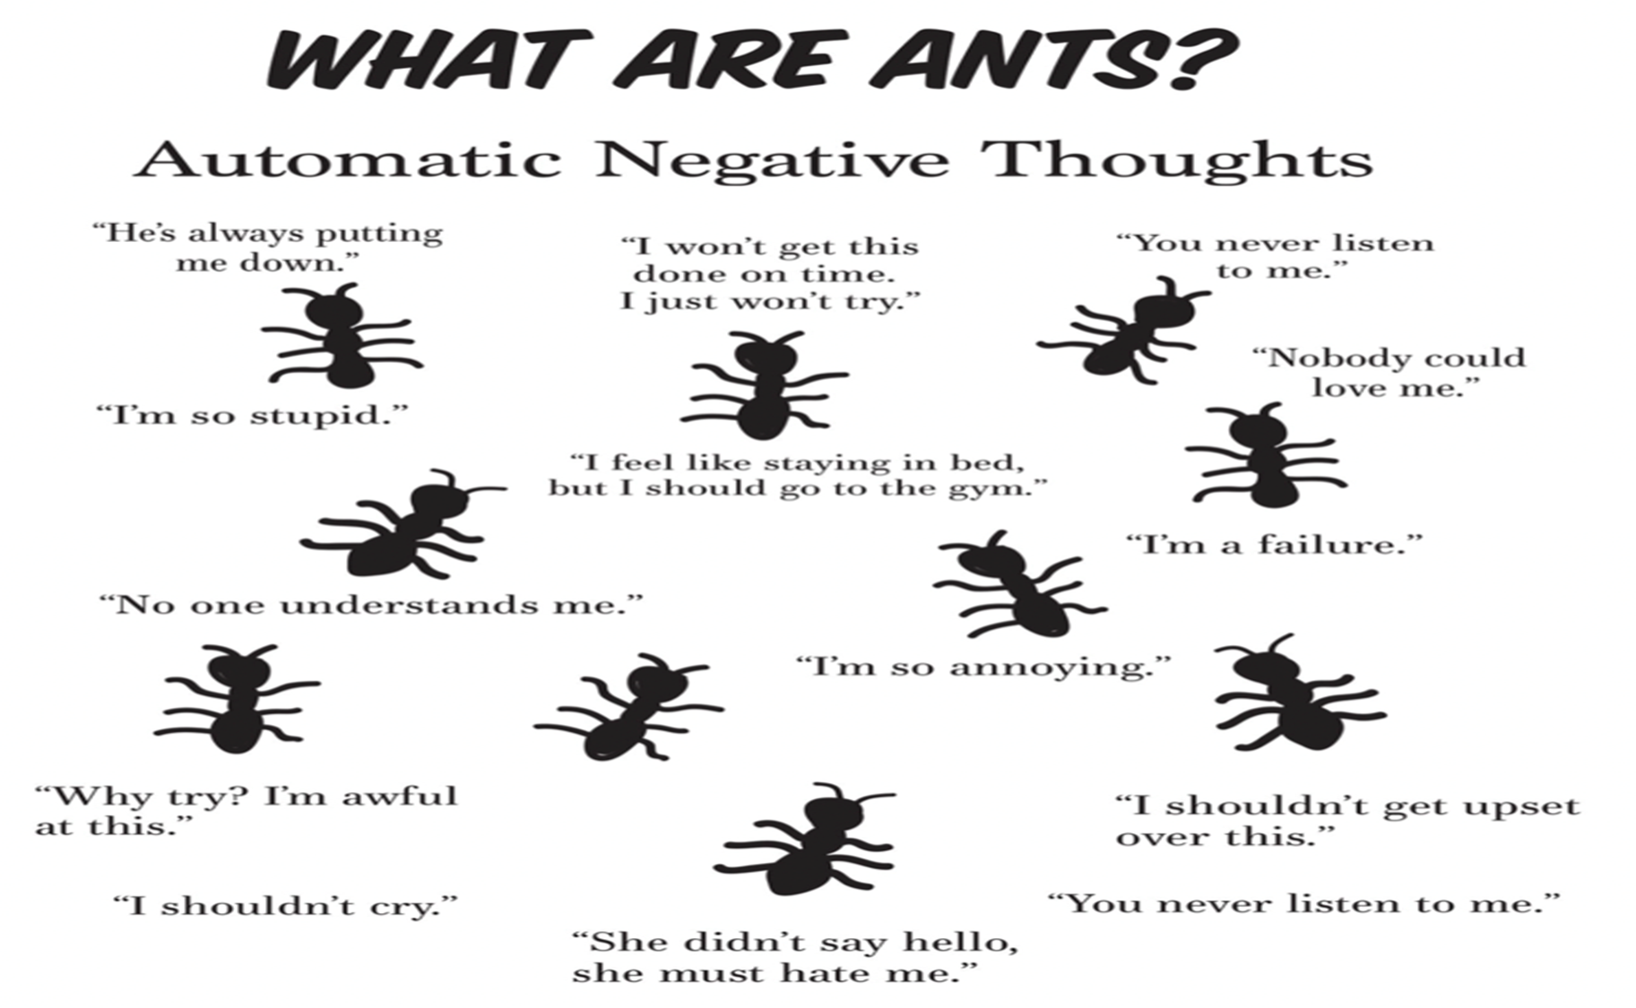
Think Better Thoughts
⁸⁻⁹ Summing it all up, friends, I’d say you’ll do best by filling your minds and meditating on things true, noble, reputable, authentic, compelling, gracious—the best, not the worst; the beautiful, not the ugly; things to praise, not things to curse. Put into practice what you learned from me, what you heard and saw and realized. Do that, and God, who makes everything work together, will work you into his most excellent harmonies. Philippians 4:8-9 (MSG)
Hear Better Sounds
Romans 10:17-21 (NLT)
¹⁷ So faith comes from hearing, that is, hearing the Good News
about Christ

Slide 9
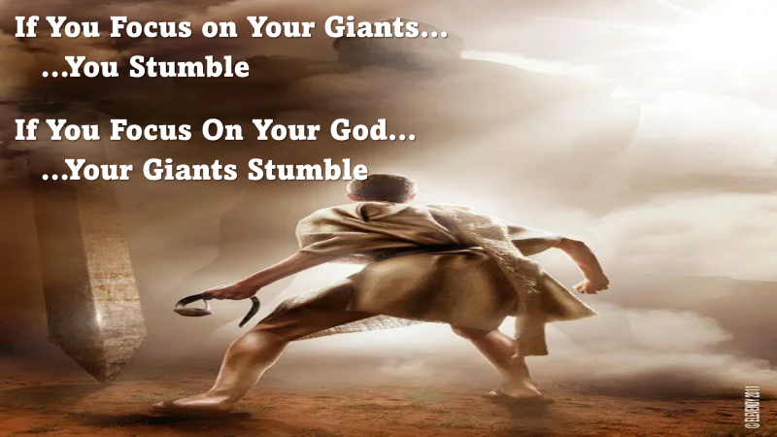
See Better Sights
“Looking unto Jesus the author and finisher of our faith” -Heb. 12:2
Many Look for the Bad In People and Circumstances…
…Seeing Only The Faults and Negatives
  In Order to Be a Better Person…
…Its Requires a Better…Positive…Perspective
Train Yourself to Look for the Good…
…and Look to Jesus in All Situations

Slide 10

Becoming a Better You
Perform Better Deeds
“And whatsoever ye do, do it heartily, as to the Lord, and not unto men” -Col. 3:23
…And whatsoever ye do
…do it heartily
…as to the Lord
…and not unto men
Col. 3:23
= Life
= Life w-in
= Life Giver
= Life Takers

Slide 11
Becoming a Better You
Perform Better Deeds
“And whatsoever ye do, do it heartily, as to the Lord, and not unto men” -Col. 3:23
Matt 25:40 (GW) -“The king will answer them, ‘I can guarantee this truth: Whatever you did for one of my brothers or sisters, no matter how unimportant they seemed, you did for me.’
The Deeds of Many are Negative…
(Selfishly Motivated, Dishonest, and Displeasing to God)
So Many Need to Be Lifted Up…
…But How Can We Lift Anybody
…From a Down Position

Slide 12
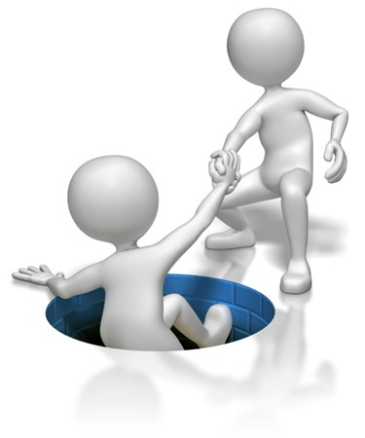
Becoming a Better You
Attend Better Places
“I was glad when they said . . . Let us go into the house of the LORD” -Ps. 122:1
More Than Better…
  Best
  Blessed
(Going in and Going Out!)

Slide 13

Surrender
  God has a Plan
  “Forsake not assembling…” -Heb 10:25
Safety
  His Plan is a Good Plan
  “where no counsel is, the people fall, but in multitude, of counsellors there is safety” -Proverbs 11:14
Strength
  His Plan is a Powerful Plan
  one chase a thousand, and two put ten thousand to flight- Deut 32:30

Slide 14
Becoming a Better You
Attend Best Places
“I was glad when they said . . . Let us go into the house of the LORD” -Ps. 122:1
Christians Hurt Their Souls When They…
…Go To Wrong Places In Search of God Things
  Peace
  Power
  Plan
    Be a Part of What God’s Doing
    Make a Positive Difference
    Discover His Will
    All Found in His House

Slide 15

How to Discover Gods Will
  W -Walk with God
    Born from Above
  I -Investigate His Word
    What is It Saying to Me?
  L -Let Go of the Reigns
    Realize Its Not About Me
  L -Let God Lead
    Rest in His Word Lived Out!

Slide 16




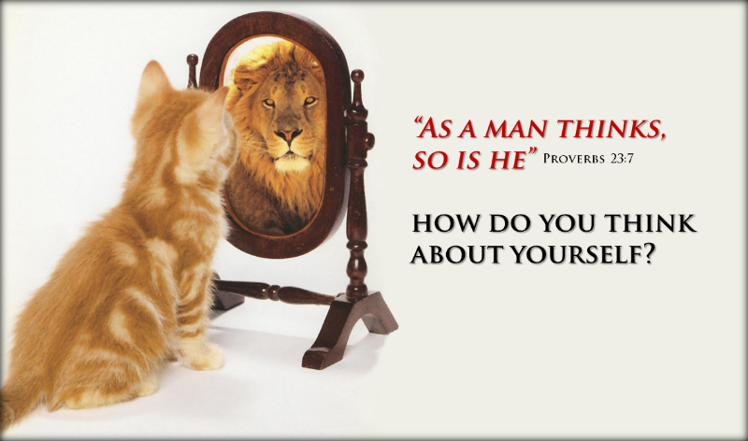

This Weeks Challenge
Get Back Into the Word of God
Let it …
Challenge You
Enlighten You
Charge You
ReCharge You
Live It Out…
…Beyond These Walls
Watch God Show Up/ Show Off

Slide 18
A minister decided that a visual demonstration would add emphasis to his Sunday sermon.
Four worms were placed into four separate jars.
> The first worm was put into a container of alcohol.
> The second worm was put into a container of cigarette smoke
> The third worm was put into a container of chocolate syrup.
> The fourth worm was put into a container of good clean soil
At the conclusion of the sermon, the Minister reported the following results:
> The first worm in alcohol - Dead
> The second worm in cigarette smoke - Dead
> Third worm in chocolate syrup - Dead
> Fourth worm in good clean soil - Alive
So the minister asked the congregation, "What can you learn from this demonstration?"
Maxine was sitting in the back, quickly raised her hand and said, "As long as you drink, smoke and eat chocolate, you won't have worms!"
That pretty much ended the service.
Instead of a sign that says "Do Not Disturb", I need one that says "Already Disturbed, Proceed With Caution".

Slide 19
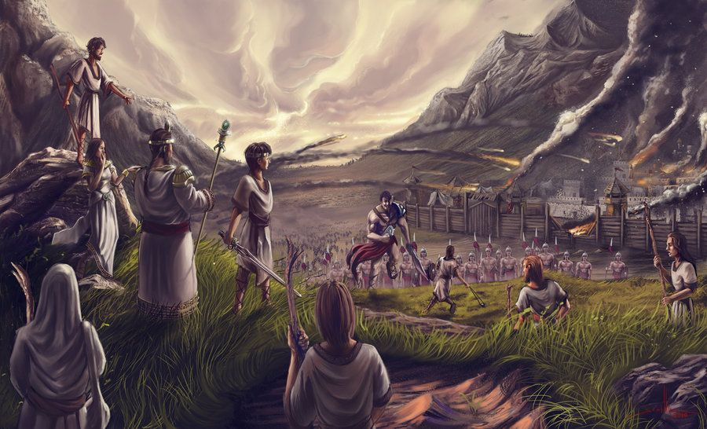


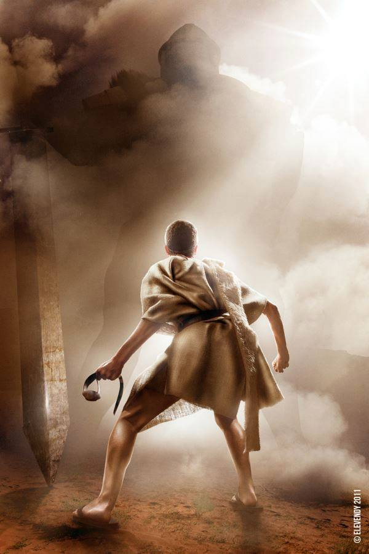

Slide 20


This Weeks Challenge
Whenever You Feel…
ANTS Attack
ATTACK Back!
RAID
R- Resist
A- Adjust
I- Inspect the Truth
D- Dwell on Truth Instead
Watch Your Life/ Attitude
Shift for the Better

Slide 21
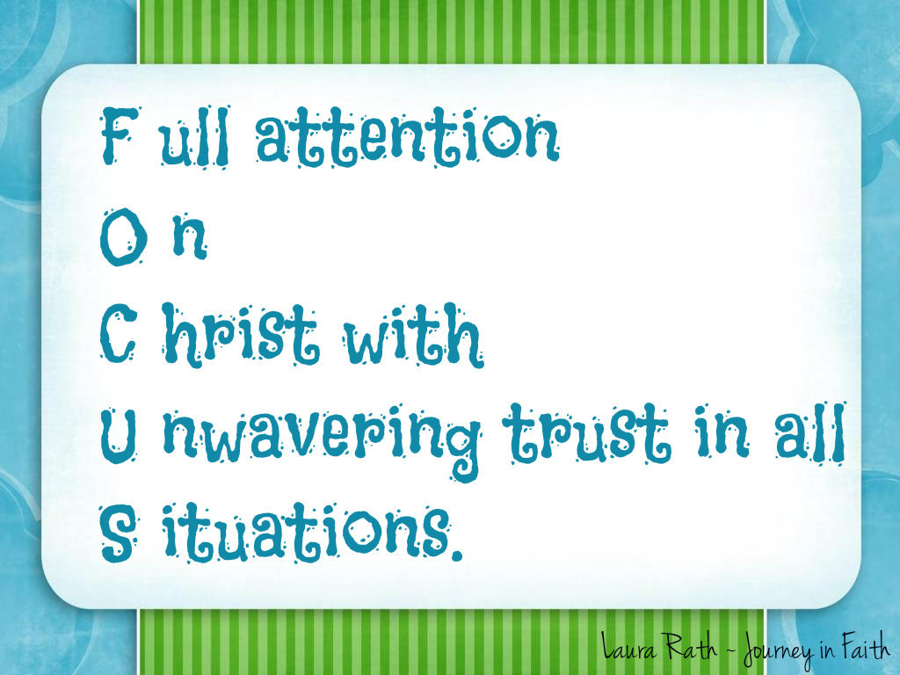


Slide 22



Matthew 25:40 GOD’S WORD Translation (GW)
⁴⁰ “The king will answer them, ‘I can guarantee this truth: Whatever you did for one of my brothers or sisters, no matter how unimportant they seemed, you did for me.’

Slide 23
God’s Will is Not a Destination..
..But a Daily Journey of Discovery

Slide 26
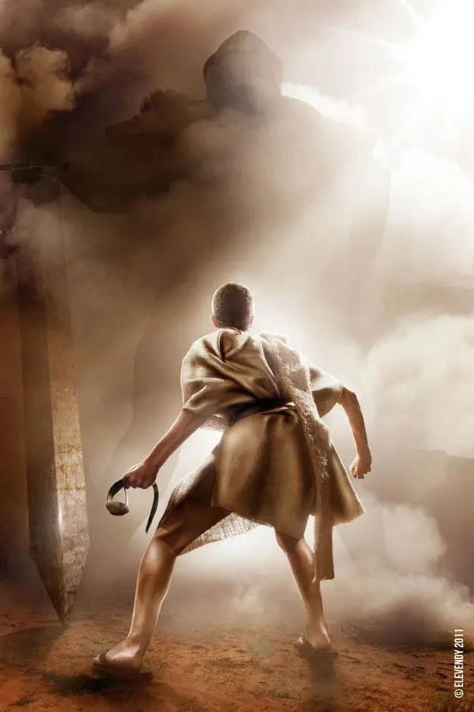
If You Focus on Your Giants…
…You Stumble
If You Focus On Your God…
…Your Giants Stumble

Slide 28

Think Better Thoughts
“Whatsoever things are of good report . . . think on these things” -Phil. 4:8
Philippians 4:8-9 (MSG)
⁸⁻⁹ Summing it all up, friends, I’d say you’ll do best by filling your minds and meditating on things true, noble, reputable, authentic, compelling, gracious—the best, not the worst; the beautiful, not the ugly; things to praise, not things to curse. Put into practice what you learned from me, what you heard and saw and realized. Do that, and God, who makes everything work together, will work you into his most excellent harmonies.

Slide 29

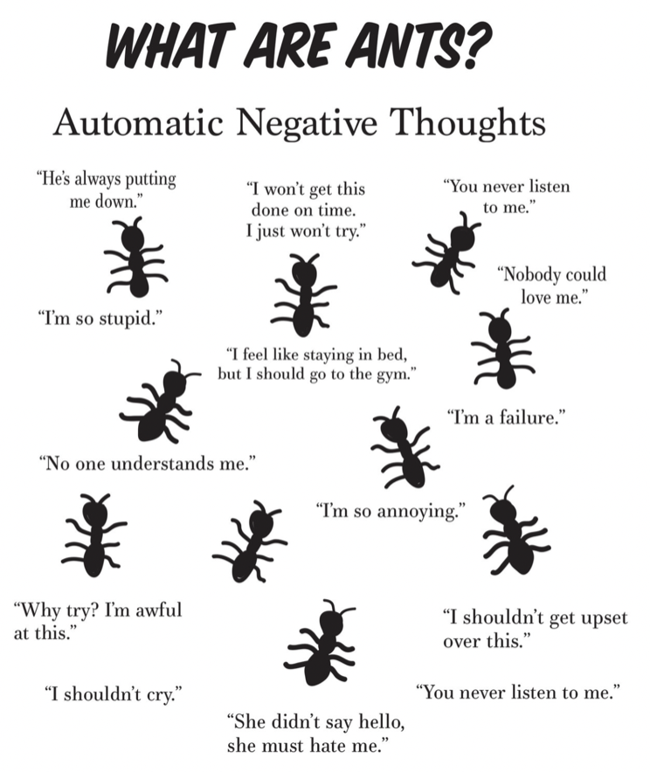
Discipline Our Thinking
Quit Allowing Negatives To Dominate Our Minds
ANTS
We Must Take Deliberate Action,
…Replacing Negative Thoughts With Positives
…And Keeping An Optimistic Outlook

Slide 30

Becoming a Better You
Hear Better Sounds
Romans 10:17-21 (NLT)
¹⁷ So faith comes from hearing, that is, hearing the Good News
about Christ
  Quit Listening Negative, and Destruction
  It Will Dwarf Your Spirit
  We Must Listen to the Good, Resist the Bad.
  We Must Hear From the Lord And Heed His Word.

Slide 31
ILLUST: Get ready to play the "Blame Game":
You driving 100 mph in a 45 mph zone, you lose control, flip your car on a sharp curve, and critically injure yourself, who is at fault? No, not you, It’s the HIWAY Dept. for not making the degree of banking on the curve great enough to keep you on the road at 100 mph.
You are wearing a shirt that¬ needs to be ironed. Instead of taking it off, you try to iron with it on and guess what? That’s right, you get burned. Shame on you right? No, it is the company who made the iron --they should have warned you that ironing clothes while they are on your body is dangerous.
McDonalds for hotϖ coffee…trying to drive car, eat your Egg McMuffun, you spill hot, hot coffee all over yourself. You’re moron right?
No, it is McDonalds fault for makingϖ that coffee too hot!
OK, one more. You decide that you need to fix yourϖ TV. Without unplugging it, you begin your work. Uh Oh! You guessed it. You get fried! Dumb -- right? No, RCA should have told you that you were at risk for electric shock!
B. Things happen you can’t control – but you can control your response. Let me say that again. Things happen you can’t control – but you can control your response.
1. I hear people say all the time, “He makes me so mad” or “She makes me so mad”.
2. Nobody can make you mad. You’re the only person
who can make you mad.
3. People can do things that upset you, but you decide
how you’re going to respond.

Slide 32


Slide 33


Slide 34
Becoming a Better You
Think Better Thoughts
Hear Better Sounds
“And it was revealed in mine ears by the LORD” (Isa. 22:14).
See Better/ Positive Sights
“Looking unto Jesus the author and finisher of our faith” -Heb. 12:2
Some Christians look for the bad in people and circumstances, seeing only the faults and negatives.
To be a positive person one must look for the good and look to Jesus.

Slide 35
Speak Better/ Positive Words
“Talk ye of all his wondrous works” (Ps. 105:2).
Many people talk mostly about evil and bad events. Some are harsh, unkind, and take God’s name in vain.
We should talk positively, seeking to glorify God by extolling his goodness, grace, and love.

Slide 36
Perform Better/ Positive Deeds
“And whatsoever ye do, do it heartily, as to the Lord, and not unto men” (Col. 3:23).
The deeds of many are negative.
They are selfishly motivated, dishonest, and displeasing to God.
We must be truthful, ready to lift those who are down, and witness for Christ.
Attend Better/ Positive Places
“I was glad when they said . . . Let us go into the house of the LORD” (Ps. 122:1).
Christians hurt their influence when they go to the wrong places in search of
Be a positive Christian.
Attend church faithfully.
Go with God and he will go with you

Slide 38



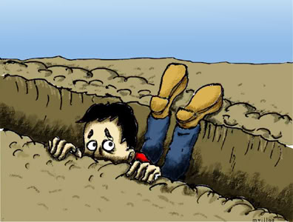
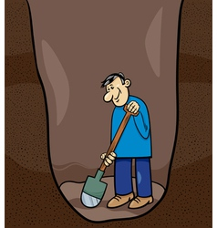


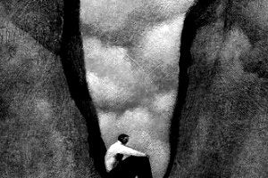

Slide 39
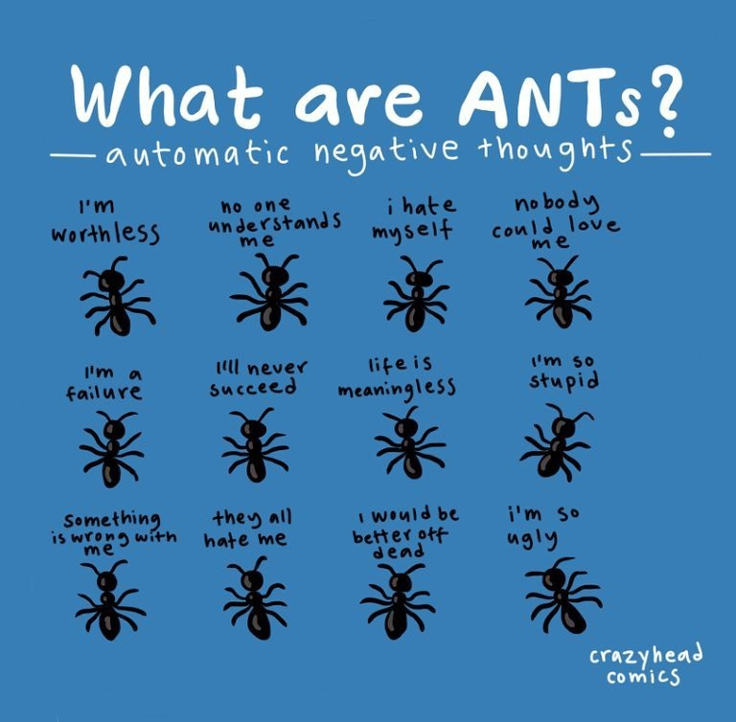


Slide 40
[looking away from all that will distract us and] focusing our eyes on Jesus, who is the Author and Perfecter of faith [the first incentive for our belief and the One who brings our faith to maturity], who for the joy [of accomplishing the goal] set before Him endured the cross, ^{[a]}disregarding the shame, and sat down at the right hand of the throne of God -Heb 12:2 (AMP)
Keep your eyes on Jesus, who both began / finished this race we're in. Study how he did it. Because he never lost sight of where he was headed- that exhilarating finish in and with God- he could put up with anything along the way: cross, shame, whatever. And now he's there, in the place of honor, right alongside God. -Heb 12:2 (MSG)

Slide 41
Speak Better Words
“Talk ye of all his wondrous works” -Ps. 105:2
Many People Talk Mostly About Evil and Bad Events…
…Some are Harsh, Unkind, and Take God’s Name In Vain.
We Should Talk Positively, Seeking to Glorify God…
…Words of Encouragement, Healing Words
“Death and life are in the power of the tongue, and those who love it will eat its fruits.” – Proverbs 18:21, ESV
“Let the words of my mouth and the meditation of my heart be acceptable in your sight, O Lord, my rock and my redeemer.” (Amen!) – Psalm 19:14, ESV
“There is one whose rash words are like sword thrusts, but the tongue of the wise brings healing.” – Proverbs 12:18, ESV

Slide 42
Building a Better You…
  …Will Build a Better
    Marriage
    Family
    Church
    Work Place

Slide 43
This Weeks Challenge
Whenever You Feel Your…
Focus is Off
Take Time to Align…
FOCUS
F- full attention
O- on
C- Christ with
U- unwavering trust in all
S- situations
This Will Shift Your Focus…
..to the Positive

