Slide 2
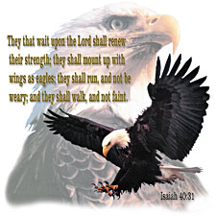
Getting Your 2nd Wind: The Wind beneath… …my Wings pt1
Isaiah 40:29-31
Edward Church
August 6, 2023

Slide 3
Top Ten Signs - Wired
#10- You Answer the Door…
…Before People Knock.
#9- You Got A Speeding Ticket…
…When You Where Parked.
#8- You Chew On Other People's Fingernails.
#7- You Walk Twenty Miles On Your Treadmill…
…Before You Realize It's Not Plugged In.
#6- You Channel Surf Faster Without a Remote.

Slide 4
Top Ten Signs - Wired
#5- You Can Outlast the Energizer Bunny.
#4- You Short Out Motion Detectors.
#3- You Have A Cry Over Spilled Milk.
#2- You Help Your Dog Chase Its Tail.
#1- Charles Manson Thinks…
…You Need to Calm Down.

Slide 5
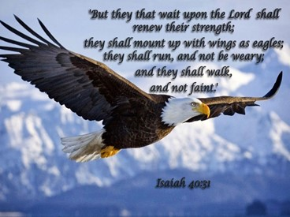
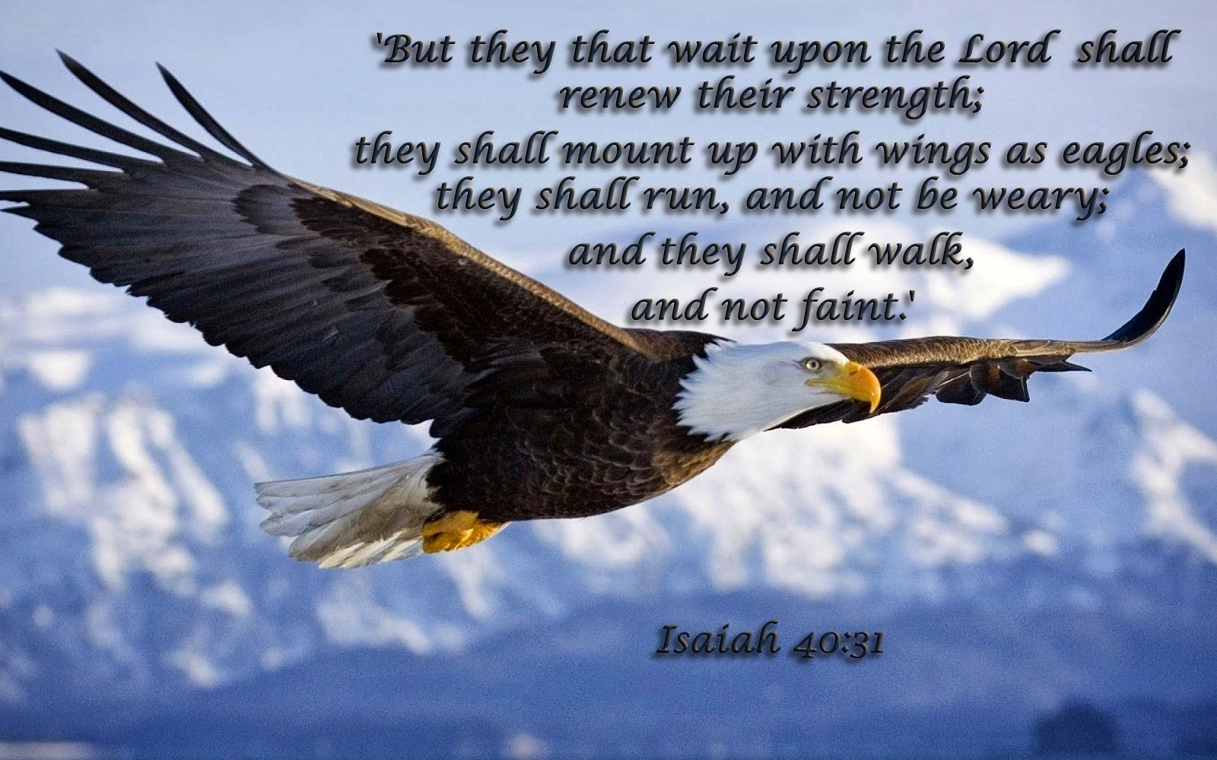
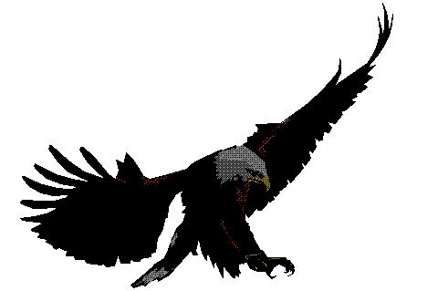
Pictures From Nature
God Uses Many Examples from Nature to Describe the Nature of People…
Lion, Bear, Leopard,
Satan - Serpent
Jesus -
Lamb - Redemptive Nature
Lion - Reigning Nature
Eagle -
…Israel
…the Church

Slide 6
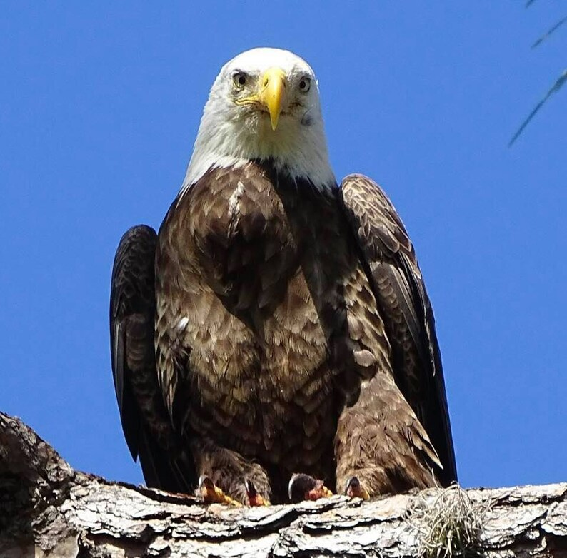
Eagle Facts
The Eagle is…
mentioned 32 times in the Word
(more than any other bird).
is Called the “King of the Birds”
(just as the lion is king of the jungle).
Of Anything Made Up of Flesh and Blood, Pound for Pound…
…it is the Strongest Thing on the Earth.

Slide 7
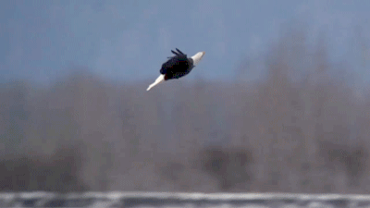
Eagle Facts
An Eagle…
Will Always Build Its Nest In The Heights Of The Mountain, Upon A Rock
Will Claim A Rock And He Never Changes Rocks.
Always Dies Looking Toward His Rock
Mates For Life
Eagle Parents Do Everything Together
Does Not Fear The Storm –But Welcomes It And Flies Above It
Soars!

Slide 8
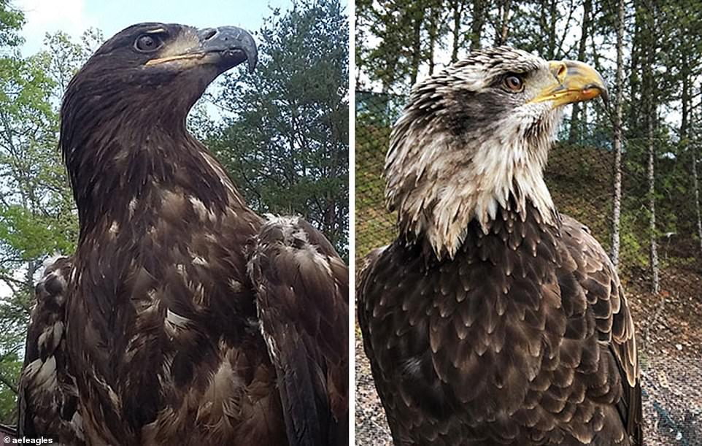
Times of Stress Overcome the Mighty Eagle
The Eagle Suffers Great Loss…
..the Abilities of His Youth
The Eagle then Begins a…
…Painful Process of Renewal
Afterward…
…The Eagles Finds Restoration

Slide 9

The Provision of Stress
There Is Serving Power (31)
“wait on the Lord”
Wait =
is not a Cessation of Activity
it is a Realignment to Activity
Wait = to bind or twist
…to Combine Strength with
…an Outside Source

Slide 10
The Provision Of Stress
There Is Serving Power (31)
“wait on the Lord.”
Matthew 11:28-30
Labor = Exhausted Physically
Heavy Laden = Exhausted Mentally
Stressed Out!
Yoke = device used to combine strength
for Synergy to exist

Slide 11
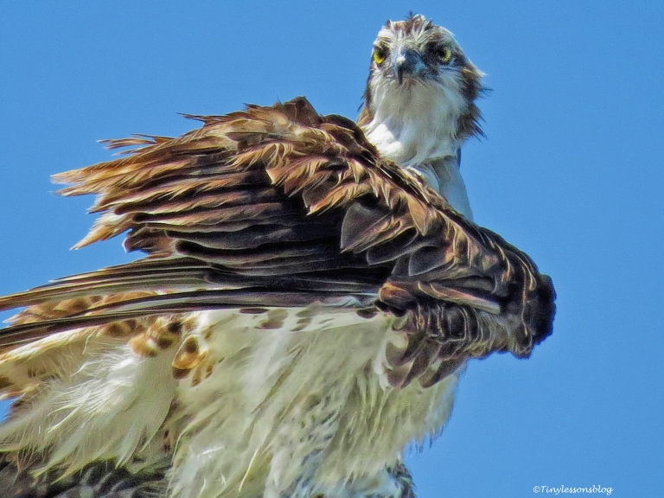
Realization
…brings Renewal =
to pierce or change :- abolish, alter, change, cut off, go on forward, grow up, be over, pass (away, on, through), renew, sprout, strike through.

Slide 12
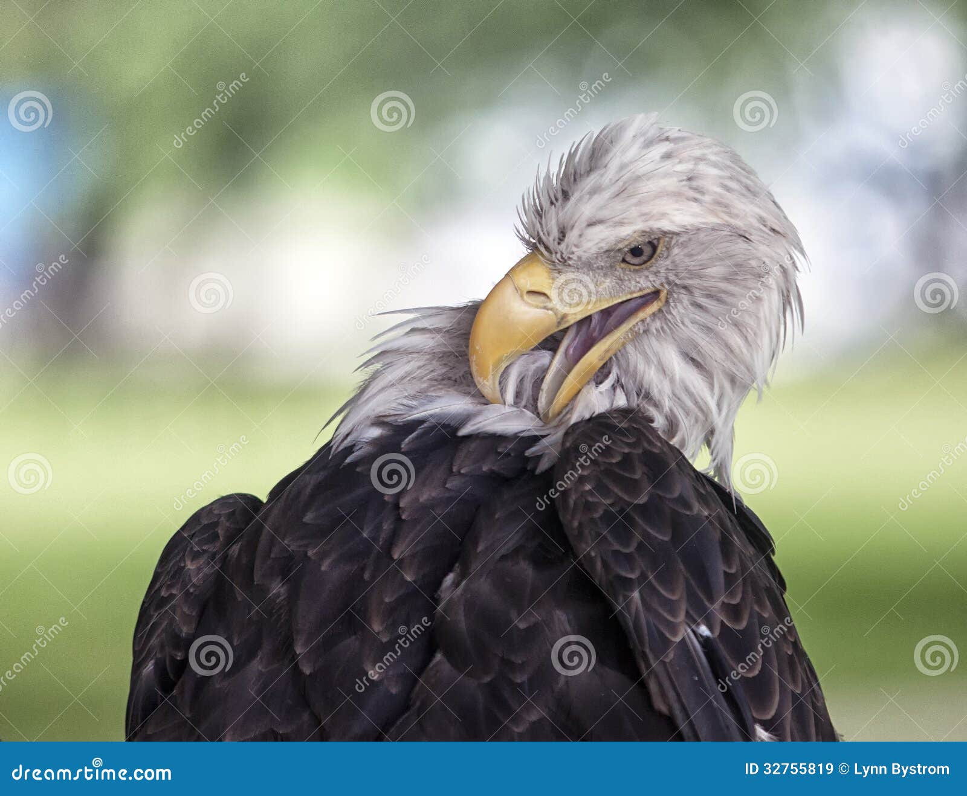
Realization
Difficulty Trying to…
Soar
Overgrown
Ability Fading
Seek
Eyesight Dim
Beak and Talons Overgrown
Ability to Hunt / Defend Fading
Satisfy
Never Satisfied
Ability Fading To Do What Eagles Do

Slide 13
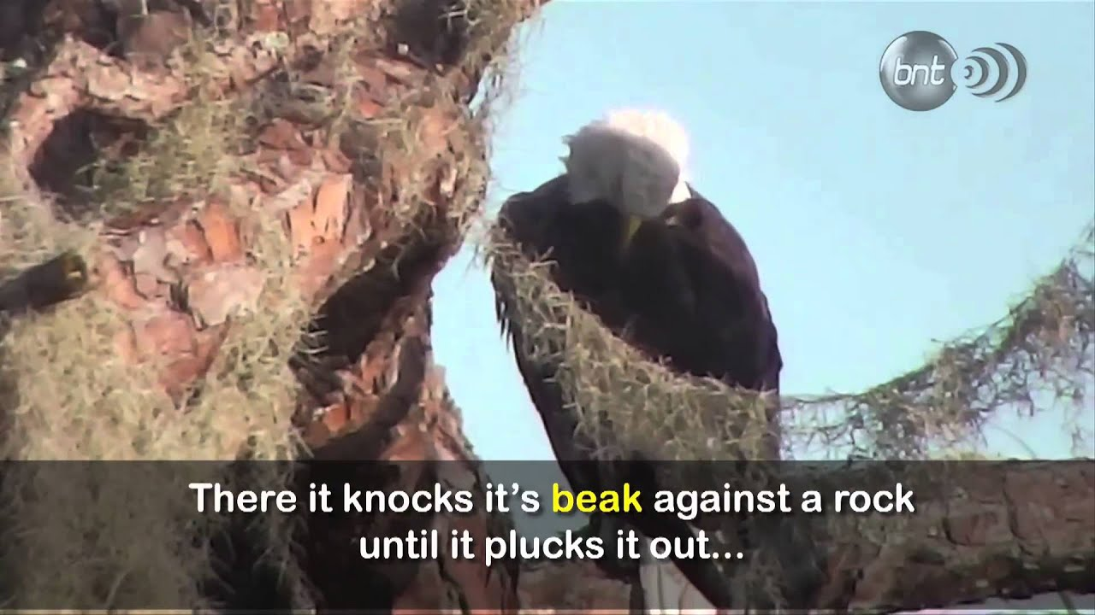
Resolve
Time of Seclusion…
Productive Pain
Pulls Feathers
Beats Beak Against Rock
It Cries and Waits
Protection
Other Eagles Fly Above
Drive Predators Away
Provision
Other Eagles Fly Above
Deliver What Food They Can Eat

Slide 14
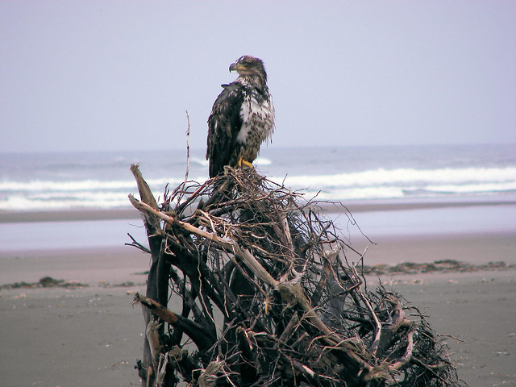
The Wait
The Mighty Becomes Dependant
The Eagle…
Waits For Wings to Grow Back
Looses Self Dependence
Learns to Lean On God as Source
Other Birds Dropping Food
Sacrifice of Praise -

Slide 15
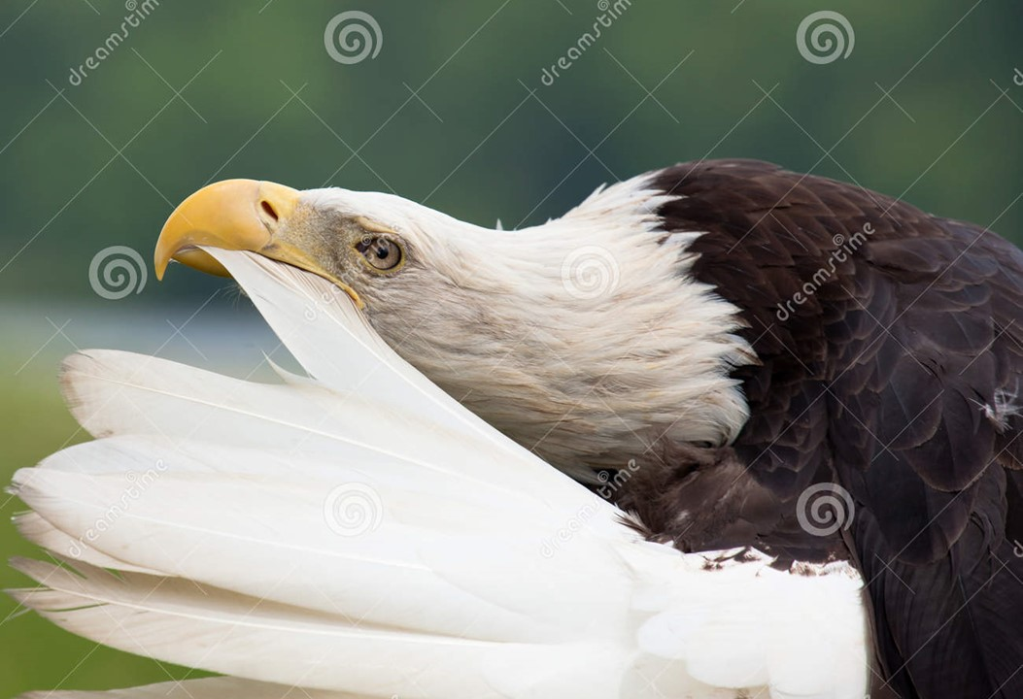
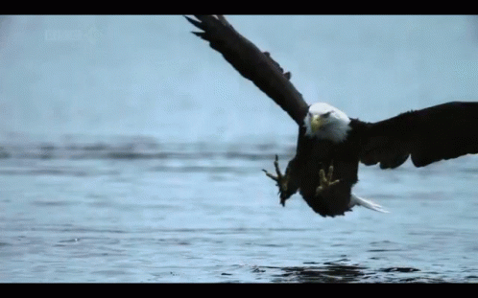
Resolve
Time of Seclusion…
Productive Pain
Protection
Provision
Progress
a- Feathers and Beak Grow Back
b- Oil Sack on Chest
–pierced /oil spread on Feathers
c- Sight Restored
d- Agility Returns

Slide 16
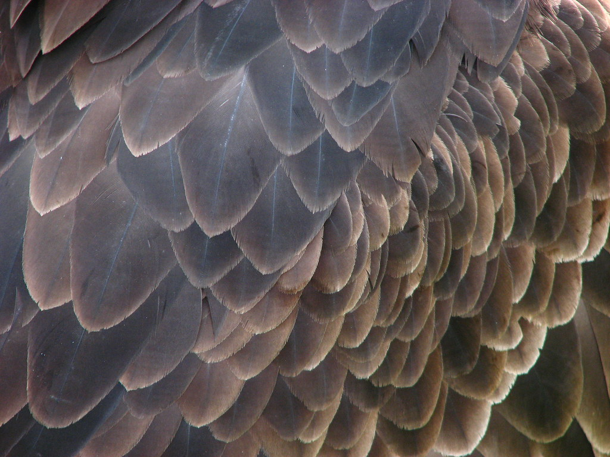
Our Time of Resolve
Time of Seclusion…
Productive Pain
Lose Self-Dependence
Wait on God
Protection
Learn to Lean on God as Strength
If God doesn’t Protect …
Provision
Learn to Lean on God as Source
If God doesn’t Provide…

Slide 17
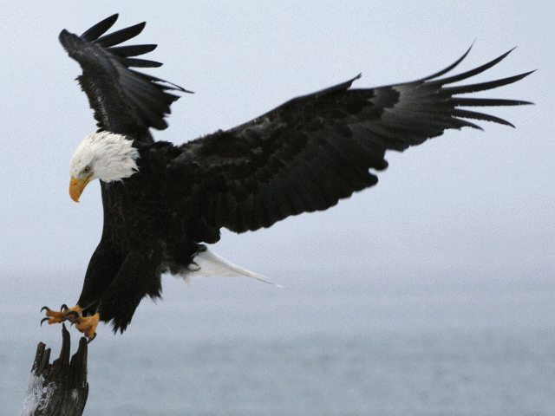
Our Time of Resolve
Time of Seclusion…
Productive Pain
Protection
Provision
Progress
Life Grows Back in Order
Holy Ghost brings Fresh Anointing
Discernment Restored
Agility Returns

Slide 18
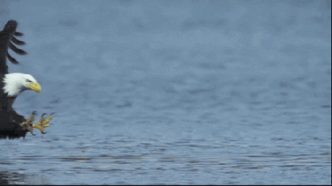
Restoration
Some Never Make It…
Destroyed Before Trying
Give up in the Process
Those Who Do Make It, Discover New…
Freshness
Strength
Boldness
Freedom…
Soar !
The Choice is Yours

Slide 19
Get Your 2nd Wind: He Is… The Wind beneath… …Your Wings
This Weeks Assignment
If Sometime this Week …
… You Experience Unexpected Downtime
Learn to Say This…
“Thank You God for this…
“Season of Renewal”

Slide 21
62 years ago
Eddie: "Thanks for that harmonica you gave me -- it's the best birthday present ever!"
Uncle Joe: "Well, that's great! What songs can you play?"
Eddie: "Oh, I don't play it. Mom gives me a nickle a day not to play it during the day, and Dad gives me a quarter a week not to play it at night."

Slide 22
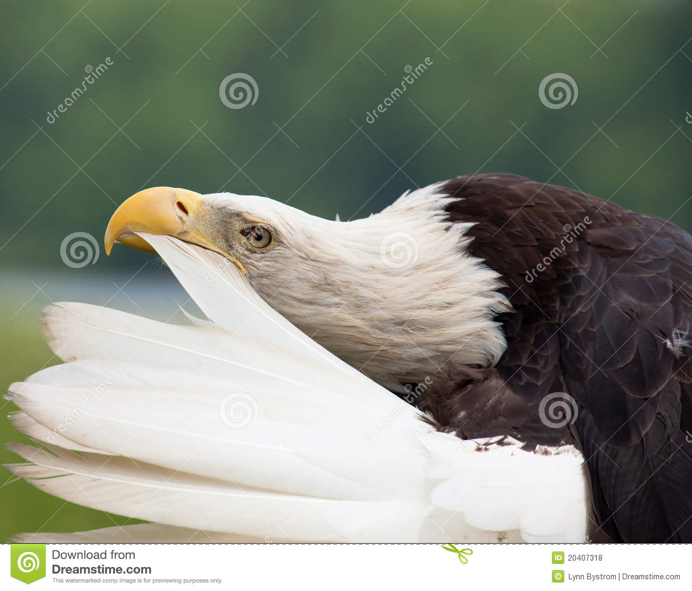

Slide 23
