Slide 2

The Ants Go Marching One by One
Philippians 4:8

Slide 3

God Knows the Power of Our Thoughts
That’s Why Philippians 4:8 Declares…
Summing it all up, friends, I’d say you’ll do best by filling your minds and meditating on things true, noble, reputable, authentic, compelling, gracious—the best, not the worst; the beautiful, not the ugly; things to praise, not things to curse. Put into practice what you learned from me, what you heard and saw and realized. Do that, and God, who makes everything work together, will work you into his most excellent harmonies. Philippians 4:8-9 (MSG)
But This Way of Thinking is Not Natural
We Are Prone to the Negative
If We Arent Careful It Will Overcome Our Thinking…
We Get Infested with ANTS

Slide 4
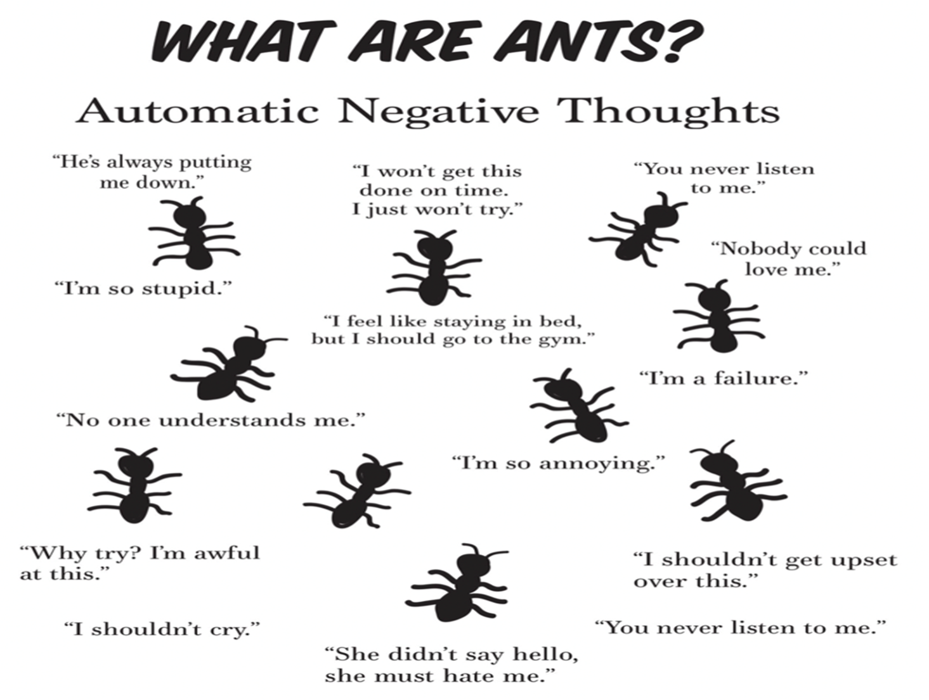


Slide 5
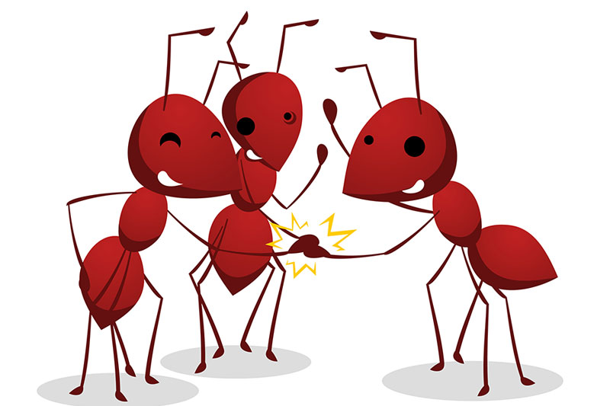
Whenever You Feel…
…ANTS Attack
…ATTACK Back!
RAID
R- Resist
A- Adjust
I- Inspect the Truth
D- Dwell on Truth Instead

Slide 6
There are Many Different “Species" of ANTs:
"Always" or "Never"
Thinking Includes words like always, never, no one, everything
Focusing on the Negative
Only seeing the bad parts of a situation
Fortune Telling
Predicting the worst case scenario
Mind Reading
Believing that you know what another person is thinking without them telling you

Slide 7
There are Many Different “Species" of ANTs:
Thinking with your Feelings
Believing negative feelings rather than questioning them
Guilt Beatings
Thinking of what you should have done, ought to have done
Labeling
Giving yourself or someone else a negative label
Personalization
Harmless events are seen as personal in nature
Blame
Blaming someone else for your problems

Slide 8

Time to Get Real
Letting Down the Plow
Today I Want to See Hands
How Many in Here Have…
Watched Things They Should Not Have Watched
Participated in Things They Should Not Have
Been Places They Should Have Stayed Away From
Said Things They Should Have Never Said
Thought Things They Should Not Have Thought

Slide 9
Let’s All Adjust Our Halos
If We Are Honest…
We ALL Have…
Satan Uses It to His Advantage
In Order to Hold Us Hostage
Beat Us Up!
Cripple Us Spritually
Emotionally
Mentally
In Order to Keep Us from Being All We Can Be
At First Satan is Our Tempter…
…Then He Becomes Our Accuser

Slide 10

Automatic Negative Thought Syndrome
A.N.T.S. are:
Automatic And Happen Without You Realizing It
Negative
Exaggerated
Convincing
Not Accurate Reflections Of Reality
Something Everyone Does, But Happens More In People Suffering From Anxiety, Depression

Slide 11
You Can Never Get Past Your Past
Truth
ALL CHARGES ARE DROPPED
Romans 8:33-34
33 Who shall lay any thing to the charge of God's elect? It is God that justifieth.
AMP -Who will bring any charge against God’s elect (His chosen ones)?

Slide 12
You Are Condemned By Your Past
No CONDEMNATION upon us – Rom 8:34
Jesus Wiped the Slate Clean! We Are Free!
Romans 8:33-34
33 Who shall lay any thing to the charge of God's elect? It is God that justifieth. 34 Who is he that condemneth? It is Christ that died, yea rather, that is risen again, who is even at the right hand of God, who also maketh intercession for us.
AMP -Who will bring any charge against God’s elect (His chosen ones)? It is God who justifies us [declaring us blameless and putting us in a right relationship with Himself]. Who is the one who condemns us?

Slide 13
Nothing Good Ever Happens to You
God Promises Us that He Takes the Good / Bad / Ugly/
Takes It All and Brings Something For Us and Too Us
Romans 8:28
And we know that all things work together for good to those who love God, to those who are the called according to His purpose.
New Living Translation
And we know that God causes everything to work together for the good of those who love God and are called according to his purpose for them.
Amplified Bible
And we know [with great confidence] that God [who is deeply concerned about us] causes all things to work together [as a plan] for good for those who love God, to those who are called according to His plan and purpose.

Slide 14
God is Withholding His Grace from You
God Has More than Showed Us the Lengths He Went to
In Order to Take Care of Our NEEDS - Romans 8:32
KJV
He that spared not his own Son, but delivered him up for us all, how shall he not with him also freely give us all things?
32 If God didn't hesitate to put everything on the line for us, embracing our condition and exposing himself to the worst by sending his own Son, is there anything else he wouldn't gladly and freely do for us? –Message

Slide 15
This Trial IS Going to Get the Best of You!
No TRIAL Can overcome us – Jesus IS Fighting for US Romans 8:37
King James Bible
Nay, in all these things we are more than conquerors through him that loved us.
37 No, despite all these things, overwhelming victory is ours through Christ, who loved us. NLT
AMP Yet in all these things we are more than conquerors and gain an overwhelming victory through Him who loved us [so much that He died for us].

Slide 16
You Have Gone Too Far –God Doesn’t Love You
No POWER Can Separate Us from His Love Rom 8:38-39
³⁸ For I am persuaded, that neither death, nor life, nor angels, nor principalities, nor powers, nor things present, nor things to come, ³⁹ Nor height, nor depth, nor any other creature, shall be able to separate us from the love of God, which is in Christ Jesus our Lord.
³⁸ For I am convinced [and continue to be convinced—beyond any doubt] that neither death, nor life, nor angels, nor principalities, nor things present and threatening, nor things to come, nor powers, ³⁹ nor height, nor depth, nor any other created thing, will be able to separate us from the [unlimited] love of God, which is in Christ Jesus our Lord.
38 I'm absolutely convinced that nothing - nothing living or dead, angelic or demonic, today or tomorrow, 39 high or low, thinkable or unthinkable - absolutely nothing can get between us and God's love because of the way that Jesus our Master has embraced us.

Slide 17
This Is IT! …It is Not Worth Going On!
This Is Not It! - No COMPARISON of the glory that awaits us
Romans 8:18
KJV
For I reckon that the sufferings of this present time are not worthy to be compared with the glory which shall be revealed in us.
Amp 18 For I consider [from the standpoint of faith] that the sufferings of the present life are not worthy to be compared with the glory that is about to be revealed to us and in us!

Slide 18


Slide 19
This Weeks Assignment
Attacking Your Ants
Remove “Should” Thoughts
Recognize Automatic Negative Thinking
Putting Your Thoughts On Trial
Acknowledge How Overwhelmed You Feel
Don’t Force Positive Thoughts
But Instead Embrace Them
Watch Your ANTS Lose Power !

Slide 20
This Weeks Assignment
Attacking Your Ants
Remove “Should” Thoughts
Recognize Automatic Negative Thinking
Putting Your Thoughts On Trial
Acknowledge How Overwhelmed You Feel
Don’t Force Positive Thoughts
But Instead Embrace Them
Watch Your ANTS Lose Power !

Slide 22
One day a man passed by a farm and saw a beautiful horse.
Hoping to buy the animal, he said to the farmer: "I think your horse looks pretty good, so I'll give you $500 for him."
"He doesn't look good, and he's not for sale," the farmer said.
The man insisted, "I think he looks good and I'll up the price to $1000!"
"He doesn't look so good," the farmer said, "but if you want him that much, he's yours."
The next day the man came back raging mad. He went up to the farmer and screamed, "You sold me a blind horse! You cheated me!"
The farmer calmly replied, "I told you he didn't look so good, didn't I?"

