Slide 2
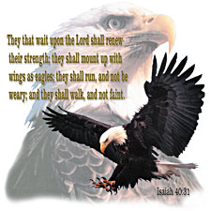
Getting Your 2nd Wind:
The Wind beneath…
…my Wings pt2
Isaiah 40:29-31
Edward Church
August 13, 2023

Slide 3
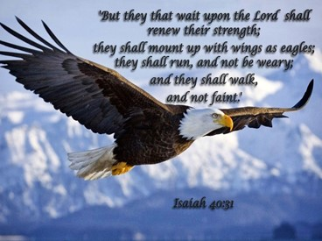
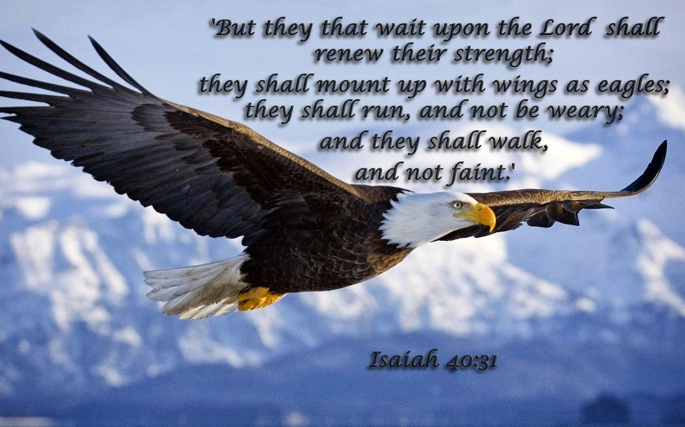
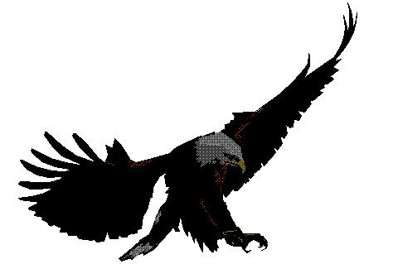
Pictures From Nature
God Uses Many Examples from Nature to Describe the Nature of People…
Lion, Bear, Leopard,
Satan - Serpent
Jesus -
  Lamb - Redemptive Nature
  Lion - Reigning Nature
Eagle -
…Israel
…the Church

Slide 4
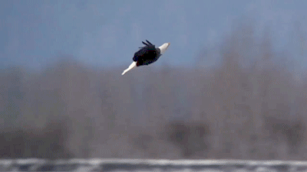
Eagle Facts
An Eagle…
Will Always Build Its Nest In The Heights Of The Mountain, Upon A Rock
Will Claim A Rock And He Never Changes Rocks.
Always Dies Looking Toward His Rock
Mates For Life
Eagle Parents Do Everything Together
Does Not Fear The Storm –But Welcomes It And Flies Above It
Soars!

Slide 5
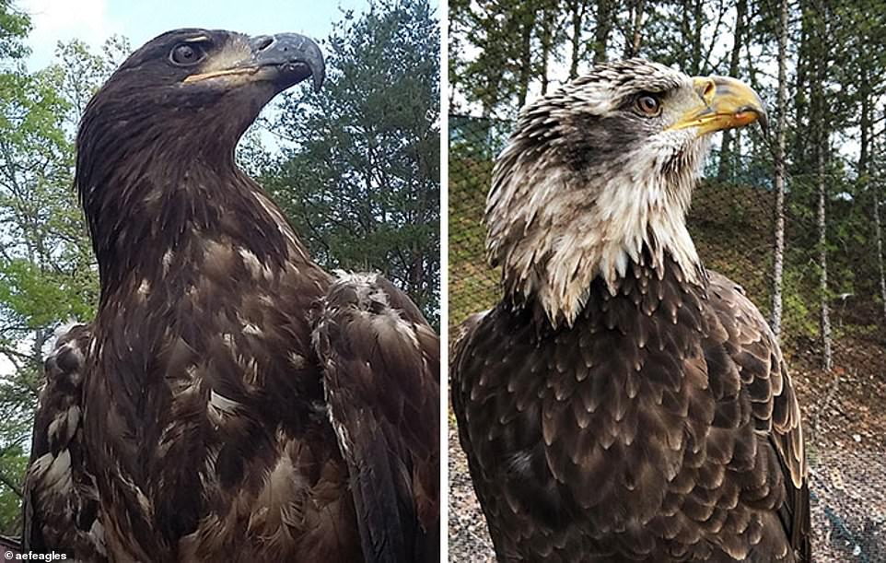
Times of Stress Overcome the Mighty Eagle
The Eagle Suffers Great Loss…
..the Abilities of His Youth
The Eagle then Begins a…
…Painful Process of Renewal
Afterward…
…The Eagles Finds Restoration

Slide 6

The Provision of Stress
There Is Serving Power (31)
“wait on the Lord”
Wait =
  is not a Cessation of Activity
  it is a Realignment to Activity
Wait = to bind or twist
…to Combine Strength with
…an Outside Source

Slide 7
The Provision Of Stress
There Is Serving Power (31)
“wait on the Lord.”
Matthew 11:28-30
Labor = Exhausted Physically
Heavy Laden = Exhausted Mentally
Stressed Out!
Yoke = device used to combine strength
for Synergy to exist

Slide 8
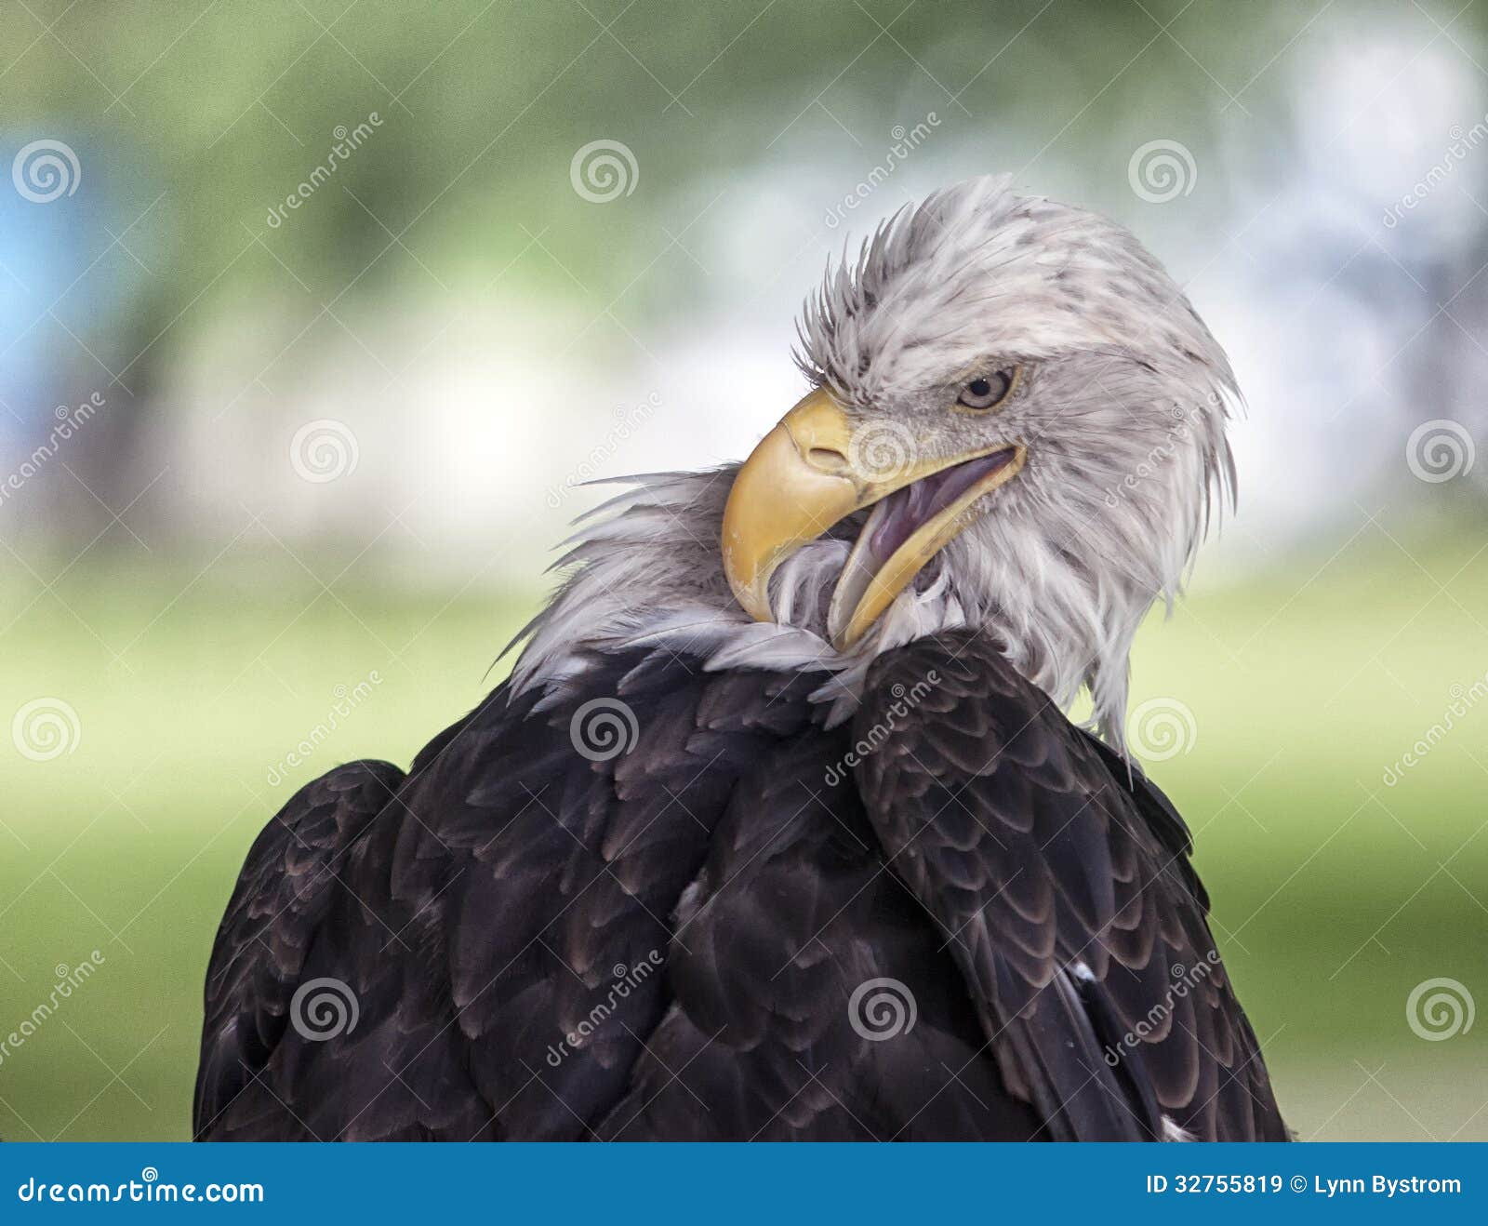
Realization
Difficulty Trying to…
Soar
  Overgrown
  Ability Fading
Seek
  Eyesight Dim
  Beak and Talons Overgrown
  Ability to Hunt / Defend Fading
Satisfy
  Never Satisfied
  Ability Fading To Do What Eagles Do

Slide 9
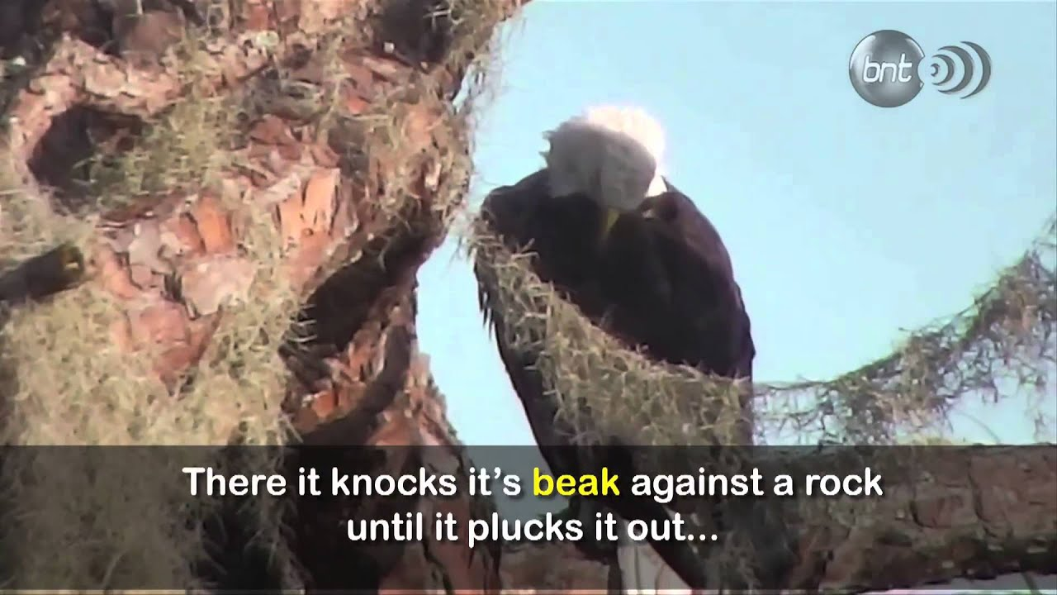
Resolve
Time of Seclusion…
Productive Pain
  Pulls Feathers
  Beats Beak Against Rock
  It Cries and Waits
Protection
  Other Eagles Fly Above
  Drive Predators Away
Provision
  Other Eagles Fly Above
  Deliver What Food They Can Eat

Slide 10
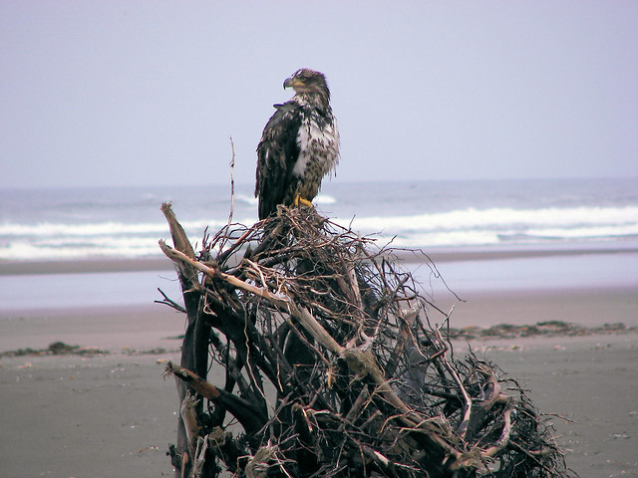
The Wait
The Mighty Becomes Dependant
The Eagle…
Waits For Wings to Grow Back
Looses Self Dependence
Learns to Lean On God as Source
Other Birds Dropping Food
Sacrifice of Praise -

Slide 11
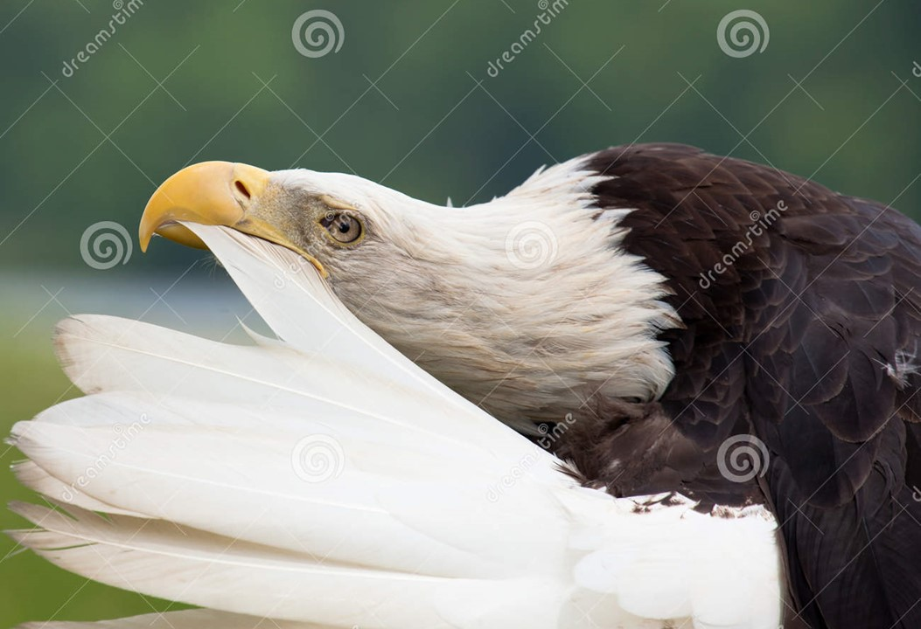
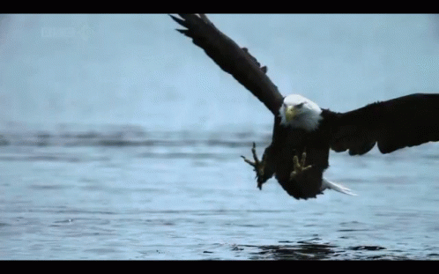
Resolve
Time of Seclusion…
Productive Pain
Protection
Provision
Progress
a- Feathers and Beak Grow Back
b- Oil Sack on Chest
–pierced /oil spread on Feathers
c- Sight Restored
d- Agility Returns

Slide 12
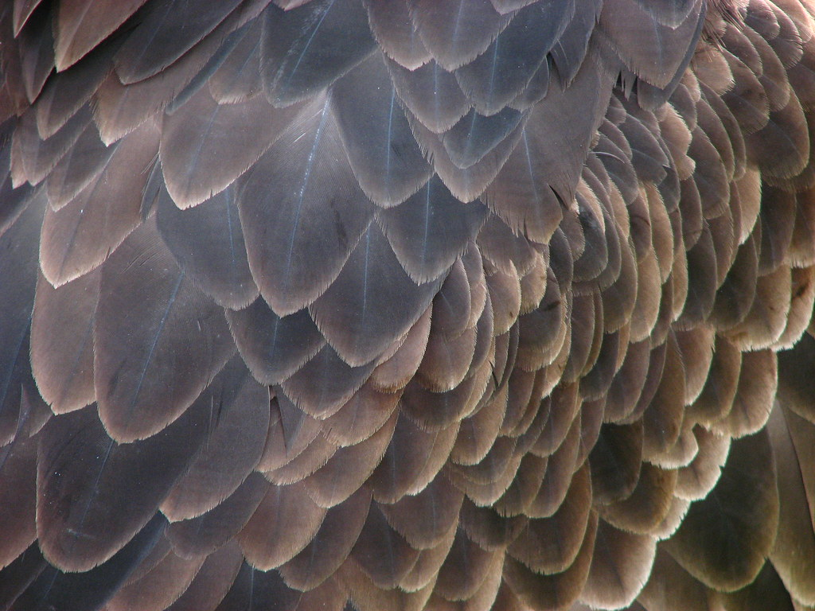
Our Time of Resolve
Time of Seclusion…
Productive Pain
  Lose Self-Dependence
  Wait on God
Protection
  Learn to Lean on God as Strength
  If God doesn’t Protect …
Provision
  Learn to Lean on God as Source
  If God doesn’t Provide…

Slide 13
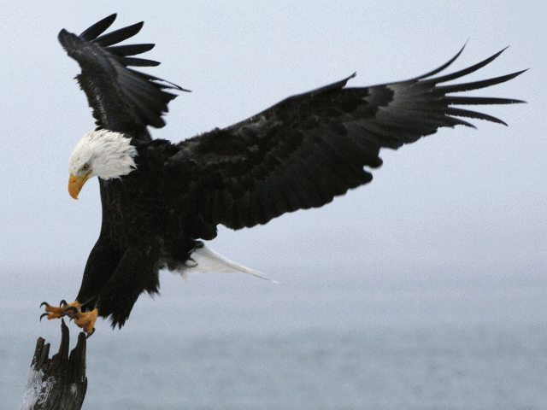
Our Time of Resolve
Time of Seclusion…
Productive Pain
Protection
Provision
Progress
  Life Grows Back in Order
  Holy Ghost brings Fresh Anointing
  Discernment Restored
  Agility Returns

Slide 14
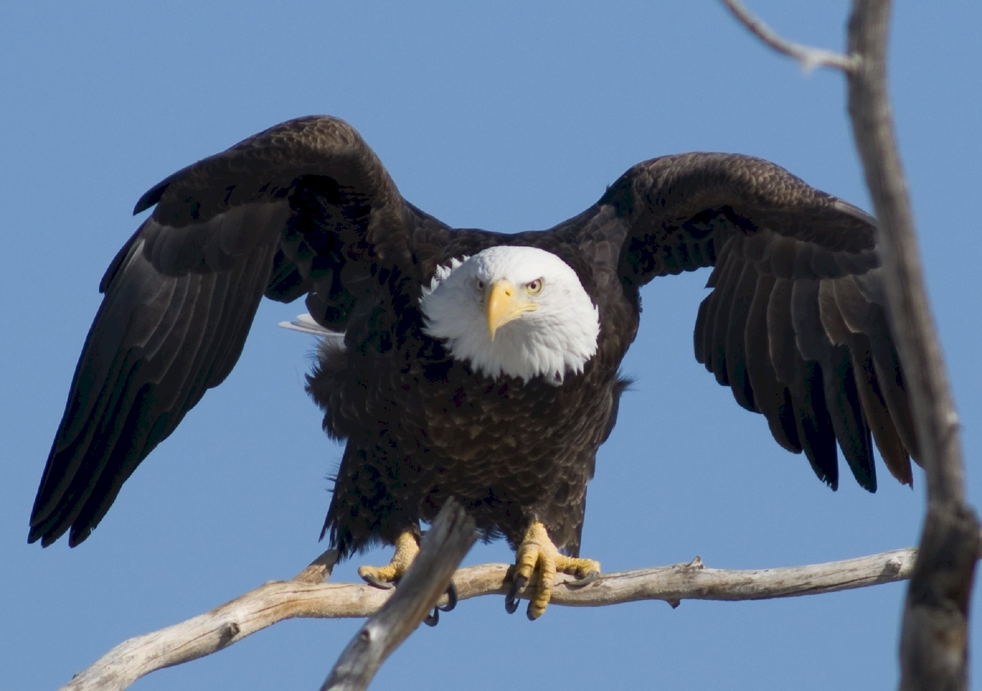
Renewal
There Is Soaring Power (31)
"They shall mount up w- wings like eagles."
Mounting Up

Slide 15
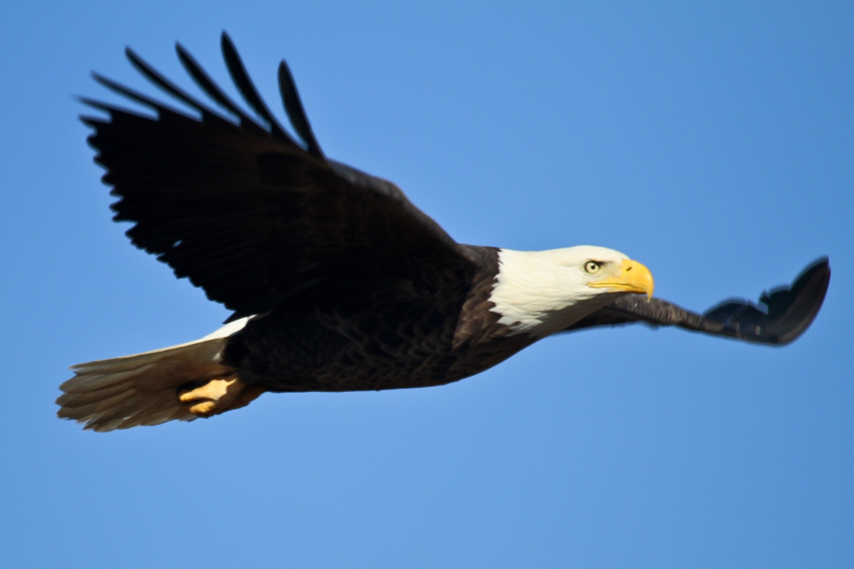
Different Types of Flight Used by Birds:
Flapping - “No Rest”
keeping their wings in constant motion
to counteract gravity
Gliding - “Partial Rest”
going up high and heading back to earth
Soaring - “Rest”
Only eagles and hawks do this

Slide 16
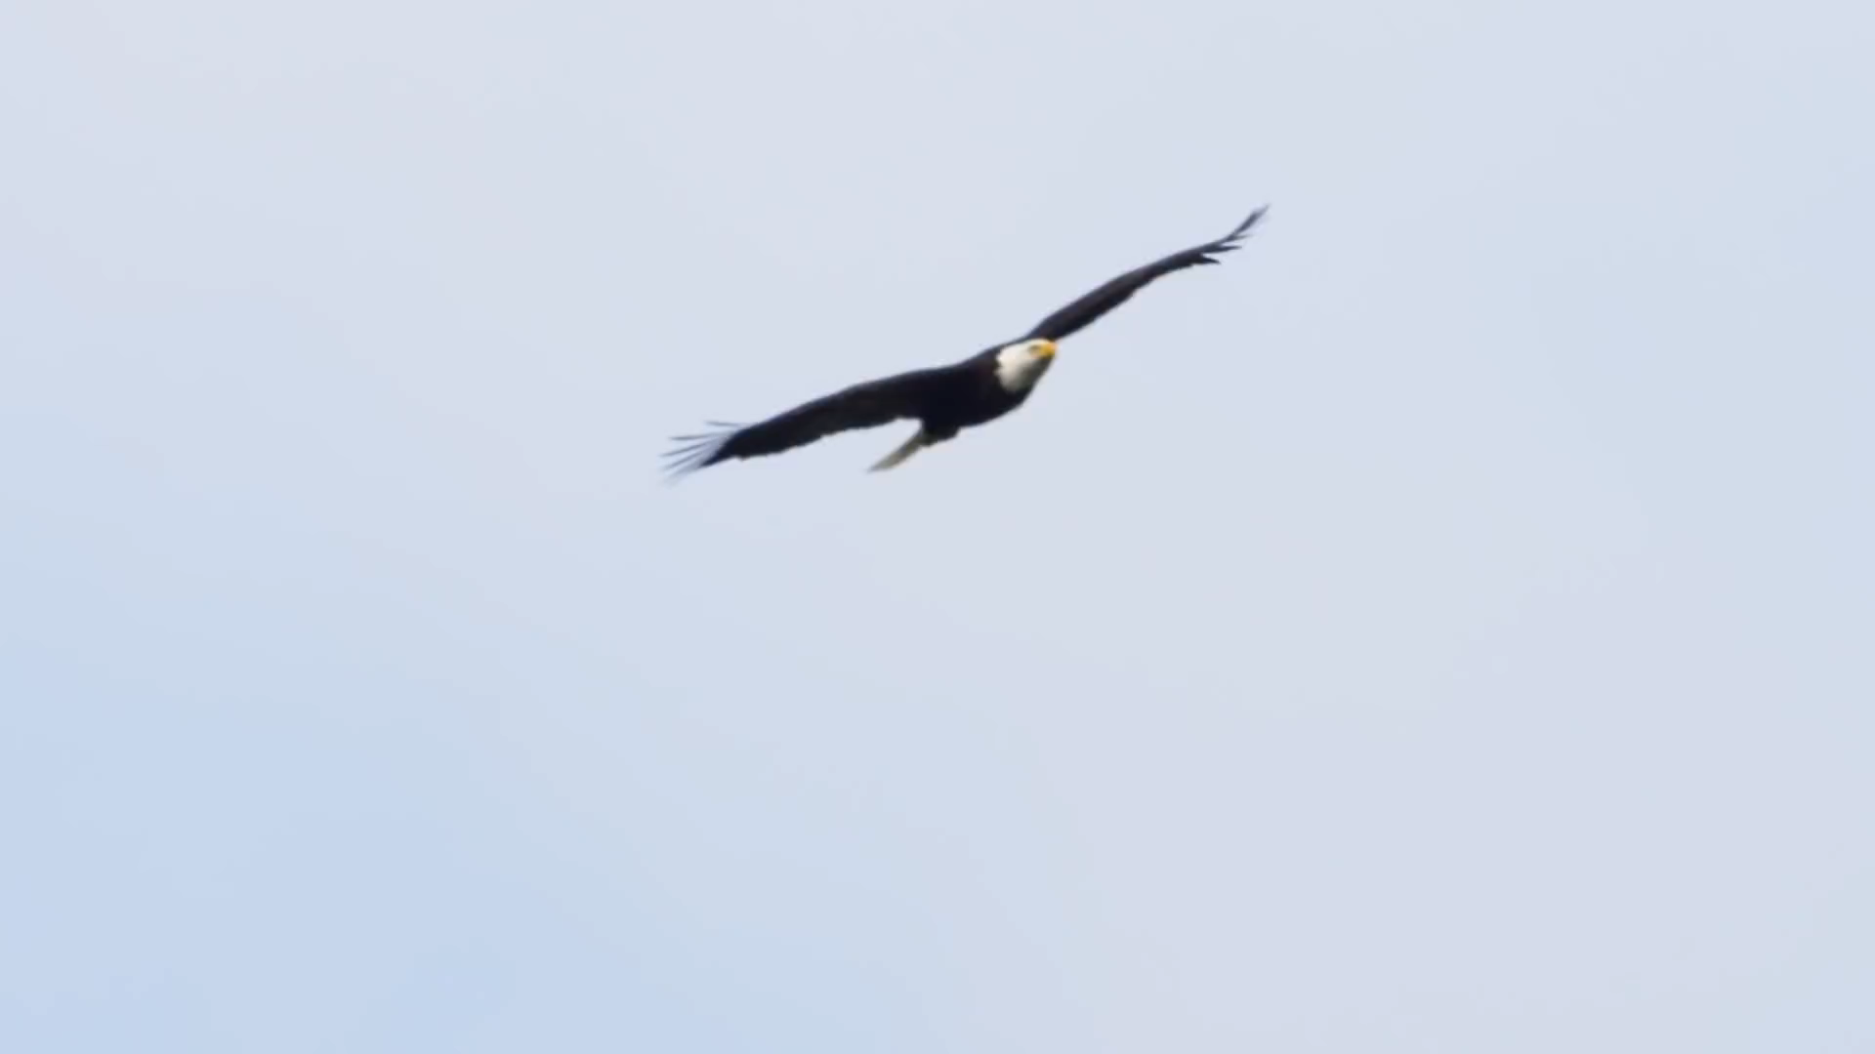
Renewal

Slide 17
Renewal
Soaring Power (31)
"They shall mount up with wings like eagles.“
Mounting Up
Gather Strength
Fresh Wind

Slide 18
Renewal
Surging Power (31)
“They shall run and not be weary."
Run- to rush –offensive position
  footman –soldier chosen to run ahead of
  Kings Chariot to protect it
  foot soldier –infantry
Not Weary– not winded -exhausted

Slide 19
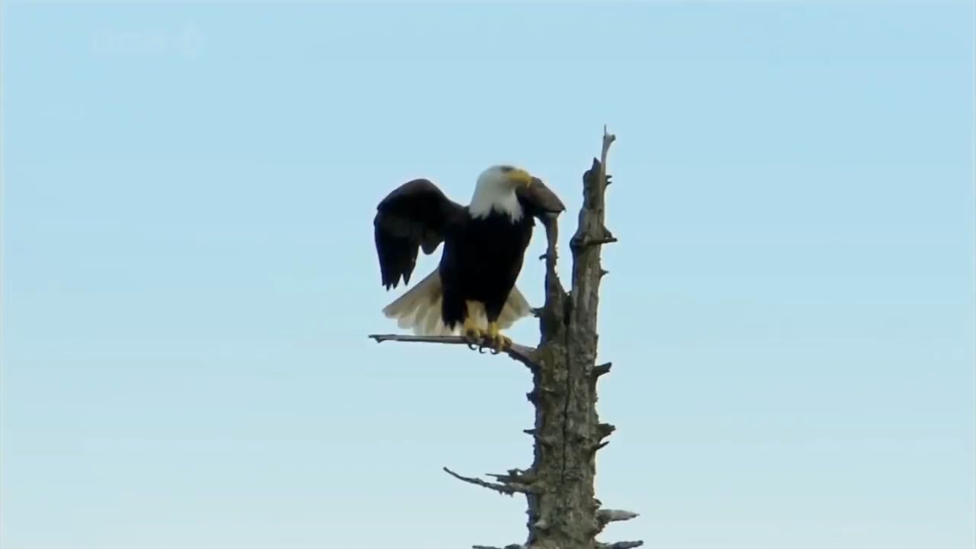

Slide 20
Renewal
Staying Power (31)
“They shall walk and not faint..."
Walk - to walk -offensive position
  march, pursue, cause to run
  carry away
Faint - fatigued;exhausted,
winded, out of breath

Slide 21
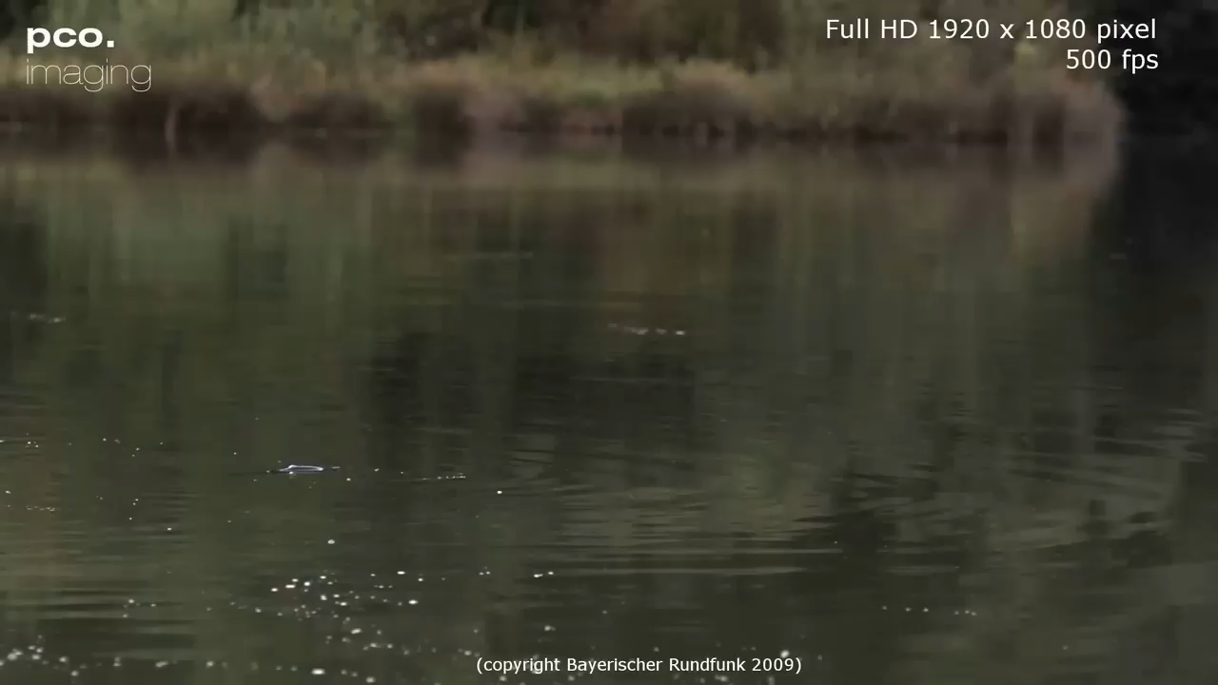

Slide 22
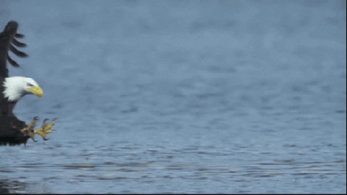
Restoration
Some Never Make It…
  Destroyed Before Trying
  Give up in the Process
Those Who Do Make It, Discover New…
  Freshness
  Strength
  Boldness
  Freedom…
Soar !
The Choice is Yours

Slide 23
Get Your 2nd Wind:
He Is…
The Wind beneath…
…Your Wings
This Weeks Assignment
Look For and Expect New Strength
When You
Walk = Normal Activity
Run = Beyond Activity
Rest in It!
Soar!!!

Slide 24
This Weeks Assignment
Look For and Expect New Strength
When You
Walk = Normal Activity
Run = Beyond Activity
Rest in It!
Soar!!!
I Dare You!!!

Slide 26
Disclaimer
If You Have a Problem with
Organized Religion …
This is the Church For You !
Come Join In
Praise and Worship!

Slide 28
An old wild west fort was about to be attacked. The wily old general sent for his trusty Sioux scout.
"You must use all your thirty years of skill in trying to estimate the sort of army we are up against here."
The trusty scout laid down and put his ear to the ground.
"Large war party," he said, "maybe three hundred braves, four chiefs, two on black stallions, two on white stallions. All have war paint; Many many guns. Medicine man also with them."
"Good grief!" exclaimed the general, "you can tell all of that just by listening to the ground?"
"No," replied the Indian, "I can see under the gate."

