Slide 2

When God Doesn’t Make Sense
The Challenge of Faith
Matthew 15:21

Slide 3

Has Your Faith Ever Been Challenged?
There are Times…
Satan Challenges Us to Produce…
“DOUBT”
But God Allows Challenges to Produce…
“DETERMINATION”
Either Way
It Starts By Bringing Us to a…
“Crisis of Faith”
How We Respond Will Determine Our…
“Destination”

Slide 4

What Did…
Abraham
Moses
Saul
David
Jeremiah
Disciples
Paul
Demas
…Have In Common?
They All Had Their Faith
“Challenged”
It Came as a
“Crisis of Faith”
Some Did Great
Others Not So Great
This Woman was About
to Discover this Too

Slide 5
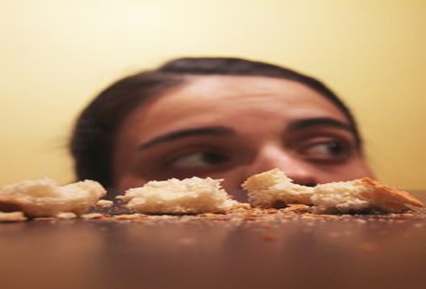
This Little Story Is
Confusing In Many Ways
Not Given a Lot of Attention
But It Does Give Insight When Our Faith is Challenged
This Mom’s Daughter Was Experiencing a Hardship…
…Out Of Mom’s Control
…She Doesn’t Understand
…So She Takes it to Jesus
…Now She Really Doesn't Understand
All of Us Can Relate to the Tests She Went Through…
…And Her Success Can Give Us All Encouragement

Slide 6

Empowered By Great Love
Her Love was More Powerful than Her…
Unworthiness
Fear
Shame
Hardship And Sacrifice Combined

Slide 7
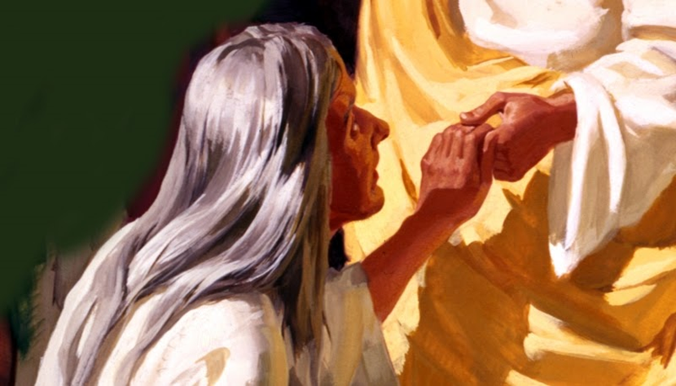
It Seems Her Whole Life had Been a Series of Tests
Mothering was More of a Chore than a Pleasure
She Finally Gets Jesus’ Attention
She Wasn’t Expecting…
…More Tests
These Tests Were NOT for Jesus’ Benefit…
…But For Hers
…And Ours

Slide 8
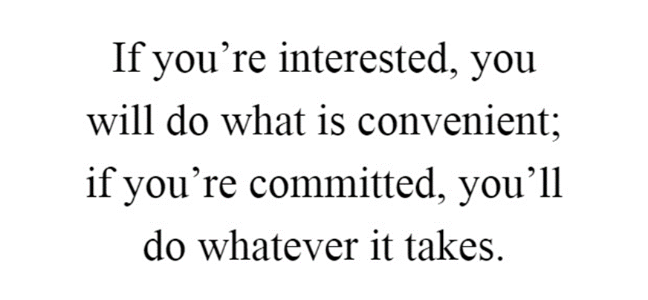

Slide 9

She Passed the Test of Patience… …During Divine Silence (23)
But He answered her not a word.
Has God Ever Been Silent When You Pray?
God’s Silence Is Not Neglect.
“When Nothin’s Happenin’; Somethin’s Happenin’.”
God’s Timetable Is Not Ours…
… And God’s Wisdom Exceeds Ours.
God Sees A Bigger Picture…
…And Seeks To Fashion Us Into Jesus’ Image.
He Hones Our Faith, Trust, Patience…

Slide 10

She Passed the Test of… …Doubt / Discouragement (23)
23 And His disciples came and urged Him,
saying, “Send her away…”
Hard Times Always Bring Worry, Doubt and Discouragement.
Everything Looks Like the Worst Case Scenario
God Gives Comfort and Assurance That…
He Will Walk Through the “Valley Of Death” With Us.

Slide 11

She Passed The Test Of Rejection (24)
24 But He answered and said, “I was not sent except to the lost sheep of the house of Israel.”
Have You Ever Felt Rejection From God?
Did You Know There Are Great Heroes In The Bible That Did Too?
Rejection Can Actually Be A Manifestation Of God’s Love.
Many Have Felt Rejection…
Ruth, Jonah, Jeremiah, King Hezekiah
They All Felt God’s Rejection, Sought God And Found His Favor.

Slide 12

She Passed the Test of Humility (26)
26 But He answered and said, “It is not good to
take the children’s bread and throw it to the little dogs.”
She Was At The Mercy Of God.
She Had No Leverage; No Bargaining Chips…
…Nothing To “Wow” God With Or Offer In Exchange.
Such A Place Makes Us Feel Vulnerable – Even Out Of Control
…But When Standing Before God, It Is A Safe Place

Slide 13

God Allows These Tests
#1- Teach Us to
“Walk By Faith Not Sight”
#2- Prepare Us for
“Promotion”

Slide 14
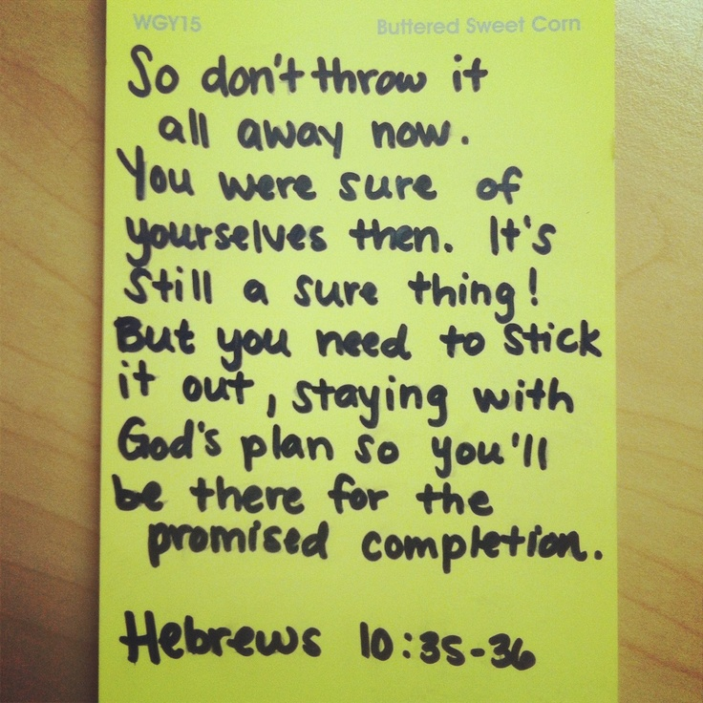
Faith’s Reward "O Woman, Your Faith Is Great;
Be It Done For You As You Wish."
Jesus Certainly Knew This About The Woman's Faith
Great Faith Brings Great Rewards
It Took Courage
It Took Commitment
It Took A Spirit That Refused To Be Deterred
Her Faith Was Tested And Passed The Test

Slide 15
This Weeks Assignment
When You Face Adversity
Iinstead of Living in Constant “Why?”
Try Asking God “What”
Try Thanking God For the Adversity
Try Changing Your Outlook
From “God why are you letting this happen to me?”
To “Thank You God, I realize this Adversity is Happening FOR ME”

Slide 16
This Weeks Assignment
When You Face Adversity
Iinstead of Living in Constant “Why?”
Try Asking God “What”
Try Thanking God For the Adversity
Try Changing Your Outlook
From “God why are you letting this happen to me?”
To “Thank You God, I realize this Adversity is Happening FOR ME”

Slide 17
The Challenge of Faith

Slide 18
Disclaimer
If You Have a Problem with
Organized Religion …
This is the Church For You !
Come Join In
Praise and Worship!

Slide 19
Dentist - "Try to relax. I'll pull your aching tooth in five minutes."
Patient - "How much will this cost?"
Dentist - "It'll be $2,000."
Patient - "That much for just five minutes work?"
Dentist - "Well if you prefer, I can pull it out very slowly."

