Slide 1
Spiritual Warfare
10% Satan’s Tactics
90% How We Respond
Remember… With God We Are Not
Helpless
Hopeless
We Are Powerful!!

Slide 2
Repeat
These are the 2 Most Important Hours of My Week – Help Me to Cherish Them
I Am Here Today to Worship
Not to Be Entertained
I Am Singing to An Audience of One
Accept My Worship Oh Lord!

Slide 3
Disclaimer
If You Have a Problem with
Organized Religion …
This is the Church For You !
Come Join In
Praise and Worship!

Slide 4
I sing praises to Your name, O Lord,
Praises to Your name, O Lord,
For Your name is great and
greatly to be praised.
I give glory to Your name, O Lord,
Glory to Your name, O Lord,
For Your name is great and
greatly to be praised.

Slide 5
AMAZING GRACE
Notes:
5

Slide 6
Amazing grace how sweet the sound
That saves a wretch like me
I once was lost but now I’m found
Was blind but now I see
I get a peaceful easy feeling
I know you won’t let me down
Cause I’m all ready standing
On solid ground
Notes:
6

Slide 7
Through many dangers, toils and snares
I have already come,
'Tis grace has brought me safe thus far
And grace will lead me home.
I get a peaceful easy feeling
I know you won’t let me down
Cause I’m all ready standing
On solid ground
Notes:
7

Slide 8
When we've been there ten thousand years
Bright shining as the sun,
We've no less days to sing God's praise
Than when we've first begun.
I get a peaceful easy feeling
I know you won’t let me down
Cause I’m all ready standing
On solid ground
Notes:
8

Slide 9
Repeat
I Lift My Offering to You
Let It Please You Oh Lord
This is My Seed
Although It Leaves My Hand
It will Never Leave My Life
You Will Multiply It!
Accept My Seed Oh Lord!

Slide 10
This Little Light of Mine
Power in the Blood
Ill Fly Away

Slide 11
A couple in their nineties is having problems remembering things, so they decide to the go the doctor for a checkup. The doctor tells them that they are physically okay, but they might want to start writing things down to help them remember. Later that night, while watching TV, the old man gets up from his chair. His wife asks, "Where are you going?“ "To the kitchen," he replies. She asks, "Will you get me a bowl of ice cream?" The husband says, "Sure." She gently reminds him, "Don't you think you should write it down so you can remember it?“ He says, "No, I can remember that!" She then says, "Well, I'd like some strawberries on top. You'd better write it down 'cause I know you'll forget it." He says, "I can remember that! You want a bowl of ice cream with strawberries.“ She adds, "I'd also like whipped cream. Now I'm certain you'll forget that, so you'd better write it down.“ Irritated, he says, "I don't need to write it down! I can remember that! Ice cream with strawberries! And whipped cream!" He then grumbles into the kitchen. After about 20 minutes the old man returns from the kitchen and hands his wife a plate of bacon and eggs. She stares at the plate for a moment and says, "Where's my toast?" >>>Today's Thot I don't like to brag, but...cashiers are always checking me out.

Slide 13

Edward Christian Church
September 3, 2023
Philemon v 8-9
Lessons Learned…
…from
Grace Pt 1

Slide 14
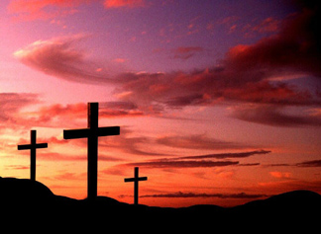
Tolerance= Key Word of Hour
Tolerant of Our…
Differences
Diversities
Directions
The Problem is…
There is Very Little of It
Some Expect It But Don’t Return It

Slide 15
Tolerance’s Key
So Many Have Neglected…
…the Key Ingredients
It is Found in God’s
Perception
Passion

Slide 16
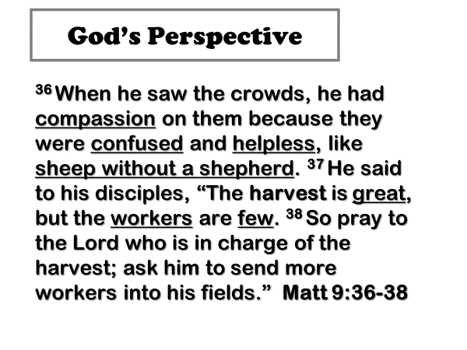
³⁶ When He saw the throngs, He was moved with pity and sympathy for them, because they were bewildered (harassed and distressed and dejected and helpless), like sheep without a shepherd.
³⁷ Then He said to His disciples, The harvest is indeed plentiful, but the laborers are few.
³⁸ So pray to the Lord of the harvest to ^{[a]}force out and thrust laborers into His harvest.
Matt 9:36-38 AMP

Slide 17
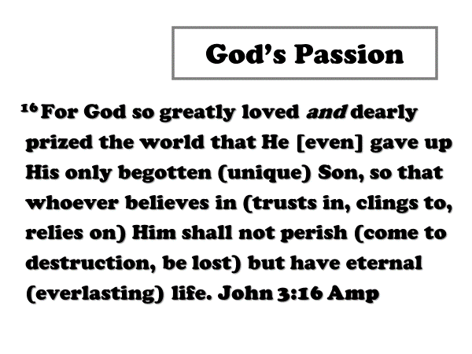
God’s Passion
¹⁶ For God so loved the world, that he
gave his only begotten Son, that
whosoever believeth in him should not
perish, but have everlasting life.
John 3:16 KJV

Slide 18

"Eros" -This Love Arises from Passion
It is the Love Between a Man / a Woman
Gives and Receives
“Storge" -This Love Arises from Affection
The Affection of Family Love
Gives and Receives
“Phileo" -This Love Arises from Affection
The Affection of Friendship
Gives and Receives
“Agape" -This is a Sacrificial Love…….

Slide 19
God’s Love = AGAPE
Agape =
An Active Determination Of
Your Will
To Benefit Another…
…Without Regard
…For Your Own Benefit
Power Behind Grace

Slide 20

Agape Explained
John 3:16
Agape is Compassion in Action
“For God so loved the world...”
Compassionate for Our Lost Situation
Compassionate About Our Sorrows
Agape is Committed to Giving
“…that he gave his only son”
God Committed His Son
Jesus Committed Himself

Slide 21
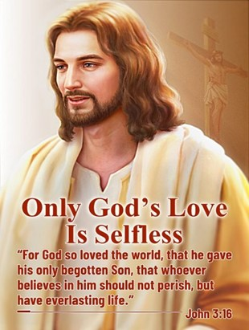
Agape Explained
John 3:16
Agape is Completely Forgiving
“…whosoever believes shall have…”
God Completely Saves
God Completely Satisfies
Agape is Contagious
“if I be lifted up…draw all men...”
It Can’t Be Stopped
It Must Be Spread

Slide 22

Our Challenge to Grace
Accept
By Faith
Pass ON
By Works
(Attitude – Actions)

Slide 23
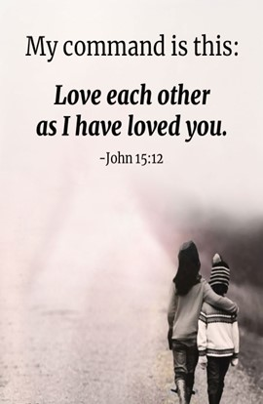
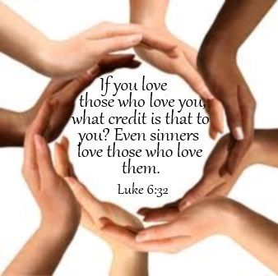

Slide 24

God Never Said
That We Had To…
Approve Of
Participate With
We Do Have to Show
Agape
Above all, have fervent and unfailing love for one another, because love covers a multitude of sins [it overlooks unkindness and unselfishly seeks the best for others]. 1 Peter 4:8

Slide 25


Slide 26


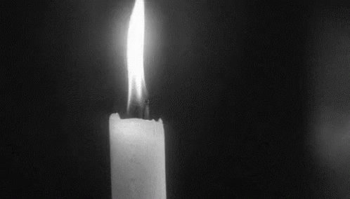
This Weeks Assignment
Romans 12:18, If it be possible, as much as lieth in you, live peaceably with all men.
Do Your Best to See Everyone You Meet as An Opportunity to Show AGAPE
Ask God to Empower You to Accept this Opportunity If Door Opens
Do It Expecting Nothing in Return
Knowing that It IS the Closest to
Following Christ’s Example

Slide 28


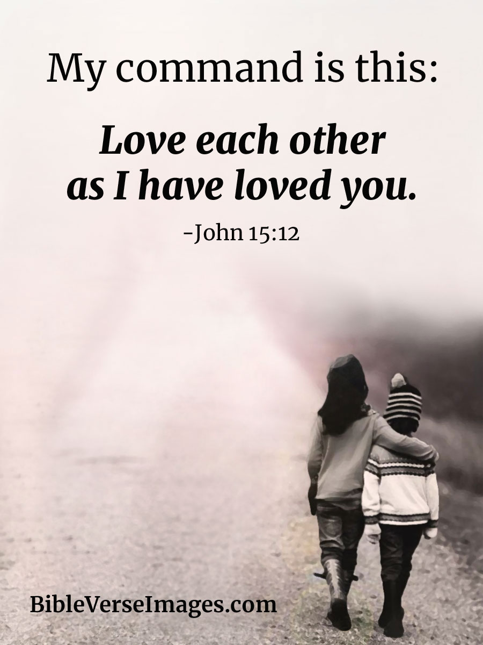
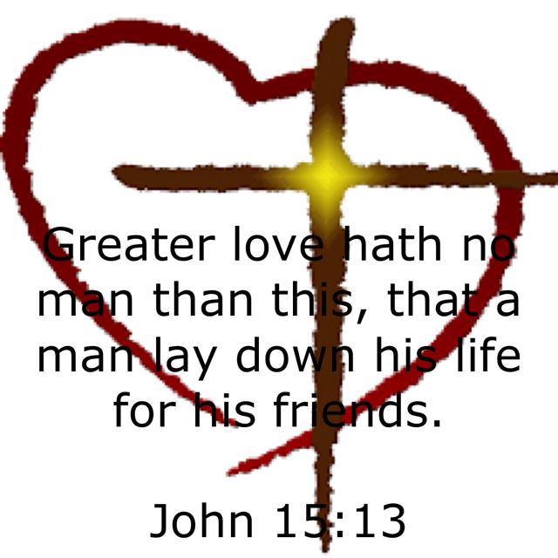



Slide 29
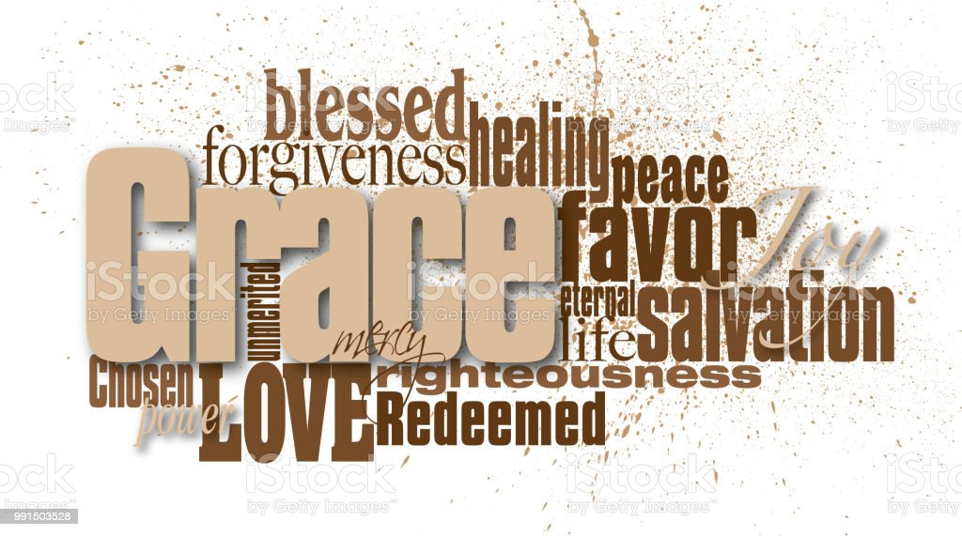

Slide 30
Agape Exemplified
Look at the book of…
…Philemon
It gives us one of the greatest
examples of…
“God’s love in action”

Slide 31
I. Grace Will Chase You
…will find you where you are
The Slave
The Status
Socially without status
Criminally without excuses
Personally without hope
The Stop

Slide 32
The Stopping Point
When you’ve gone as far as you can go…
Your Stopping Point…
…Becomes HIS Starting Point.
For at this point…
…Grace can take over!!!

Slide 33
The Stopping Point
Signs you are at your Stopping Point:
Overloaded
No more options
Overcommitted
No more excuses
Overspent
No more energy
The Fork in the Road has become a…
“Dead End”

Slide 34
II. Grace Will Confront You (8-11)
…deals directly with the Problem
Removes Excuses
Recalls Responsibility
Philemon (8-10)
Onesimus (10-11)

Slide 35
II. Grace Will Confront You (8-10)
…deals directly with the Problem
Grace does not help you
escape your past
It helps you Face it…
…Deal with it
Rise above it

Slide 36
III. Grace Will Change You
…will not leave you as you are
Philemon (1, 7)
Was unsaved when found
Paul evangelized, discipled
Served with Paul
2. Onesimus (11)
Was also unsaved
Paul evangelized, discipled
Served with Paul

Slide 37
IV. Grace Will Challenge You
…to become what you can be
Restoration (12)
Onesimus – make things right
Resolution (12, 20, 21)
Philemon – take him back as a brother
Resolution (16-17)
Paul – I will repay

Slide 38
IV. Grace Will Challenge You
…to become what you can be
44 years later…
Ignatius wrote to…
…Bishop of Ephesus.
…His Name was Onesimus
I Cor 13:7, “Love beareth all things
Believeth all things…

Slide 39
IV. Grace Will Challenge You
I Cor 13:7,
Love beareth all things- to roof over
-love covers multitude of sins
Believeth all things- to have faith
-not gullible – but has faith in people
Hopeth all things- to expect or confide
-sees the bright side of things
Endureth all things- to stay under
-Perseveres –like a stout-hearted soldier

Slide 40
IV. Grace Will Challenge You
Calvary
the greatest show of Agape/ Grace
takes away…
…All of Our Rights to
…Avenge or
…Hold a Grudge

Slide 41

Love

Slide 42
Characteristics of God’s Love
Love is patient
Love is kind
Love knows no envy
Love is not boastful
Love is not proud
Love is not rude
Love is not self-seeking
Love is not easily angered

Slide 43
Characteristics of God’s Love
Love keeps no record of wrongs
Love does not delight in evil
Love rejoices with the truth
Love always protects
Love always trusts
Love always hopes
Love always perseveres

Slide 44
Characteristics of God’s Love
Love never fails
Love perfects us
Love is supreme

Slide 46
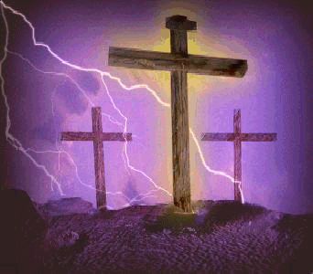

Slide 47
Agape Explained
John 3:16
Agape is Compassion in Action
“For God so loved the world...”
Agape is Committed to Giving
“…that he gave his only son”

Slide 48
Oh, it gets sweeter,
As the days go by.
It gets sweeter as the moments Fly
His love is richer, deeper, fuller Sweeter
Sweeter, sweeter, sweeter as the days go by

