Slide 2
Disclaimer
If You Have a Problem with
Organized Religion …
This is the Church For You !
Come Join In
Praise and Worship!

Slide 3

Edward Christian Church
September 10, 2023
Philemon v 8-9
Lessons Learned…
…from
Grace Pt 2

Slide 4


Slide 5
God’s Love = AGAPE
Agape =
An Active Determination Of
Your Will
To Benefit Another…
…Without Regard
…For Your Own Benefit
Power Behind Grace

Slide 6

Our Challenge to Grace
Accept
By Faith
Pass ON
By Works
(Attitude – Actions)

Slide 7

God Never Said
That We Had To…
Approve Of
Participate With
We Do Have to Show
Agape
Above all, have fervent and unfailing love for one another, because love covers a multitude of sins [it overlooks unkindness and unselfishly seeks the best for others]. 1 Peter 4:8

Slide 8

Agape Exemplified

Slide 9

Onesimus
Slave = Employee Today
Grace Will Chase You
…Will Find You Where You Are
Slave
Status
Socially without Status
Criminally without Excuses
Personally without Hope
Stop

Slide 10
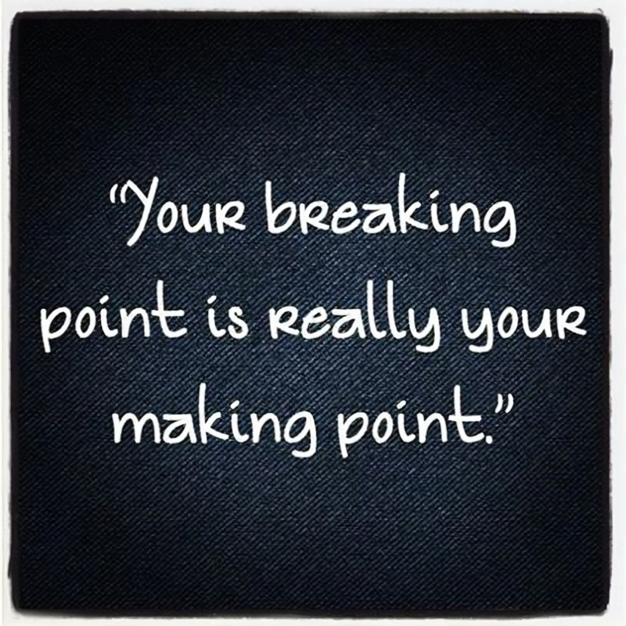
When You’ve Gone As Far As You Can Go-
Your Stopping Point…
…Becomes HIS Starting Point
For at this Point…
…Grace Can Take Over!!!

Slide 11

Signs You Are At Your
“Stopping Point”
Overloaded
No More Options
Overcommitted
No More Excuses
Overspent
No More Energy
The Fork in Road Turned Into…
“Dead End”

Slide 12

Why Does God Allow Us to… …Get to this Point?
Points to Power of the Cross…
We All Need His Help
Brings Message of Grace/ Mercy to Life
Now It’s Personal
Prompts Reliance Upon Him/ Others
We Can’t Do It Alone
Show Us/ Others We Can Still Be Used
Even in the Worst of Situations
Move Beyond Guilt to Usefulness Again!

Slide 13
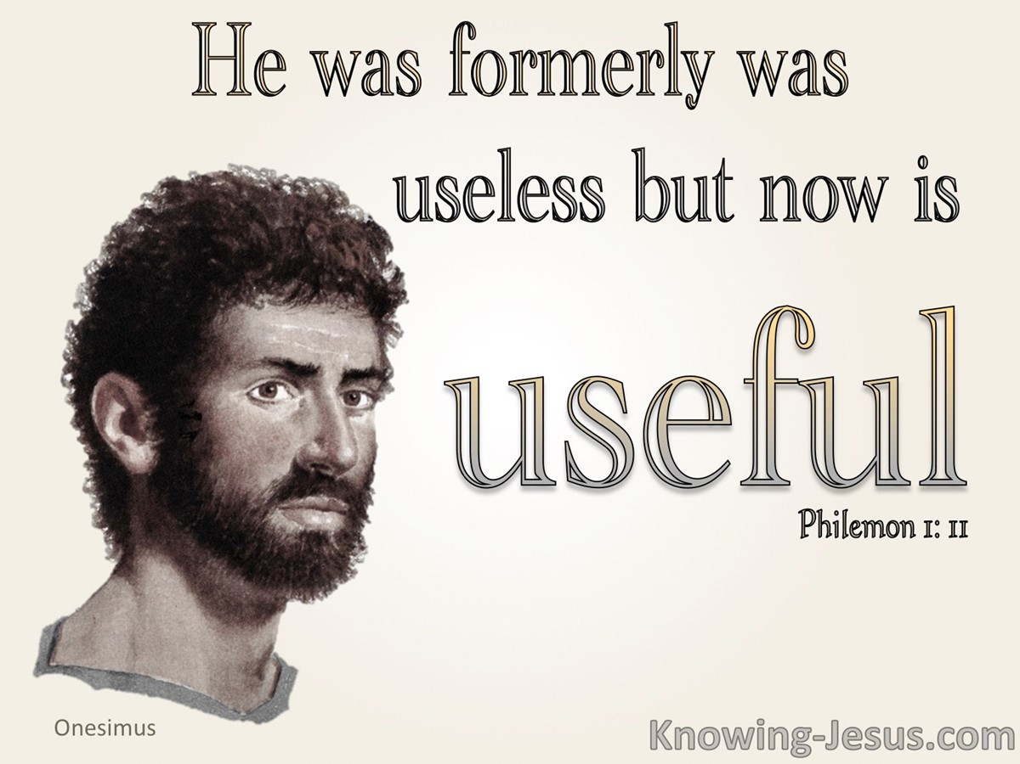
God was About to
Transform His Life
From “Negative”
To “ Positive”
He Just Could Not See It
At this Time
Ever Been There?

Slide 14

This Weeks Assignment
When You Are in a
Season that You Wish
Would Just End,
Don’t Complain
Don’t Make Excuses
Start Taking Notes
It’s Preparation…
For Break Through

