Slide 2

Edward Christian Church
September 24, 2023
Philemon v 8-11
1 Peter 4: 10
Lessons Learned…
…from
Grace - REVISITED

Slide 3
God’s Love = AGAPE
Agape =
An Active Determination Of
Your Will
To Benefit Another…
…Without Regard
…For Your Own Benefit
Agape is the Power Behind Grace
Grace is the Power Behind Ministry

Slide 4
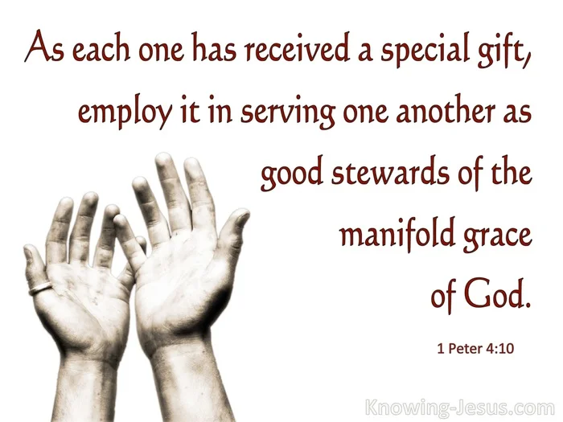
¹⁰ Just as each one of you has received a special gift [a spiritual talent, an ability graciously given by God], employ it in serving one another as [is appropriate for] good stewards of God’s multi-faceted grace [faithfully using the diverse, varied gifts and abilities granted to Christians by God’s unmerited favor]. 1 Pet 4:10

Slide 5
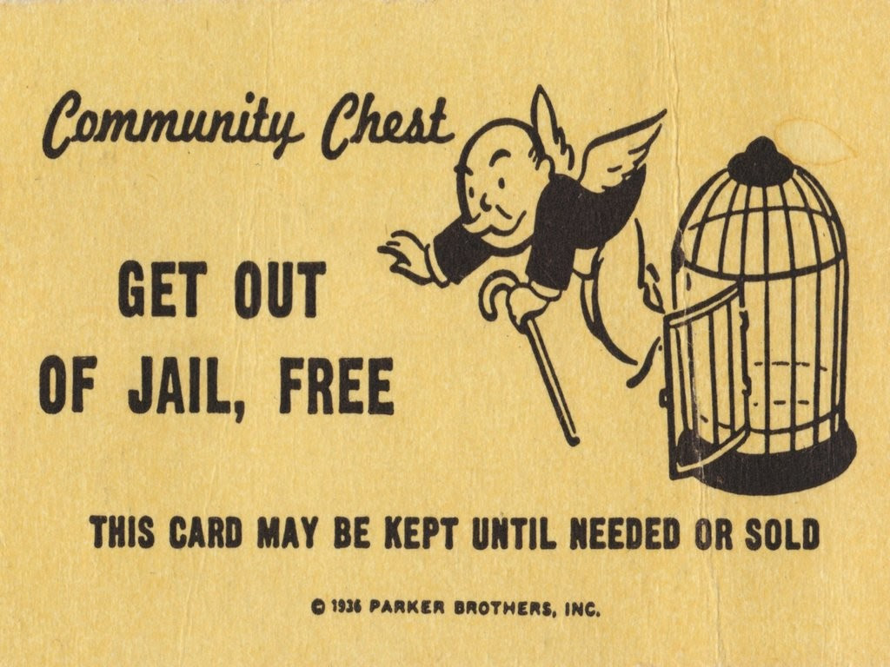
Lessons Learned from Grace Revisited
Don’t Think that Grace is a
Wild Card
Get Out of Jail Free Card
Grace Not Only …
Forgives
Forges
Fault
Forms

Slide 6
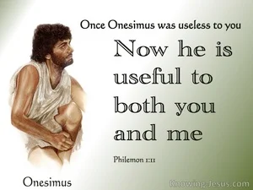
Forgives
Lessons Learned from Grace Revisited
Rescued –Onesimus
Rough Start
Rescued
God Got Involved
Imprisoned
Improved
Interceded for
Refined

Slide 7
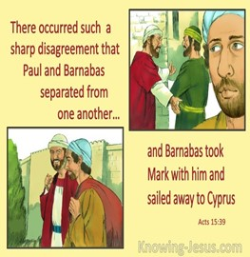
Forges
Lessons Learned from Grace Revisited
Rescued –Onesimus
Redirected –Mark
By Paul for Service -not ready – Acts 15:38
Barnabas wanted to take John along, the John nicknamed Mark. But Paul wouldn’t have him; he wasn’t about to take along a quitter who, as soon as the going got tough, had jumped ship on them in Pamphylia. Tempers flared, and they ended up going their separate ways
Great Start
Great Stall
Great Stop

Slide 8
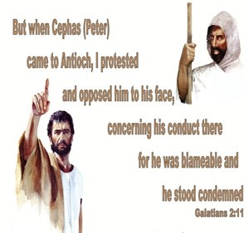
Fault
Lessons Learned from Grace Revisited
Rescued –Onesimus
Redirected –Mark
Rebuked– Peter
Rebuked by Paul Gal 2:11-12
¹² For he regularly ate with the Gentiles before certain men came from James. However, when they came, he withdrew and separated himself, because he feared those from the circumcision party. ¹³ Then the rest of the Jews joined his hypocrisy, so that even Barnabas was carried away by their hypocrisy. ¹⁴ But when I saw that they were deviating from the truth of the gospel, I told Cephas^{[a]} in front of everyone, “If you, who are a Jew, live like a Gentile and not like a Jew, how can you compel Gentiles to live like Jews?”

Slide 9

Fault
Lessons Learned from Grace Revisited
Rescued –Onesimus
Redirected –Mark
Rebuked– Peter
Rejected – Demas
Rejected Paul – II Tim 4:10
for Demas, having= loved [the pleasures of] this present world, has deserted me and gone to Thessalonica; Crescens has gone to Galatia, Titus to Dalmatia.
Forsaken= to leave in a bind, helpless
Hebrews 11:25-26

Slide 10
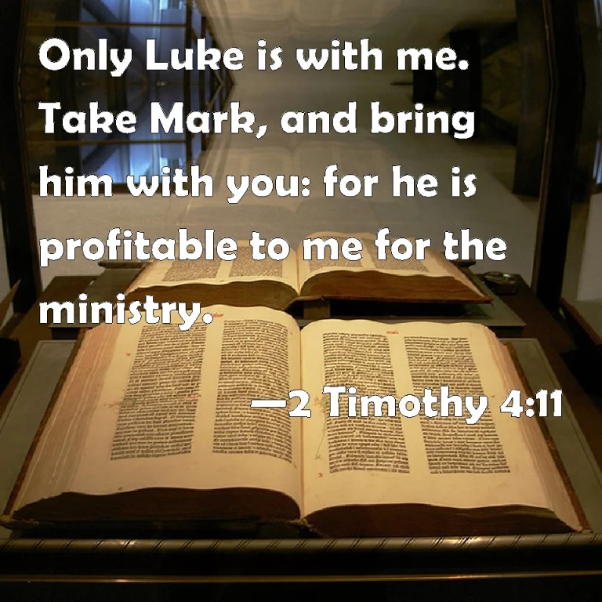
Forms
Lessons Learned from Grace Revisited
Rescued –Onesimus
Redirected –Mark
Rebuked– Peter
Rejected – Demas
Restored -Mark
Paul Changed His Mind - 2 Tim 4:11
Only Luke is with me. Take Mark, and bring him with thee: for he is profitable to me for the ministry.
Mark Allowed God’s Grace to Pick Him Up…
…Brush Him Off and Make Him Useful
With Grace It is Always Too Early to Quit!!!!

Slide 11

Grace Does Keep Us From Eternity in Hell
But Doesn’t Stop Us From Traveling Through Hell
We Travel Through Because of …
Decisions (ours)
Development
Discovery

Slide 12

This Weeks Challenge
Ask God to Help You See His Grace
In Its Many Facets
In Life’s…Good, Bad, Uglys
Learn to Embrace God Through It All
With His Grace
2 Cor 12:9
My Grace is sufficient for You, for power is perfected in weakness…

Slide 13
This Weeks Challenge
Ask God to Help You See His Grace
In Its Many Facets
In Life’s…Good, Bad, Uglys
Learn to Embrace God Through It All
With His Grace
2 Cor 12:9
My Grace is sufficient for You, for power is perfected in weakness…

