Slide 2
E-x-c-u-s-e M-e!
“Excuses”
Edward Church
October 1, 2023
Exodus 3

Slide 3

Now is Not the Time…
…to Lay Low and Stay in the Shadows…
Now is the Time…
…for the Church to Rise and Shine…
  We Are …
    City on a Hill that Cannot Be Hid
    Salt of the World
    Light of the World
    Instead
  We Have Become a Generation of Excuses

Slide 4

We Have Traded Excellence For…
Instead of Searching For a Way to Excellence
We Search for an Excuse to Explain Mediocrity
COVID, Economy, No Time, No Money,
This Attitude has Crept Into the Church
Remember…
There is a Difference in a Reason and an Excuse

Slide 5

He that is good for making excuses is seldom good for anything else” – Benjamin Franklin
“Excuses are the crutches of the uncommitted.”
R. Bernard
“Excuses are merely nails used to build a house of
failure.” – A. Lincoln
“Excuses will always be there for you, opportunity won’t.”

Slide 6

Why is that we feel that we can offer excuses when it comes to church that would be ridiculous if used anywhere else. Years ago Moody Monthly ran a piece which included excuses which a fellow might use for quitting sports.
“Every time I went they asked for money.
The people with whom I had to sit didn’t seem very friendly.
The seats were too hard and uncomfortable.
The coach never came to see me.
The referee made a decision with which I could not agree.
It Seems that the Game Often Didn’t Start/ Stop on Time

Slide 7

If Anybody Had…
  Call on Their Life It was Moses
  Some Falls in Their Life It was Moses
Moses’ Big Mission was Overshadowed by..
…His Five Big Excuses… Exodus 3:11–4:14
What Caused This ?
He Focused on the “What If’s” …
… Instead of the “What Is’”

Slide 8
Excuse #1
“Who Am I?” (3:11)
Moses Struggled with His Identity
He Just Didn’t Feel Qualified;
he thought God had picked the wrong man
  God’s Response: It doesn’t matter
who you are. I Am with you (3:12).
Who saved us and called us to a holy calling, not because of
our works but because of his own purpose and grace, which he
gave us in Christ Jesus before the ages began 2 Tim 1:9

Slide 9
Excuse #2-
“Who Are You?” (3:13)
He Didn’t Know God Well Enough…
….to describe Him to the people and lacked convictions concerning his relationship with God.
  God’s Response: I AM WHO I AM…
…I AM ever Present
…I AM Everything you Need (3:14).
Know therefore that the Lord your God is God, the faithful God who keeps covenant and steadfast love with those who love him and keep his commandments, to a thousand generations, -Deut 7:9

Slide 10

Ask Yourself…
Have I Settled Into
Making Excuses
verses…
Making it Happen?
Has My Default Become
Search for Someone to Blame
Verses
Seek to Take Responsibility?

Slide 11
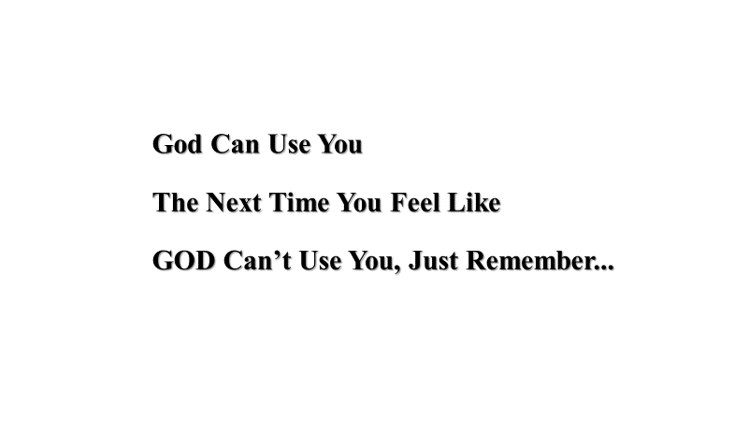
Noah got drunk,
Abraham was too old,
Jacob was a liar,
Joseph was abused,
Moses was a muderer,
Gideon was afraid,
Rahab was a prostitute,
Jeremiah and Timothy were too young,
David had an affair and was a murderer
Jonah ran from God,
Peter denied Christ
Zaccheus was too small,
Paul was too religious,
Lazarus was dead!
Now! No more excuses!
God can use you to your full potential.
Besides you aren’t the message,
you are just the messenger!

Slide 12

This Weeks Challenge
Refuse to Look for Excuses
Instead look for Reasons to Get It Done
This will Change Your Life …
…and Effectiveness

Slide 14
Picked up a hitchhiker.
He asked if I wasn't afraid he might be a serial killer?
I told him the odds of two serial killers being in the same car was extremely unlikely.

