Slide 1
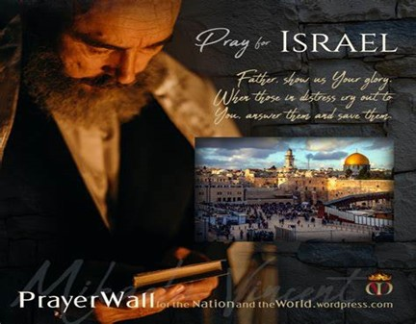


Slide 2
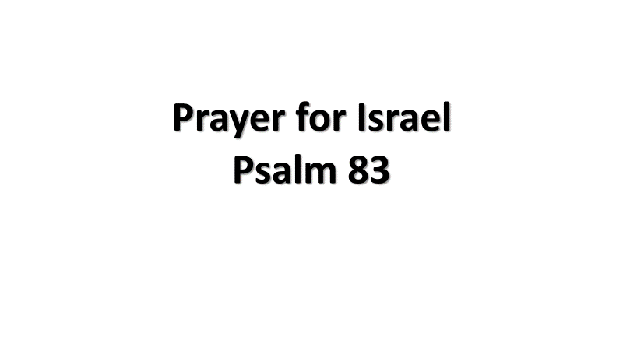
¹ O God, do not be silent! Do not be deaf. Do not be quiet, O God. ² Don’t you hear the uproar of your enemies? Don’t you see that your arrogant enemies are rising up? ³ They devise crafty schemes against your people; they conspire against your precious ones. ⁴ “Come,” they say, “let us wipe out Israel as a nation. We will destroy the very memory of its existence.” ⁵ Yes, this was their unanimous decision. They signed a treaty as allies against you— ⁶ these Edomites and Ishmaelites; Moabites and Hagrites; ⁷ Gebalites, Ammonites, and Amalekites; and people from Philistia and Tyre. ⁸ Assyria has joined them, too, and is allied with the descendants of Lot.

Slide 3
⁹ Do to them as you did to the Midianites / as you did to Sisera / Jabin at the Kishon River. ¹⁰ They were destroyed at Endor/ their decaying corpses fertilized the soil. ¹¹ Let their mighty nobles die as Oreb and Zeeb did. Let all their princes die like Zebah and Zalmunna, ¹² for they said, “Let us seize for our own use these pasturelands of God!” ¹³ O my God, scatter them like tumbleweed, like chaff before the wind! ¹⁴ As a fire burns a forest and as a flame sets mountains ablaze, ¹⁵ chase them with your fierce storm; terrify them with your tempest. ¹⁶ Utterly disgrace them until they submit to your name, O Lord. ¹⁷ Let them be ashamed and terrified forever. Let them die in disgrace. ¹⁸ Then they will learn that you alone are called the Lord, that you alone are the Most High, supreme over all the earth.

Slide 4
Spiritual Warfare
10% Satan’s Tactics
90% How We Respond
Remember… With God We Are Not
Helpless
Hopeless
We Are Powerful!!

Slide 5
Repeat
These are the 2 Most Important Hours of My Week – Help Me to Cherish Them
I Am Here Today to Worship
Not to Be Entertained
I Am Singing to An Audience of One
Accept My Worship Oh Lord!

Slide 6
I sing praises to Your name, O Lord,
Praises to Your name, O Lord,
For Your name is great and
greatly to be praised.
I give glory to Your name, O Lord,
Glory to Your name, O Lord,
For Your name is great and
greatly to be praised.

Slide 7
Repeat
I Lift My Offering to You
Let It Please You Oh Lord
This is My Seed
Although It Leaves My Hand
It will Never Leave My Life
You Will Multiply It!
Accept My Seed Oh Lord!

Slide 8
This Little Light of Mine
Power in the Blood
Ill Fly Away

Slide 10
Jesus Jesus Jesus There's just something about that name Master Savior Jesus Like a fragrance after the rain

Slide 11
Jesus Jesus Jesus Let all heaven and earth proclaim Kings and kingdoms may all pass away But there's something about that name

Slide 13
A dinner speaker was in such a hurry to get to his engagement that when he arrived and sat down at the head table, he suddenly realized that he had forgotten his false teeth. Turning to the man next to him, he complained, "I forgot my teeth, what am I going to do now!?“ The man said, "No problem." He reached into his pocket and pulled out a pair of false teeth. "Try these," he said. The speaker tried them on. "Too loose," he said. The man then said, "I have another pair -- try these.“ The speaker tried them on and responded, "Too tight." The man was not taken back at all. He said, "I have one more pair. Try them."
The speaker said, "They fit perfectly." With that, he ate his meal and gave his speech. After the dinner meeting was over, the speaker went to thank the man who had helped him. "I want to thank you for coming to my aid. Where is your office? I've been looking for a good dentist."
The man replied, "I'm not a dentist. I'm an undertaker."

Slide 15
E-x-c-u-s-e M-e! Pt 2 “Excuses”
Edward Church
October 8, 2023
Exodus 3

Slide 16

Now is Not the Time…
…to Lay Low and Stay in the Shadows…
Now is the Time…
…for the Church to Rise and Shine…
We Are …
City on a Hill that Cannot Be Hid
Salt of the World
Light of the World
Instead
We Have Become a Generation of Excuses

Slide 17

We Have Traded Excellence For…
Instead of Searching For a Way to Excellence
We Search for an Excuse to Explain Mediocrity
COVID, Economy, No Time, No Money,
This Attitude has Crept Into the Church
Remember…
There is a Difference in a Reason and an Excuse

Slide 18

He that is good for making excuses is seldom good for anything else” – Benjamin Franklin
“Excuses are the crutches of the uncommitted.”
R. Bernard
“Excuses are merely nails used to build a house of
failure.” – A. Lincoln
“Excuses will always be there for you, opportunity won’t.”

Slide 19

If Anybody Had…
Call on Their Life It was Moses
Falls in Their Life It was Moses
Moses’ Big Mission was Overshadowed by..
…His Five Big Excuses… Exodus 3:11–4:14
What Caused This ?
He Focused on the “What If’s” …
… Instead of the “What Is’”

Slide 20
Excuse #1 “Who Am I?” (3:11)
Moses Struggled with His Identity
He Just Didn’t Feel Qualified;
he thought God had picked the wrong man
God’s Response: It doesn’t matter
who you are. I Am with you (3:12).
Who saved us and called us to a holy calling, not because of
our works but because of his own purpose and grace, which he
gave us in Christ Jesus before the ages began 2 Tim 1:9

Slide 21
Excuse #2- “Who Are You?” (3:13)
He Didn’t Know God Well Enough…
….to describe Him to the people and lacked convictions concerning his relationship with God.
God’s Response: I AM WHO I AM…
…I AM ever Present
…I AM Everything you Need (3:14).
Know therefore that the Lord your God is God, the faithful God who keeps covenant and steadfast love with those who love him and keep his commandments, to a thousand generations, -Deut 7:9

Slide 22

Big But #3- What If They Don’t Listen? (4:1)
Moses Felt Intimidated
He Worried about the People’s Reaction to Him.
God’s Response: When I’m
finished, they’ll listen (4:2–9)
2 Timothy 1:7 (AMP) ⁷ For God did not give us a spirit of timidity (of cowardice, of craven and cringing and fawning fear), but [He has given us a spirit] of power and of love and of calm and well-balanced mind and discipline and self-control.

Slide 23
Big But #4- I’ve Never Been a Good Speaker (4:10)
Moses Fretted About His Inadequacies
Who Would Listen To Him…
…If He Couldn’t Even Speak Well?
God’s Response: Guess who made your mouth? (4:11, 12)
¹⁰ For we are God's [own] handiwork (His workmanship), recreated in Christ Jesus, [born anew] that we may do those good works which God predestined (planned beforehand) for us [taking paths which He prepared ahead of time], that we should walk in them [living the good life which He prearranged and made ready for us to live] Eph 2:10 (AMP)

Slide 24
Big But #5- I Know You Can Find Someone Else (4:13)
Moses Felt Inferior
He Compared Himself to Others—even his brother—and
…decided that he came up short.
God’s Response: OK, I will let Aaron go with you . . .
…but I’m still calling you to go (4:14)
Jeremiah 29:11 (MSG) I know what I'm doing. I have it all planned out—plans to take care of you,
not abandon you, plans to give you the future you hope for.

Slide 25
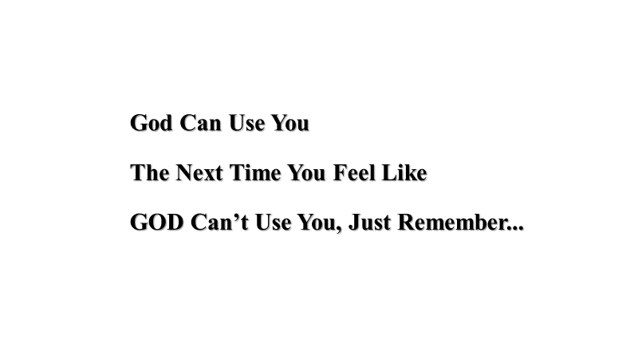
Noah got drunk,
Abraham was too old,
Jacob was a liar,
Joseph was abused,
Moses was a muderer,
Gideon was afraid,
Rahab was a prostitute,
Jeremiah and Timothy were too young,
David had an affair and was a murderer
Jonah ran from God,
Peter denied Christ
Zaccheus was too small,
Paul was too religious,
Lazarus was dead!
Now! No more excuses!
God can use you to your full potential.
Besides you aren’t the message,
you are just the messenger!

Slide 26

Start
Smart
Simple
Strong
ASAP
After
Seeking
Authority /
Power
Simply Put…
Do Small Things…
…in a Big Ways

Slide 27

Ask Yourself…
Have I Settled Into
Making Excuses
verses…
Making it Happen?
Has My Default Become
Search for Someone to Blame
Verses
Seek to Take Responsibility?

Slide 28
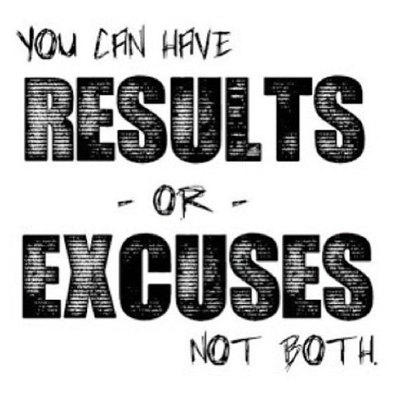
This Weeks Challenge
Refuse to Look for Excuses
Instead look for Reasons to Get It Done
START A.S.A.P.
This will Change Your Life …
…and Effectiveness

Slide 29
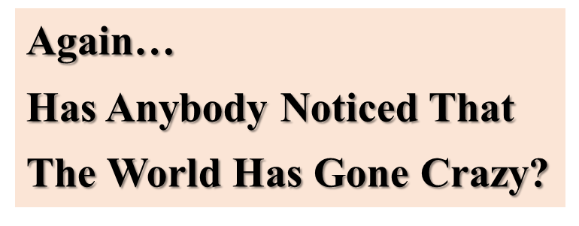

G- Give Your Best
R- Refuse to Play the Game
A- Act Through Faith –vs Emotions
C- Calm
E- Example

Slide 31
Prayer for Israel
Psalm 83

Slide 33
G- Give Your Best
R- Refuse to Play the Game
A- Act Through Faith –vs Emotions
C- Calm
E- Example

Slide 34
God Can Use You
The Next Time You Feel Like
GOD Can’t Use You, Just Remember...

Slide 35
Do you have a big but. I know I have a big but.
I think at one time or another, we have all had a big but.
Some of us might even have more than 1 big but.
When God asks us to do something, our big but appears.
We don’t even have to use the word But or But God..
any excuse we come up with to not obey is a big but. Today, we are going to look at another man that had a big but, 5 big buts to be exact.
Today we are going to look at Moses and his big buts and how God dealt with him and his big buts
and hopefully we can get rid of our own big buts once and for all.

Slide 36
God can use you The next time you feel like GOD can’t use you, just remember... Noah got drunk, Abraham was too old, Isaac was a daydreamer, Jacob was a liar, Joseph was abused, Moses had a stuttering problem, Gideon was afraid, Rahab was a prostitute, Jeremiah and Timothy were too young, David had an affair and was a murderer , Jonah ran from God, Naomi was a widow, Peter denied Christ. The Disciples fell asleep while praying, Martha worried about everything , Zaccheus was too small, Paul was too religious, ..AND Lazarus was dead! Now! No more excuses! God can use you to your full potential. Besides you aren’t the message, you are just the messenger!

Slide 37
It Seems …
Easier to Make Excuses
Than to
Make Attempts

Slide 39
This Little Light of Mine
Power in the Blood
Ill Fly Away

Slide 40
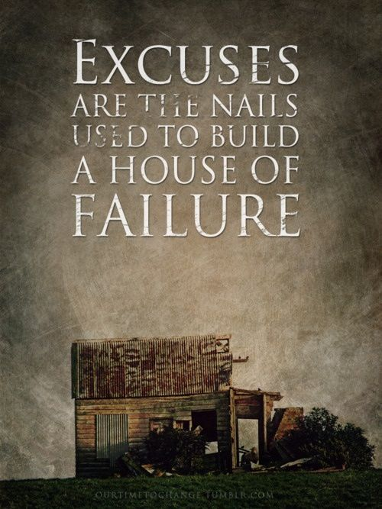
Why is that we feel that we can offer excuses when it comes to church that would be ridiculous if used anywhere else. Years ago Moody Monthly ran a piece which included excuses which a fellow might use for quitting sports.
“Every time I went they asked for money.
The people with whom I had to sit didn’t seem very friendly.
The seats were too hard and uncomfortable.
The coach never came to see me.
The referee made a decision with which I could not agree.
It Seems that the Game Often Didn’t Start/ Stop on Time

Slide 41
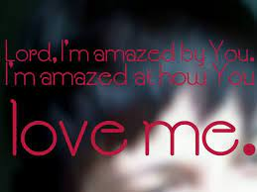

Slide 42
You dance over me While I am unaware You sing all around But I never hear the sound

Slide 43
Lord, I'm amazed by You Lord, I'm amazed by You Lord, I'm amazed by You How You love me

Slide 44
You paint the morning sky With miracles in mind My hope will always stand For You hold me in Your hand

Slide 45
Lord, I'm amazed by You Lord, I'm amazed by You Lord, I'm amazed by You How You love me

Slide 46
How deep, how wide How great is Your love for me How deep, how wide How great is Your love for me

Slide 47
How deep, how wide How great is Your love for me How deep, how wide How great is Your love for me

Slide 48
Lord, I'm amazed by You Lord, I'm amazed by You Lord, I'm amazed by You How You love me

Slide 49
Lord, I'm amazed by You Lord, I'm amazed by You Lord, I'm amazed by You How You love me

