Slide 2
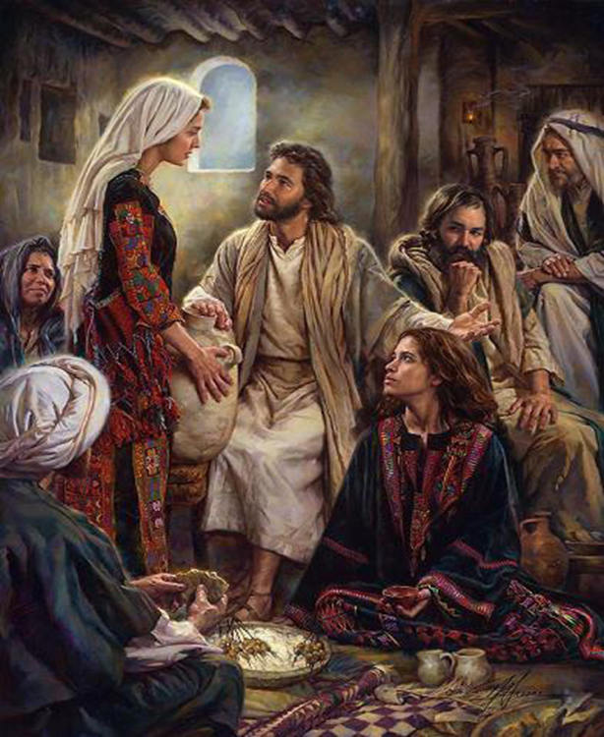

Edward Church
Oct 15, 2023
Getting My Focus
Back!
Luke 10:38-42

Slide 3

Break Your Focus
Satan Wants to Rob Your:
Personal Blessings
Your Ability to Be a…
…Personal Blessing
He Doesn’t Just Want to Stop Your Momentum
He Wants to Prevent it from Ever…
…Starting Back Up Again!
How?

Slide 4

Proverbs 29:18 (KJV)
¹⁸ Where there is no vision, the people perish: but he that keepeth the law, happy is he
Vision= Clear Word from God
Unbroken Focus
Perish= Pine Away
Slowly Let Go

Slide 5
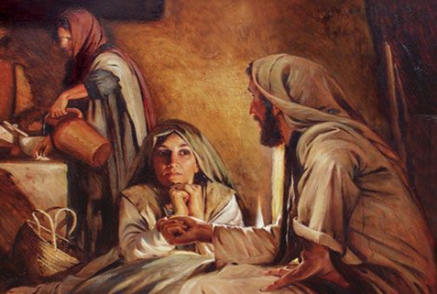
Deeper Look
These Sisters had a Lot in Common.
Both were Loving, Sincere Women Who:
Close to Jesus
Spent Time with Him
Welcomed His Presence Now
But Now the “Similarities” Begin to Change
Starting with their…
…Focus on “His Presence”

Slide 6
Deeper Look
One was Preparing to…
“Work for Him”
The Other was Preparing to…
Let Him “Work Through Her”
One was Being…
…Stressed!!!!!!!!
The Other was Being…
…Blessed!!!!!!

Slide 7
It was a Matter of FOCUS!
Both were Seeking to Do the…
Right Thing !
But One Did It the…
Wrong Way !

Slide 8
Getting Back My Focus
Speaks of “Position” (39)
Mary Sat at the Feet of Jesus
Sat (means > to just sit, but sit near)
got as close as Possible
Acts 22:3 Paul taught “feet of Gamaliel”
At the Feet of the Master…
…Proper Place for a Disciple
Place of “Submission”
Place of “Peace”

Slide 9
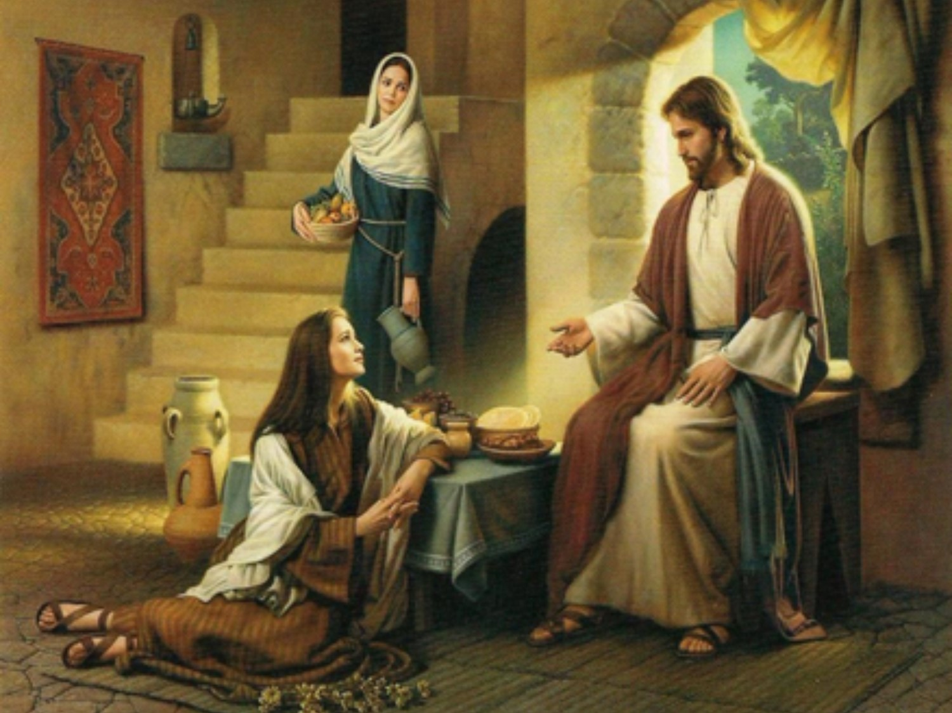
Getting Back My Focus
Speaks of “Position” (39)
Mary Sat at the Feet of Jesus
Martha Went to the Kitchen

Slide 10
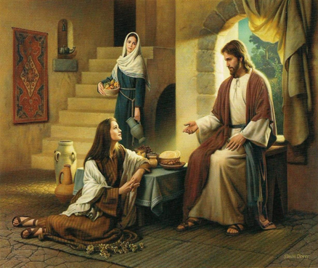
Getting My Focus On the Right Voice
Speaks of “Perception” (39)
Mary Heard the Words of Christ
Heard (cont listening & hearing);
Didn’t tire of His Teaching
It implies= continued thinking
after He quit talking
Martha Couldn’t Hear the Words of Christ
Distracted by “Commotion”

Slide 11
Getting Back My Focus Beyond Distractions
Speaks of “Priorities ” (40)
Mary’s Priority was Being Close to Christ.
Not Aware of Events about to Take Place
Still Refused to take His Presence for Granted

Slide 12
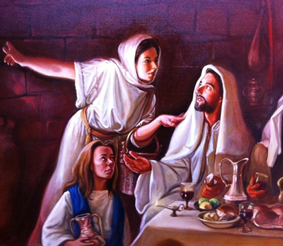
Getting Back My Focus Beyond Distractions
Speaks of “Priorities ” (40)
Martha’s Priority-Serving Christ and others.
Serving (diakonias-“deacon”)
She was Being a Deacon/ Servant
Cumbered (to be driven about mentally;
to be distracted; to be over-occupied;
too busy about a thing)
Could It Be She Took His Presence…
…for Granted

Slide 13
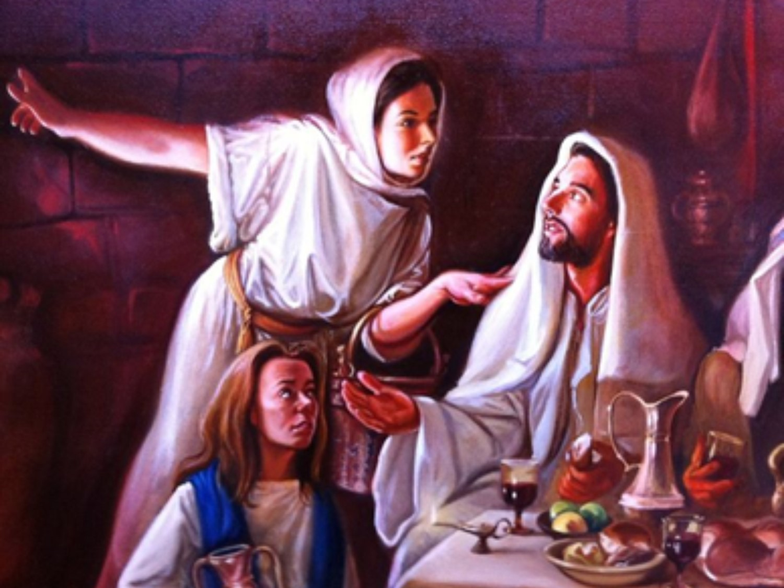
Getting Back My Focus Beyond Distractions
Mary was Blessed – Martha was Busy
It is Possible to Work
Outside of Anointing (no call)
Beyond Anointing (called but overloaded)
It is Possible
To have Enough to Get you Going…
…But Not Enough to Keep you
Danger
Burnout
Rust out

Slide 14
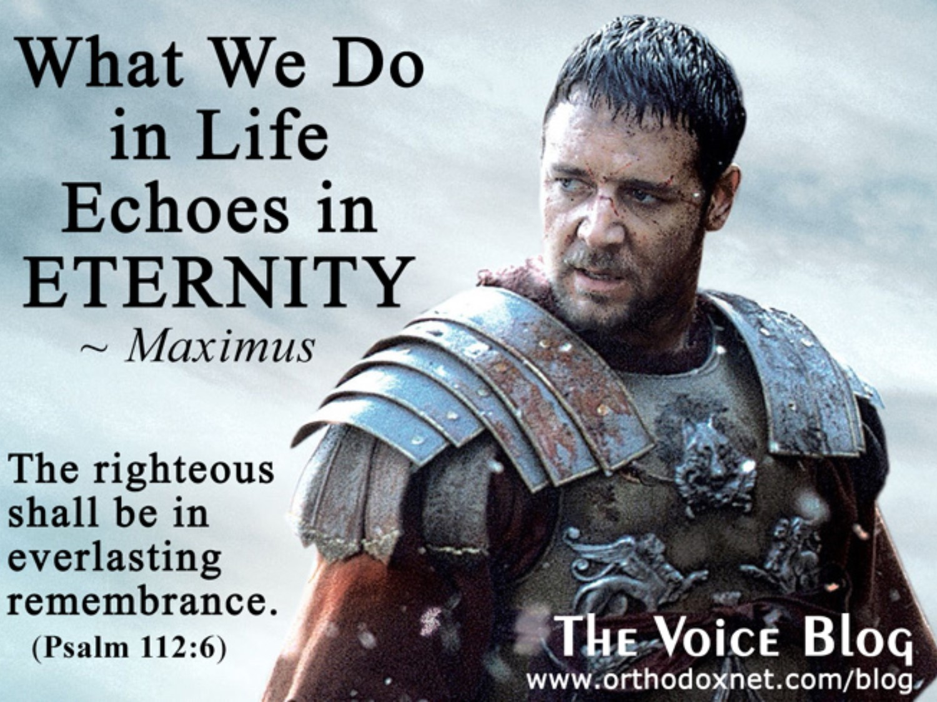
Psalms 112:6-8, “Surely he shall not be moved
for ever: the righteous shall be in everlasting
remembrance. ⁷ He shall not be afraid of evil
tidings: his heart is fixed, trusting in the LORD.
⁸ His heart is established, he shall not be afraid, until he see his desire upon his enemies”

Slide 15

Danger of Broken Focus
Distorts…
Balanced Life
Relationships
Martha was Distracted
Relationship with the Lord
Relationship with Mary
Our Vision
Personal Joy
Prayer Life

Slide 16
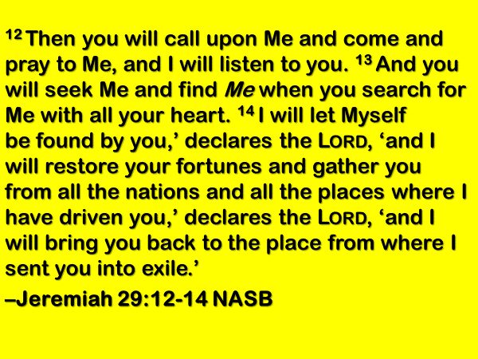
This Weeks Assignment
Work on Your Focus
Seek His Presence
Honor His Presence
Move in His Presence
Trust His Presence

Slide 17
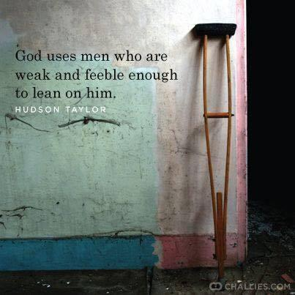


Slide 18



Slide 19

May the Lord answer you in the day of trouble! May the name of the God of Jacob protect you! ² May he send you help from the sanctuary and give you support from Zion! ³ May he remember all your offerings and regard with favor your burnt sacrifices! Selah
⁴ May he grant you your heart's desire and fulfill all your plans! ⁵ May we shout for joy over your salvation, and in the name of our God set up our banners! May the Lord fulfill all your petitions!
⁶ Now I know that the Lord saves his anointed; he will answer him from his holy heaven with the saving might of his right hand. ⁷ Some trust in chariots and some in horses, but we trust in the name of the Lord our God. ⁸ They collapse and fall, but we rise and stand upright.
⁹ O Lord, save the king! May he answer us when we call.

Slide 21
Texas rancher, visiting a South Dakota farmer friend, asked him to show him his farm.
After seeing the 1,000-acre spread, the Texan bragged that down-home he could get into his Ford, drive all day, and by evening would not have gotten to the distant point of his ranch.
The South Dakotan simply replied, "You know, I had a Ford once."

