Slide 1

Edward Church October 22, 2023
2023
Welcome to Church!

Slide 2
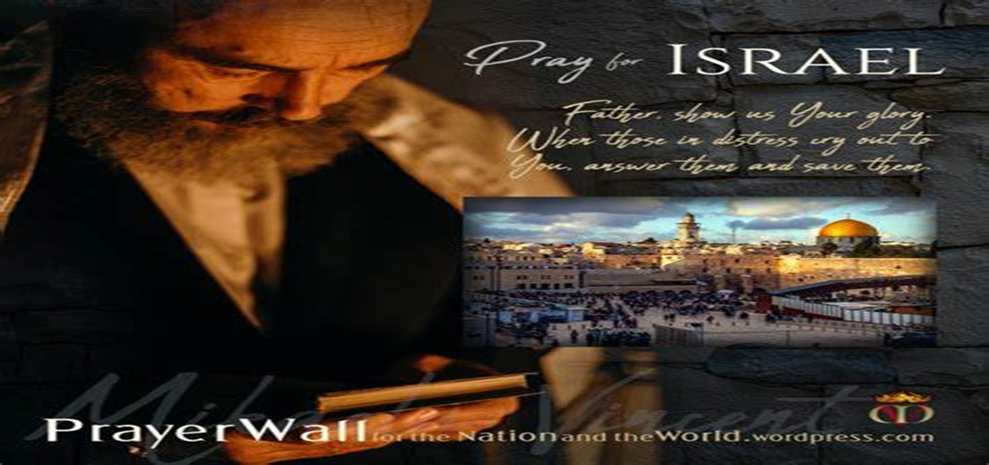

And All of the Innocent Victims
on Both Sides

Slide 3

May the Lord answer you in the day of trouble! May the name of the God of Jacob protect you! ² May he send you help from the sanctuary and give you support from Zion! ³ May he remember all your offerings and regard with favor your burnt sacrifices! Selah ⁴ May he grant you your heart's desire and fulfill all your plans! ⁵ May we shout for joy over your salvation, and in the name of our God set up our banners! May the Lord fulfill all your petitions! ⁶ Now I know that the Lord saves his anointed; he will answer him from his holy heaven with the saving might of his right hand. ⁷ Some trust in chariots and some in horses, but we trust in the name of the Lord our God. ⁸ They collapse and fall, but we rise and stand upright. ⁹ O Lord, save the king! May he answer us when we call.

Slide 5
Welcome to Our 107th
Edward Christian Church
Homecoming
History
Memory Candle
Names Listed on Back of Bulletin
Thank You
Search and Rescue

Slide 6

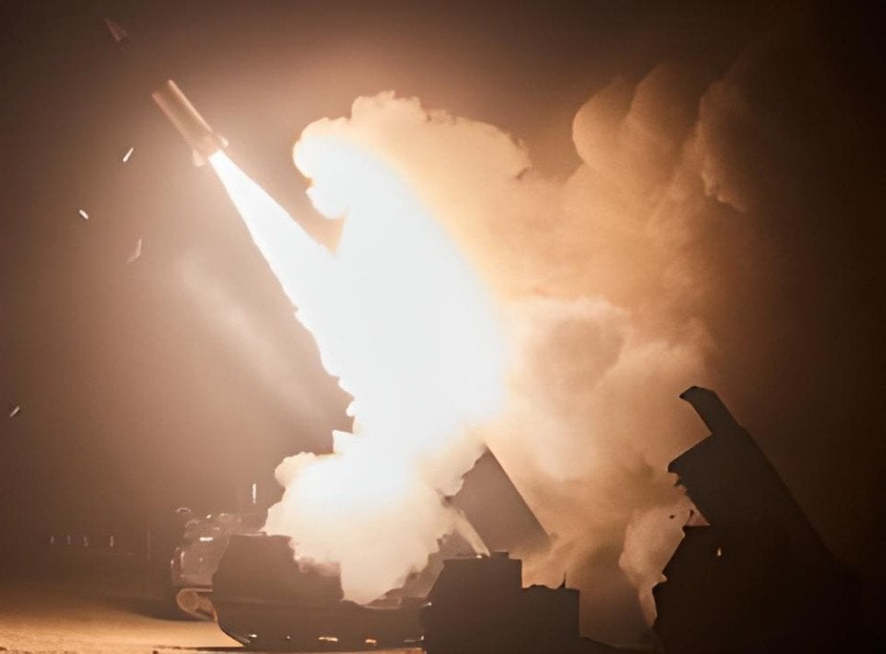
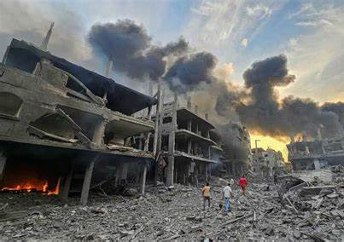
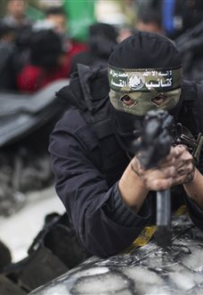
Ukraine under attack from Russia
Taiwan possible attack from China
Israel under attack Hamas/ Hezbollah
Anti-Semitism at Boiling Point -Worldwide
Turbulent Times

Slide 7

Turbulent Times
Lift Up Your Head you Redemption Draweth Nigh
Luke 21:9-11 NKJV
⁹ But when you hear of wars and commotions, do not be terrified; for these things must come to pass first, but the end will not come immediately.”
¹⁰ Then He said to them, “Nation will rise against nation, and kingdom against kingdom. ¹¹ And there will be great earthquakes in various places, and famines and pestilences; and there will be fearful sights and great signs from heaven.
Commotions- instability, state of disorder
Terrified- frightened -terrorized
Nation- Ethnos- Ethnic Group
Matt 24:8- All of these are beg. of sorrows

Slide 8

Yes- These ARE Turbulent Times
No- There IS Little We CAN DO ABOUT IT
Yes- God IS STILL IN CONTROL!
Yes- We Can Live in Fear and Terror of What’s Coming
No – Instead …
I Choose to Trust God and
Live Each Day as His GIFT

Slide 9

Just Another Day !?!
Edward Church
Homecoming 2023
Psalm 118:24
Oct 22, 2023

Slide 10

Question
How Many Days Have You Wasted Stressing…..
…Over Things Out of Your Control
Week?
Month?
Year?
Lifetime?
Giving the Devil More Credit than He Deserves…
Blaming Him
Listening to Him
Giving Him the Day
Never Realizing the God of the Good Days
…Is the Still God in the Bad Days

Slide 11
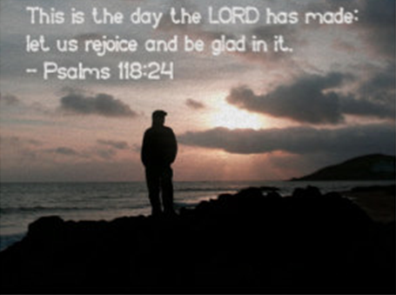
TODAY is the Day that the Lord has Made!
It is Not Just Any Other Day
It has God’s Fingerprints All Over It!
Determine Your Attitude in this Day
Don’t Let Events Determine it for You

Slide 12
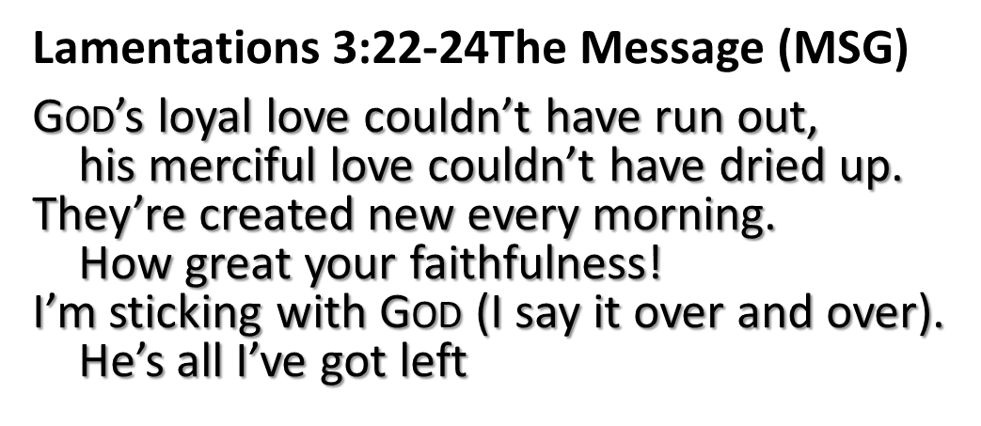
God Only Gives You Today, Not Tomorrow
Manna was for the Day at Hand
Focus on Today
Don’t get Distracted with…
Failures of Yesterday
Worries of Tomorrow
Matthew 6:34 (MSG)
“Give your entire attention to what God is doing right now, / don’t get worked up about what may or may not happen tomorrow. God will help you deal with whatever hard things come up when the time comes”

Slide 13

God Made this Day Especially for You
Live in this Day
Don’t Waste this 24 hours
Focused on Tomorrows 24
There is Always a …
Plan
Purpose

Slide 14
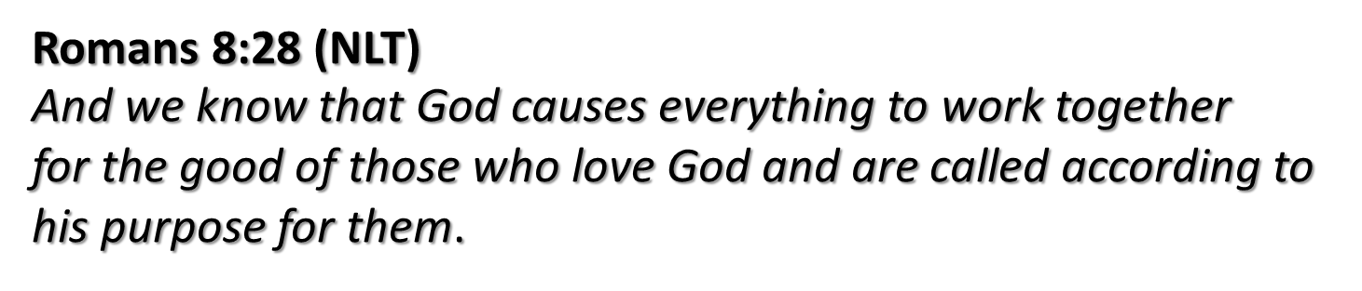
Everything in Each Day is Designed for You
The Ups
The Downs
The Joys
The Sorrows
When the Path is…
Smooth
Beaten
Beyond
God has Promised that He is…
…Involved in Every Aspect of Today

Slide 15
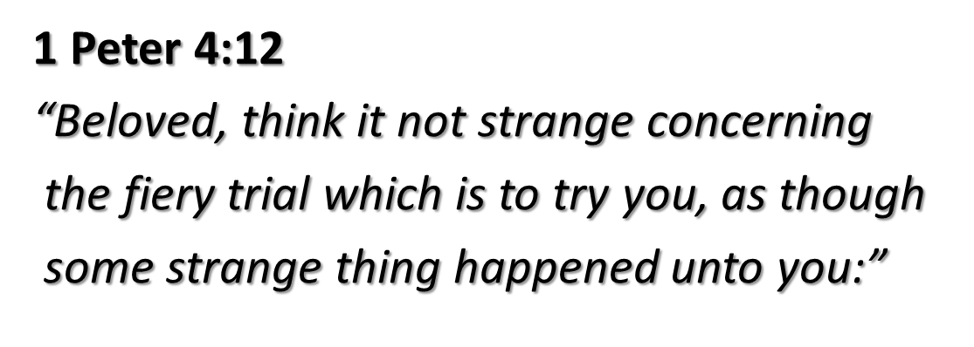
Everything in this Day is Designed for You
The Ups
The Downs
The Joys
The Sorrows
When the Path is…
Smooth
Beaten
Beyond
Psa 34:8, “Taste/ See that the Lord is Good”
Psa 40:2, “He Lifted Me Up out of Slimy Pit”
Neh 8:10, “Joy of the Lord is Your Strength”
Psa 43:5, “Why Cast Down, Put Hope in God”
Proverbs 3:6
“In All Your Ways Acknowledge Him and He Shall Direct Your Paths
(Straighten Out Your Paths)
Malachi 3:3
And he shall sit as a refiner and purifier of silver: and he shall purify the sons of Levi, and purge them as gold and silver, that they may offer unto the LORD an offering in righteousness.

Slide 16
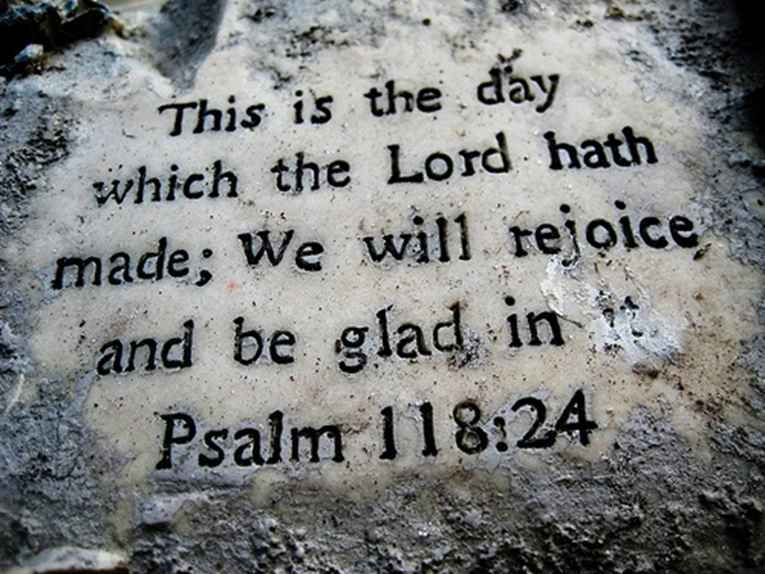
Expect Something Good to Happen Today
Go Make Something Good Happen Today
I Will…
Rejoice (spin around under the Influence )
Be Glad (cheer up- change attitude )
Get Busy! (Do Something! )
All Signs Point to His Coming!

Slide 17


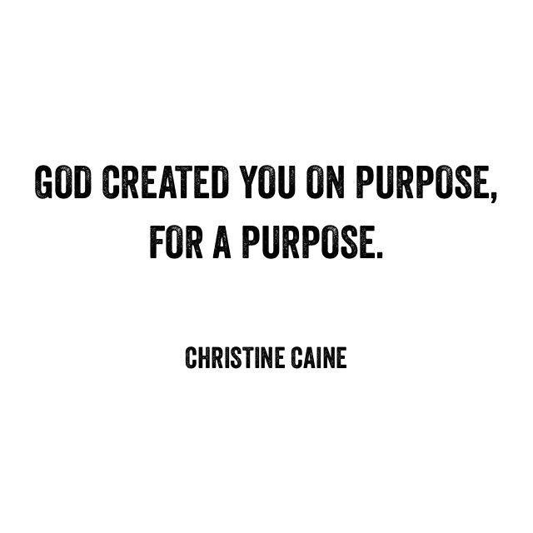
This Weeks Challenge
Be the Good …
You Expect to See
World Needs to See
God Designed You to Be

Slide 18
Romans 8:28 (NLT)
And we know that God causes everything to work together
for the good of those who love God and are called according to his purpose for them.
1 Peter 4:12
“Beloved, think it not strange concerning the fiery trial which is to try you, as though some strange thing happened unto you:”

Slide 19
A guy was on the side of the road hitchhiking on a very dark night and in the middle of a storm. The night was rolling on and no car went by. The storm was so strong he could hardly see a few feet ahead of him.
Suddenly he saw a car coming toward him and stop.
Without thinking about it, the guy got into the back seat, closed the door and then realized there was nobody behind the wheel! The car starts slowly; the guy looks at the road and sees a curve coming his way. Scared, he starts to pray begging for his life. He hasn't come out of shock, when just before he hits the curve, a hand appears through the window and moves the wheel. The guy, paralyzed in terror, watched how the hand appears every time right before a curve. Gathering his strength, the guy jumps out of the car and runs to the nearest town. Wet and in shock, he goes to a restaurant and starts telling everybody about the horrible experience he went through. A silence enveloped everybody when they realize the guy was serious.
About half an hour later, two guys walked in the same restaurant. They looked around for a table when one said to the other, "Look John, that's the dummy who got in the car when we were pushing it."

