Slide 1
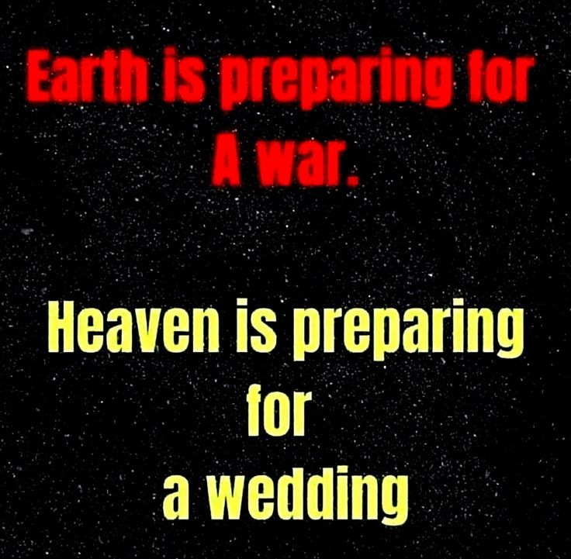

Slide 2
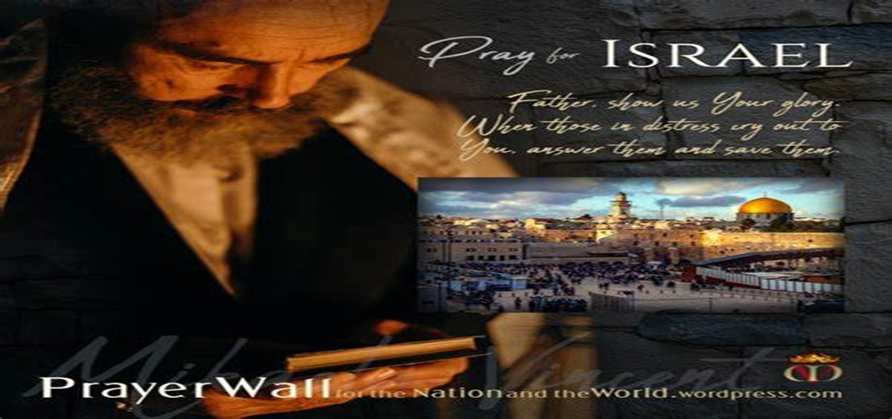

And All of the Innocent Victims
on Both Sides

Slide 3
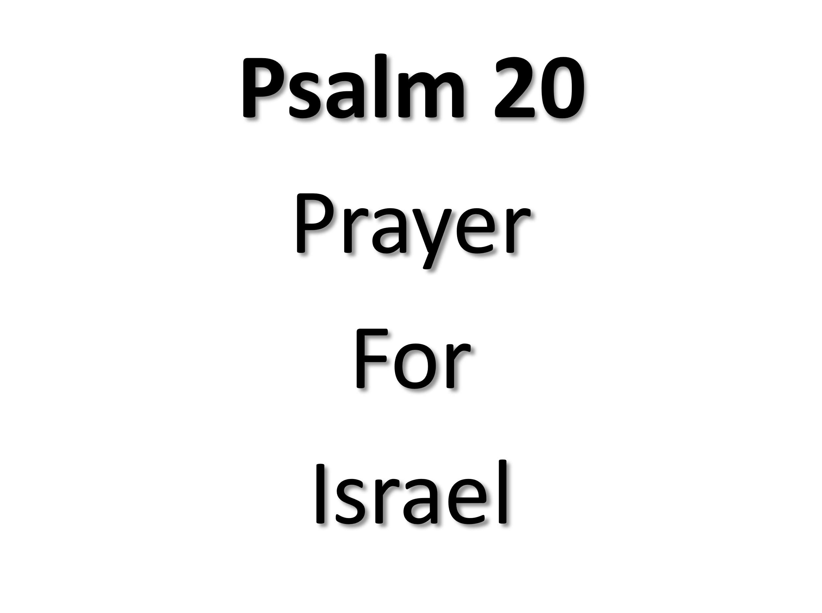
May the Lord answer you in the day of trouble! May the name of the God of Jacob protect you! ² May he send you help from the sanctuary and give you support from Zion! ³ May he remember all your offerings and regard with favor your burnt sacrifices! Selah ⁴ May he grant you your heart's desire and fulfill all your plans! ⁵ May we shout for joy over your salvation, and in the name of our God set up our banners! May the Lord fulfill all your petitions! ⁶ Now I know that the Lord saves his anointed; he will answer him from his holy heaven with the saving might of his right hand. ⁷ Some trust in chariots and some in horses, but we trust in the name of the Lord our God. ⁸ They collapse and fall, but we rise and stand upright. ⁹ O Lord, save the king! May he answer us when we call.

Slide 5

“Rebuilding Your Focus” pt2
Edward Christian Church
October 29, 2023
Philippians 3:13-14
10 Rebuild Points

Slide 6

Rebuild My Focus
God Uses Rebuild Mode
Draw Us Out
Complacency
Collapse
Draw Out of Us
Freshness
Further

Slide 7

Rebuilding Our Focus
Our Focus Should Start on God / His…
Word -Quick/ Powerful –not come back void
Ability -is anything too hard?
Mission -Seek and Save

Slide 8


Distraction
Any Type of…
Activity
Action
Attitude
that Consumes…
You
Time
Interest
…to the Point God Becomes a Blur

Slide 9

Our Focus has Unlimited Value
Satan Doesn’t Want us to Realize the…
Potential
Power
Position
...of an Undivided Focus
10 Focal Points

Slide 10

Our Focal Points Are Powerful
#1- He Called You…
…it Wasn’t to Get to this Place so He Can
…Drop You! (Our Position)
Philippians 1:6 (AMP) ⁶ And I am convinced and sure of this very thing, that He Who began a good work in you will continue until the day of Jesus Christ [right up to the time of His return], developing [that good work] and perfecting and bringing it to full completion in you.
The Good Work In You is God’s
He Began It and He Will Complete It
He is the Mighty God!!!

Slide 11

Our Focal Points Are Powerful
#2- He Will Build His Church! (Our Power)
Matt 16:18 (AMP) ¹⁸ And I tell you, you are Peter [Greek, Petros-a large piece of rock], and on this rock [Greek, petra-a huge rock like Gibraltar] I will build My church, and the gates of Hades (the powers of the infernal region) shall not overpower it [or be strong to its detriment or hold out against it].
Gates =
Wise Men of City Met -Governed
Lawyers met- Court Held –Civil Matters
Punishment Dealt / Administered
Stationary -Time to Go On Offense!

Slide 12
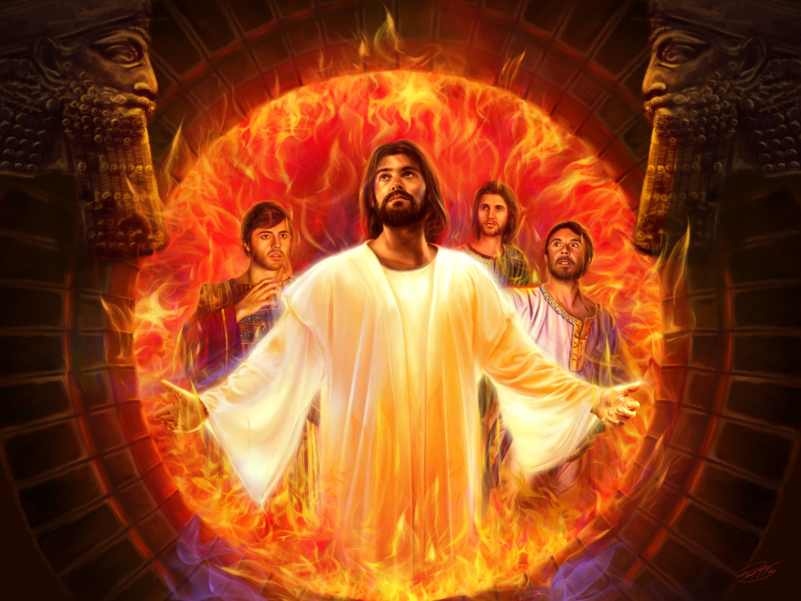
Our Focal Points Are Powerful
#3- He Did Not Promise to Deliver you From
the Fire, but to Walk with You Through It!
(Our Protection-His Presence)
Isaiah 43:1-2 (KJV) ¹ But now thus saith the LORD that created thee, O Jacob, and he that formed thee, O Israel, Fear not: for I have redeemed thee, I have called thee by thy name; thou art mine. ² When thou passest through the waters, I will be with thee; and through the rivers, they shall not overflow thee: when thou walkest through the fire, thou shalt not be burned; neither shall the flame kindle upon thee.

Slide 13
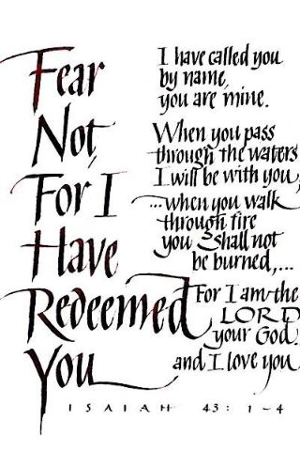
Created –Shape (Jacob)
Formed –Squeeze (Israel)
Redeemed –Salvation (price)
Called –Summoned (purpose)
Belong –Safe (place)

Slide 14


#4- There is More in Store for...
...Your Life/ Ministry! (Our Potential)
Hosea 10:12 (KJV) ¹² Sow to yourselves in righteousness, reap in mercy; break up your fallow ground: for it is time to seek the LORD, till he come and rain righteousness upon you.
2 Timothy 1:6 (AMP) ⁶ That is why I would remind you to stir up (rekindle the embers of, fan the flame of, and keep burning) the [gracious] gift of God, [the inner fire] that is in you by means of the laying on of my hands [with those of the elders at your ordination].
You May Feel Like Your Purpose is Dead and Buried
There’s a Difference in Burying and Planting
What You Think is an End Can Actually Be a Beginning

Slide 15

Our Focal Points Are Powerful
#5- When We Obey the Voice of God…
…We Are Unstoppable (Our Persevering)
¹¹ And the Lord utters His voice before His army, for His host is very great, and [they are] strong and powerful who execute [God's] word. For the day of the Lord is great and very terrible, and who can endure it? Joel 2:11 (AMP)
¹¹ So shall My word be that goes forth out of My mouth: it shall not return to Me void [without producing any effect, useless], but it shall accomplish that which I please and purpose, and it shall prosper in the thing for which I sent it. Isaiah 55:11 (AMP)
The godly may trip seven times, but they will get up again. But one disaster is enough to overthrow the wicked. Prov 24:16 NLT

Slide 16

Don’t Focus On
Problems
Pain
Panic
Focus Instead
Promise
Power
Peace

Slide 17

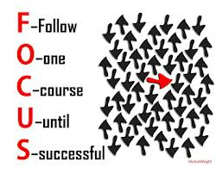
This Weeks Challenge
Make a Conscious Effort to…
Examine Your Focus
Expect Distractions
Eliminate the Unnecessary
Examine Your Focus Again
Expect God to Use You…
…As You Hone-in Your Focus
…Like Never Before

Slide 19
A guy hears a knock at the door.
He opens it up to find a snail. He picks up the snail and throws it across the street.
Several Weeks go by...
he hears a knock on the door and opens it to see the snail.
The snail says, "What the heck was that about?!"

