Slide 1
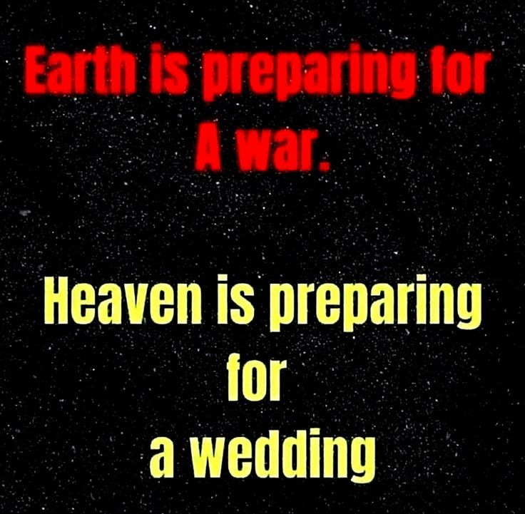

Slide 2
Spiritual Warfare
10% Satan’s Tactics
90% How We Respond
Remember… With God We Are Not
Helpless
Hopeless
We Are Powerful!!

Slide 3
Repeat
These are the 2 Most Important Hours of My Week – Help Me to Cherish Them
I Am Here Today to Worship
Not to Be Entertained
I Am Singing to An Audience of One
Accept My Worship Oh Lord!

Slide 4
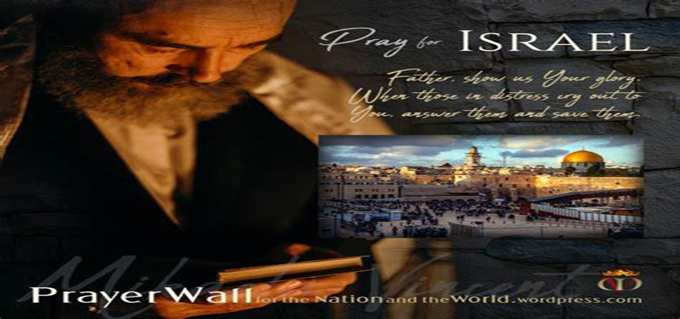

And All of the Innocent Victims
on Both Sides

Slide 5
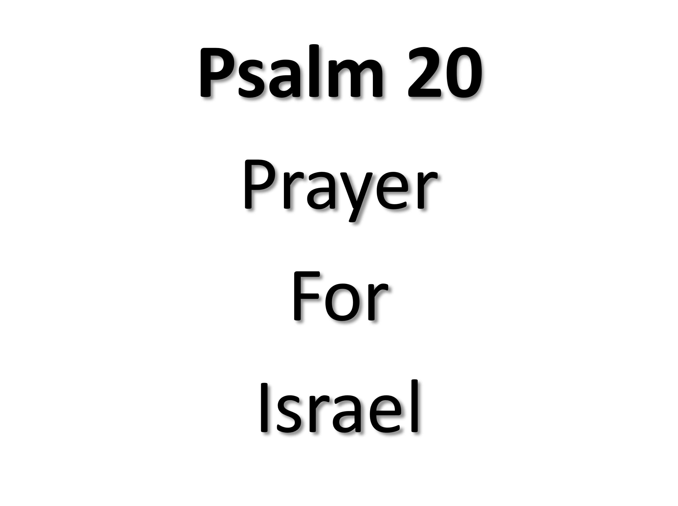
May the Lord answer you in the day of trouble! May the name of the God of Jacob protect you! ² May he send you help from the sanctuary and give you support from Zion! ³ May he remember all your offerings and regard with favor your burnt sacrifices! Selah ⁴ May he grant you your heart's desire and fulfill all your plans! ⁵ May we shout for joy over your salvation, and in the name of our God set up our banners! May the Lord fulfill all your petitions! ⁶ Now I know that the Lord saves his anointed; he will answer him from his holy heaven with the saving might of his right hand. ⁷ Some trust in chariots and some in horses, but we trust in the name of the Lord our God. ⁸ They collapse and fall, but we rise and stand upright. ⁹ O Lord, save the king! May he answer us when we call.

Slide 6
Repeat
I Lift My Offering to You
Let It Please You Oh Lord
This is My Seed
Although It Leaves My Hand
It will Never Leave My Life
You Will Multiply It!
Accept My Seed Oh Lord!

Slide 7
Jesus Jesus Jesus Let All Heaven And Earth Proclaim Kings And Kingdoms May All Pass Away But There's Something About That Name

Slide 9

“Rebuilding Your Focus” pt3
Edward Christian Church
November 5, 2023
Philippians 3:13-14
10 Rebuild Points

Slide 10

Rebuild My Focus
God Uses Rebuild Mode
Draw Us Out
Complacency
Collapse
Draw Out of Us
Freshness
Further

Slide 11

Rebuilding Our Focus
Our Focus Should Start on God / His…
Word -Quick/ Powerful –not come back void
Ability -is anything too hard?
Mission -Seek and Save

Slide 12


Distraction
Any Type of…
Activity
Action
Attitude
that Consumes…
You
Time
Interest
…to the Point God Becomes a Blur

Slide 13


One of Satan’s Chief Tools
It is a…
Subtle Tool
It Sneaks Up So Soft It Is Unnoticeable
Deceptive Tool
It Makes You Feel Effective (temporarily)
Patient Tool
Like a Trap Waiting to Be Sprung
Cooling Tool
Cools you Down/ Keeps you Down or
Prevents You From Getting Hot/ Effective

Slide 14

Our Focus has Unlimited Value
Satan Doesn’t Want us to Realize the…
Potential
Power
Position
...of an Undivided Focus
10 Focal Points

Slide 15
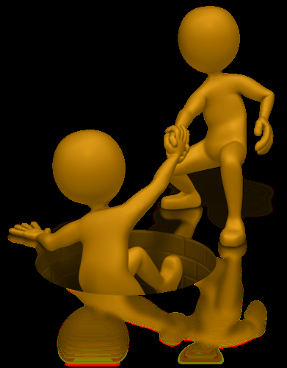
#1- He Called You…
…it Wasn’t to Get to this Place so He Can
…Drop You! (Our Position)
Philippians 1:6 (AMP) ⁶ And I am convinced and sure of this very thing, that He Who began a good work in you will continue until the day of Jesus Christ [right up to the time of His return], developing [that good work] and perfecting and bringing it to full completion in you.
#2- He Will Build His Church! (Our Power)
Matt 16:18 (AMP) ¹⁸ And I tell you, you are Peter [Greek, Petros-a large piece of rock], and on this rock [Greek, petra-a huge rock like Gibraltar] I will build My church, and the gates of Hades (the powers of the infernal region) shall not overpower it [or be strong to its detriment or hold out against it].

Slide 16
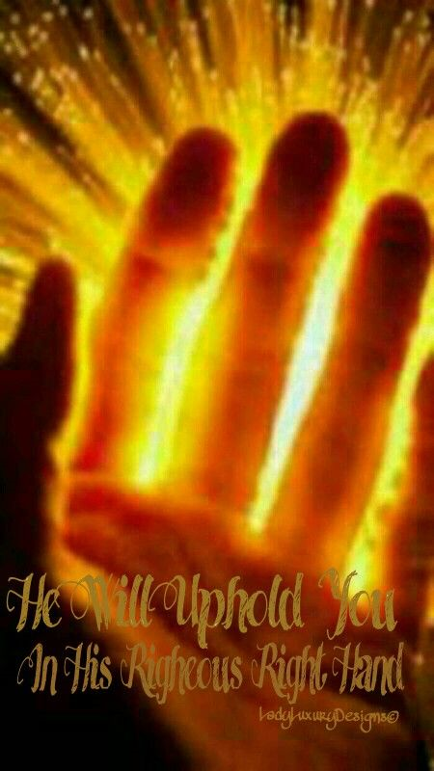
#3- He Did Not Promise to Deliver you From
the Fire, but to Walk with You Through It!
(Our Protection-His Presence) ¹ But now thus saith the LORD that created thee, O Jacob, and he that formed thee, O Israel, Fear not: for I have redeemed thee, I have called thee by thy name; thou art mine. ² When thou passest through the waters, I will be with thee; and through the rivers, they shall not overflow thee: when thou walkest through the fire, thou shalt not be burned; neither shall the flame kindle upon thee. Isaiah 43:1-2 (KJV)
#4- There is More in Store for...
...Your Life/ Ministry! (Our Potential)
Hosea 10:12- Break Up Your Fallow Ground

Slide 17

#5- When We Obey the Voice of God…
…We Are Unstoppable (Our Persevering)
So shall My word be that goes forth out of My mouth: it shall not return to Me void [without producing any effect, useless], but it shall accomplish that which I please/ purpose,/ it shall prosper in the thing for which I sent it. Isa 55:11 (AMP)

Slide 18
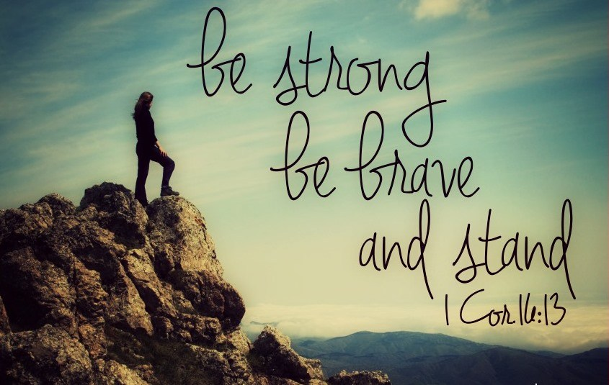
#6 –Have Courage, Be Strong, Don’t Back Down or Give In to Satan/ His Plan! (Stand)
¹³ Watch ye, stand fast in the faith, quit you like men, be strong. 1 Cor 16:13 (KJV)
Watch ye- be on guard– Satan desires to attack
Stand Fast in the Faith- persevere, do not deviate in trust
Quit you like Men- to act in a mature manner –not tossed
Be Strong- be strengthened in the Lord

Slide 19
#7 –God Didn’t Call You Because of Your Greatness but His…
He’s Still Great Even at Times…
You May Feel Like You are Not! (Understand)
2 Corinthians 4…
(1) Therefore seeing we have this ministry, as we have received mercy, we faint not;
(7) But we have this treasure in earthen vessels, that the excellency of the power may be of God, and not of us
Ask a shepherd boy as he stood over Mighty Goliath
Ask a Prisoner as he stood as Prime Minister over Egypt!

Slide 20

#8 –This Problem Will Not Destroy You! (Withstand)
2 Corinthians 4:8-9 (AMP) ⁸ We are hedged in (pressed) on every side [troubled and oppressed in every way], but not cramped or crushed; we suffer embarrassments and are perplexed and unable to find a way out, but not driven to despair; ⁹ We are pursued (persecuted and hard driven), but not deserted [to stand alone]; we are struck down to the ground, but never struck out and destroyed;

Slide 21
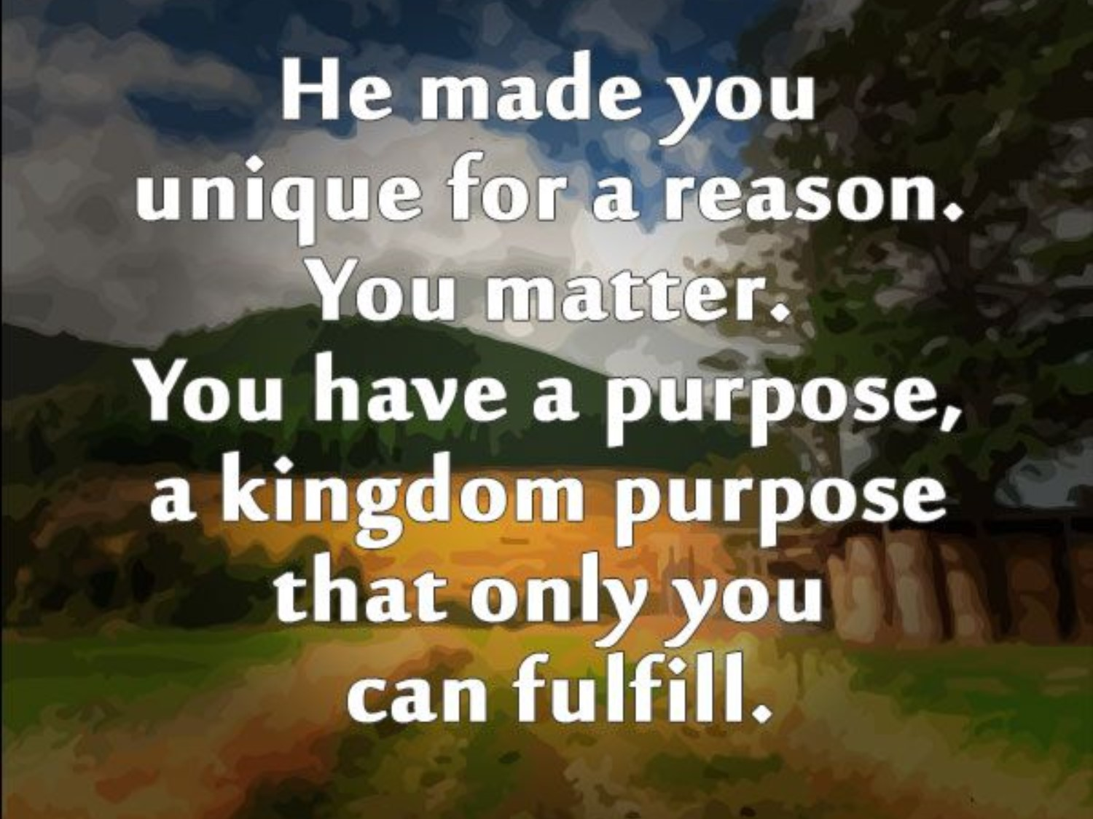
#9 –Stop Comparing Yourself to Others…
…Same God Who Called/ Empowered Them
…Did the Same for You! –
(Stand Up)
¹⁴ Thank you for making me so wonderfully complex! Your workmanship is marvelous—how well I know it. Psalm 139:14 (NLT)
⁸ For He Who motivated and fitted Peter and worked effectively through him for the mission to the circumcised, motivated and fitted me and worked through me also for [the mission to] the Gentiles. Galatians 2:8 (AMP)

Slide 22
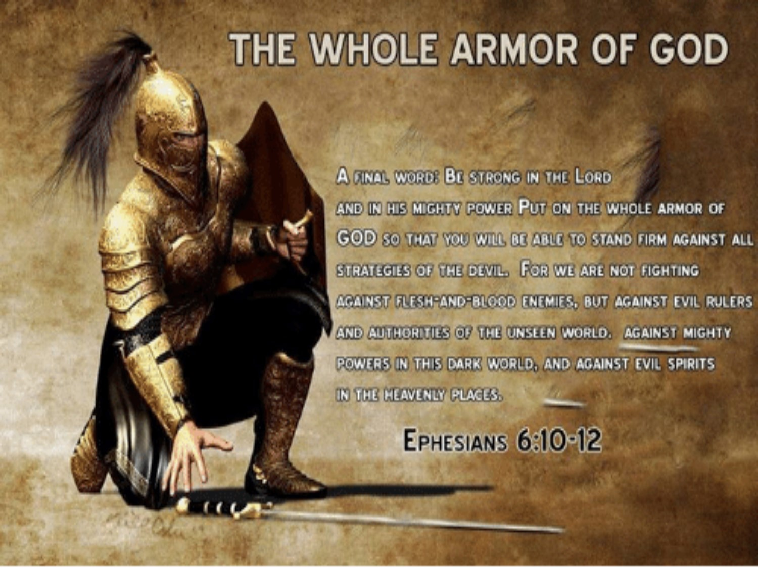
#10 –Stop Praying for…
…Protection(defense)…ONLY
…Pray For Boldness(offense)!!!
(Stand Strong)
Acts 4:29-31 (AMP) ²⁹ And now, Lord, observe their threats and grant to Your bond servants [full freedom] to declare Your message fearlessly, ³⁰ While You stretch out Your hand to cure and to perform signs and wonders through the authority and by the power of the name of Your holy Child and Servant Jesus. ³¹ And when they had prayed, the place in which they were assembled was shaken; and they were all filled w- the Holy Spirit, /they continued to speak the Word of God with freedom / boldness / courage.

Slide 23

Don’t Focus On
Problems
Pain
Panic
Focus Instead
Promise
Power
Peace

Slide 24

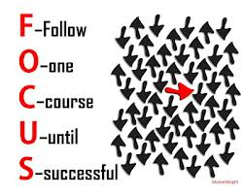
This Weeks Challenge
Make a Conscious Effort to…
Examine Your Focus
Expect Distractions
Eliminate the Unnecessary
Examine Your Focus Again
Expect God to Use You…
…As You Hone-in Your Focus
…Like Never Before

Slide 26
Sally had lived a good life, having been married four times. Now she stood before the Pearly Gates.
The angel at the gates said to her, "I see that you first of all married a banker, then an actor, next a pastor and lastly an undertaker. Why? This does not seem appropriate for a Christian woman."
"Oh yes it is," Sally replied.
"It's one for the money, two for the show, three to make ready and four to go!"

