Slide 1
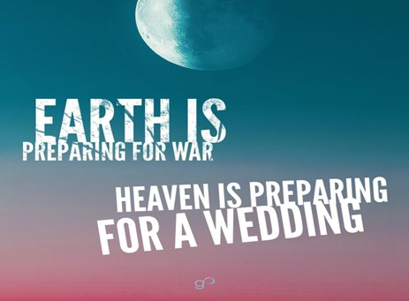

Slide 3
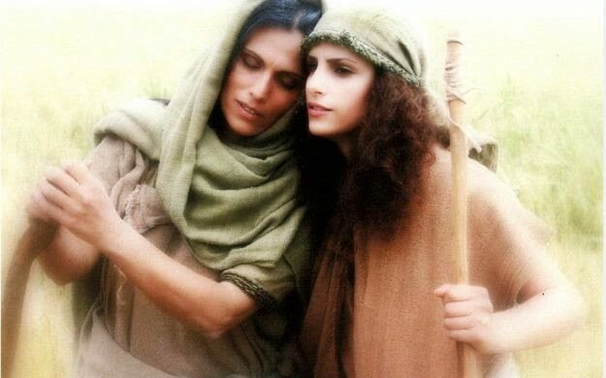

Ruth 1
Moving Beyond…
…My Circumstantial Trap
“Call Me Mara” pt1
Edward Church
November 12, 2023

Slide 4

Ruth 1: 1-14: Now it came to pass, in the days when the judges ruled, that there was a famine in the land. And a certain man of Bethlehem, Judah, went to dwell in the country of Moab, he and his wife and his two sons. The name of the man was Elimelech, the name of his wife was Naomi, and the names of his two sons were Mahlon and Chilion— Ephrathites of Bethlehem, Judah. And they went to the country of Moab and remained there. Then Elimelech, Naomi’s husband, died; and she was left, and her two sons. Now they took wives of the women of Moab: the name of the one was Orpah, and the name of the other Ruth. And they dwelt there about ten years. Then both Mahlon and Chilion also died; so the woman survived her two sons and her husband. ….
²⁰ She said to them, “Do not call me Naomi (sweetness); call me Mara (bitter), for the Almighty has caused me great grief and bitterness. amp

Slide 5
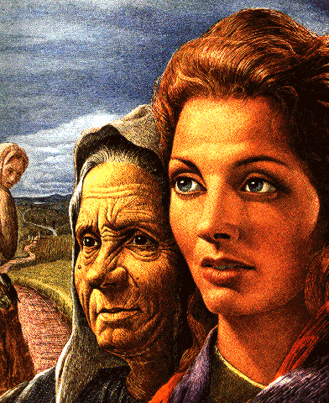
Ten Years, Naomi Subjected to Life in Moab.
(Circumstances)
She Felt …
Alone - Husband and Sons Dead
Abandoned - Daughter-in-Law Left
Altered - Name Change Proved It
Naomi= “to be good, sweet, and pleasant.”
Mara= “bitter.”
She Didn’t See…
Attention – God was Watching
Active - And Waiting
Attending – Until She Turned to Him

Slide 6
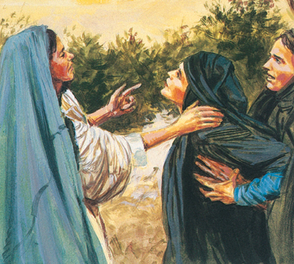
Peter Walked on the Water Until…
…He Got His Eyes Off Jesus/ onto Circumstances.
…He Sank
Disciples with Jesus in Garden Until…
…They Got Eyes on Circumstances..
..They Ran
Circumstances Kept All but One Disciple from the Cross.
…They Stayed Away
Circumstances Kept Them Behind Locked Doors..
…They Hid
Circumstances Had Taken It’s Toll on Naomi…
…Call Me Mara

Slide 7
From Naomi to Mara
Names Very Important to Hebrew
…Represents
Picture of Self (Identity)
Potential (Path)
Prophet of Future (Destiny)

Slide 8

She was to be an Influence…
…in an Ungodly Land
Instead...
Her Environment…
Influenced her…
...Strongly
…Negatively
Circumstances Had Her Trapped

Slide 9
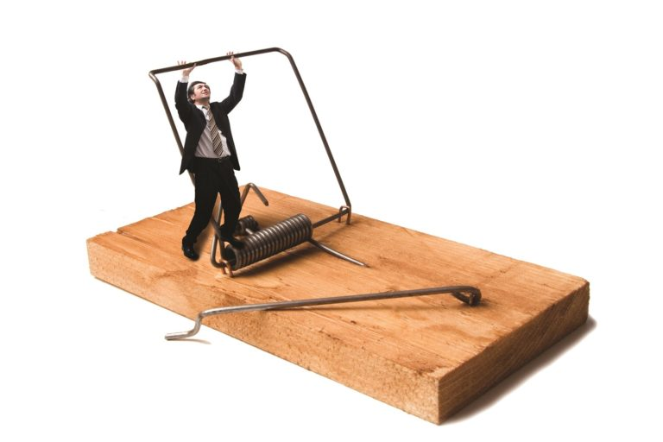
Four Ways To Overcome…
…Live Beyond
…Circumstantial Trap

Slide 10
Refuse to Let Circumstance… …Determine Your Identity
¹⁶ Then they journeyed from Bethel. And when there was but a little distance to go to Ephrath, Rachel labored in childbirth, and she had hard labor. ¹⁷ Now it came to pass, when she was in hard labor, that the midwife said to her, “Do not fear; you will have this son also.” ¹⁸ And so it was, as her soul was departing (for she died), that she called his name ^{[a]}Ben-Oni; but his father called him ^{[b]}Benjamin. ¹⁹ So Rachel died and was buried on the way to Ephrath (that is, Bethlehem). Genesis 35: 16-19
I Am Not What I Am Living Through…
…Nor Am I What I’ve Already Been Through.
Rachel Died in Child Birth
Named Son -Ben-Oni = “son of my sorrow”
Jacob Decided to Make a Difference
Changed Name – Benjamin = “son of the right hand”

Slide 11
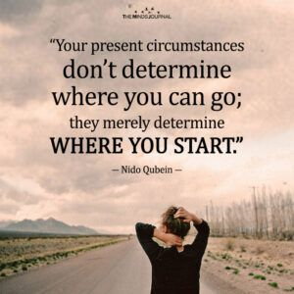
Refuse to Let Circumstance… …Determine Your Identity
I Am Not What I Am Living Through…
…Nor Am I What I’ve Already Been Through.
What Does Your Father Call You?
I Am Blessed and Highly Favored. -Luke 1: 28
We are the Head and Not the Tail -Deut 28:13
Blessed Coming in and Going Out -Deut 28:6
No Weapon Formed against Me shall Prosper -Isa 54:17

Slide 12
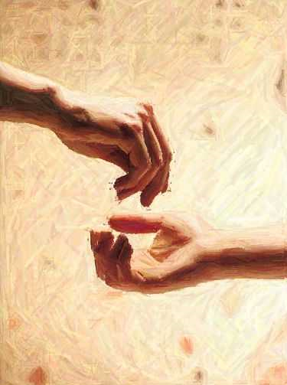
Refuse to Let Circumstance… …Distort Your View of God
What Have You Been Through That Left You With A…
…Distorted View Of Your Heavenly Father?
“Do not call me Naomi; call me Mara, for the Almighty has dealt very bitterly with me” (20).
She is Blaming God for All Her Misfortunes.
Do Not Allow the Enemy to Distort Vision of God
Her Family Took Matters in Their Own Hands
This was NOT God’s Doing but Bad Decisions!

Slide 13
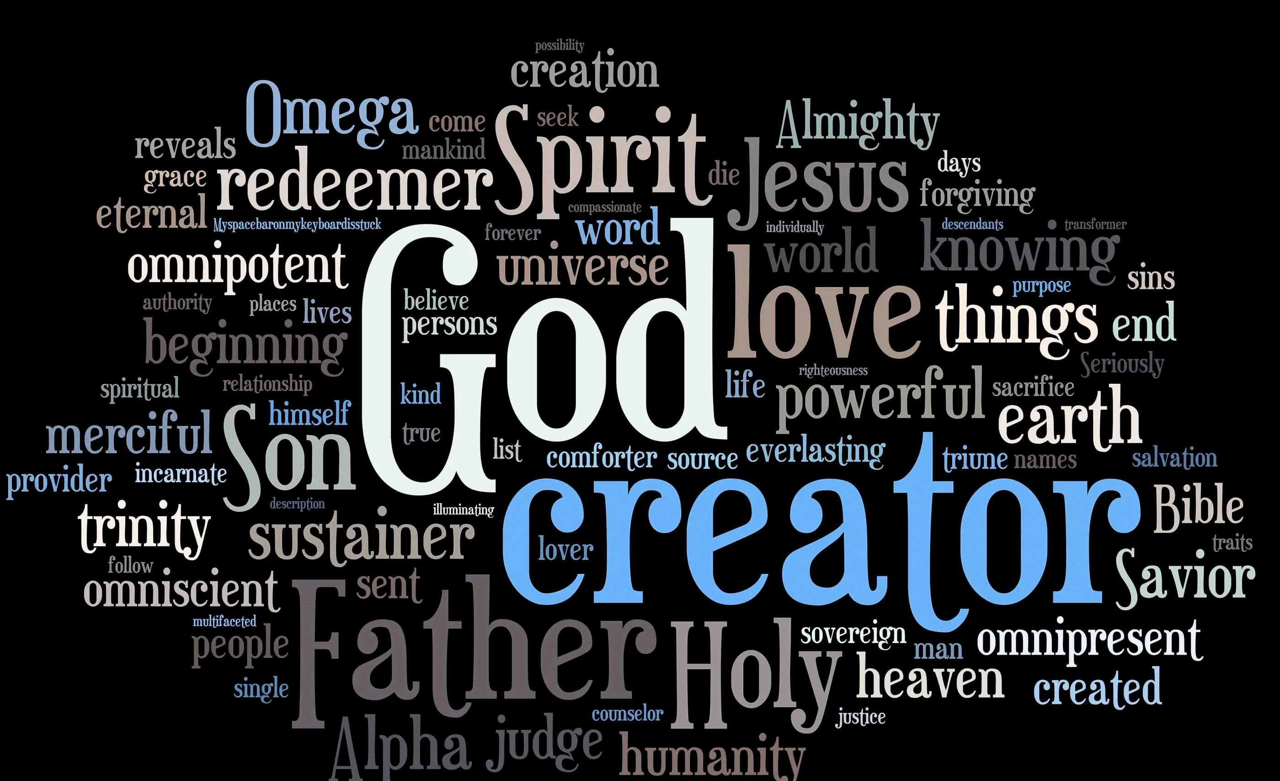
Refuse to Let Circumstance… …Distort Your View of God
What Have You Been Through That Left You With A…
…Distorted View Of Your Heavenly Father?
“Do not call me Naomi; call me Mara, for the Almighty has dealt very bitterly with me” (20).
Consider All That Job Endured.
Crisis in Finances, Family, Fitness, Faith
His Wife said, “Curse God and die!” -Job 2: 9
This Showed a Distorted View of God
Job Had Diff. Opinion. “I Know My Redeemer Liveth…”
My Troubles in Life Do Not Alter Who God Is

Slide 14
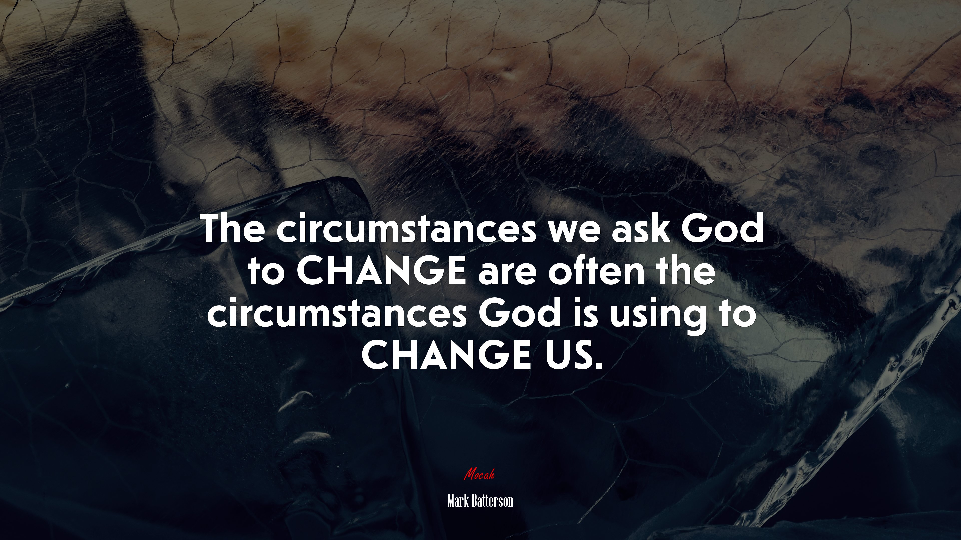
This Weeks Challenge…
Instead of Asking God Why?
Why This?
Why Now?
Why Me?
Train Yourself to Ask God What?
What Are You Teaching Me Through This Now?
Thank You Father For Trusting Me Enough…

Slide 16
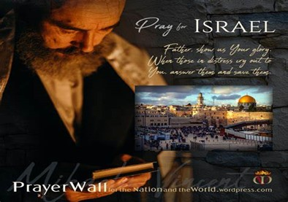

And All of the Innocent Victims
on Both Sides

Slide 17

May the Lord answer you in the day of trouble! May the name of the God of Jacob protect you! ² May he send you help from the sanctuary and give you support from Zion! ³ May he remember all your offerings and regard with favor your burnt sacrifices! Selah ⁴ May he grant you your heart's desire and fulfill all your plans! ⁵ May we shout for joy over your salvation, and in the name of our God set up our banners! May the Lord fulfill all your petitions! ⁶ Now I know that the Lord saves his anointed; he will answer him from his holy heaven with the saving might of his right hand. ⁷ Some trust in chariots and some in horses, but we trust in the name of the Lord our God. ⁸ They collapse and fall, but we rise and stand upright. ⁹ O Lord, save the king! May he answer us when we call.

Slide 19
"A man parks his bicycle nearby the Capitol in Washington, DC and walks on.
A police officer stops him and asks, "Why did you park your bicycle here? Don't you know it is a VIP road and all congressmen and senators pass from here?"
Man replied, "Don't you worry about it, I locked my bicycle!"

Slide 20
A juggler, driving to his next performance, is stopped by a policeman.
"What are those machetes doing in your car?" asks the cop.
"I juggle them in my act."
"Oh, yeah?" says the doubtful cop. "Let's see you do it."
The juggler gets out and starts tossing and catching the knives. Another man driving by slows down to watch.
"Wow" says the passer-by. "I'm glad I quit drinking. Look at the test they're giving now!

