Slide 1
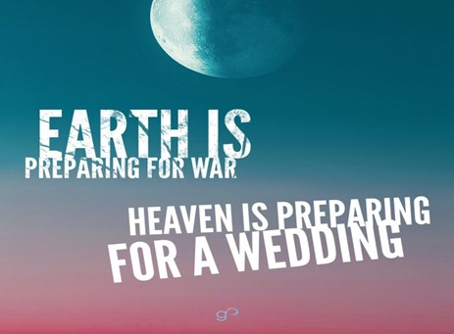

Slide 2
Spiritual Warfare
10% Satan’s Tactics
90% How We Respond
Remember… With God We Are Not
Helpless
Hopeless
We Are Powerful!!

Slide 3
Repeat
These are the 2 Most Important Hours of My Week – Help Me to Cherish Them
I Am Here Today to Worship
Not to Be Entertained
I Am Singing to An Audience of One
Accept My Worship Oh Lord!

Slide 4
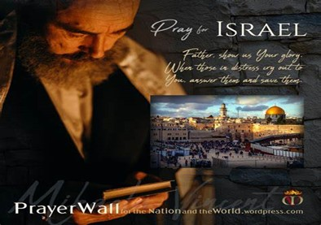

And All of the Innocent Victims
on Both Sides

Slide 5
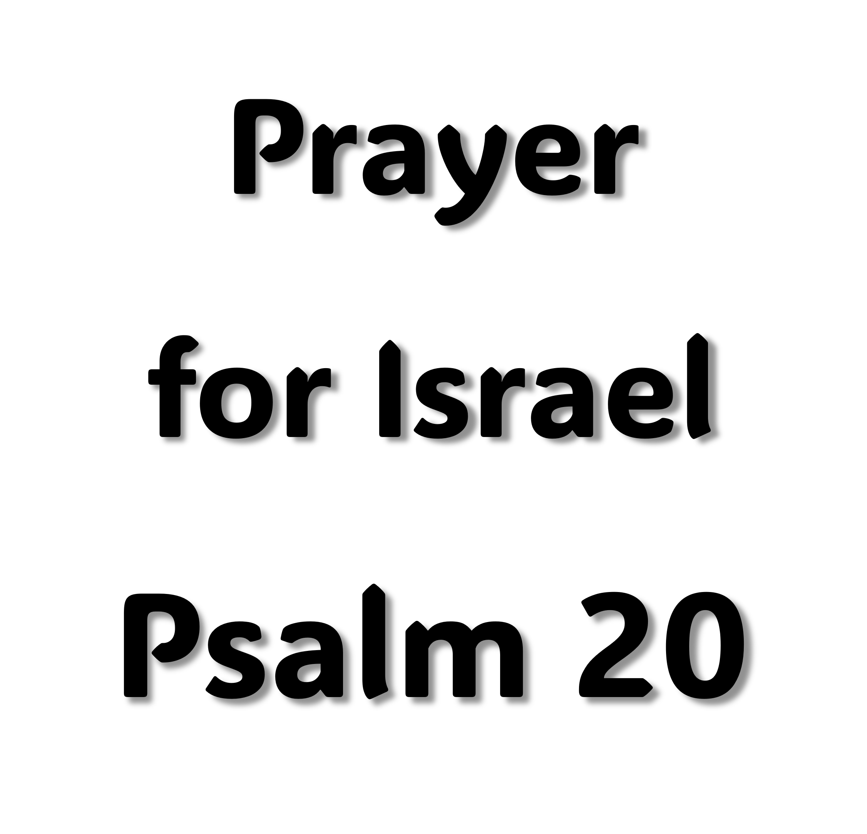
May the Lord answer you in the day of trouble! May the name of the God of Jacob protect you! ² May he send you help from the sanctuary and give you support from Zion! ³ May he remember all your offerings and regard with favor your burnt sacrifices! Selah ⁴ May he grant you your heart's desire and fulfill all your plans! ⁵ May we shout for joy over your salvation, and in the name of our God set up our banners! May the Lord fulfill all your petitions! ⁶ Now I know that the Lord saves his anointed; he will answer him from his holy heaven with the saving might of his right hand. ⁷ Some trust in chariots and some in horses, but we trust in the name of the Lord our God. ⁸ They collapse and fall, but we rise and stand upright. ⁹ O Lord, save the king! May he answer us when we call.

Slide 6
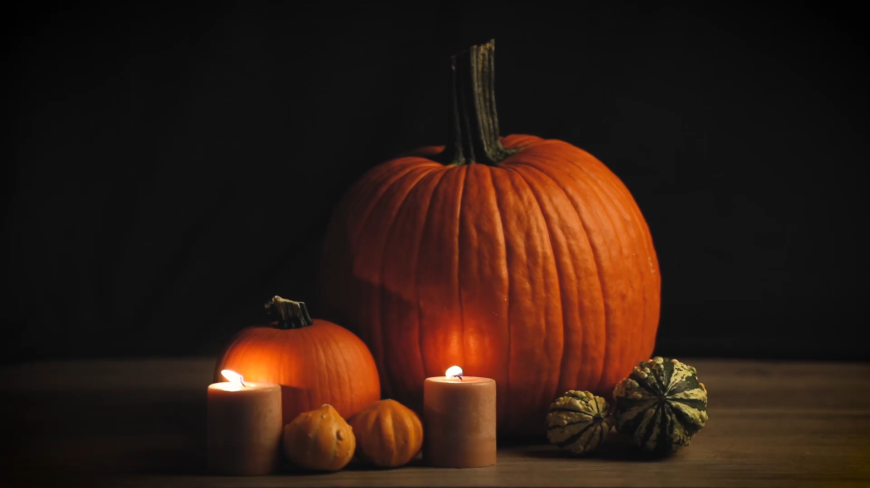
Simple Steps To Thanksgiving
Luke 17:11-19

Slide 7
Thanksgiving Day List (Housewives)
"For automatic dishwashers because they make it possible for us to get out of the kitchen before the family comes back in for their after-dinner snacks.
"For husbands who attack small repair jobs around the house because they usually make them big enough to call in the professionals.
"For children who put away their things & clean up after themselves. They’re such a joy you hate to see them go home to their own parents
"For teenagers because they give parents an opportunity to learn a second language.
For Smoke alarms because they let you know when the turkey’s done

Slide 8
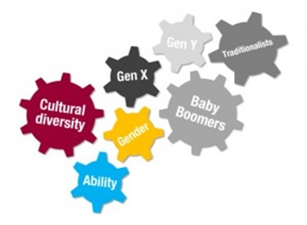
Notice That the Way Things Were When We Were Kids
…Is Not The Same Today?
Not Only Is This Generation Not Learning…
History
Spiritual And National
Not Learning Simple Things Like
Value of Hard Work
Power of a Thankful Spirit

Slide 9
Gratitude Power…
has lasting positive effects on the brain
boosts the immune system
reduces stress, anxiety, and depression
promotes optimism and positivity
helps create and strengthen relationships
reduces chronic pain
improves overall sleep
keeps us grounded in reality
promotes exercise and healthy habits
improves our overall self-esteem

Slide 10
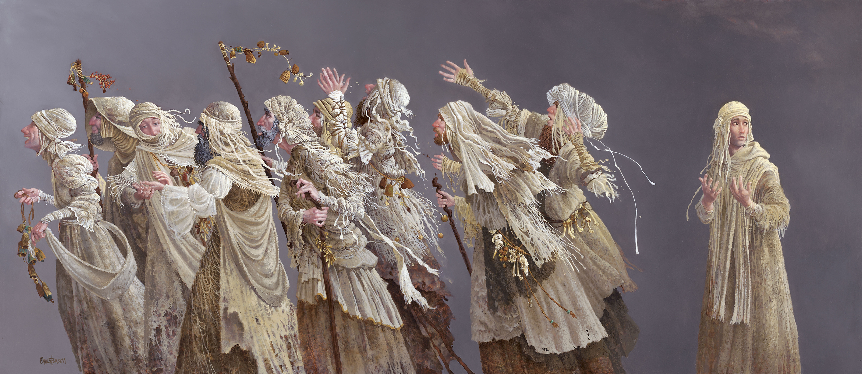

Step One “Stop”
Stopping is the first step to thanksgiving.
Leprosy was the AIDS of the First Century.
It was highly contagious/ could be caught merely by touch
Since there was no antidote, leprosy would spread throughout the body, slowly but surely progressing until one died.
Because of the horrific nature of this disease and the death it brought, it was seen as the absolute worst thing that God could do to someone.
To have it meant, as they believed, that the victim was in the most horrifying judgment of God.

Slide 11
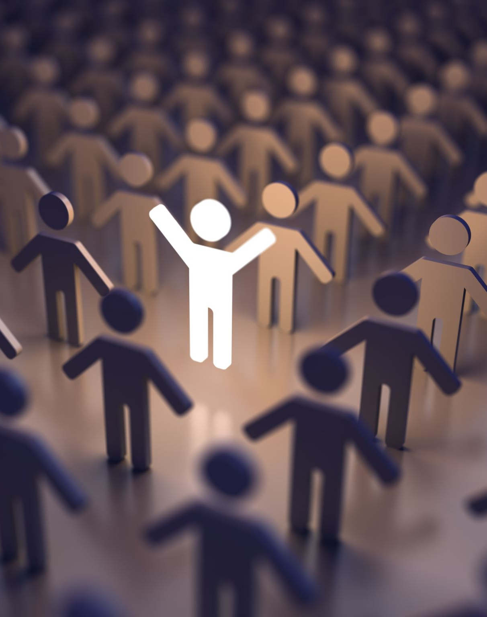
When Jesus healed these lepers, he wasn’t just offering them a Kleenex for a runny nose.
He literally changed, saved and spared their lives!
What was their response? They just walked on to show themselves to the priest.
But one leper was different. He came back to Jesus. Why? Because he went through the first step of thanksgiving. “Stop.”

Slide 12
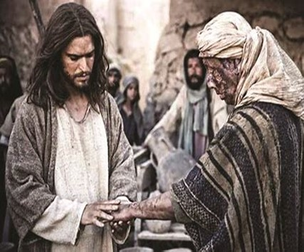
Step Two “Look”
He Looked at what happened.
He saw he was healed!
Did the others experience that? Of course!
But they didn’t stop.
They just went along their merry way.

Slide 13
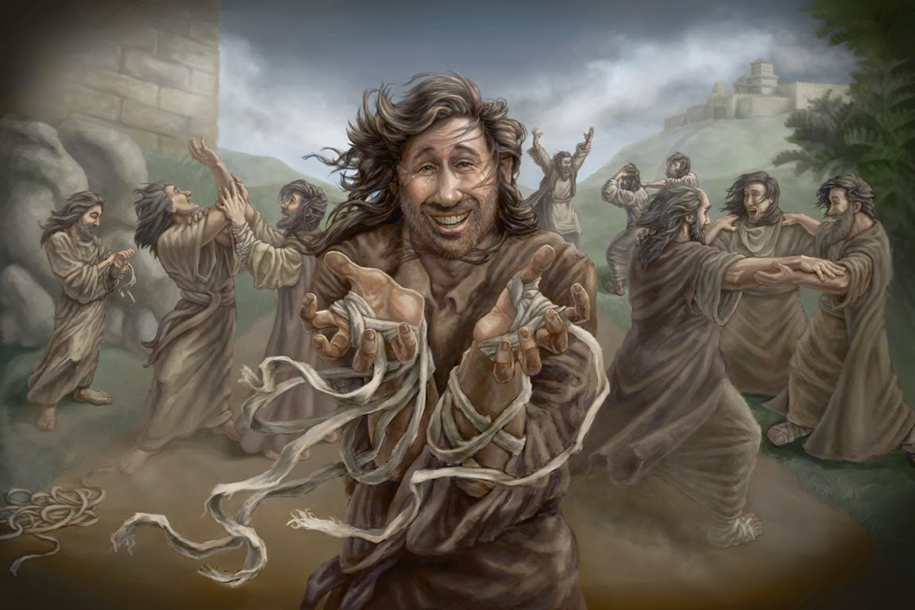
Third Step is “Listen.”
When the Samaritan leper was healed, after he stopped and looked - He ran to Jesus. Why?
Having experienced physical healing, he was running back to Jesus to hear more… about grace, love and the new life that Jesus was offering to him.
Stop, Look and Listen.
Those are the First Three Steps of Thanksgiving.
What is the last one? It’s simple. Thanks God! Remember Jesus’ words to the Samaritan Leper? 17 “Jesus asked, "Were not all ten cleansed? Where are the other nine? 18 Was no one found to return and give praise to God except this foreigner?"

Slide 14
¹⁴ And when he saw them, he said unto them, Go shew yourselves unto the priests. And it came to pass, that, as they went, they were cleansed.
Cleansed= Healed
Still Scars of Leprosy
17 And Jesus answering said, Were there not ten cleansed? but where are the nine? 18 There are not found that returned to give glory to God, save this stranger. 19 And he said unto him, Arise, go thy way: thy faith hath made thee whole.
Whole= Restored
Scars Healed

Slide 15
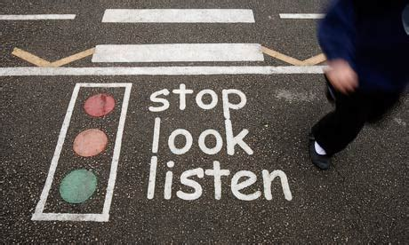
Let’s Practice This Right Now!
Step One: “Stop”
Let’s stop everything— the rat race, the swirl in your head planning and wondering about Thanksgiving Dinner’s
Stop it!
Step Two: “Look”
Let’s look to see what God has done in your life. As you look in your life, what things are you thankful for?
Step Three: “Listen”
What is it that God wants you to hear about His plan, His goodness and His love for you?

Slide 16


Step Four:
Let’s Thank God For All He’s Done…
and Will Do…
In Your Life and Mine!

Slide 17
Dear God, I want to thank you for what you have already done
I am not going to wait until I see results or receive rewards
I am thanking you right now
I am not going to wait until I feel better or things look better
I am thanking you right now
I am not going to wait until people say they are sorry or until they stop talking about me
I am thanking you right now
I am not going to wait until the pain in my body disappears
I am thanking you right now

Slide 18
I am not going to wait until my financial situation improves
I am going to thank You right now
I am not going to wait until the children are asleep/ house is quiet
I am going to thank You right now
I am not going to wait until I get promoted or until I get the job
I am going to thank You right now
I am not going to wait until I understand every experience in my life that has caused me pain or grief
I am going to thank You right now
I am not going to wait until the journey gets easier or the challenges removed
I Am Thanking You Right Now.

Slide 19
I am thanking You because I am alive
I am thanking You because I made it through the day's difficulties.
I am thanking You because I have walked around the obstacles.
I am thanking You because I have the ability and the opportunity to do more and do better.
I am thanking You because You have not given up on me.
God, thank You for being so good to me.
Continue to enable me to stop, look, listen and thank You for your goodness!
In Jesus name I pray, Amen.

Slide 20
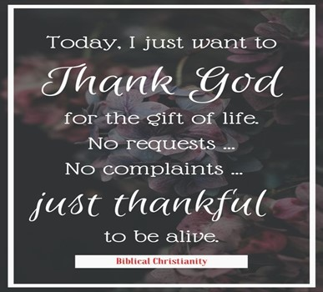
This Weeks Assignment
In Any Situation- Try a Thankful Attitude and Actions First

Slide 21
When I have a thankful attitude When I have thankful actions
It changes the way I enter my trials
It changes the way I endure my trials
It changes the way I accept my trials
Just be thankful

