Slide 1
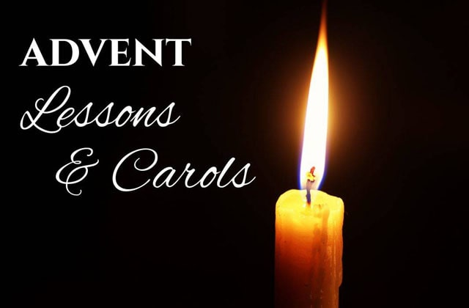

Slide 2

“Advent”
Hope In Hopeless Times

Slide 3

Hope=
Expectation, a thing longed for, Expecting God to Do Something
For Abe…
Hope was Ram Caught in the Thicket
In the Midst of a Broken World...
it was a Cross Covered Red in the Blood of Jesus
Those Facing Tragedy and Loss
Its an Empty Tomb
But It All Points to a Baby in a Manger

Slide 4
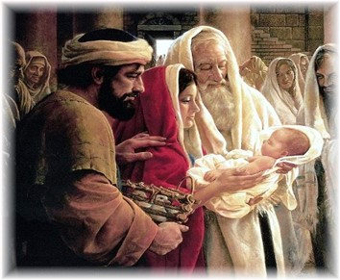
²⁵ Now there was a man in Jerusalem called Simeon, who was righteous and devout. He was waiting for the consolation of Israel, and the Holy Spirit was on him. ²⁶ It had been revealed to him by the Holy Spirit that he would not die before he had seen the Lord’s Messiah. ²⁷ Moved by the Spirit, he went into the temple courts. When the parents brought in the child Jesus to do for him what the custom of the Law required, ²⁸ Simeon took him in his arms and praised God, saying:
²⁹ “Sovereign Lord, as you have promised, you may now dismiss your servant in peace. ³⁰ For my eyes have seen your salvation, ³¹ which you have prepared in the sight of all nations: ³² a light for revelation to the Gentiles, and the glory of your people Israel.”
³³ The child’s father and mother marveled at what was said about him. 34 Then Simeon blessed them and said to Mary, his mother: “This child is destined to cause the falling and rising of many in Israel, and to be a sign that will be spoken against, ³⁵ so that the thoughts of many hearts will be revealed. And a sword will pierce your own soul too.”

Slide 5
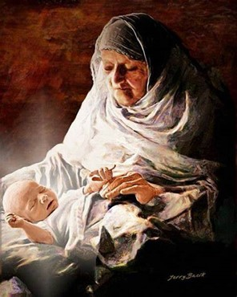
³⁶ There was also a prophet, Anna, the daughter of Penuel, of the tribe of Asher. She was very old; she had lived with her husband seven years after her marriage, ³⁷ and then was a widow until she was eighty-four. She never left the temple but worshiped night and day, fasting and praying. ³⁸ Coming up to them at that very moment, she gave thanks to God and spoke about the child to all who were looking forward to the redemption of Jerusalem” -Luke 2:22-38 NIV
Simeon and Anna Teach Us…
…Life Lessons in Hope

Slide 6
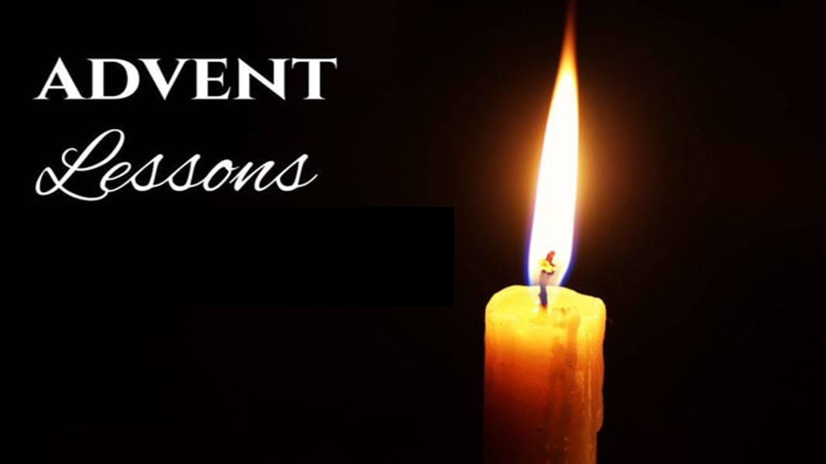
No Matter How Bad Things Are…
…Never Give Up Hope
What A Year It Has Been
A Year Filled With Uncertainty
Politically
Spiritually
Socially
Stress, Worry, Anxiety Have Hit High Levels

Slide 7

If There’s Ever a Year We Need to Rediscover Christmas,
…This Is The Year.
If There’s Ever a Year We Need to Hear And Rediscover Hope
…It Is Now, Today
If There’s Ever a Year The World Needs to Hear The Hope of Christ
…It Is Now!
ADVENT
This is the “Season of Hope”

Slide 8
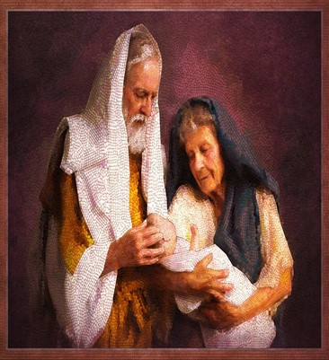
Simeon and Anna were Sparks of Hope in Israel.
More Than That, They Were Torches Of Hope,
Expecting God to Fulfill What He Had Promised.
They Believed It And…
…They Were Waiting for the Promised Child!

Slide 9
They Were Ready to See God Act and Do Great Things.
What About You?
Day after day, year after year…
Simeon and Anna Served God Faithfully,
inspired by Hope that God was at Work.
  Even if they couldn’t see it, they believed / Remained Hopeful.
  Even when surrounded by hardship.
  Even as they grew older and older.
Simeon and Anna Still Held Onto Hope.

Slide 10
HOPE SEES BEYOND the PRESENT
Hope Is The Fuel Of Faith, Dreams And Possibilities
It’s the Spark that ignites a Blazing Fire
Undying Ember That Speaks Life Ready to Give Up
No Matter How Bad Things Have Been…
…Struggles You Are Facing
…Season of Darkness and Pain
Be Encouraged—You Are Not Alone
God is at work. There is Hope
Allow hope to Be Alive Even In Your Deepest Pain / Hopelessness
Hope Chases Away the Darkness and Uncertainty

Slide 11
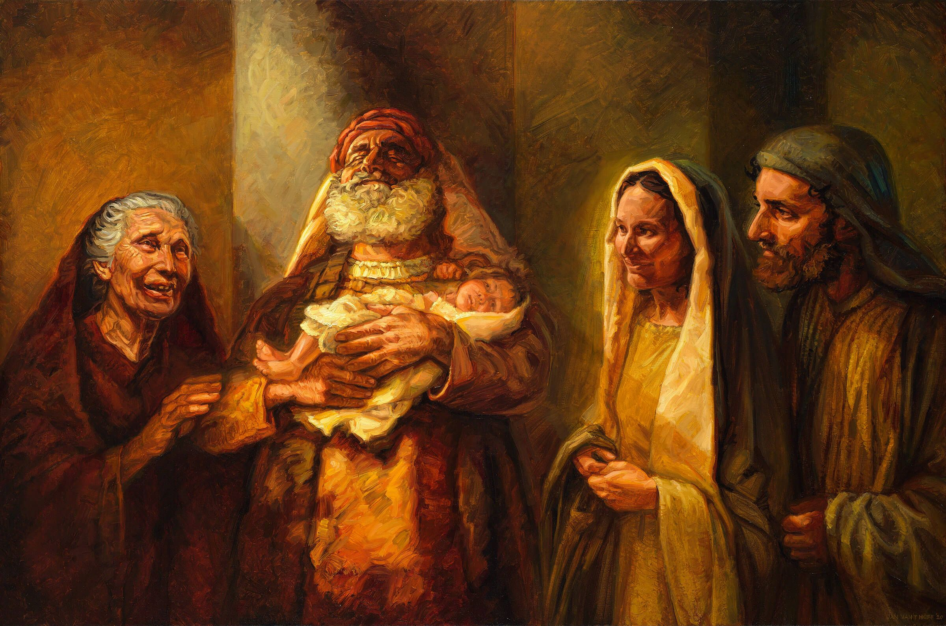
HOPE SEES BEYOND the PRESENT
“For in this hope we were saved. But hope that is seen is no hope at all. Who hopes for what they already have? ²⁵ But if we hope for what we do not yet have, we wait for it patiently. ²⁶ In the same way, the Spirit helps us in our weakness. We do not know what we ought to pray for, but the Spirit himself intercedes for us through wordless groans. ²⁷ And he who searches our hearts knows the mind of the Spirit, because the Spirit intercedes for God’s people in accordance with the will of God” -Romans 8:24-27
Hope Exists Before Reality Comes To Pass
Hope Precedes Reality
Hope, By Its Very Nature, Exists in the Uncertainty
Hope Is the Willingness and…
…Desire To Believe Beyond Your Present Conditions

Slide 12
Hope Believes GOD is with US
HERE, NOW, and ALWAYS
There is no uncertainty in Christ, He knows all you are going through.
He knows your pain, challenges and struggles.
He was not taken by surprise by …
Covid, Economy, Global Unrest
It is a real hope. Hope even in times of weakness.
Hope in your deepest pain, even when hope seems far away
“For I know the plans I have for you,” declares the Lord, “plans to prosper you and not to harm you, plans to give you hope and a future -Jer 29:11
We Are Not Alone, Even At Our Loneliest Or Darkest Moments.

Slide 13
HOPE INSPIRES US to KEEP BELIEVING
“through whom we have gained access by faith into this grace in which we now stand. And we boast in the hope of the glory of God. ³ Not only so, but we also glory in our sufferings, because we know that suffering produces perseverance; ⁴ perseverance, character; and character, hope. ⁵ And hope does not put us to shame, because God’s love has been poured out into our hearts through the Holy Spirit, who has been given to us” -Romans 5:2-5
This hope we have in God will not let us down.
It gives us new strength to see beyond the pain and confusion
It can feel impossible to take first step toward hope when weighed down
Receive the Promise of hope in God’s Word, we can find new strength.
Hope Inspires us. Hope Emboldens us.
Keep Hoping, Keep Believing. Keep Putting One Foot In Front Of The Other

Slide 14
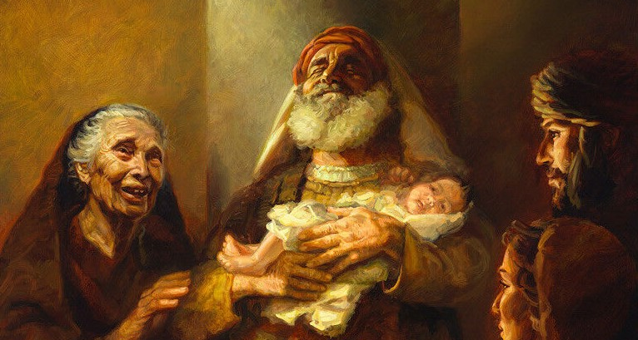
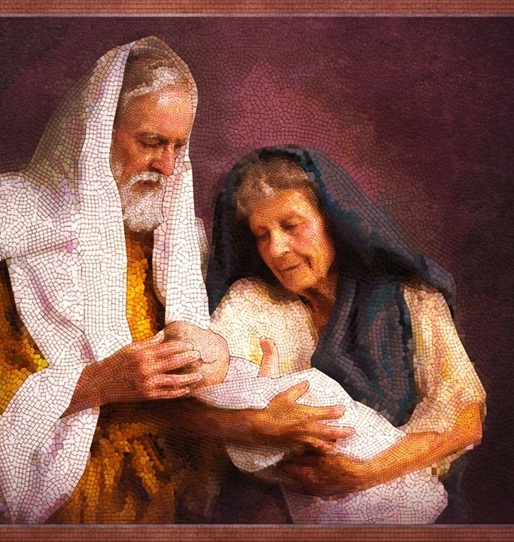


IS YOUR NEXT STEP A STEP OF HOPE
This Advent Season, look for hope in the birth of Jesus.
Draw hope from God’s faithfulness in his long-awaited promises
Focus on the hope of God’s continued work in and all around you.
Whatever life is throwing at you, you can experience the hope of
God’s Spirit within you, carrying you, strengthening you
Start today, take a step toward hope in this Advent season.
Hope is dawning. Christ is coming. Christ is returning soon.

Slide 15
This Weeks Challenge
No Matter the Challenges You Face This Week..
Instead of Reacting in Fear
Respond in Hope
Watch God Reveal Himself…
In Ways You May Have Never Seen Before
Watch the Effect on…
Your Circumstances
Those Around You

Slide 17
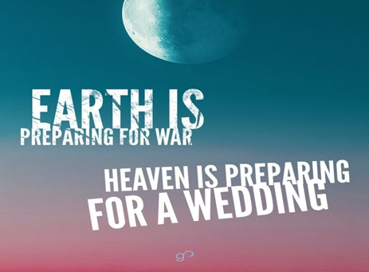

Slide 18
Spiritual Warfare
10% Satan’s Tactics
90% How We Respond
Remember… With God We Are Not
Helpless
Hopeless
We Are Powerful!!

Slide 19
Repeat
These are the 2 Most Important Hours of My Week – Help Me to Cherish Them
I Am Here Today to Worship
Not to Be Entertained
I Am Singing to An Audience of One
Accept My Worship Oh Lord!

Slide 20
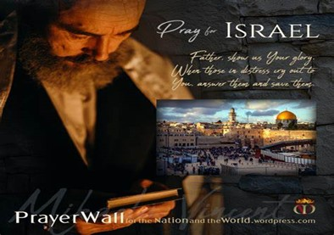

And All of the Innocent Victims
on Both Sides

Slide 21
May the Lord answer you in the day of trouble! May the name of the God of Jacob protect you! ² May he send you help from the sanctuary and give you support from Zion! ³ May he remember all your offerings and regard with favor your burnt sacrifices! Selah ⁴ May he grant you your heart's desire and fulfill all your plans! ⁵ May we shout for joy over your salvation, and in the name of our God set up our banners! May the Lord fulfill all your petitions! ⁶ Now I know that the Lord saves his anointed; he will answer him from his holy heaven with the saving might of his right hand. ⁷ Some trust in chariots and some in horses, but we trust in the name of the Lord our God. ⁸ They collapse and fall, but we rise and stand upright. ⁹ O Lord, save the king! May he answer us when we call.
Prayer
for Israel
Psalm 20

Slide 22
Repeat
I Lift My Offering to You
Let It Please You Oh Lord
This is My Seed
Although It Leaves My Hand
It will Never Leave My Life
You Will Multiply It!
Accept My Seed Oh Lord!

Slide 23
There was once a handyman who had a dog named Mace. Mace was a great dog except he had one weird habit: he liked to eat grass -- not just a little bit, but in quantities that would make a lawnmower blush. And nothing, it seemed, could cure him of it. One day, the handyman lost his wrench in the tall grass while he was working outside. He looked and looked, but it was nowhere to be found.
As it was getting dark, he gave up for the night and decided to look the next morning. When he awoke, he went outside and saw that his dog had eaten all the grass in the area, around where he had been working, and his wrench now lay in plain sight, glinting in the sun.
Going out to get his wrench, he called the dog over to him and said, "A grazing Mace, how sweet the hound, that saved a wrench for me."

