Slide 1
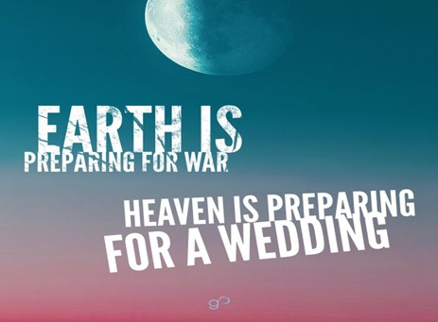

Slide 2
Spiritual Warfare
10% Satan’s Tactics
90% How We Respond
Remember… With God We Are Not
Helpless
Hopeless
We Are Powerful!!

Slide 3
Repeat
These are the 2 Most Important Hours of My Week – Help Me to Cherish Them
I Am Here Today to Worship
Not to Be Entertained
I Am Singing to An Audience of One
Accept My Worship Oh Lord!

Slide 4
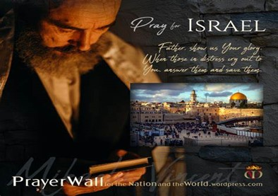

And All of the Innocent Victims
on Both Sides

Slide 5
May the Lord answer you in the day of trouble! May the name of the God of Jacob protect you! ² May he send you help from the sanctuary and give you support from Zion! ³ May he remember all your offerings and regard with favor your burnt sacrifices! Selah ⁴ May he grant you your heart's desire and fulfill all your plans! ⁵ May we shout for joy over your salvation, and in the name of our God set up our banners! May the Lord fulfill all your petitions! ⁶ Now I know that the Lord saves his anointed; he will answer him from his holy heaven with the saving might of his right hand. ⁷ Some trust in chariots and some in horses, but we trust in the name of the Lord our God. ⁸ They collapse and fall, but we rise and stand upright. ⁹ O Lord, save the king! May he answer us when we call.
Prayer
for Israel
Psalm 20

Slide 6
Repeat
I Lift My Offering to You
Let It Please You Oh Lord
This is My Seed
Although It Leaves My Hand
It will Never Leave My Life
You Will Multiply It!
Accept My Seed Oh Lord!

Slide 7
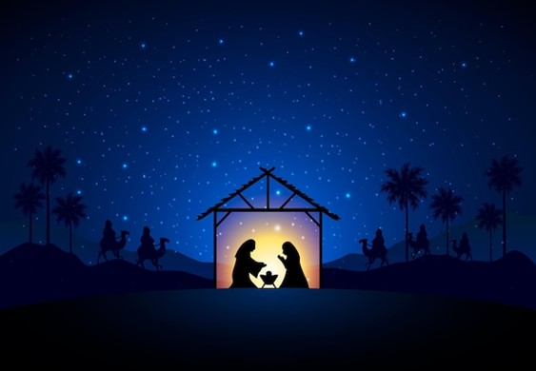
God’s Peace May the Force Be with You
Christmas 2023

Slide 8

The world in which Jesus was born was not the…
…peaceful place many of us have imagined.
Galilee was under the control of the brutal Roman Empire.
When the Romans captured a region or country, they ruled it with marshal law, and levied heavy taxes that put significant burdens on the people.
Rome took 50%, Herod, the governor, took another 25%, and tax collectors kept 15% or more for themselves.
That left the people with 10% or less of their income to live.

Slide 9
40% of infants in Galilee died before the age of five.
They had to work non-stop every day just to survive.
The political, economic /spiritual climate was in shambles
Rome had a Powerful Foothold
Religion had a Powerful Foothold
What They Needed was Peace
But Peace was Only in Dreams

Slide 10

God Saw and in the “Fullness of Time” –Gal 4:4
Peace of God is not just a Condition….
…it is a Powerful Force
It is not fragile like the world’s peace
It is a Tangible Force
Rom 16:20, “The God of peace will crush satan under your feet”
He didn’t say the God of Power or God of Strength…
Why?...
God’s Peace is a
3-Fold Force
to be Reckoned With

Slide 11

Luke 2:14 KJV
Glory to God in the highest, / on earth peace, good will toward men.
Peace=Eirene, to bind together that which was separated
John 14:27 KJV
Peace I leave with you, my peace I give unto you: not as the world giveth, give I unto you. Let not your heart be troubled, neither let it be afraid.
John 14:27 NLT
I am leaving you with a gift—peace of mind and heart. And the peace I give is a gift the world cannot give. So don’t be troubled or afraid.
His name shall be called Wonderful, Counsellor, The mighty God, The everlasting Father, The Prince of Peace. -Isa 9:6
Peace= Shalom – whole mentally, physically, spiritually

Slide 12
Romans 5:1 - Therefore, having been justified by faith, we have peace with God through our Lord Jesus Christ.
Therefore, since we have been justified [that is, acquitted of sin, declared blameless before God] by faith, [let us grasp the fact that] we have peace with God [and the joy of reconciliation with Him] through our Lord Jesus Christ (the Messiah, the Anointed). AMP
Philippians 4:6-7 - Do not be anxious about anything, but in everything by prayer and supplication with thanksgiving let your requests be made known to God. And the peace of God, which surpasses all understanding, will guard your hearts and your minds in Christ Jesus.
Spiritual Peace

Slide 13

1 Cor 14:33, For God is not a God of confusion but of peace
Message- God doesn't stir us up into confusion; he brings us into harmony.
Isaiah 26:3, You will keep in perfect peace those whose minds are steadfast, because they trust in you.
Psalm 4:8 -In peace I will both lie down and sleep; for you alone, O Lord, make me dwell in safety.
Phil 4:7, And the peace of God, which surpasses all understanding, will guard your hearts / your minds in Christ Jesus.
Personal Peace

Slide 14

Ephesians 2:14, For he himself is our peace, who has made us both one and has broken down in his flesh the dividing wall of hostility.
Ephesians 6:15, And, as shoes for your feet, having put on the readiness given by the gospel of peace.
Colossians 3:15 - And let the peace of Christ rule in your hearts, to which indeed you were called in one body. And be thankful.
John 16:33 - I have said these things to you, that in me you may have peace. In the world you will have tribulation. But take heart; I have overcome the world.”
Relational Peace

Slide 15

How Do I Know His Birth Can Bring Such a Force of Peace?
How Can I Trust the Angels Announcement?
Look at Just 12 Prophecies that where Fulfilled at His Birth
The offspring of a woman. – Genesis 3:15
From a virgin. – Isaiah 7:14
The Son of God – Psalm 2:7
A descendant of Abraham – Genesis 22:18
From the line of Isaac – Genesis 21:12
From the nation of Israel – Numbers 24:17
From the tribe of Judah – Genesis 49:10
From the family of Jesse – Isaiah 11:1
From the house of David – Jeremiah 23:5
In Bethlehem – Micah 5:2
Presented with gifts – Psalm 72:10
Children will be killed – Jeremiah 31:15

Slide 16
How Can this Force Be with You?
First You Have to Believe this IS POSSIBLE
Then Believe it is Possible FOR ME
Accept His Peace and Walk in It
Numbers 6:24-26, The Lord bless you and keep you; the Lord make his face to shine upon you and be gracious to you; the Lord lift up his countenance upon you and give you peace.

Slide 17



This Weeks Challenge
This Week When the Force of Life’s Challenges…
…Start To Press You Down
Press Up to God (Power of Prayer)
Draw on the Force of His Peace!!! (Power of Faith)
Rest in His Forceful Peace! (Power of Resistance)

Slide 19
An old country preacher needed to have a sign made that would tell the people passing on the freeway about The Wonder of Christmas. He lived quite a ways out of town and did not have access to any of the modern conveniences of phone or email, in fact, he only was able to send quick messages via Telegraph from the local General store.
Since telegraphs charge by the letter, he tried to make his message concise so that the sign builder would know exactly what he wanted, but without wasting extra characters. He rushed down to the General Store and sent his message off.
This story picks up at the sign-making company and the poor clerk who received the telegraph message. As the message printed out she gasped, and fainted. The message that she read, "Unto us a child is born 6 ft long and 3 ft wide.

