Slide 1
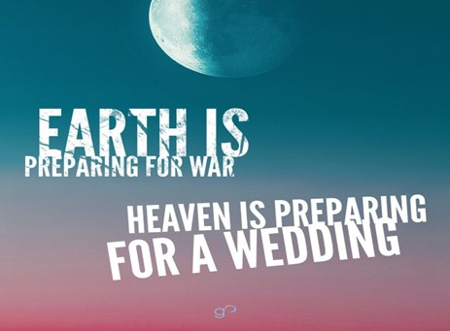


Slide 2
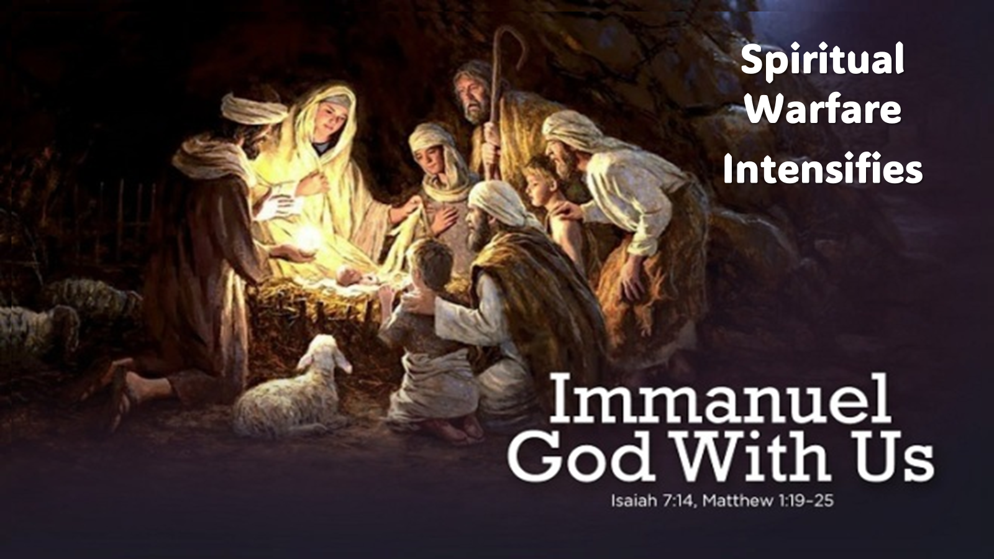
Spiritual Warfare
10% Satan’s Tactics
90% How We Respond
Remember… With God We Are Not
Helpless
Hopeless
We Are Powerful!!

Slide 3
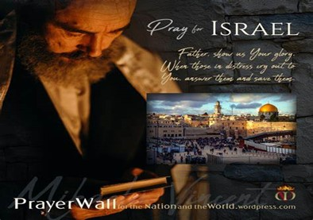

And All of the Innocent Victims
on Both Sides

Slide 4
May the Lord answer you in the day of trouble! May the name of the God of Jacob protect you! ² May he send you help from the sanctuary and give you support from Zion! ³ May he remember all your offerings and regard with favor your burnt sacrifices! Selah ⁴ May he grant you your heart's desire and fulfill all your plans! ⁵ May we shout for joy over your salvation, and in the name of our God set up our banners! May the Lord fulfill all your petitions! ⁶ Now I know that the Lord saves his anointed; he will answer him from his holy heaven with the saving might of his right hand. ⁷ Some trust in chariots and some in horses, but we trust in the name of the Lord our God. ⁸ They collapse and fall, but we rise and stand upright. ⁹ O Lord, save the king! May he answer us when we call.
Prayer
for Israel
Psalm 20

Slide 6


Slide 7


Slide 8


Slide 9


Slide 10

Christmas
2023

Slide 11
Christmas is a Time of Great Joy
Luke 2:10-11 KJV
¹⁰ And the angel said unto them, Fear not: for, behold, I bring you good tidings of great joy, which shall be to all people. ¹¹ For unto you is born this day in the city of David a Saviour, which is Christ the Lord.
Luke 2:10-11 ISV
¹⁰ Then the angel told them, “Stop being afraid! Listen! I am bringing you good news of great joy for all the people. ¹¹ Today your Savior, the Lord Messiah,^{[a]} was born in the City of David.
Joy= calm delight
Chairo -> Charis=Grace -> Charisma=Gift

Slide 12
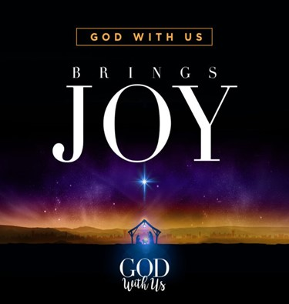
We'll begin by Understanding the Gift of Joy from God.
We'll see how Joy is not just an Emotion…
…but a Divine Gift
…Jesus is Our Source
A Manifestation of the Fruit of the Spirit…
…God Plants in Our Hearts
It Moves from our Hearts to…
  Our Feet to Walk it Out (example)
  Our Hands+Mouth to Share it Out (witness)

Slide 13
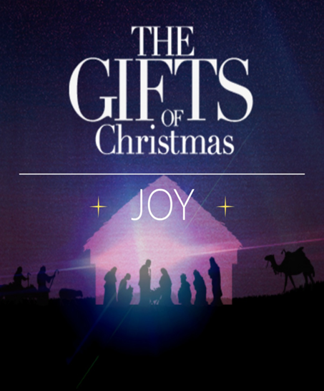
This joy is not just a feeling or just a moment of happiness or
…fleeting sense of pleasure
It's a deep-seated, unshakeable certainty no matter what happens,
…we are held secure in the loving arms of our Savior
More than an emotion, but a divine gift freely given to us
…by our Heavenly Father
A gift that's meant to be cherished, nurtured, and shared

Slide 14
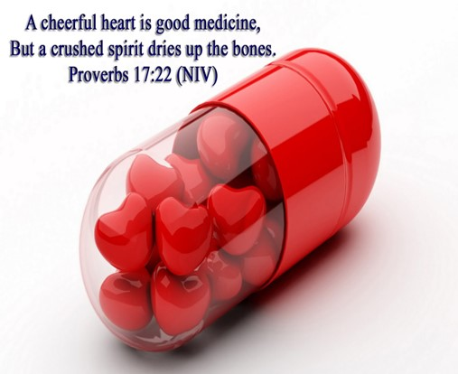
Proverbs 17:22, "A cheerful heart is good medicine, but a crushed spirit dries up the bones."
  a Cheerful Heart, a Heart Filled with Joy
  It's Good for Our Health, Our Well-being, Our Spirit.
But a Crushed Spirit, a Spirit Void Of Joy, Dries Up the Bones.
  It Saps Our Strength, Our Vitality, Our Life Force.
What Does This Tell Us About The Gift Of Joy?
  Joy Is Essential For Our Well-being.
  It's Not a Luxury, Not an Optional Extra, But a Necessity
Without Joy, our Spirit is Crushed, our Life Force is Drained,
…Our Bones Are Dried Up
With Joy, Our Spirit Is Uplifted, Our Life Force Is Renewed,
…Our Bones Are Strengthened

Slide 15
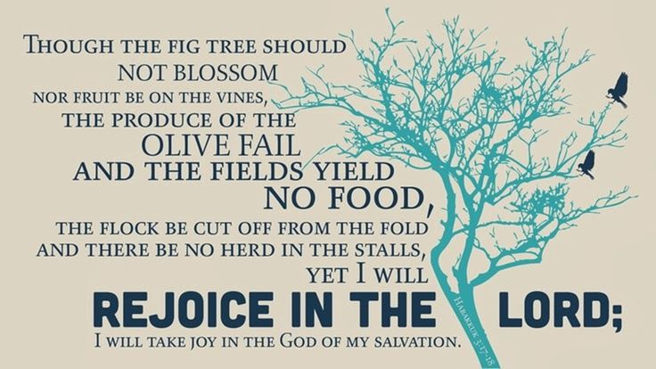
Habakkuk 3:18, "yet I will rejoice in the Lord, I will be joyful in God my Savior." This verse is a declaration of faith, a proclamation of joy. It's saying that no matter what happens, no matter how dire the circumstances, I will rejoice in the Lord. I will be joyful in God my Savior.
What Does This Tell Us About The Gift Of Joy?
It Tells Us That Joy Is Not Dependent On Circumstances
      It's Not Contingent On What's Happening Around Us
      It's Not Determined By The Ups And Downs Of Life
      It's Dependent On Our Relationship With God
      It's Determined By Our Trust In His Promises

Slide 16
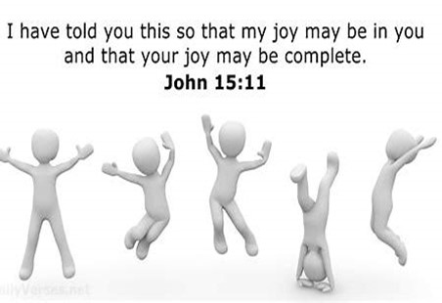
"These things I have spoken to you, that my joy may be in you, and that your joy may be full." John 15:11
    This is a Promise From Jesus
    He's Saying That His Joy Is In His Relationship With The Father
    Not Just a Little Bit Of Joy, But Full Joy...
    …Complete Joy, Overflowing Joy
What Does This Tell Us About the Gift Of Joy?
Joy Is Not Something We Have To Strive For,
Or to Earn, or Work for
It's a Gift
He Doesn't Just Give Us A Little Bit Of Joy, But Full Joy.
Complete Joy
Overflowing Joy

Slide 17
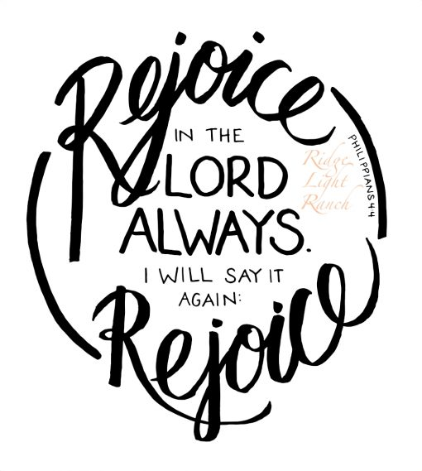
Phi 4:4, "Rejoice in the Lord always. I will say it again: Rejoice!“
This is a Command, Not a Suggestion
    It's a call to action, not a passive observation
    Paul is telling us to rejoice, to celebrate, to be joyful (x2)
The Command to Rejoice is Not Conditional
    Not, "Rejoice if you feel like it, or things are going well"
    He simply says, "Rejoice in the Lord always“
    This is a call to constant, unceasing, unwavering joy
    It's a call to celebrate, regardless of circumstances, feelings
    Its a profound challenge, but also a profound opportunity

Slide 18
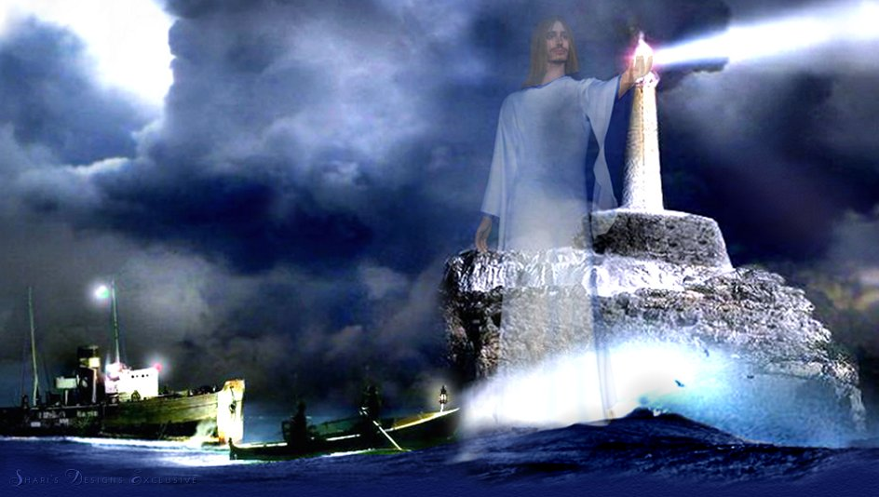
Rejoice in the Lord Always
And Again, I Say Rejoice
Be His Beacon in the Night !
This Call to Rejoice a Benefit to Ourselves and Others
When We Rejoice, Celebrate, Express Our Joy,
…We Become A Source Of Joy For Others.
We Become A Beacon Of Hope, A Light In The Darkness,
…A Source Of Encouragement
We Become A Living Testimony To The Power Of God's Love…
...To The Reality Of His Presence
…To The Truth Of His Promises

Slide 19
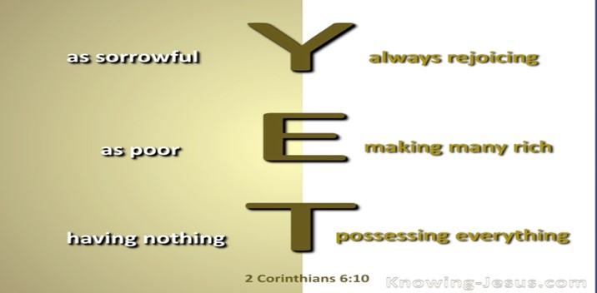
Apostle Paul knew what it meant to rejoice in the Lord.
Despite facing numerous trials and tribulations,
imprisonment, beatings, shipwrecks,/ various forms of persecution,
…Paul remained Joyful.
2 Cor 6:10, he describes himself as "sorrowful, yet always rejoicing.“
This is a testament to Paul's unwavering faith, his unshakeable trust in God, his unyielding commitment to the gospel.
It's a Testament to His Understanding of the True Nature Of Joy,
Not As A Fleeting Emotion,
But As A Deep-seated…
…Unshakeable Certainty In The
…Goodness And Faithfulness Of God.

Slide 20
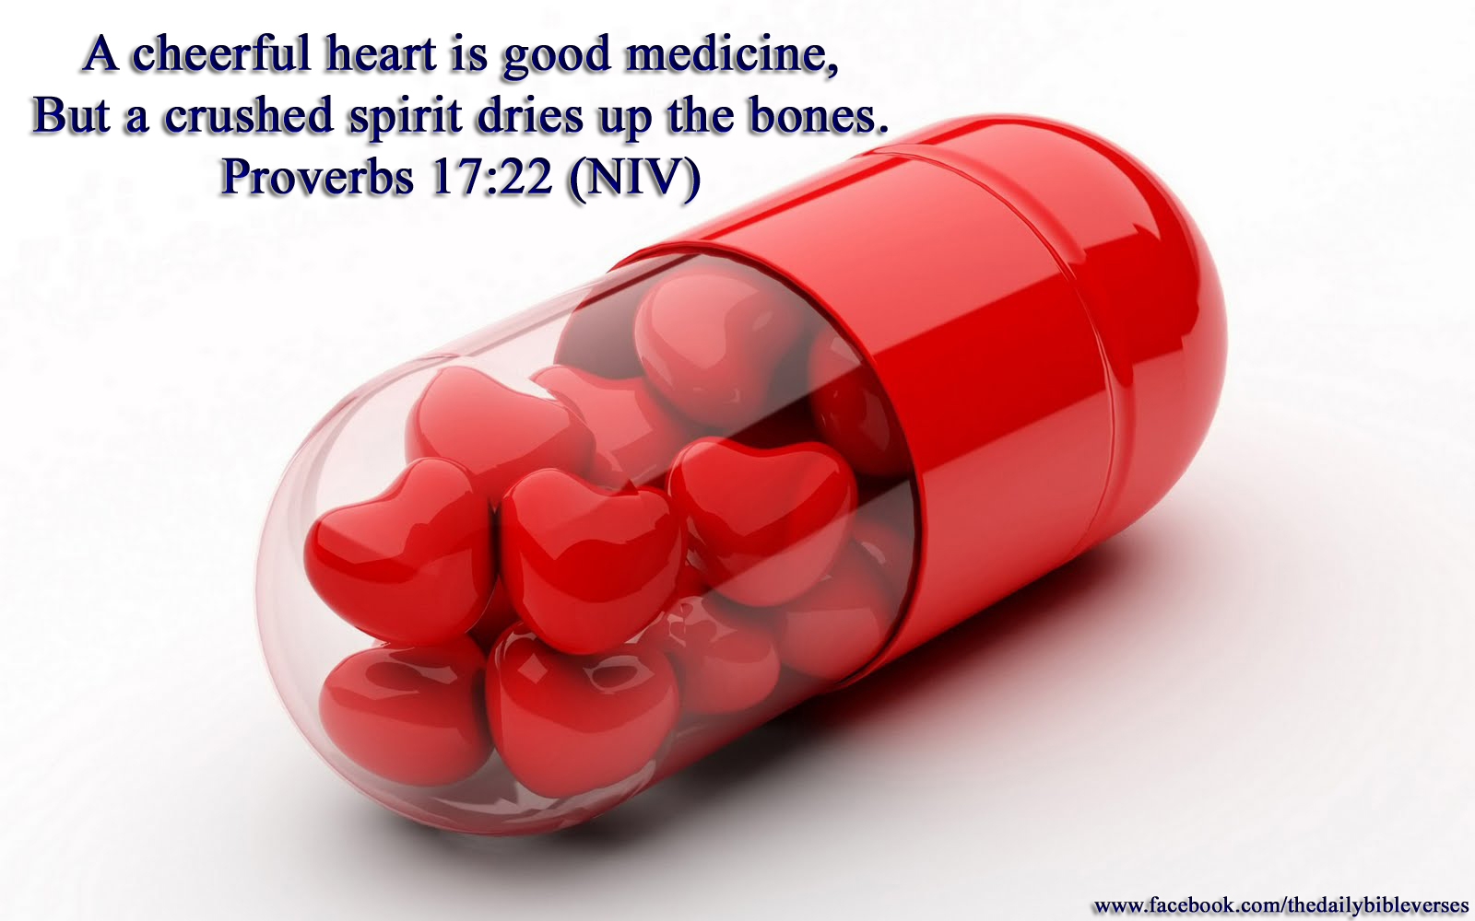

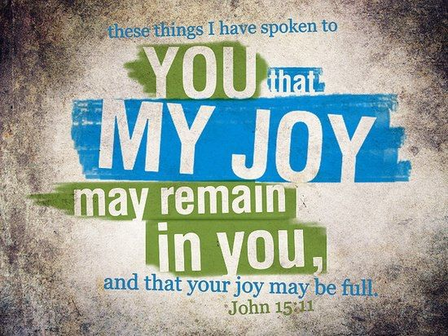

This Weeks Challenge
Let’s Take the “Paul Attitude Challenge”
2 Cor 6:10,"sorrowful, yet always rejoicing”
No Matter What Challenges or Obstacles
We Face This Week…
Learn to Face It …
Head On
With Your…
Praise On
Watch How Your Life Will Bloom with Opportunity!
With God- For God- Through God

Slide 22
Wise women
Someone speculated what the first Christmas might have been like if Wise Women had come from the east instead of Wise Men.
First of all, they would have asked for directions and made it to Bethlehem on time. Second, they would have helped with the delivery, cleaned up the stable, and brought some practical gifts like a casserole so the family would have something to eat.
"Christmas is just like any day at the office - you do all the work and one guy in a suit gets all the credit."

