Slide 1

Top Ten + One Sayings/ Proverbs (5yo)
11- Better to be safe than –
…Punch a fifth grader.
10- Strike while the –
…Bug is close
9- It is always darkest before –
…Daylight savings time
8- Never underestimate the power of –
…Termites
7- Don’t bite the hand that –
…Looks dirty

Slide 2
6- A miss is as good as a –
…A mister
5- Where there is smoke –
…There’s pollution
4- If as first you don’t succeed –
…Get new batteries
3- Laugh / the world laughs with you; cry and -
…You’ll have to blow your nose
2- A penny saved is –
…Not much
1- If you lie down with dogs –
…You will stink in the morning!

Slide 4
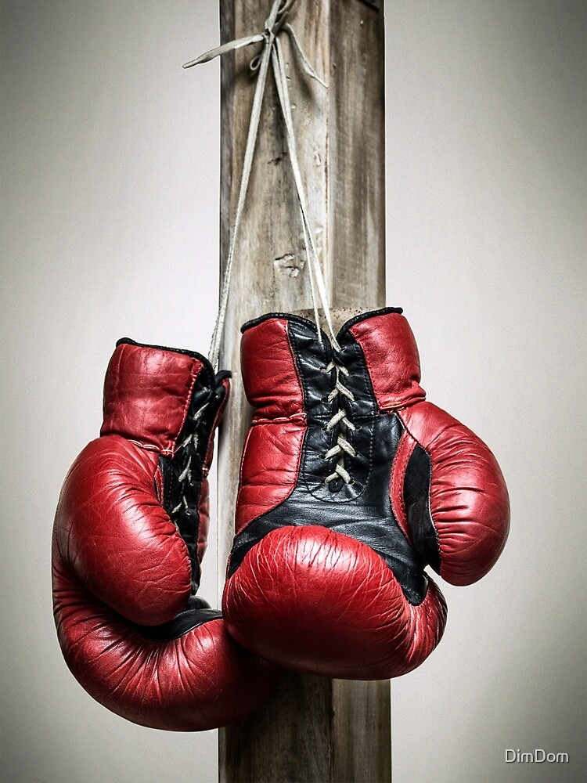
Get Out From Under Table
And Fight Like a Man …
…Christian Soldier
Judges 1:1-7
Edward Christian Church

Slide 5
1 Now after the death of Joshua it came to pass, that the children of Israel asked the Lord, saying, Who shall go up for us against the Canaanites first, to fight against them? ² And the Lord said, Judah shall go up: behold, I have delivered the land into his hand. ³ Judah said unto Simeon his brother, Come up with me into my lot, that we may fight against the Canaanites; I likewise will go with thee into thy lot. So Simeon went with him. ⁴ And Judah went up; and the Lord delivered the Canaanites the Perizzites into their hand: and they slew of them in Bezek ten thousand men. ⁵ They found Adonibezek in Bezek/ they fought against him, and they slew the Canaanites/ the Perizzites. ⁶ But Adonibezek fled; they pursued after him, caught him,/ cut off his thumbs/ his great toes.⁷ Adonibezek said, 70 kings, having their thumbs/ their great toes cut off, gathered their meat under my table: as I have done, so God hath requited me. And they brought him to Jerusalem, and there he died.

Slide 6

The Plan
God has a Plan
  Each person has an opportunity to be part of that plan
  God has placed potential in each of us
Satan also has a Counter Plan
  Satan cannot see all…
  Satan does not know all…
  But he does mark our potential

Slide 7
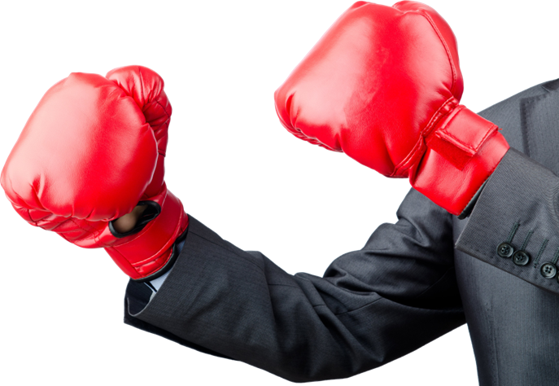
God Wants Us Positioned for Victory
Our Position has Four Sides
      Spiritual
      Mental
      Physical
      Financial

Slide 8
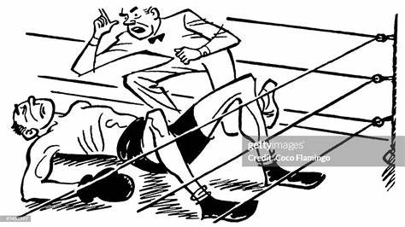
Satan Knows If He Can Shut Us Down in Any One of the Four Sides…
He Can Hinder our Position and Drastically…
…Reduce our Potential
  Spiritually- hinder ability to act in Christ
  Mentally- hinder ability to think
  Physically- hinder ability to participate
  Financially- hinder ability to invest in Kingdom

Slide 9
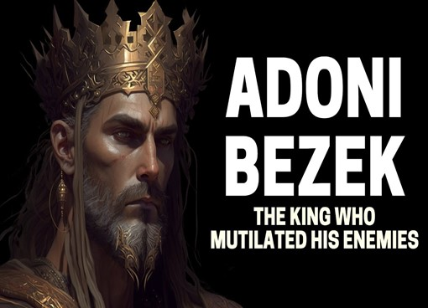
The Story
Joshua Dead –
  Judah (praise) leading
  Simeon (hear intelligently)
Adonibezek (Lord Lightning) –
  Acquired Name
  Describes his Method of Warfare
  Ambush
Sealed Defeat - ambush led attack, but
the things he does next seals defeat...

Slide 10
The Strategy
Dethrone
Best Way To Destroy Kingdom: Attack King
  Authority Attacked
  No Good to Capture Common Man or Foot
  Soldier; No Authority
  Remove Potential to Fulfill Call
  All possibilities Removed at Once

Slide 11
The Strategy
Disarm
“cut off thumbs”
  Grip Attacked
  Remove Potential…
  …to aggressively hold a sword or bow
  Remove Potential…
  … to fight back

Slide 12
The Strategy
Disable
“great toes cut off”
  Balance Attacked
  The big toe placed on foot to allow balance
  Remove Potential…
  …to Stand and Fight--taken away

Slide 13
The Strategy
Debase
“gathered their meat under table”
  Integrity Attacked
  Humiliate
  Remove Potential…
  …to have Self-respect
  Used to feasting on best brought before
  Now Gather (glean) under the table

Slide 14
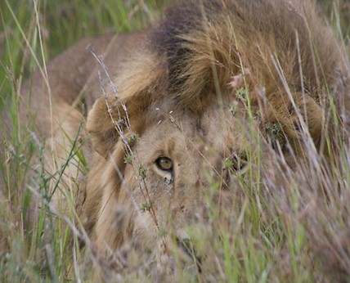
The Satan’s Strategy
There is Another Lord Lightening on the Prowl
1 Peter 5:8 (MSG)
⁸ Keep a cool head. Stay alert. The Devil is poised to pounce, and would like nothing better than to catch you napping.

Slide 15

Ephesians 6:11 KJV
¹¹ Put on the whole armour of God, that ye may be able to stand against the wiles of the devil.
Ephesians 6:11 NLT
¹¹ Put on all of God’s armor so that you will be able to stand firm against all strategies of the devil.
Ephesians 6:11 Amp
¹¹ Put on God’s whole armor [the armor of a heavy-armed soldier which God supplies], that you may be able successfully to stand up against [all] the strategies and the deceits of the devil.

Slide 16
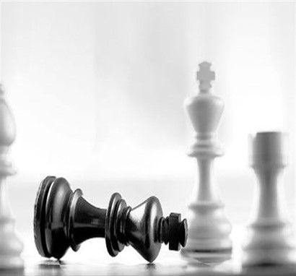
Spiritual Warfare
Dethrone
  Rev. 1:6, “He hath made us kings / priests
  Potential
  Means you can operate in a realm of authority and power that can deal deadly blows to Satan
  Remove Potential to Fulfill Call
  all possibilities removed at once

Slide 17

Spiritual Warfare
Disarm
“cut off thumbs”
  Remove Potential to…
…grip on the Sword of the Word
  Too many are experience-centered
  it’s not experience, but by every Word
  2 Timothy 3:16-17 (MSG)
¹⁶ Every part of Scripture is God-breathed/ useful one way or another—showing us truth, exposing our rebellion, correcting our mistakes, training us to live God's way. ¹⁷ Through the Word we are put together/ shaped up for the tasks God has for us.

Slide 18
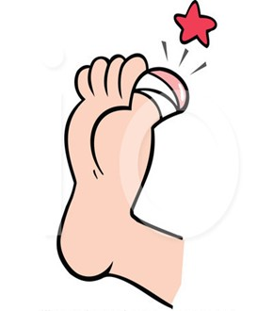
Spiritual Warfare
Disable
“great toes”
  Balance Attacked
-out of Spiritual balance
  Remove Potential…
…to stand and fight
  Too many overboard - shout today, pout tomorrow - big toe amputation

Slide 19
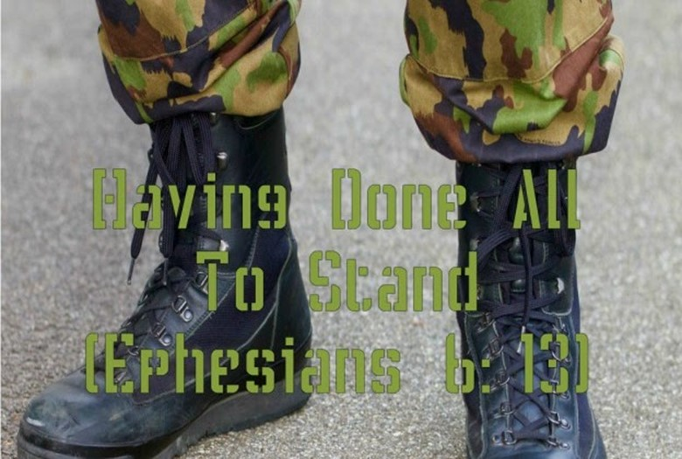
Ephesians 6:13-14,¹³ Therefore, put on the complete armor of God, so that you will be able to [successfully] resist and stand your ground in the evil day [of danger], and having done everything [that the crisis demands], to stand firm [in your place, fully prepared, immovable, victorious]. ¹⁴ So stand firm and hold your ground, 1 Corinthians 15:58
I Cor 15:58 Amp -Therefore, my beloved brothers and sisters, be steadfast, immovable, always excelling in the work of the Lord [always doing your best and doing more than is needed], being continually aware that your labor [even to the point of exhaustion] in the Lord is not futile nor wasted [it is never without purpose

Slide 20
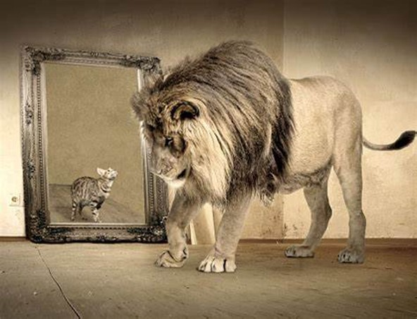
Spiritual Warfare
Debase
“gathered meat under table”
-take away authority, grip, balance; then
  Integrity Attacked
    Humiliate
  Remove Potential…
…to have Self-Respect and Will to Resist
  Talk to You – You’re Nothing, Nobody
  Blessed when he says you can be blessed!

Slide 21
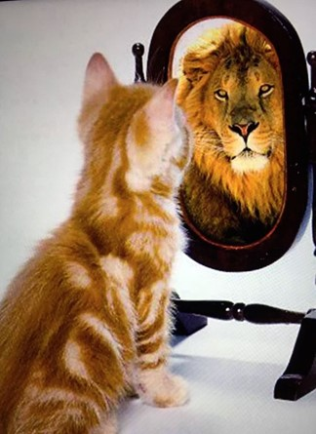
“In fact, even the hairs on your head are all numbered. Do not be afraid; you are more valuable than many sparrows.” – Luke 12:7
“For you created my inmost being; you knit me together in my mother’s womb. I praise you because I am fearfully and wonderfully made; your works are wonderful, I know that full well.” – Psalm 139:13–14
“You were bought at a price. Therefore honor God with your bodies.” – 1 Corinthians 6:20

Slide 22
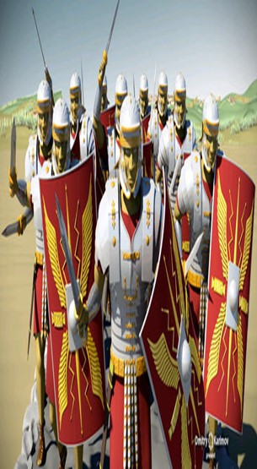
God’s Strategy (4-6)
Recognize the Enemy
  Satan seeks to Destroy Potential
Recognize the Attack
  any situation used or ordered by Satan to Sabotage Your Assignment from God
Recognize We Must the Aggressor
  Don’t Wait for the Battle to Come to You

Slide 23
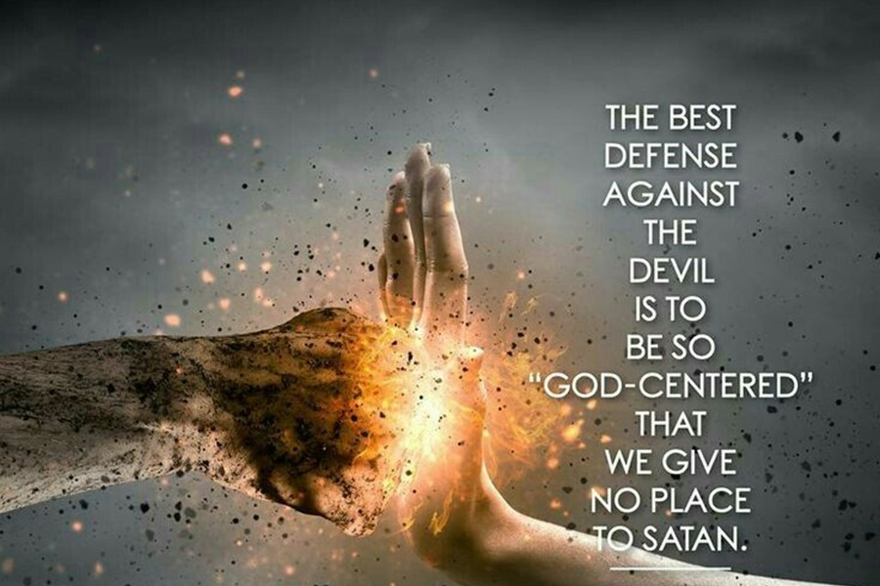
God’s Promise (4-6)
Prov 28:1
The wicked flee when no man pursueth: but the righteous are bold as a lion.
Deut 28:7, “The LORD shall cause thine enemies that rise up against thee to be smitten before thy face: they shall come out against thee one way, and flee before thee seven ways”
Prov 24:16
“For a just man falleth seven times, and riseth up again: but the wicked shall fall into mischief”

Slide 24
This Weeks Assignment
Remember - God Never Wastes His Words
He Only Speaks Words that He Means, Words that Produce Life and Words that Produce Results
Numbers 23:19 KJV - God is not a man, that he should lie; neither the son of man, that he should repent: hath he said, and shall he not do it? or hath he spoken, and shall he not make it good? God is Faithful to Keep His Word.
God Has Enabled Us to Get Out From Under the Table
With- His Truth and Power to Fulfil
Challenge is ---Just Do It!
Start 2024 – Strong!!!

