Slide 1
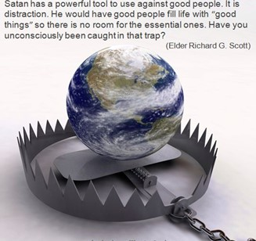
Spiritual
Warfare Intensifies
Spiritual Warfare
10% Satan’s Tactics
90% How We Respond
Remember… With God We Are Not
Helpless
Hopeless
We Are Powerful!!

Slide 3
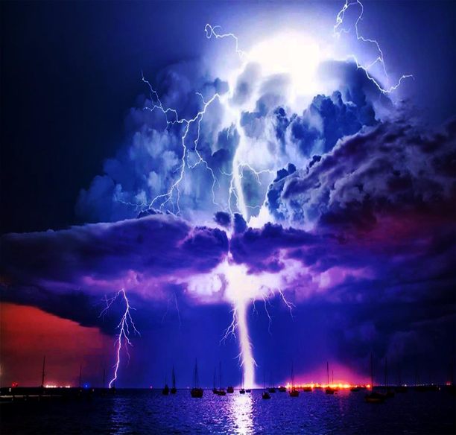
When the Bottom Drops Out -pt1
Edward Christian Church
Jan 7, 2024
Matthew 14:22-33
“Assurances We Can Count On”

Slide 4
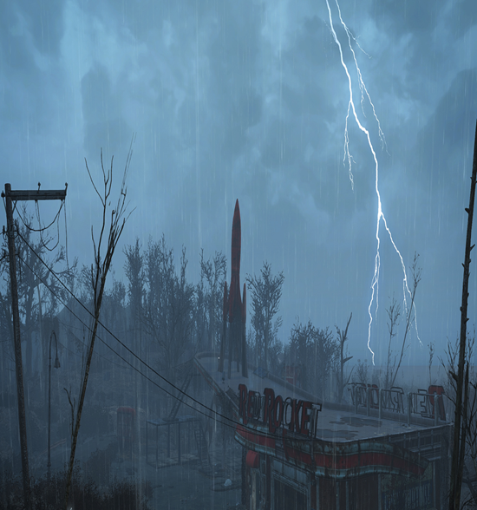
Storms= Violent Disturbance in Atmosphere
Causing Damage to Any Thing/ One in it’s Path
Classified=Physical, Mental, Emotional, Spiritual
Origin…
Satan ..Purpose to “Destroy”
John 10a …Thief cometh…steal, kill, destroy
God ..Purpose to “Build Up”
John 10b …But I AM Come..life..more abound..
Always in Control -Great God Jehovah
Always a Lesson - Search the Purpose

Slide 5
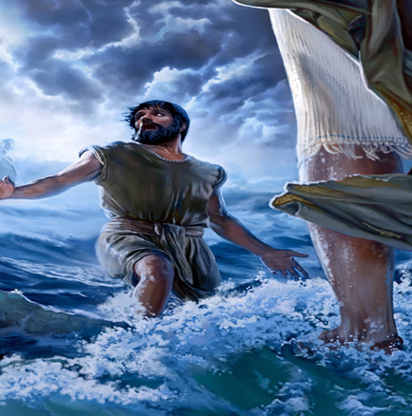
Matthew 14
This Passage Speaks of Unstable Times…
Vision = Obscure
Footing = Unsure
Security = Insecure
Ship -“Collective”
Peter -“Individual”
The Bottom had Dropped Out …
…2 Storms that Day at Same Time
Circumstances on Outside
Disrupted Peace on Inside

Slide 6
Matthew 14
In These Times…
It is Useless to…
…Focus on the Unsure Things
Brings Fear, Frustration, No Hope
It is Useful to…
…Focus on the Sure Things
Calms Fear, Frustration, Brings Hope
There Were 5 Things…
…Sure Things
Let Us Focus on Them

Slide 7
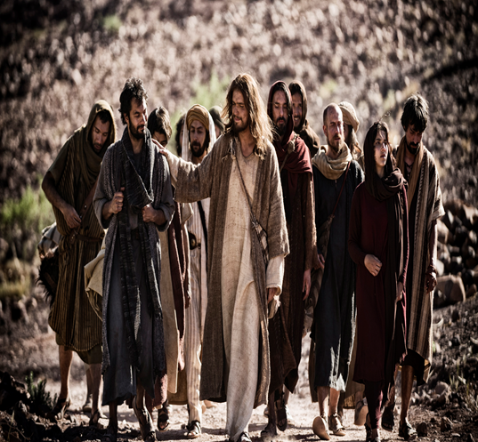
Five Assurances in Our Storms
#1- The Lord Brought Them There (22)
“Immediately Jesus made the disciples get into the boat and go on ahead of him to the other side, while he dismissed the crowd.”
No Accident, No Blind Move
The Timing of the Storm Jesus Knew:
Opportunity was Present
Storm was About to Strike
Test Time after the Lesson

Slide 8
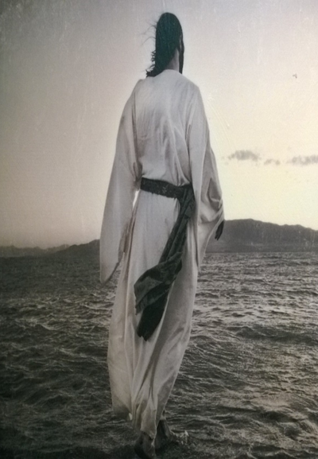
The Storms of Life Reveal…
God’s Great Love for Us!
He Knows that Some Things Can Only…
…Be Learned in the Storm!!!
During These Seasons...
Remember…
James 1:12 (KJV) ¹² Blessed is the man that endureth temptation: for when he is tried, he shall receive the crown of life, which the Lord hath promised to them that love him.

Slide 9
Six Purposes for Storms in Our Life:
Connecting - gets our attention
Psa 119:71 It is good for me that I have been afflicted, That I may learn Your statutes.
71 My troubles turned out all for the best - they forced me to learn from your textbook. -Message
Companionship -intimate relationship
Be merciful to me, O God, be merciful to me! For my soul trusts in You; And in the shadow of Your wings I will make my refuge, Until these calamities have passed by. -Psa 57:1
Conformity - conforming our image
Rom 8:29- For whom He foreknew, He also predestined to be conformed to the image of His Son, that He might be the firstborn among many brethren.

Slide 10
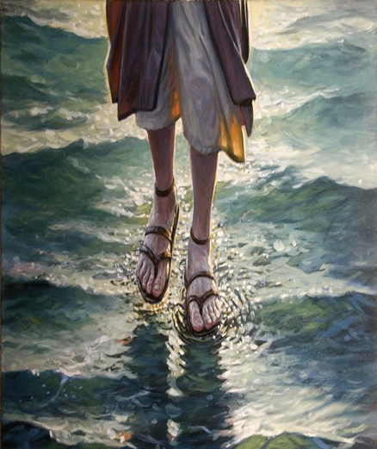
Six Purposes for Storms in Our Life:
Comfort
God doesn’t always just do something
IN us, but often He does something THROUGH us.
if you want to be a Blessing to others, you have to be Broken. A vessel that's unbroken has very limited use. 2 Cor 1:3-4
Convictions
Pain Solidifies your Conviction that God is Sufficient / will Take Care of you.
Change
Paul is a great Example of Change
when God got his Attention on Damascus Road.

Slide 11



Slide 12

This Weeks Challenge
When Things Don’t Go As You Planned…
…Refuse to Jump to the Conclusion
God is…
Angry at Me
Punishing Me
Driving Me Away
…Realize that God Always Has…
Plan
Path
Power
Practice Praising Him in the Storm

Slide 13
END part 1
Pt 2 r
http://edwardnc.org/ecc/2024/01jan/14

Slide 14
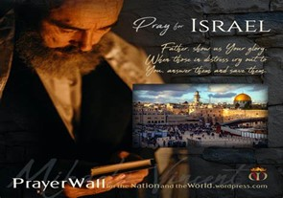

And All of the Innocent Victims
on Both Sides

Slide 15
May the Lord answer you in the day of trouble! May the name of the God of Jacob protect you! ² May he send you help from the sanctuary and give you support from Zion! ³ May he remember all your offerings and regard with favor your burnt sacrifices! Selah ⁴ May he grant you your heart's desire and fulfill all your plans! ⁵ May we shout for joy over your salvation, and in the name of our God set up our banners! May the Lord fulfill all your petitions! ⁶ Now I know that the Lord saves his anointed; he will answer him from his holy heaven with the saving might of his right hand. ⁷ Some trust in chariots and some in horses, but we trust in the name of the Lord our God. ⁸ They collapse and fall, but we rise and stand upright. ⁹ O Lord, save the king! May he answer us when we call.
Prayer
for Israel
Psalm 20

Slide 17
It was at the end of the year, and a kindergarten teacher was receiving Xmas gifts from her pupils. The florist's son handed her a gift. She shook it, held it overhead, and said, "I bet I know what it is. Some flowers.“ "That's right" the boy said, "but how did you know?" "Oh, just a wild guess," she said. The next pupil was the sweet shop owner's daughter. The teacher held her gift overhead, shook it, and said, "I bet I can guess what it is. A box of sweets.“ "That's right, but how did you know?" asked the girl.
"Oh, just a wild guess," said the teacher. The next gift was from the son of the liquor store owner. The teacher held the package overhead, but it was leaking. She touched a drop of the leakage with her finger and touched it to her tongue. "Is it wine?" she asked. "No," the boy replied, with some excitement. The teacher repeated the process, taking a larger drop of the leakage to her tongue. "Is it champagne?" she asked. "No," the boy replied, with more excitement. The teacher took one more taste before declaring "I give up, what is it?“ With great glee, the boy replied, "It's a puppy!"

