Slide 2
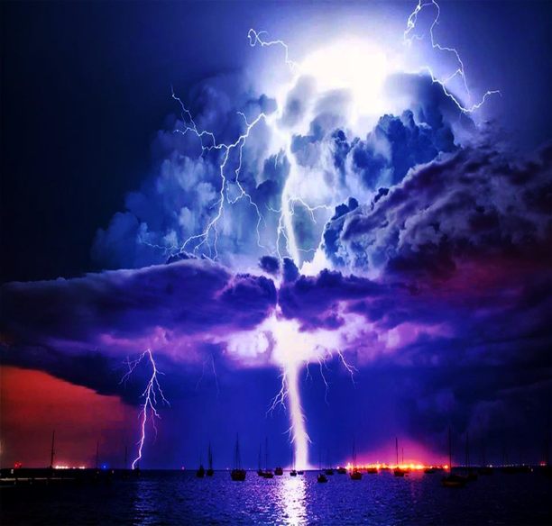
When the Bottom Drops Out –pt2
Edward Christian Church
Jan 14, 2024
Matthew 14:22-33
“Assurances We Can Count On”

Slide 3
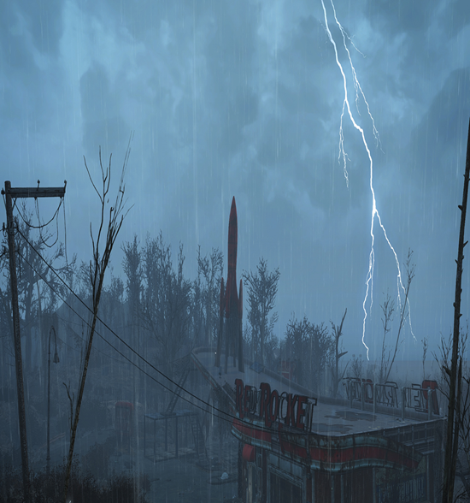
Storms= Violent Disturbance in Atmosphere
Causing Damage to Any Thing/ One in it’s Path
Classified=Physical, Mental, Emotional, Spiritual
Origin…
Satan ..Purpose to “Destroy”
John 10a …Thief cometh…steal, kill, destroy
God ..Purpose to “Build Up”
John 10b …But I AM Come..life..more abound..
Always in Control -Great God Jehovah
Always a Lesson - Search the Purpose

Slide 4
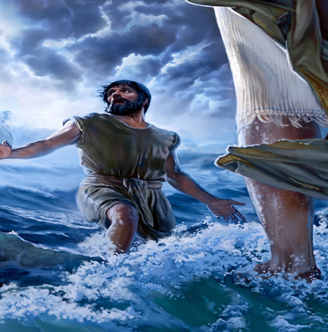
Matthew 14
This Passage Speaks of Unstable Times…
Vision = Obscure
Footing = Unsure
Security = Insecure
Ship -“Collective”
Peter -“Individual”
The Bottom had Dropped Out …
…2 Storms at Same Time
Circumstances on Outside
Disrupted Peace on Inside

Slide 5
Matthew 14
In These Times…
It is Useless to…
…Focus on the Unsure Things
Brings Fear, Frustration, No Hope
It is Useful to…
…Focus on the Sure Things
Calms Fear, Frustration, Brings Hope
There Were 5 Things…
…Sure Things
Let Us Focus on Them

Slide 6
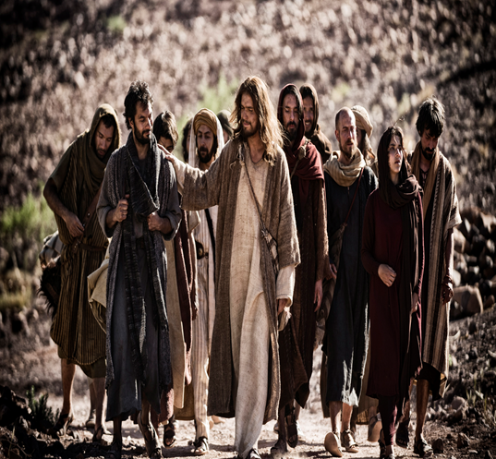
Five Assurances in Our Storms
#1- The Lord Brought Them There (22)
“Immediately Jesus made the disciples get into the boat and go on ahead of him to the other side, while he dismissed the crowd.”
No Accident, No Blind Move
The Timing of the Storm Jesus Knew:
Opportunity was Present
Storm was About to Strike
Test Time after the Lesson

Slide 7
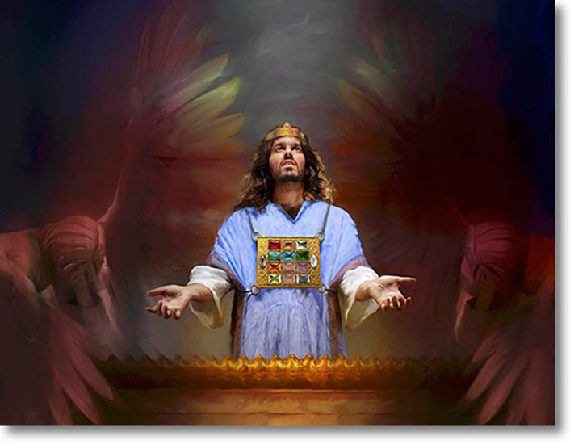
Five Assurances in Our Storms
#2- Jesus Sought God for Them there…
“There Jesus Prayed For His Followers” (23)
Hebrews 4:14-16
¹⁴ Seeing then that we have a great high priest, that is passed into the heavens, Jesus the Son of God, let us hold fast our profession. ¹⁵ For we have not an high priest which cannot be touched with the feeling of our infirmities; but was in all points tempted like as we are, yet without sin.¹⁶ Let us therefore come boldly unto the throne of grace, that we may obtain mercy, and find grace to help in time of need

Slide 8
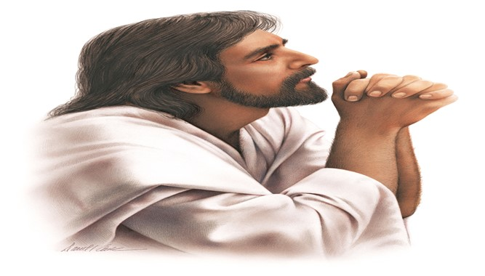
Luke 22:31-32 “Our Great Example”
His Prayer Consists of:
1st - Power
Our Faith Won’t Fail
We Won’t Give Up/ Turn Back
2nd - Prophetic
When You are Converted -Weakness
3rd - Protection -it will be…
Temporary ..When converted
Productive ..strengthen brethren
This is Love on Its Knees

Slide 9
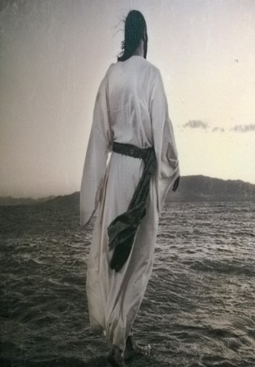
Five Assurances in Our Storms
#3- Jesus Caught Them There …
“The Lord Came To His Own” (25)
Just In Time
Darkest Hour
Victorious Over Greatest Fear!
What They Feared...
…Being Swallowed Up By the raging sea!
…He Reveals Himself Victorious Over It!
What is Your Fear Today ?

Slide 10

There is No Oil Without Squeezing…
No Wine Without Pressing the Grapes…
No Fragrance W-out Crushing the Flowers…
And No Real Joy Without Sorrow.
If You’re Going Through a Storm and…
…The Bottom Seems to be Dropping Out,
Consider that the Storm May be in…
…God’s Will For You.

Slide 11

Five Assurances in Our Storms
#4- Jesus Taught Them There…
“Jesus Helps Us Grow Through Trials”
“Come,” he said. Then Peter got down out of the
boat, walked on the water and came toward Jesus.
But when he saw the wind, he was afraid and,
beginning to sink, cried out, “Lord, save me!”(29-30)
Picture of Divine Power Meeting Human Need

Slide 12
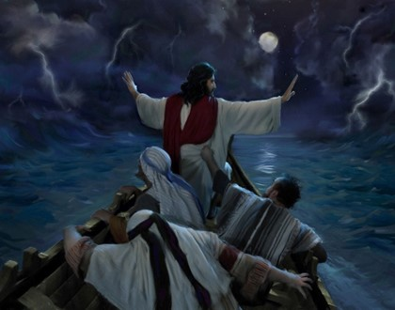
Five Assurances in Our Storms
#5- Jesus Halted The Storm There…
“Jesus Will Eventually Bring Peace”
“Immediately Jesus reached out his hand and caught
him. You of little faith, he said. Why did you doubt?
And when they climbed into the boat, the wind died
down. Then those who were in the boat worshipped
him, saying, Truly you are the Son of God.” (31-33)
Jesus Halted Two Storms that Day
W-Out –the Weather
W-In –the Disciples

Slide 13
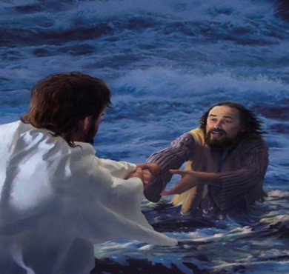
We Have No Need to Fear
When the Bottom Drops Out
Jesus Steps Up

Slide 14



Slide 15
Often After Experiencing Other Victories.
Peter witnessed the feeding of 5000
Can Occur Even In The Center Of God’s Will
Easy to assume struggling = Out of God’s will
Jesus Sent Them Into the Storm
Strengthens Our Dependence On Jesus.
As Peter began to sink he cried to Jesus
That bad thing became a positive experience.
Does Not Hinder Future Effectiveness.
Sinking people are not washed up
They are in a powerful position to see God

Slide 16
End Pt 2

Slide 17
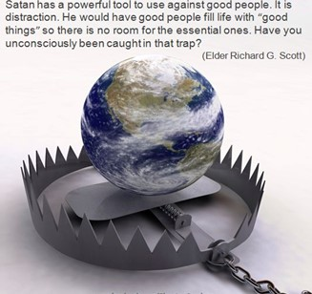
Spiritual
Warfare Intensifies
Spiritual Warfare
10% Satan’s Tactics
90% How We Respond
Remember… With God We Are Not
Helpless
Hopeless
We Are Powerful!!

Slide 18
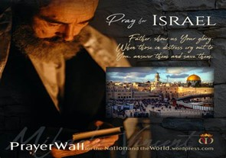

And All of the Innocent Victims
on Both Sides

Slide 19
May the Lord answer you in the day of trouble! May the name of the God of Jacob protect you! ² May he send you help from the sanctuary and give you support from Zion! ³ May he remember all your offerings and regard with favor your burnt sacrifices! Selah ⁴ May he grant you your heart's desire and fulfill all your plans! ⁵ May we shout for joy over your salvation, and in the name of our God set up our banners! May the Lord fulfill all your petitions! ⁶ Now I know that the Lord saves his anointed; he will answer him from his holy heaven with the saving might of his right hand. ⁷ Some trust in chariots and some in horses, but we trust in the name of the Lord our God. ⁸ They collapse and fall, but we rise and stand upright. ⁹ O Lord, save the king! May he answer us when we call.
Prayer
for Israel
Psalm 20

Slide 20
Repeat
These are the 2 Most Important Hours of My Week – Help Me to Cherish Them
I Am Here Today to Worship
Not to Be Entertained
I Am Singing to An Audience of One
Accept My Worship Oh Lord!

Slide 21

Victory in Jesus

Slide 22
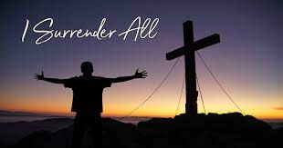

Slide 23
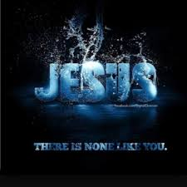

Slide 24
Repeat
I Lift My Offering to You
Let It Please You Oh Lord
This is My Seed
Although It Leaves My Hand
It will Never Leave My Life
You Will Multiply It!
Accept My Seed Oh Lord!

Slide 25
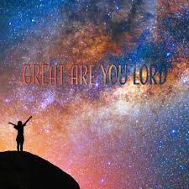

Slide 26
You know it's going to be a BAD DAY when...
> You jump out of bed in the morning / miss the floor.
> Your four-year-old greets you with the news that its almost impossible to flush a grapefruit down the toilet.
> The bird singing outside your window is a vulture.
> Your horn gets stuck when you're following a group of Hell's Angels on the freeway.
> You get to work and there's a 60 Minutes news team waiting in your office
> Your twin sister forgets your birthday
> Your doctor tells you that you're allergic to chocolate.
> Your boss tells you not to bother to remove your coat.
> Your blind date turns out to be your ex.

