Slide 1
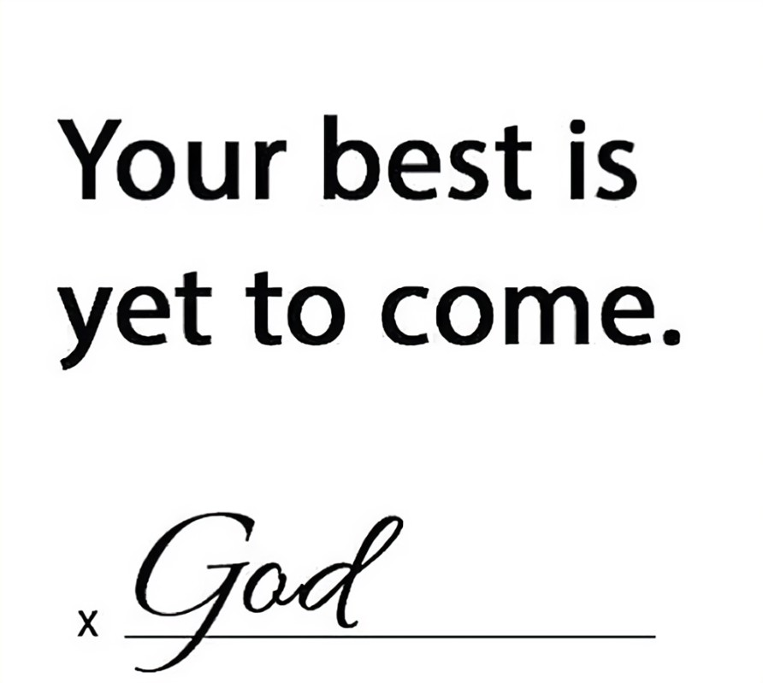
2024

Slide 3
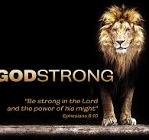

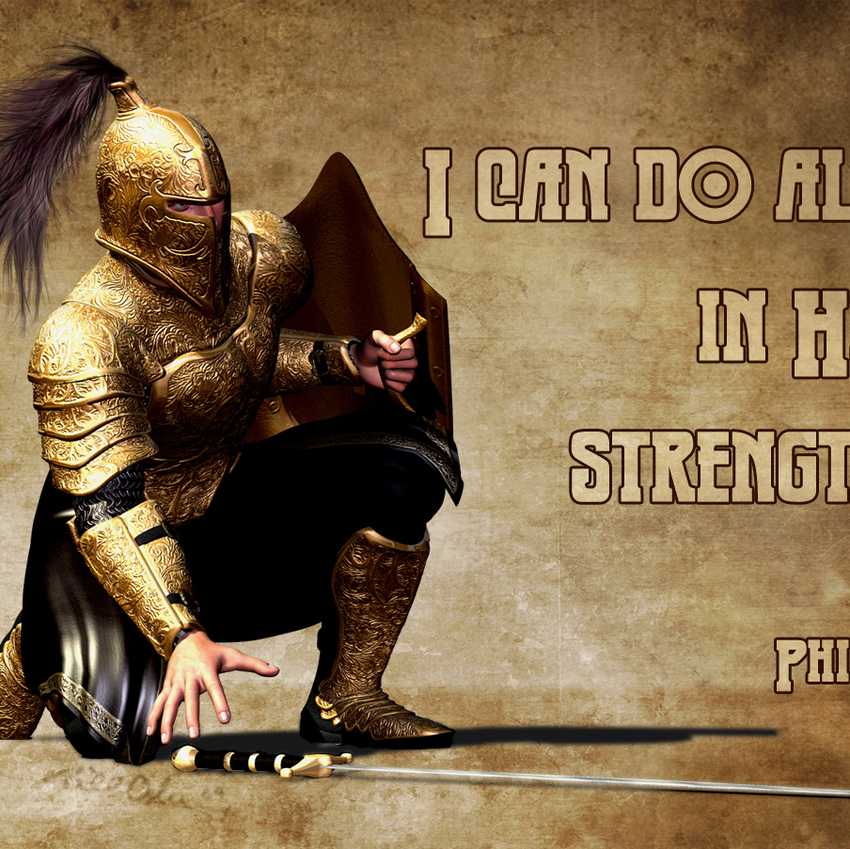
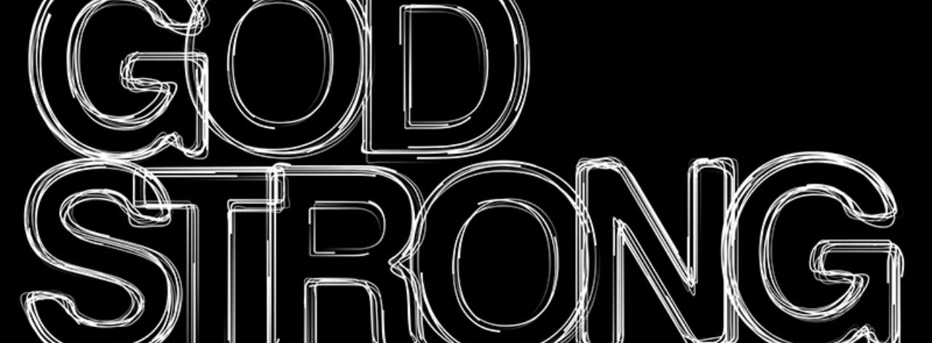
January 28, 2024
Positive
Spiritual
Mindset
Pt 2
Joshua 1
Edward Church

Slide 4
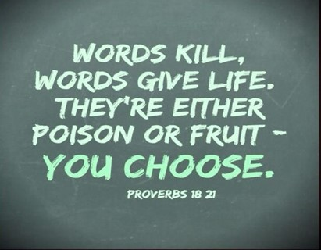
It Is Easy To Look Back Over 2023
And Expect 2024 To Be More of the Same
I Can Assure You…
Whatever You Are Expecting…
…Comes Out of Your Mouth!!!
Your Tongue has the Power of Life and Death -Prov 18:21

Slide 5
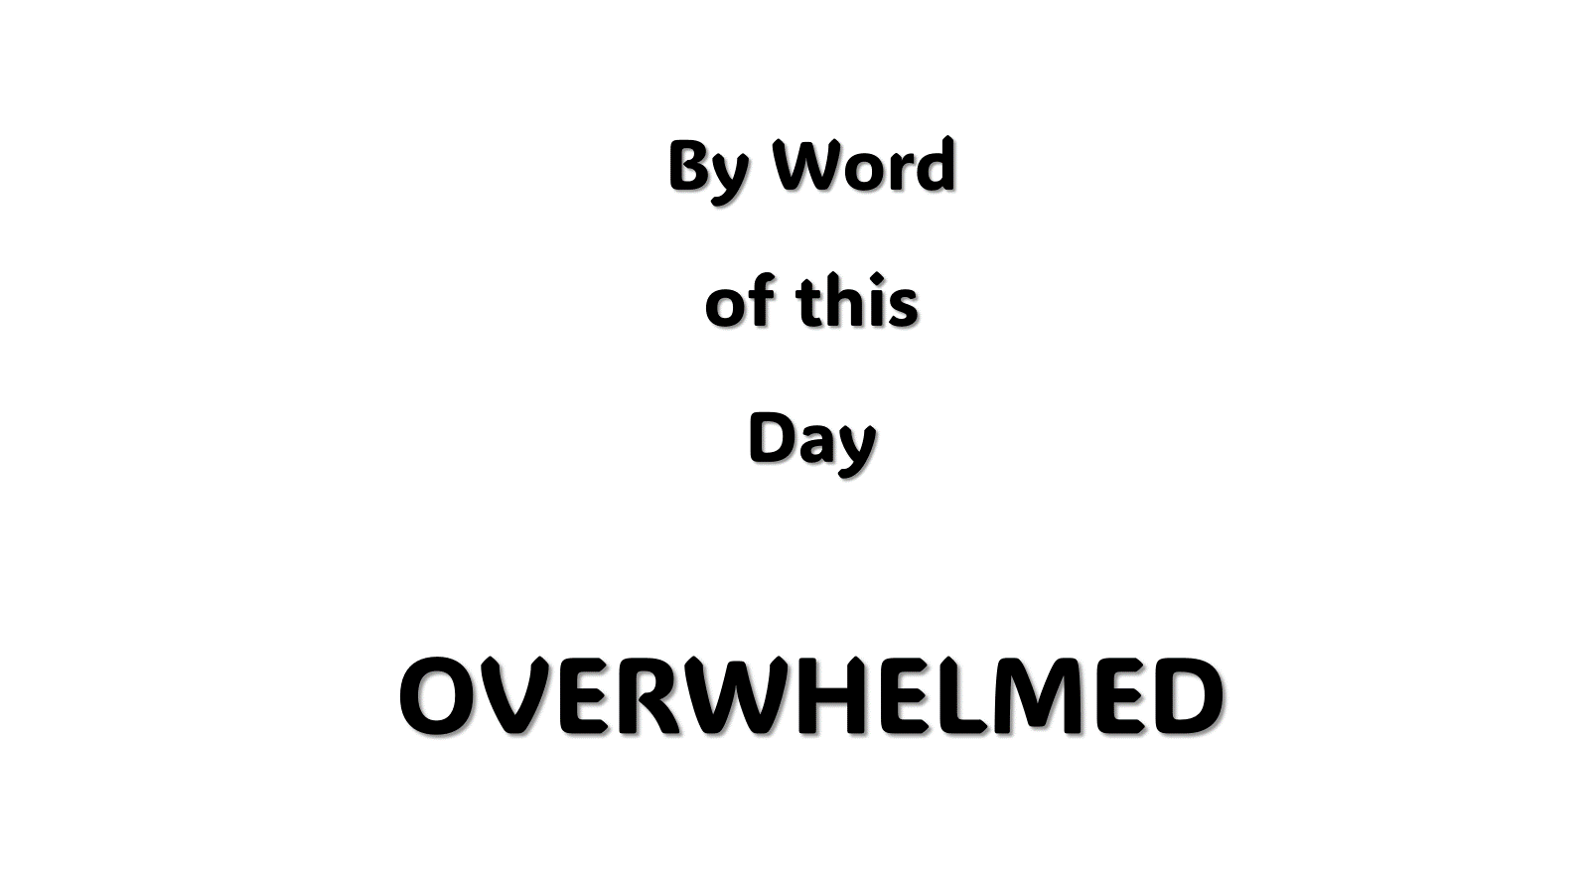
Luke 21:26 (AMP) ²⁶ Men swooning away or expiring with fear and dread and apprehension and expectation of the things that are coming on the world; for the [very] powers of the heavens will be shaken and caused to totter.
Luke 21:26 (MSG) ²⁶ in an uproar and everyone all over the world in a panic, the wind knocked out of them by the threat of doom, the powers-that-be quaking.
languish :- cover (over), fail, faint, feebler,
hide self, be overwhelmed, swoon

Slide 6
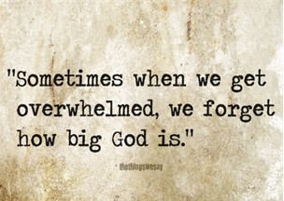
Joshua
If Ever a Person Was Overwhelmed…
He was Called to…
Take Mose’s Place
…Big Shoes to Fill
Take the Land
…Big Job to Complete
Both Seemed Impossible
…Too Big Without God

Slide 7
This Big Job Would Require
a Big Mindset

Slide 8
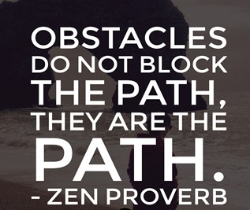
As Long as I Can Remember…
…Life has Been Full of Challenges
…But Since 2020
…Life Itself is a Challenge
How Do We Meet These?

Slide 9

Starts With Our Mindset
Romans 12:2, says that we should be “transformed by the renewing of [our] mind.”
Ephesians 4:23 says, “let the Spirit renew your thoughts and attitudes.”
Ephesians 4:23 (AMP) ²³ And be constantly renewed in the spirit of your mind [having a fresh mental and spiritual attitude]

Slide 10
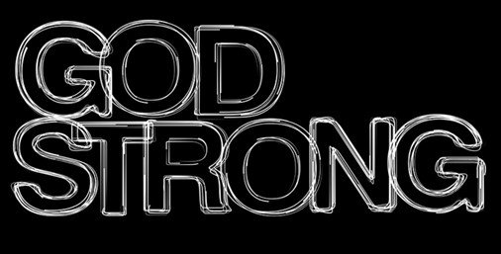
Discovering What…
Drives Your Mindset
Determines the Power of Your Mindset
M = self strong
SM = God Strong

Slide 11
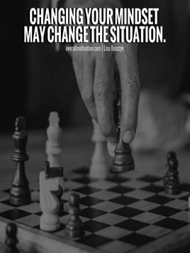
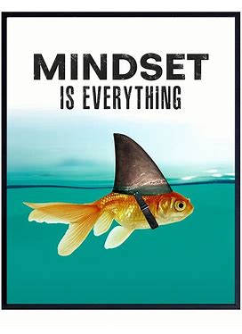
Positive Mindset (PM)
Good But Weak
Depends on Me
Positive Spiritual Mindset (PSM)
Great and Strong
Depends on God
God’s Word is the Fuel
Our Mindset is the Throttle

Slide 12
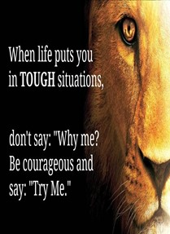
Perfect Model for a Perfect Mindset
"This book of the law shall not depart out of thy mouth; but thou shalt meditate therein day and night, that thou mayest observe to do according to all that is written therein: for then thou shalt make thy way prosperous, and then thou shalt have good success." -Josh 1:8
A Positive Mindset (State of Mind)…
…Leads to Positive Perspective (Point of View)
Three Parts of Joshua 1:8 Stand Out:

Slide 13

Positive Thinking "But thou shalt meditate therein day and night..."
What You Think Matters
Never Read Where God Says, “Whatever! It is what it is!”
God Knows
Who He IS.
What He Wants
How to Express It
God Wants Us to Do the Same
Proverbs 23:7 that as a man thinks in his heart, so is he.
If You Want to Stay Positive You Have to Think Positive.
You Need to Think on the Word!
The Bible is the Most Positive, Absolute Thing Out There

Slide 14

Positive Thinking "But thou shalt meditate therein day and night..."
What You Think Does Matter
"Finally, brethren, whatsoever things are true, whatsoever things are honest, whatsoever things are just, whatsoever things are pure, whatsoever things are lovely, whatsoever things are of good report; if there be any virtue, and if there be any praise, think on these things." Philippians 4:8
Continually Dwell on Goodness of God vs Dwell on Negative Thoughts
What You Think About Yourself Is Also Significant
You are Who God Says You Are, Have / Do What He says…
When You are in Christ = No Limit to Good Things Available
Ps 77:12, "I will meditate also of all thy work, and talk of thy doings."

Slide 15
Positive Speaking "This book of the law shall not depart out of thy mouth..."
What Comes Out of Our Mouth is So Important
Prov 12:14, "A man shall be satisfied w- good by the fruit of his mouth."
We Need to Keep the Word Continually In Our Mouths to Remind Us of Who We Are In Christ And What We Have In Christ.
Find the Scriptures in the Bible that have the Phrase
"In Him“ - "In Whom“ - and "In Christ"
When You Find these Scriptures,
Mark them, Meditate on Them, Start Confessing them Over Your Life
You’ll Be Amazed at the Positive Changes that Happen In Your Life

Slide 16
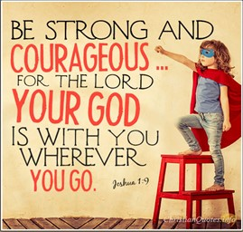
Positive Action "That thou mayest observe to do according to all. Is written therein..:
James 1:22 (Amplified)
"But obey the message; be doers of the Word/ not merely listeners to it,
betraying yourselves [into deception by reasoning contrary to the truth]."
God’s Word is Full of Positive Confession…
…We Need to Act Upon that Positive Confession.
Just as Faith Without Works Is Dead, so is Positive Mindset Without Action.
If the Word Says…
You are the light of the world, how are you going to act?
Let the weak say they are strong, how are you going to act?
Greater is He that IS IN me, how you going to act?
When We Act Upon God’s Word, We Authenticate Our Confession.

Slide 17

Positive Action "That thou mayest observe to do according to all. Is written therein..:
Deut 28:1-2, "And it shall come to pass, if thou shalt hearken diligently unto the voice of the LORD thy God, to observe/ to do all his commandments which I command thee this day, that the LORD thy God will set thee on high above all nations of the earth:/ all these blessings shall come on thee, / overtake thee..."
Keeping a Positive Mindset Is Crucial to Your Success in Life.
Isa 1:19, if you are willing /obedient, you shall eat good of the land.
Willing is a Condition of the Heart that Reflects Your Mindset.
The Only Difference Between a Stumbling Block and a Steppingstone…
…Is Your Mindset

Slide 18

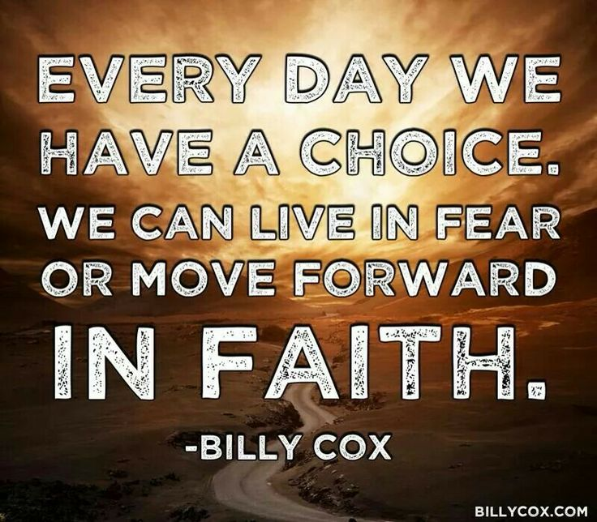
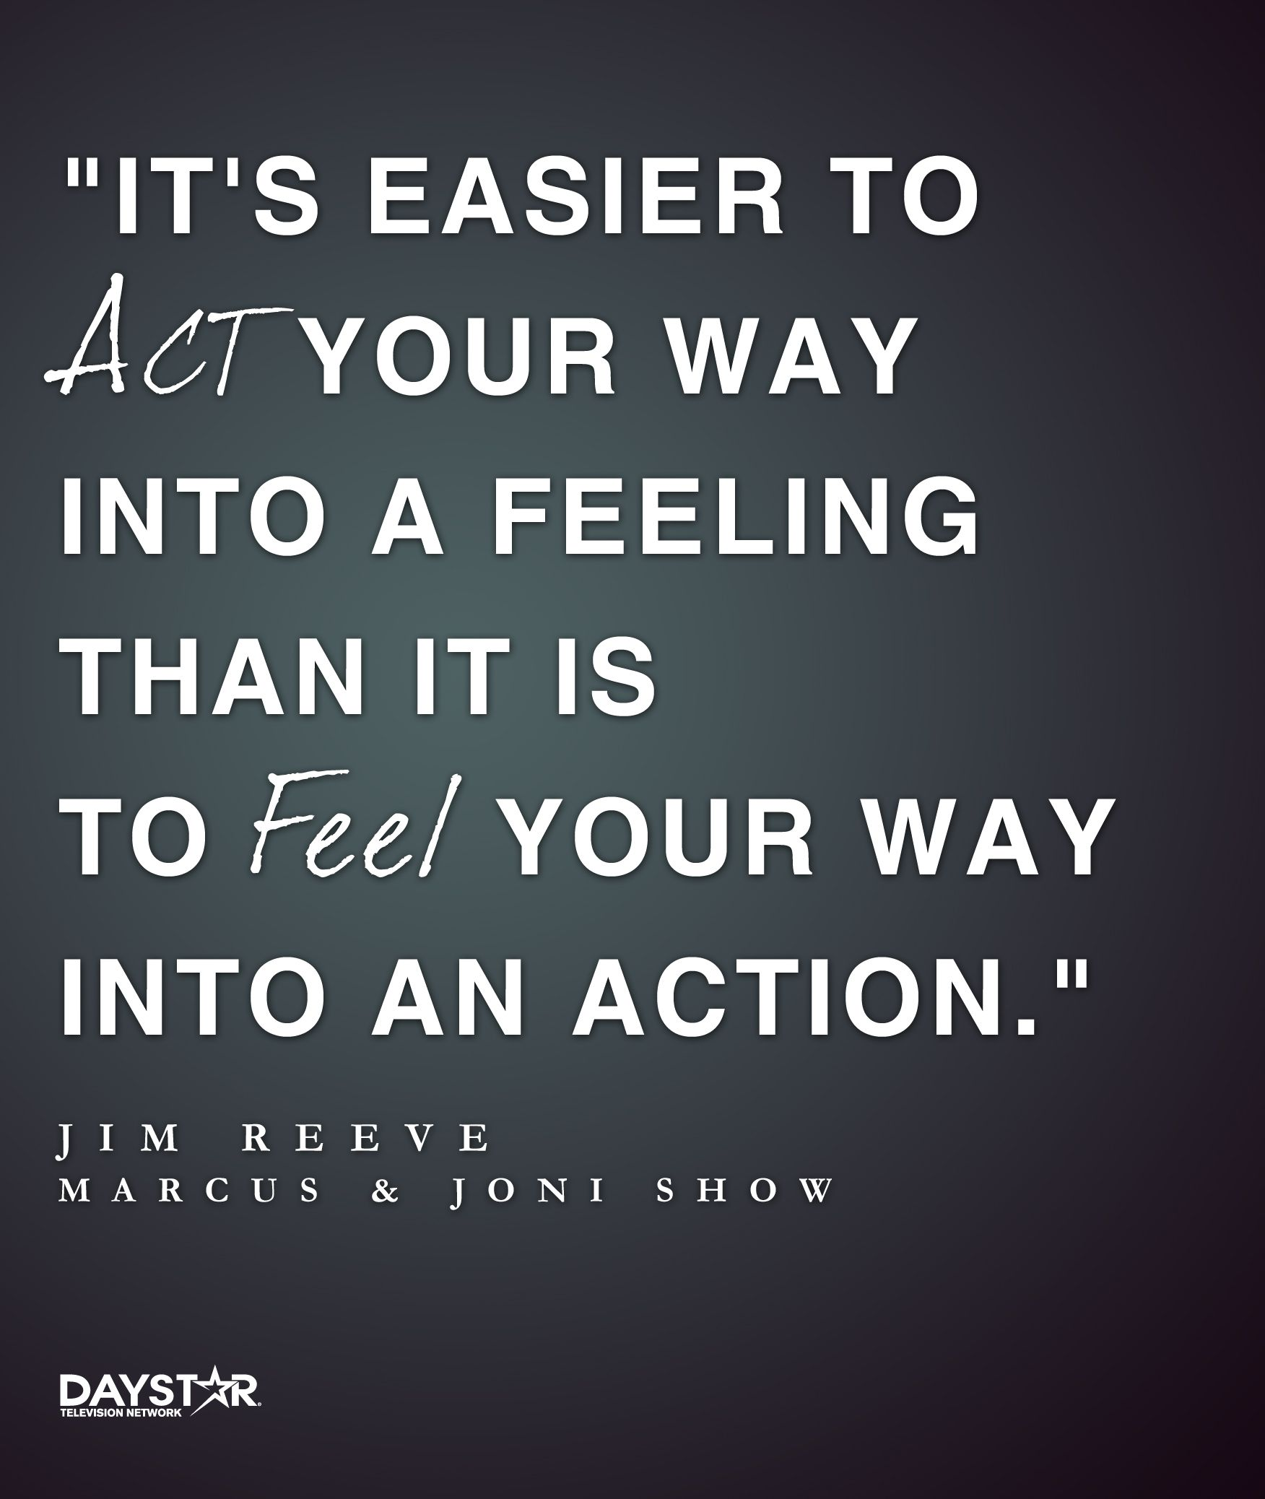
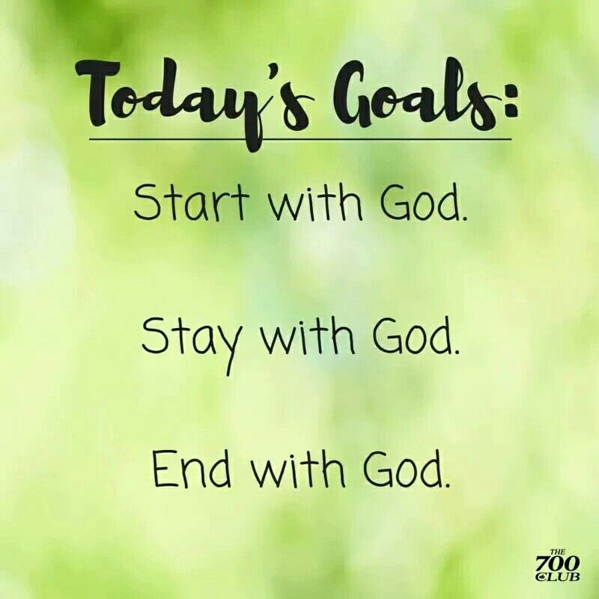

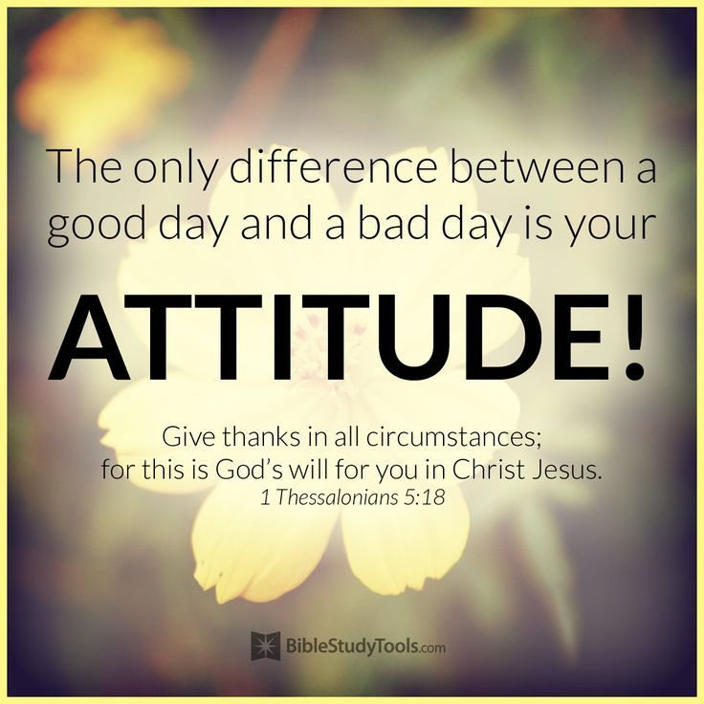

In Order to Connect
With God’s Positive Power
And
Renew Our Mindset
We Have to…
Think the Word
Speak the Word
Walk the Word

Slide 19

This Week’s Challenge
Practice a Forward-Looking Mindset
Refuse to Live in the Past
Reach Forward to God’s Promises
But
Reinforce Your Life in the Present
Any time You Begin to Feel Overwhelmed
Say This …
“I Am Here, I am Safe …God’s Promises Protect Me”

Slide 21
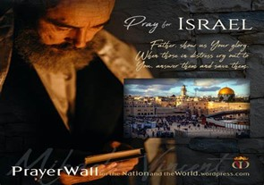

Psalm 17:7-9 -Complete Jewish Bible
⁷ Show how wonderful is your grace, savior of those who seek at your right hand refuge from their foes. ⁸ Protect them like the pupil of your eye, hide them in the shadow of your wings ⁹ from the wicked, who are assailing them, from their deadly enemies, who are all around them.
And All of the Innocent Victims
on Both Sides

Slide 22
I had a dream last night – I was a DR. and Brandan drove up in his mustang….
…Like he was be chased by a dodge charger…
A man went to see his doctor in a state of high anxiety. "Doctor," he said, "you have to help me. I'm dying. Everywhere I touch it hurts. I touch my head and it hurts. I touch my leg and it hurts. I touch my stomach and it hurts. I touch my chest and it hurts. You have to help me, Doc, everything hurts." The doctor gave him a complete examination. “Brandan" he said, "I have good news and bad news for you. The good news is you are not dying. The bad news is you have a broken finger."

