Slide 1
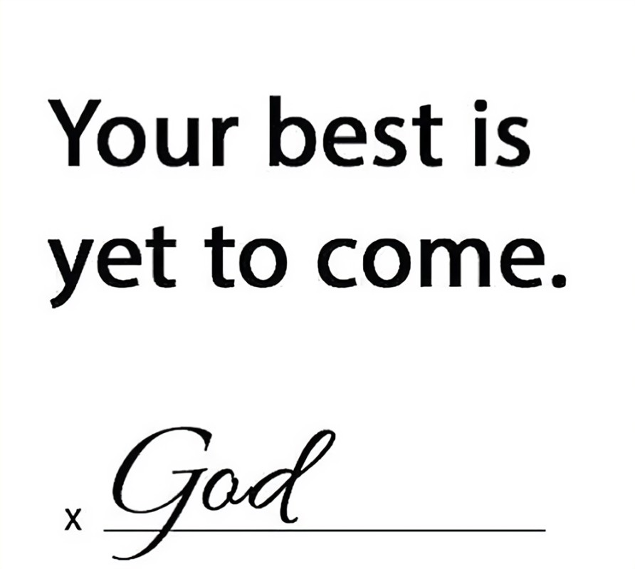
2024

Slide 2
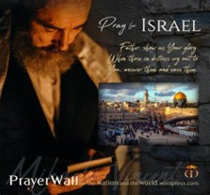

Psalm 17:7-9 -Complete Jewish Bible
⁷ Show how wonderful is your grace, savior of those who seek at your right hand refuge from their foes. ⁸ Protect them like the pupil of your eye, hide them in the shadow of your wings ⁹ from the wicked, who are assailing them, from their deadly enemies, who are all around them.
And All of the Innocent Victims
on Both Sides

Slide 3
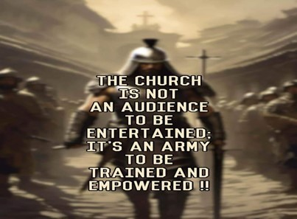
Repeat
These are the 2 Most Important Hours of My Week – Help Me to Cherish Them
I Am Here Today to Worship
Not to Be Entertained
I Am Singing to An Audience of One
Accept My Worship Oh Lord!

Slide 4
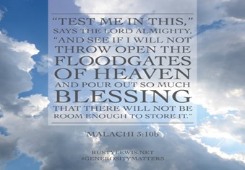
Repeat
I Lift My Offering to You
Let It Please You Oh Lord
This is My Seed
Although It Leaves My Hand
It will Never Leave My Life
You Will Multiply It!
Accept My Seed Oh Lord!

Slide 6
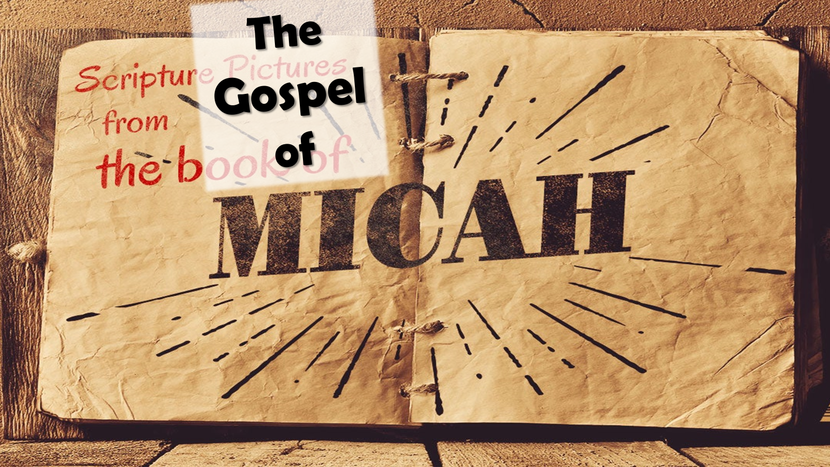
What Does God Require/Expect from Us? Mindset on the Offense - pt1
6:8

Slide 7


Slide 8
⁸ The Lord has told you, human, what is good; he has told you what he wants from you: to do what is right to other people, love being kind to others,and live humbly, obeying your God.
Micah 6:8 New Century Version
⁸ He has shown you, O man, what is good; And what does the Lord require of you But to do justly, To love ^{[a]}mercy, And to walk humbly with your God? Micah 6:8 NKJV
⁸ But he’s already made it plain how to live, what to do, what God is looking for in men and women. It’s quite simple: Do what is fair and just to your neighbor, be compassionate and loyal in your love, And don’t take yourself too seriously— take God seriously.
-Micah 6:8 The Message

Slide 9

This Message is a Profound Call to Action
A Divine Mandate that Outlines What God Requires of Us.
To Act Justly, to Love Mercy, and to Walk Humbly with Our God.
It Is a Call that Challenges Us To
Examine Our Hearts,
Assess Our Actions
Align Our Lives With The Will Of God.
It Contains Three Main Points:
Each Point Is …
Essential Pillar In Our Christian Walk
Vital Component Of Our Relationship With God.

Slide 10
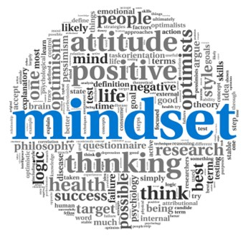

Slide 11
Remember Last Week
Mindset
What Fuels Your Mindset
Determines its Power
“Faith in God”
Provides
“Supernatural Power”
Likewise…

Slide 12
What Fuels Your Offensive Mindset
Determines its Power
“Love of God”
AGAPE
“Supernatural Love”
Matched with
“Supernatural Power”
Builds an
“Unstoppable Mindset”

Slide 13
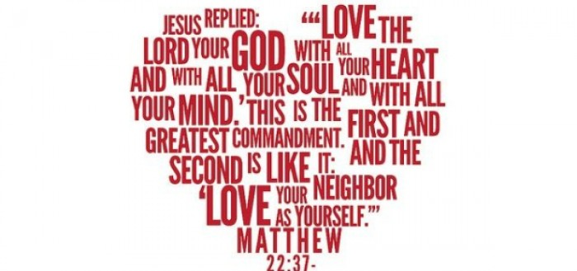

Slide 14
Matthew 22:36-40 Christian Standard Bible
³⁶ “Teacher, which command in the law is the greatest?”³⁷ He said to him,
“Love the Lord your God with all your heart, with all your soul, and with all your mind.^{[a]} ³⁸ This is the greatest and most important^{[b]} command. ³⁹ The second is like it: Love your neighbor as yourself.^{[c]} ⁴⁰ All the Law and the Prophets depend^{[d]} on these two commands.”
Matthew 22:36-40 Amplified Bible
³⁶ “Teacher, which is the greatest commandment in the Law?” ³⁷ And Jesus replied to him, “‘You shall love the Lord your God with all your heart, and with all your soul, and with all your mind.’ ³⁸ This is the first and greatest commandment. ³⁹ The second is like it, ‘You shall love your neighbor as yourself [that is, unselfishly seek the best or higher good for others].’ ⁴⁰ The whole Law and the [writings of the] Prophets depend on these two commandments.”

Slide 15
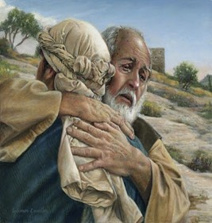

Slide 16
The Parable of the Prodigal Son:
The father's love for son is not diminished by his son's rebellion,
Instead demonstrated in his willingness to forgive and restore his son.
This is the kind of love that God has for us.
It is a love that forgives, that restores, that heals, that redeems.
His Patience and Long-Suffering:
Despite our repeated failures and shortcomings, He continues to love us and patiently waits for us to turn back to Him.
He does not give up on us, but persistently pursues us with His love.
Sacrificial Love:
Most evident in the cross, where God demonstrated His love for us by sending His only Son to die for our sins.
This act of selfless love is the ultimate demonstration of God's love
Willing to sacrifice everything, even His Son, for our sake.

Slide 17
Transformative Love:
That changes us, molds us, shapes us into the image of Christ.
That empowers us to love others, serve others, forgive others.
Personal Love:
It is not a distant, impersonal love, but a close, intimate love.
He knows us by name, our thoughts, our struggles
He is not a distant God, but a close/ personal God
Who loves us deeply and intimately.
Requires a Response:
It is not a passive love, but an active love that calls us to action.
It calls us to love Him in return, to obey His commands.
To follow His ways, to live out our faith in our daily lives.

Slide 18
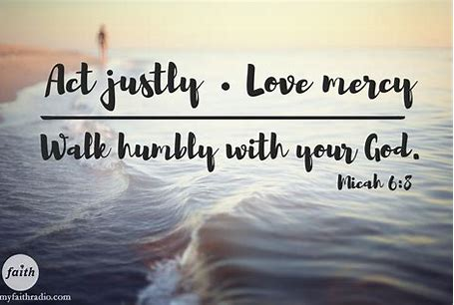

Slide 19
Mastering Justice in Our Actions
1st, Let's Consider the Idea af Justice As a Lifestyle.
Justice, in the biblical sense, is more than just a principle or a rule
It's a Way of Life.
It's about treating others with fairness, about standing up for the oppressed, and about making right what is wrong.
“Reflecting the heart of God in our everyday actions”
"let justice roll on like a river, righteousness…
…like never-failing stream" -Amos 5:24

Slide 20
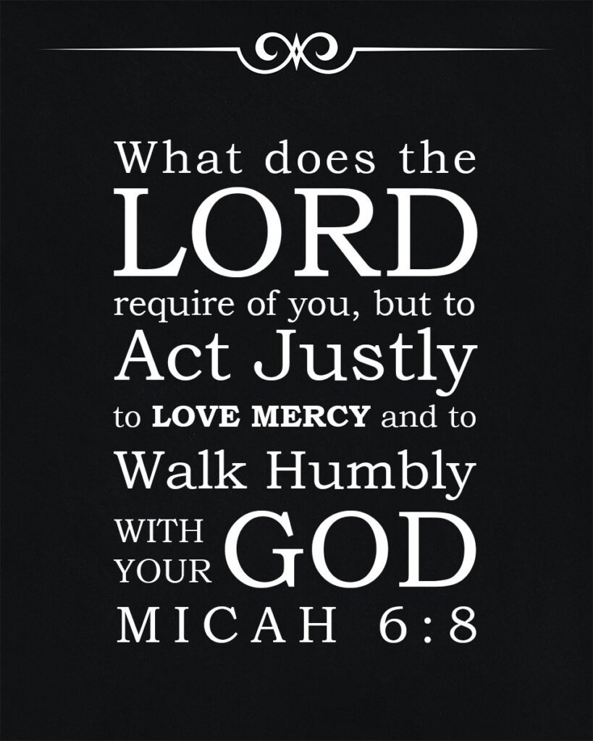

Slide 21
Mastering Justice in Our Actions
2nd, Justice Is Not Just Our Actions, Also About Our Attitudes.
It's about the Condition of Our Hearts
Having a Heart that is Sensitive to the Needs of Others
“a heart that is moved by compassion and driven by love”
This Is The Kind Of Love That Fuels Justice…
…A Love That Seeks the Ultimate Good Of Others

Slide 22
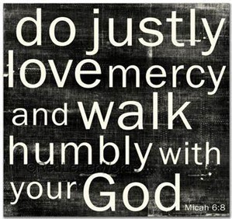

Slide 23
Firstly, let's consider the idea of justice as a lifestyle.
Secondly, justice is not just about our actions, but also about our attitudes.
3rd, Justice Is About Integrity.
It's about being honest and upright in all our dealings,
about being true to our word and faithful in our commitments. It’s
about doing what is right, even when it's hard, even when no one is watching.
"The integrity of the upright guides them, but the unfaithful are destroyed by their duplicity" -Proverbs 11:3
This underscores the importance of integrity in our pursuit of justice.

Slide 24


Slide 25
Firstly, let's consider the idea of justice as a lifestyle.
Secondly, justice is not just about our actions, but also about our attitudes.
3rd, Justice Is About Integrity. .
4th, Justice Is About Responsibility.
Taking responsibility for our actions / their impact on others.
Recognizing that our choices have consequences…
We Must Make Choices that Promote Justice / Righteousness.
"Each of us will give an account of ourselves to God" -Rom 14:12

Slide 26
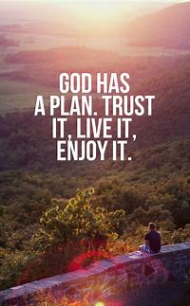

Slide 27
Let us live out our faith in ways that reflect the heart of God.
Let us treat others with fairness, stand up for the oppress
…make right what is wrong
Let us have hearts that are sensitive to the needs of others…
…hearts that are moved by compassion and driven by love.
Let us be people of integrity, honest/ upright in all our dealings.
Let us take responsibility for our actions / their impact on others.
For in doing so, we will not only please God,
we will also make a positive difference in the world around us.

Slide 29
When I was younger, my dad found out I had an imaginary girlfriend.
He said, "You know, you could do better."
"Thanks dad, that means a lot," I replied.
He said, "I was talking to your girlfriend."
Thought for today – You Could Do Better – Re-align Your Vision

