Slide 1

2024

Slide 3
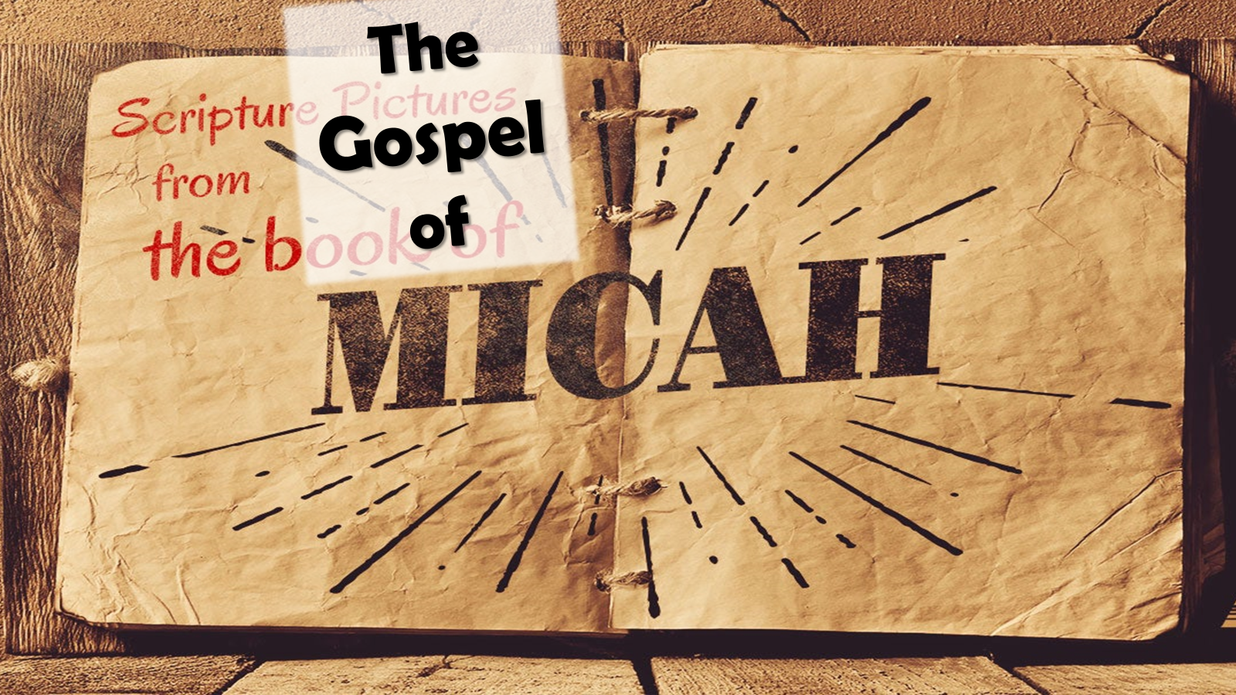
What Does God Require/Expect from Us? Mindset on the Offense - pt2
6:8

Slide 4

⁸ He has shown you, O man, what is good; And what does the Lord require of you But to do justly, To love ^{[a]}mercy, And to walk humbly with your God? Micah 6:8 NKJV
⁸ The Lord has told you, human, what is good; he has told you what he wants from you: to do what is right to other people, love being kind to others,and live humbly, obeying your God.
Micah 6:8 New Century Version
⁸ But he’s already made it plain how to live, what to do, what God is looking for in men and women. It’s quite simple: Do what is fair and just to your neighbor, be compassionate and loyal in your love, And don’t take yourself too seriously— take God seriously.
-Micah 6:8 The Message

Slide 5

This Message is a Profound Call to Action
A Divine Mandate that Outlines What God Requires of Us.
To Act Justly, to Love Mercy, and to Walk Humbly with Our God.
It Is a Call that Challenges Us To
Examine Our Hearts,
Assess Our Actions
Align Our Lives With The Will Of God.
It Contains Three Main Points:
Each Point Is …
Essential Pillar In Our Christian Walk
Vital Component Of Our Relationship With God.

Slide 6
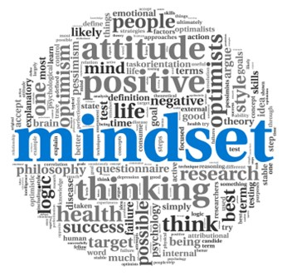
What Fuels Your Offensive Mindset
Determines its Power
“Love of God”
AGAPE
“Supernatural Love”
Matched with
“Supernatural Power”
Builds an
“Unstoppable Mindset”

Slide 7
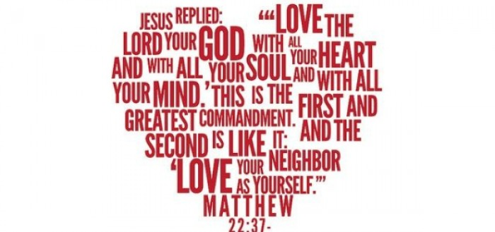
Matthew 22:36-40 Christian Standard Bible
³⁶ “Teacher, which command in the law is the greatest?”
³⁷ He said to him, “Love the Lord your God with all your heart, with all your soul, and with all your mind.^{[a]} ³⁸ This is the greatest and most important^{[b]} command. ³⁹ The second is like it: Love your neighbor as yourself.^{[c]} ⁴⁰ All the Law and the Prophets depend^{[d]} on these two commands.”
Matthew 22:36-40 Amplified Bible
³⁶ “Teacher, which is the greatest commandment in the Law?” ³⁷ And Jesus replied to him, “‘You shall love the Lord your God with all your heart, and with all your soul, and with all your mind.’ ³⁸ This is the first and greatest commandment. ³⁹ The second is like it, ‘You shall love your neighbor as yourself [that is, unselfishly seek the best or higher good for others].’ ⁴⁰ The whole Law and the [writings of the] Prophets depend on these two commandments.”

Slide 8

Manifesting Mercy in Our Lives
When We Consider the Mercy of God,
we are reminded of His unending love and grace towards us.
His mercy is a Continuous Flow of Forgiveness / Compassion.
It is this Mercy that we are called to Manifest In Our Lives.

Slide 9
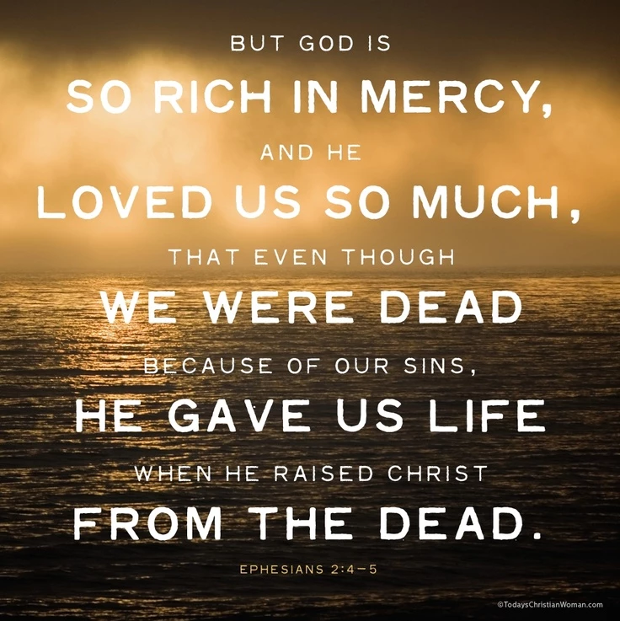
Ephesians 2:4-5 NKJV
⁴ But God, who is rich in mercy, because of His great love with which He loved us, ⁵ even when we were dead in trespasses, made us alive together with Christ (by grace you have been saved),
Eph 2:4-5 Amplified Bible
⁴ But God—so rich is He in His mercy! Because of and in order to satisfy the great and wonderful and intense love with which He loved us,
⁵ Even when we were dead (slain) by [our own] shortcomings and trespasses, He made us alive together in fellowship and in union with Christ; [He gave us the very life of Christ Himself, the same new life with which He quickened Him, for] it is by grace (His favor and mercy which you did not deserve) that you are saved (^{[a]}delivered from judgment and made partakers of Christ’s salvation).

Slide 10
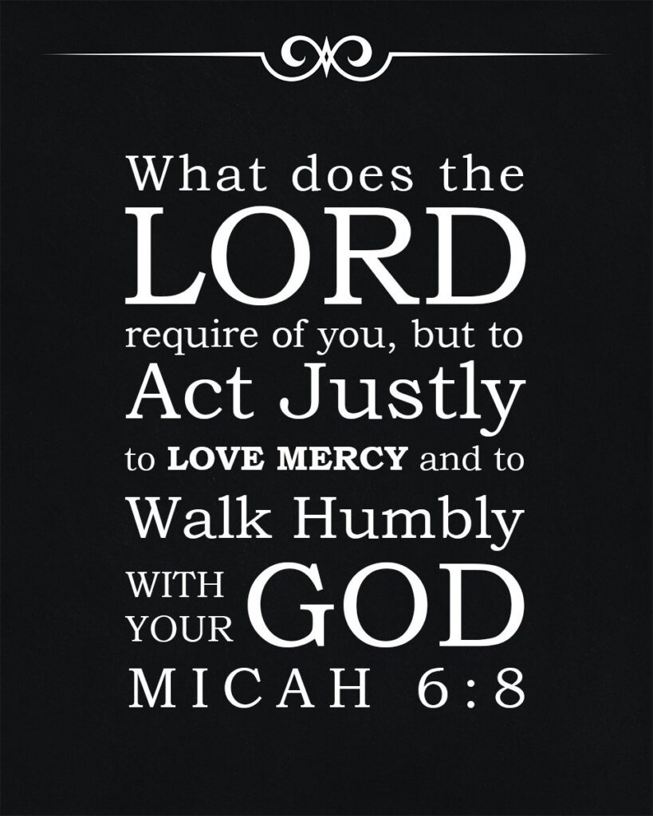
Manifesting Mercy in Our Lives
This Requires Us To Let Go Of Our Pride / Desire For Revenge
It requires us to forgive, even when it hurts
But when we choose to extend mercy…
…we are choosing to reflect the Character of God
We are choosing to love as He loves…
…and to forgive as He forgives
But how do we do this? How do we manifest mercy in our lives?

Slide 11
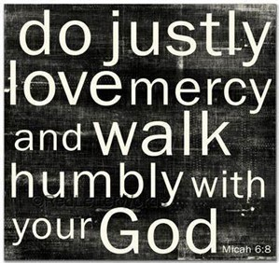
Firstly, We Must Understand What Mercy Is
Mercy is not just about Forgiveness…
…but also about Compassion
It is about Seeing the Needs of Others…
…Responding W- Kindness and Understanding
It is about Putting Ourselves in Their Shoes…
…Treating Them as We Would Want to Be Treated
Eph 2:4-5
But because of his great love for us, God, who is rich in mercy, made us alive with Christ even when we were dead in transgressions—it is by grace you have been saved.

Slide 12
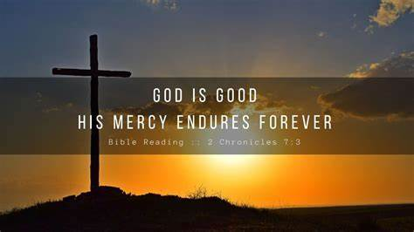
1st, We Must Understand What Mercy Is
2nd, We Must Remember That Mercy Is A Choice
Mercy Does Not Come Naturally to Us
Its something that we must consciously choose to extend as we’ve been given it from above.
Every day, we are faced with opportunities to show mercy.
Whether it is forgiving someone who has hurt us, or …
...showing kindness to someone in need,
…we have the choice to respond with mercy
James 2:13-15 NKJV
¹³ For judgment is without mercy to the one who has shown no mercy. Mercy triumphs over judgment.

Slide 13

1st, We Must Understand What Mercy Is
2nd, We Must Remember That Mercy Is A Choice
3rd, We Must Recognize Mercy is a…
…Reflection of God's Character
When we Show Mercy, we are Reflecting the heart of God.
We are Showing the world what God is like.
This is a great responsibility, but also a great privilege.
Lastly, We Must Realize That Mercy Is A Journey
It is not something that we can master overnight,
…but something that we grow in over time.
As we continue to walk with God and allow His Word to Shape us, we will become more and more merciful.

Slide 14
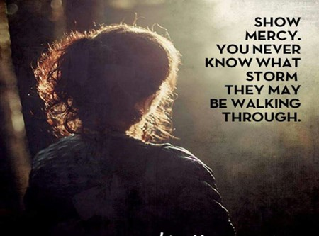
Biblical Mercy:
The term "mercy" is often used to describe God's character.
It refers to His steadfast love, His willingness to forgive, and His commitment to act on behalf of His people.
“To With Hold Deserved Retribution”
When God calls us to love mercy, He is essentially calling us…
to be like Him – to show kindness and compassion,
to forgive those who have wronged us,
and to act in ways that promote justice and righteousness.

Slide 15

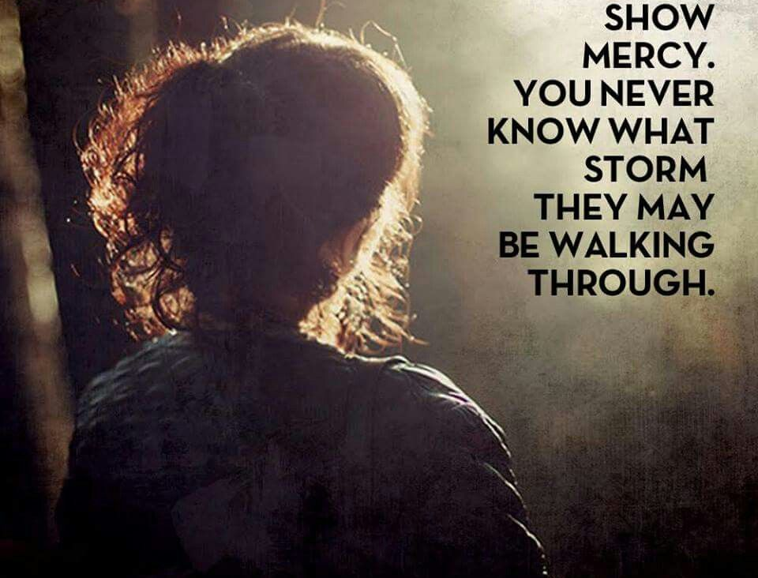
Manifesting Mercy in our lives is not just about our Actions but About Our Hearts.
It is about Allowing God's mercy to Transform Us from the Inside Out.
As we do this, We Will Not Only Experience the Joy of God’s Forgiveness, but We Will Also Become Channels of His Mercy to the World Around Us.
This Week Strive to Manifest Mercy in Our Lives, Not By Our Own Strength, But By the Grace Of God.
Instead of Judgement(retribution),Try Mercy in All of Our Relationships… Esp Close Ones.

Slide 17
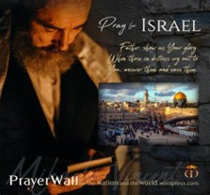

Psalm 17:7-9 -Complete Jewish Bible
⁷ Show how wonderful is your grace, savior of those who seek at your right hand refuge from their foes. ⁸ Protect them like the pupil of your eye, hide them in the shadow of your wings ⁹ from the wicked, who are assailing them, from their deadly enemies, who are all around them.
And All of the Innocent Victims
on Both Sides

Slide 18
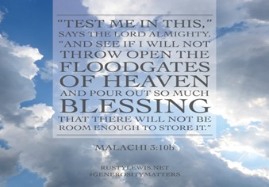

Slide 19
Every time a little boy went to a playmate's house, he found the friend's grandmother deeply engrossed in her Bible. Finally his curiosity got the better of him.
"Why do you suppose your grandmother reads the Bible so much?" he asked.
"I'm not sure," said his friend, "but I think she's cramming for finals."

