Slide 1
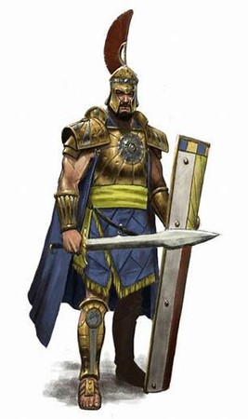
Courageous Living “Land of the Giants” Pt 1
Edward Church
1 Sam 17
February 25, 2024

Slide 2
Now the Philistines gathered their armies together to battle, and were gathered at Sochoh, which belongs to Judah; they encamped between Sochoh and Azekah, in Ephes Dammim. ² And Saul and the men of Israel were gathered together, and they encamped in the Valley of Elah, and drew up in battle array against the Philistines. ³ The Philistines stood on a mountain on one side, and Israel stood on a mountain on the other side, with a valley between them.
⁴ And a champion went out from the camp of the Philistines, named Goliath, from Gath, whose height was six cubits and a span. ⁵ He had a bronze helmet on his head, and he was ^{[a]}armed with a coat of mail, and the weight of the coat was five thousand shekels of bronze. ⁶ And he had bronze armor on his legs and a bronze javelin between his shoulders. ⁷ Now the staff of his spear was like a weaver’s beam, and his iron spearhead weighed six hundred shekels; and a shield-bearer went before him. ⁸ Then he stood and cried out to the armies of Israel, and said to them, “Why have you come out to line up for battle? Am I not a Philistine, and you the servants of Saul? Choose a man for yourselves, and let him come down to me. ⁹ If he is able to fight with me and kill me, then we will be your servants. But if I prevail against him and kill him, then you shall be our servants and serve us.” ¹⁰ And the Philistine said, “I defy the armies of Israel this day; give me a man, that we may fight together.” ¹¹ When Saul and all Israel heard these words of the Philistine, they were dismayed and greatly afraid.

Slide 3
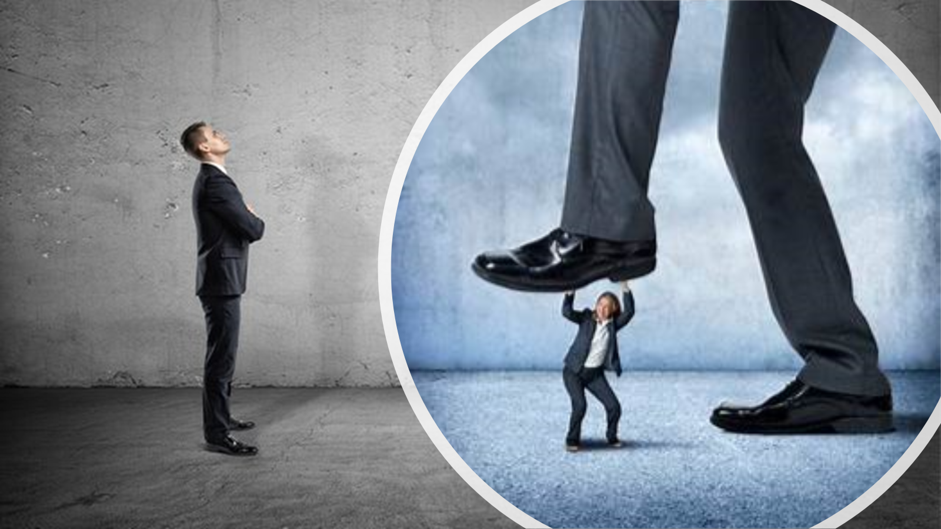
A Giant is Anything that…
…Intimidates with it’s Size
…Threatens with it’s Power
…Seeks to Take Away
Stands between You
and Victory

Slide 4
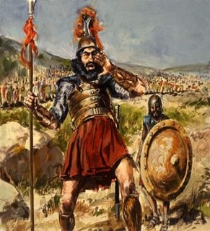
I Samuel 17:10-11
And the Philistine said, I defy the armies of Israel this day; give me a man, that we may fight together. When Saul and all Israel heard those words of the Philistine, they were dismayed, and greatly afraid.
Defy- to pull off, to expose by stripping away
Dismayed- to break down, by violence or confusion and fear, beat down, discourage –Shut Down With-out
Greatly- vehement- to farthest/ smallest part
Afraid- dread, fear –alarm, Intimidate –Shut Down With-In
Israel was Shut Down!

Slide 5
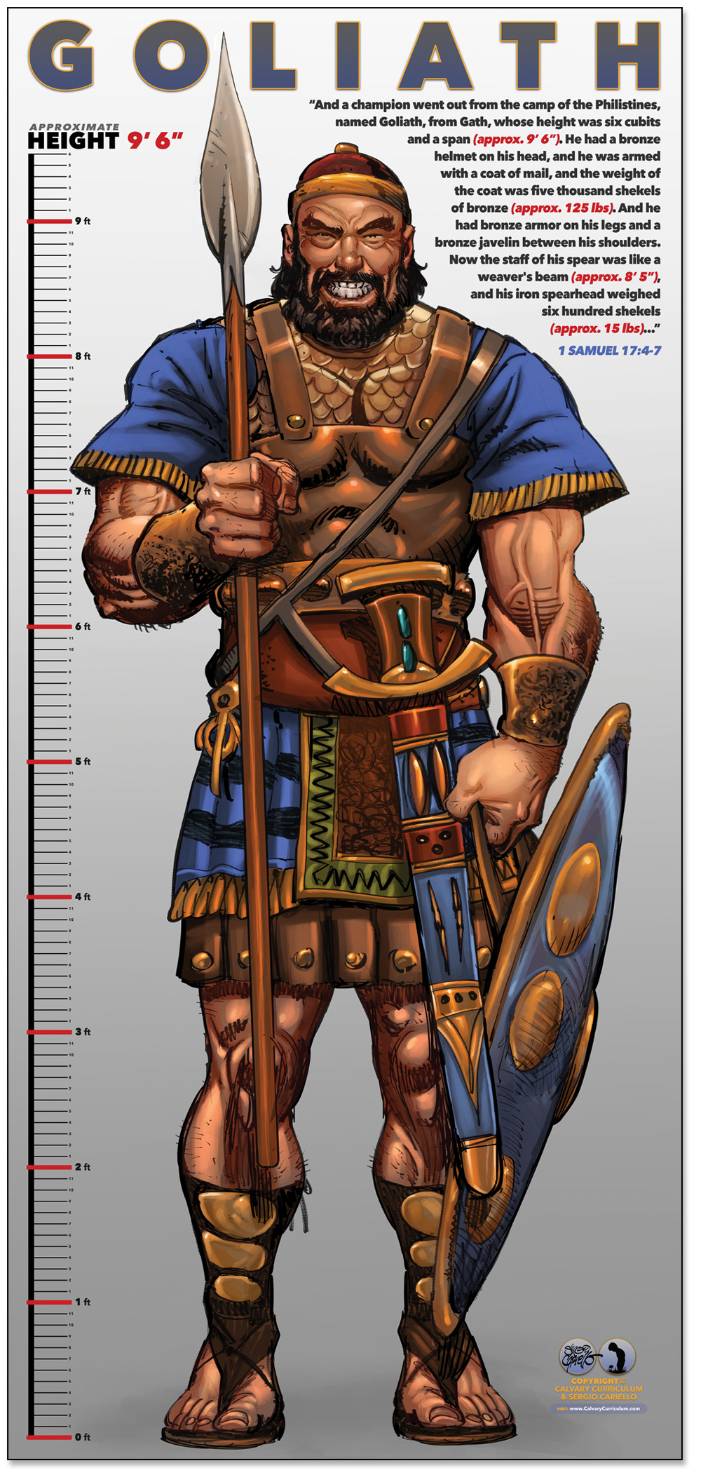
“Giants Come to Put Us in Fear”
David and Goliath, was a Literal Giant…
…a towering figure of intimidation and fear.
Goliath, a seasoned warrior, was a physical manifestation…
…of the fear that can grip us in our lives.
Giants we face today may not be physical; they can be
…situations, circumstances, or struggles that seem
…insurmountable and cause us to tremble in fear
These giants can take the form of financial difficulties, health
issues, relationship problems, or even spiritual battles
They loom large in our lives…
…casting a shadow of fear and doubt

Slide 6
Giants Come to Put Us in Fear
“Fear is a Powerful Emotion”
It can paralyze us, preventing us from moving forward.
It can cloud our judgment, causing us to make poor decisions.
It can even cause us to question our faith…
…leading us to wonder if God is really there for us.
We may feel small, insignificant, and powerless,
…just as the Israelites must have felt in the presence of Goliath.

Slide 7
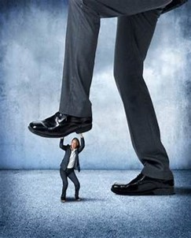
“Fear is a Powerful Emotion”
The Israelites were terrified of Goliath.
They saw his size, strength, weapons, they were filled with fear.
They focused on the giant before them rather than on their God.
They allowed their fear of Goliath to overshadow their faith in God.
This is a common response when we face giants in our lives.
We focus on the size of our problem rather than on the size of our
God. We allow our fear to dictate our actions rather than allowing
our faith to guide us.

Slide 8
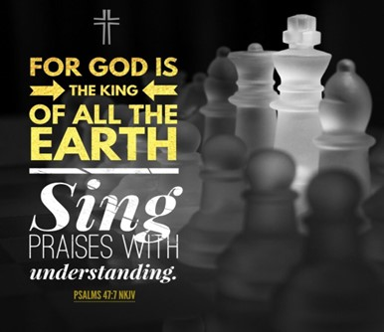
“The Giants We Face Are Real and … Intimidating”
They are designed to put us in fear…
…to make us feel small and powerless.
But we must remember that these giants…
…are Not Bigger Than Our God.
They Are Not More Powerful Than Our God.
They Are Not More Capable Than Our God.
Our God Is Bigger, Stronger, More Powerful Than Any Giant

Slide 9
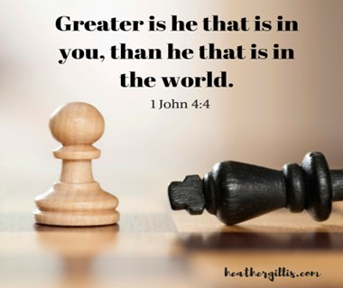
“Fear Is a Natural Response to the Giants In Our Lives”
It's a reaction to the unknown, uncertain, overwhelming.
But we must not let fear control us.
We must not let it dictate our actions or our faith.
We must remember that our God is bigger than our fear,
…that He is bigger than our giants.

Slide 10
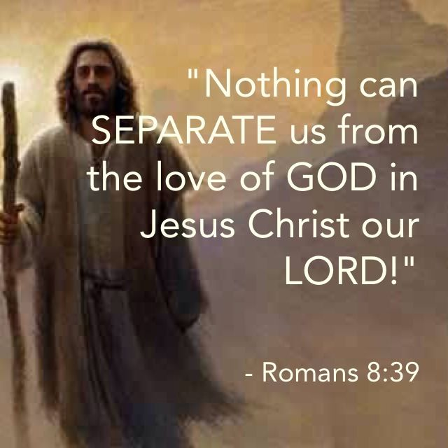
“Fear Is A Tool The Enemy Uses To Separate Us From God”
It's a Weapon that he wields to try to make us Doubt God's power,
God’s Love,
God’s Presence in Our Lives.
But We Must Not Let the Enemy Succeed.
We Must Not let him use Fear to Drive a Wedge between us/ God.
We Must Stand Firm In Our Faith
Trusting in God's Power
God's Love
God's Presence.

Slide 11

“Fear is a Part Of Life”
It's a Part of the Human Experience.
But it doesn't have to Control Us.
It doesn't have to Define Us.
We can face our Giants with Courage / Faith,
with the Knowledge that our God is with us,
He is For Us
He is Bigger Than Any Giant We Will Ever Face.

Slide 12
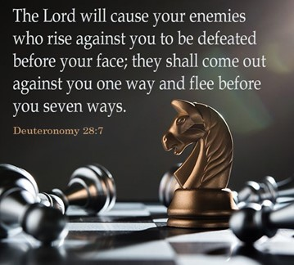
Life’s Giants/Struggles Do Not Define Us…
…But How We Overcome Them Does
Every Giant/Struggle is a Chance to Learn,
Grow,
Redefine Our Limits
Struggles are the Chisels that Sculpt Our Life’s Masterpiece
The Struggle You Face is a Sign…
…You’re On The Path To Growth

Slide 13
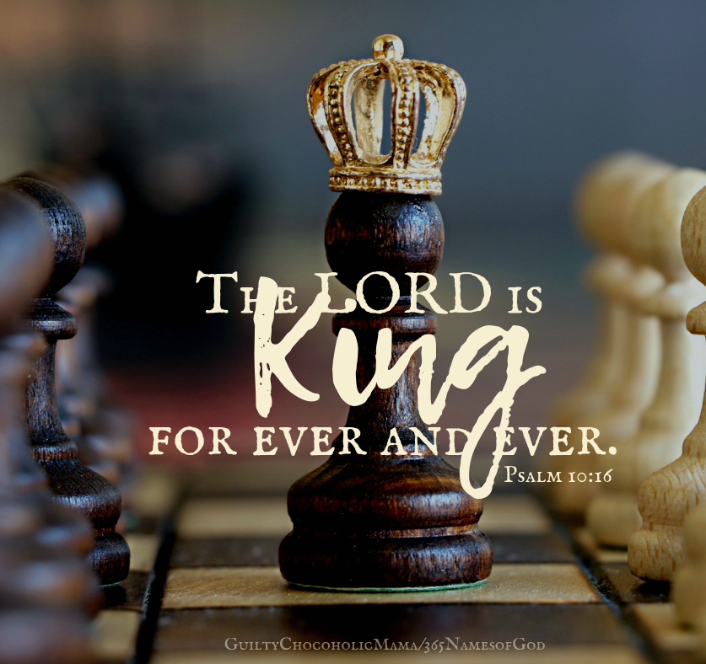
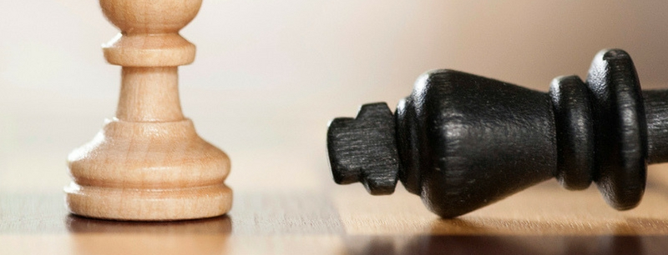
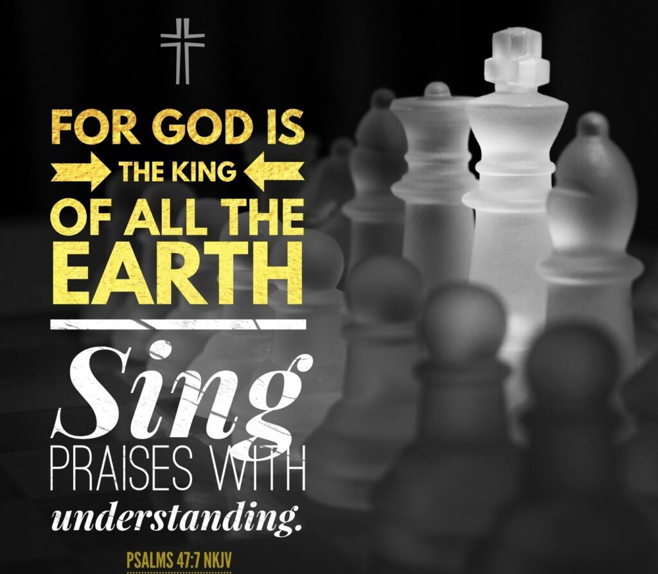
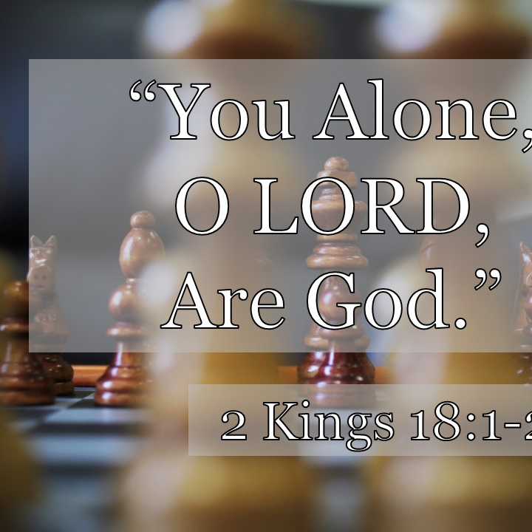
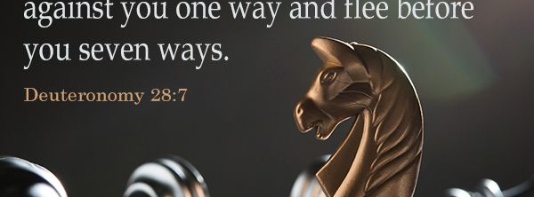
1 John 4:18
There is no fear in love; but perfect love casteth out fear:
because fear hath torment.
Fear-phobia -Unrealistic alarm or fright :- fear, terror.
Love - (agapao); Divine love, i.e. affection or benevolence;
Perfect - (telos); complete (labor, growth, mental and moral
Casteth - plucked off- cast out, thrown away, unattached
Torment - penal infliction :- punishment, torment.
God’s Freedom is Greater than Our Fear!!

Slide 14
Faith is not a magical shield that makes our problems disappear.
It is a deep trust in God that gives us the courage to face our problems, knowing that He is with us and He will help us.
This faith does not eliminate the giants (fear) in our lives,
but it gives us the strength to face them
and the assurance that we will not face them alone.

Slide 15

2024

Slide 16
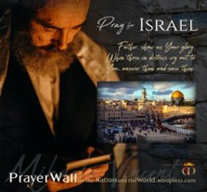

Psalm 17:7-9 -Complete Jewish Bible
⁷ Show how wonderful is your grace, savior of those who seek at your right hand refuge from their foes. ⁸ Protect them like the pupil of your eye, hide them in the shadow of your wings ⁹ from the wicked, who are assailing them, from their deadly enemies, who are all around them.
And All of the Innocent Victims
on Both Sides

Slide 17
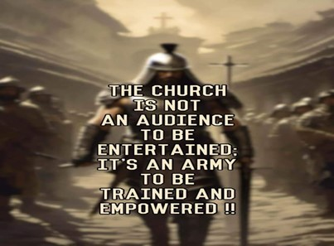
Repeat
These are the 2 Most Important Hours of My Week – Help Me to Cherish Them
I Am Here Today to Worship
Not to Be Entertained
I Am Singing to An Audience of One
Accept My Worship Oh Lord!

Slide 18
Three aspiring psychiatrists were attending their first class on emotional extremes.
"Just to establish some parameters," said the professor to the student from Arkansas, "What is the opposite of joy?"
"Sadness," said the student.
"And the opposite of depression?" he asked of the young lady from Oklahoma.
"Elation," she said.
"And you sir," he said to the young man from Texas, "How about the opposite of woe?"
The Texan replied, "Sir, I believe that would be giddy up."

