Slide 2
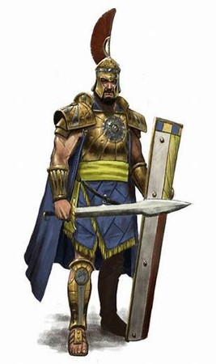
Courageous Living “Land of the Giants” Pt 2
Edward Church
1 Sam 17
March 3, 2024

Slide 3
But David said, 'What have I done now? Is there not a cause?' Then he turned from him toward another and said the same thing; and these people answered him as the first ones did. Now when the words which David spoke were heard, they reported them to Saul; and he sent for him. Then David said to Saul, 'Let no man’s heart fail because of him; your servant will go and fight with this Philistine.' And Saul said to David, 'You are not able to go against this Philistine to fight with him; for you are a youth, and he a man of war from his youth.' But David said to Saul, 'Your servant used to keep his father’s sheep, and when a lion or a bear came and took a lamb out of the flock, I went out after it and struck it, and delivered the lamb from its mouth; and when it arose against me, I caught it by its beard, and struck and killed it. Your servant has killed both lion and bear; and this uncircumcised Philistine will be like one of them, seeing he has defied the armies of the living God.' Moreover David said, 'The Lord, who delivered me from the paw of the lion and from the paw of the bear, He will deliver me from the hand of this Philistine.' And Saul said to David, 'Go, and the Lord be with you!' So David prevailed over the Philistine with a sling and a stone, and struck the Philistine and killed him. But there was no sword in the hand of David. 1 Samuel 17:29-50

Slide 4
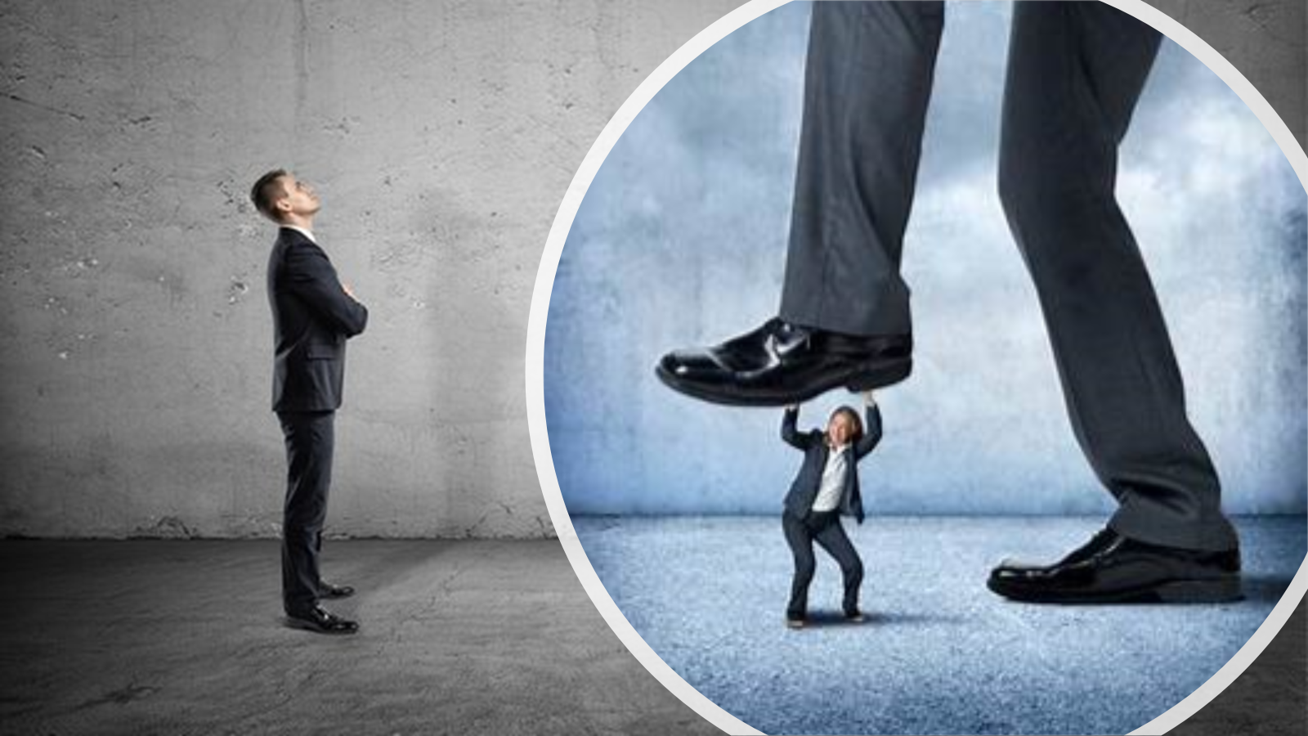
A Giant is Anything that…
…Intimidates with it’s Size
…Threatens with it’s Power …Seeks to Take Away
Stands between You
and Victory

Slide 5
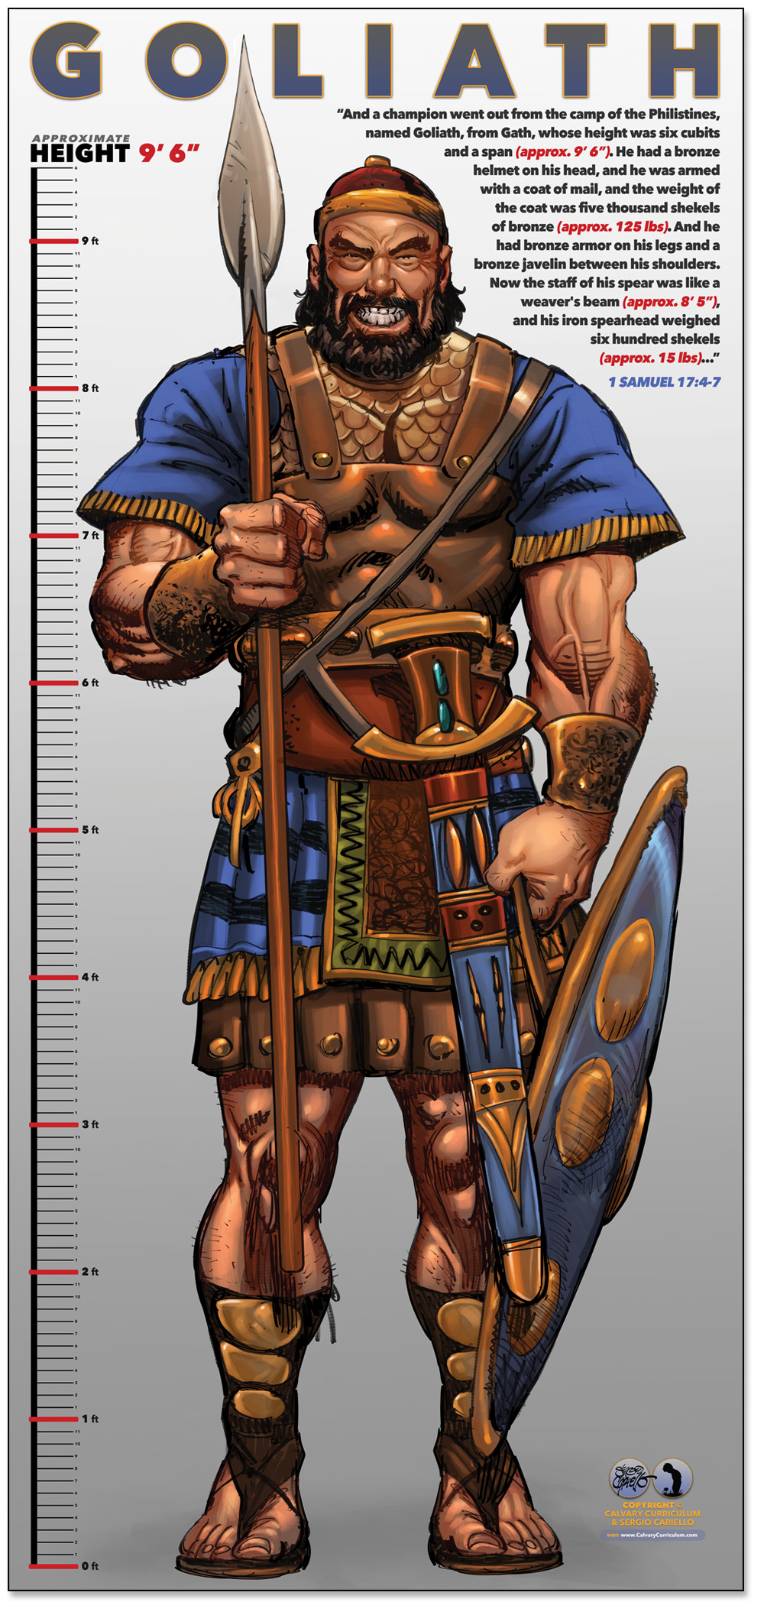
“Giants Come to Put Us in Fear”
“Giants We Face Today May Not Be Physical”
…situations, circumstances, or struggles that seem
…insurmountable and cause us to tremble in fear
“The Giants We Face Are Real and … Intimidating”
“Fear is a Tool the Enemy Uses to Separate Us from God”
“Fear is a Part of Life”

Slide 6
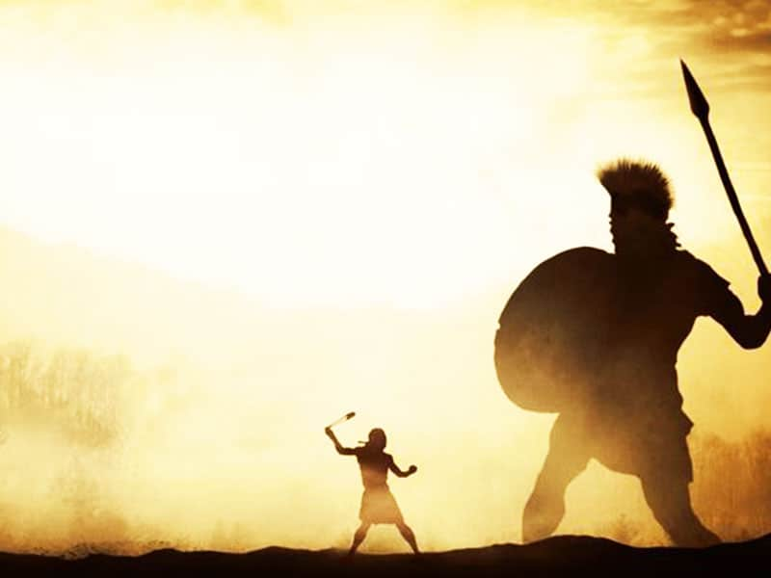
Faith Is Not A Magical Shield Making Our Problems Disappear
It is a Deep Trust In God that Gives Us The Courage to face our problems, knowing that He is with us and He will help us
This Faith Does Not Eliminate The Giants (fear) in our lives
but it Gives Us The Strength To Face Them
the Assurance That We Will Not Face Them Alone

Slide 7
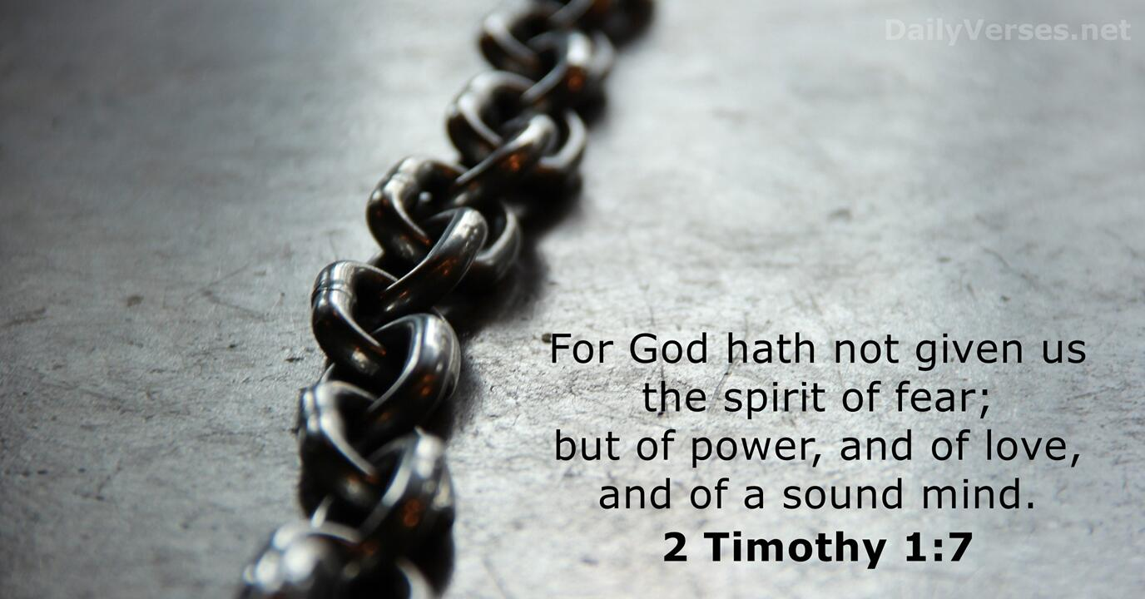
If we allow fear to take root in our lives, it can grow out of control,
keeping us awake at night, plaguing our thoughts,
We Sink on “What if?”
Our Fears Become Debilitating
When our fears threaten to overwhelm us, we should recall the
words of David: “The Lord who delivered me from the paw of the
lion and from the paw of the bear will deliver me from the hand of
this Philistine” -1 Samuel 17:37
We Stand on “What Is”
Our Faith Becomes Our Shield

Slide 8

David’s Faith was not a Blind Faith
It was a faith born out of experience
Faith is not a FEELING; it is a CHOICE
David’s Faith was also a Courageous Faith
Faith requires courage to step out of our comfort zones…
…to face our fears, and to take risks
David’s Faith was also a Humble Faith
He did not rely on his own strength or abilities
Faith requires humility to acknowledge dependence on God
David’s Faith was a Victorious Faith
He did not just talk about his faith; he lived it out
He did not just profess his trust in God; he demonstrated it
He faced the giant with a sling and a stone

Slide 9
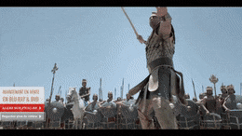
David Saw Differently… 7 Reasons
His Experience was Different (34)
he brought to battlefield past victories
His Perspective was Different (37)
he looked past giant / saw opportunity
His Methods were Different (39)
he used proven weapons that work
His Conviction was Different (26)
he recognized giant not under covenant

Slide 10
David Saw Differently… 7 Reasons
His Motives were Different (46)
he heard the threats against God and knew God could beat him
His Vision was Different (47)
he wanted to make Yehweh known as the most powerful God
His Attitude was Different (29)
he saw Goliath not as a threat too big to fight
…but a target too big to miss

Slide 11
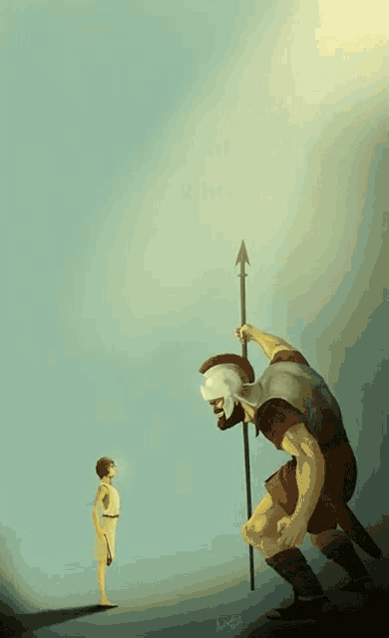
The Fight
He Moved …
Forward (48, 49) “seized opportunity”
Faith “let go & let God”

Slide 12
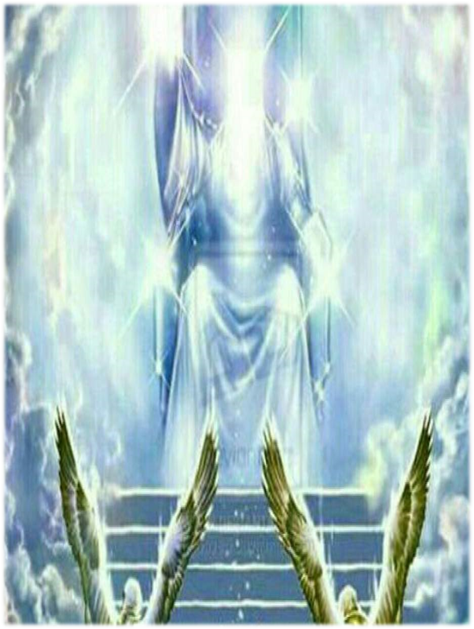
Forward
Once You Move Forward
Seize the Opportunity
Your Actions of Faith
Will Be Followed By…
An Invasion of God’s Victory

Slide 13
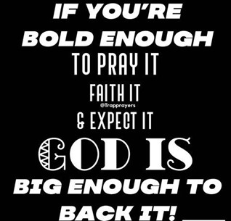
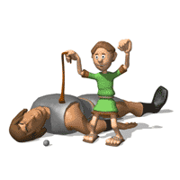
The Fight
He Moved …
Forward (48, 49) “seized opp…”
Fight “let go & let God”
Finish

Slide 14
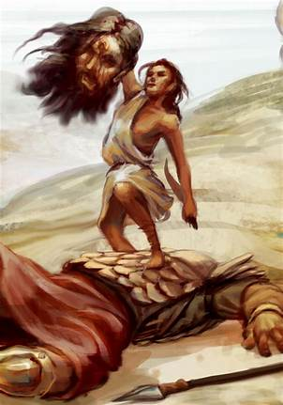
The Finish
Finish(50, 51)
Goliath means “Beheader”
Cut off his head
Turned situation around
When the Enemy Saw They Fled
When Israel Saw They Pursued

Slide 15
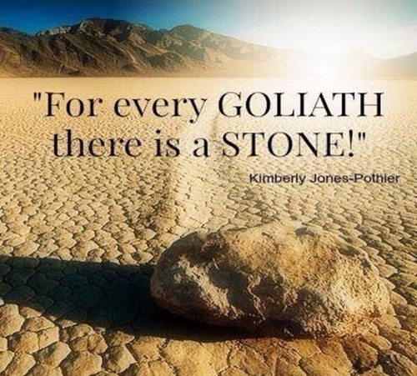
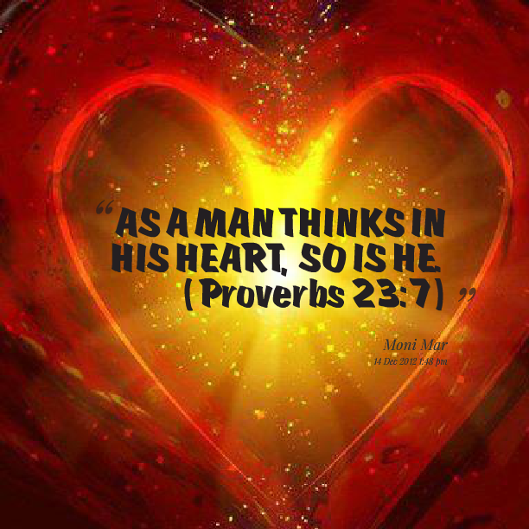
You Can Be the Hunter
“Victor Mindset”
You Can Be the Hunted
“Victim Mindset”

Slide 16
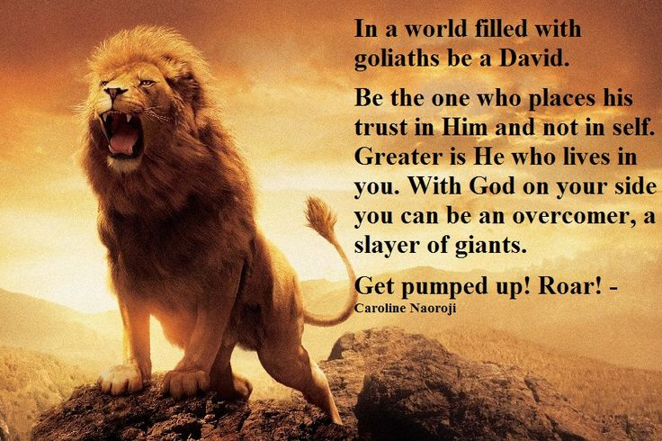

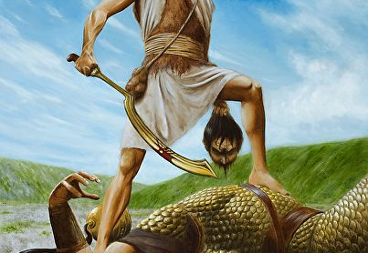


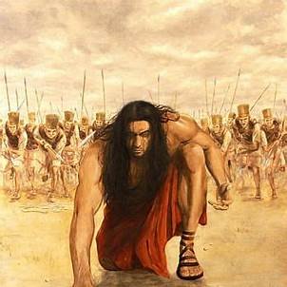


Slide 18

2024

Slide 19
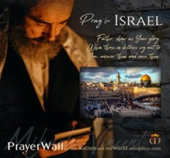

Psalm 17:7-9 -Complete Jewish Bible
⁷ Show how wonderful is your grace, savior of those who seek at your right hand refuge from their foes. ⁸ Protect them like the pupil of your eye, hide them in the shadow of your wings ⁹ from the wicked, who are assailing them, from their deadly enemies, who are all around them.
And All of the Innocent Victims
on Both Sides

Slide 20
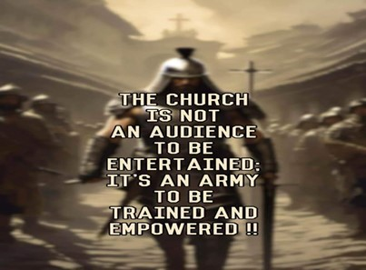
Repeat
These are the 2 Most Important Hours of My Week – Help Me to Cherish Them
I Am Here Today to Worship
Not to Be Entertained
I Am Singing to An Audience of One
Accept My Worship Oh Lord!

Slide 21
A guy spots a sign outside a house that reads "Talking Dog for Sale." Intrigued, he walks in.
"So what have you done with your life?" he asks the dog.
"I've led a very full life," says the dog. "I lived in the Alps rescuing avalanche victims. Then I served my country in Iraq.
And now I spend my days reading to the residents of a retirement home." The guy is flabbergasted.
He asks the dog's owner, "Why on earth would you want to get rid of an incredible dog like that?“
The owner says, "Because he's a liar! He never did any of that!“
Satan is a Liar – the Father of it

