Slide 1
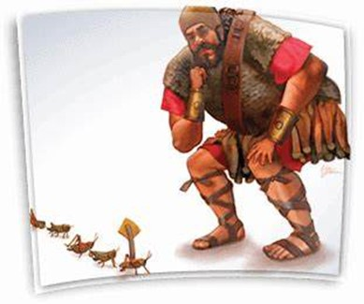
Courageous Living
“Land of the Giants”
Pt 3

Slide 2
Courageous Living
“Land of the Giants”
Pt 3
March 3, 2024
Edward Church
Rejecting the Grasshopper Mentality
Numbers 13:33

Slide 3
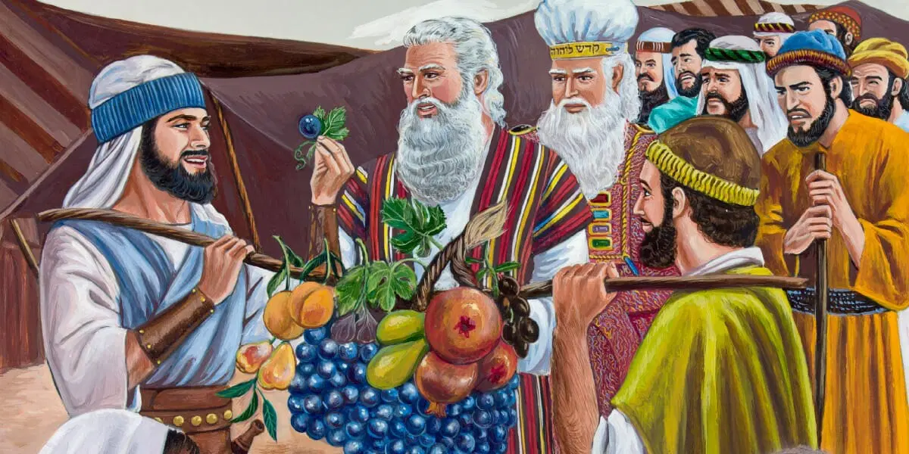
God’s Best was About to Come (1, 27)
Divine Mission
God Sent the Best of the Best (2b, 17)
Divine Commission
They Became the Worst of the Worst (28-33)
Human Omission

Slide 4
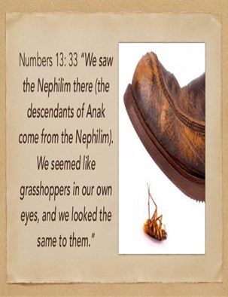
Grasshopper Mentality
Self-Defeating
Self-Limiting
Perception
We Carry of Ourselves and Abilities

Slide 5
Israel is Standing on the Brink of the Promised Land.
Delivered from the Bondage of Egypt…
...Led through the Red Sea,
Approaching the Promised land Flowing W- Milk / Honey
But instead of Stepping Forward In Faith…
…They Hesitated
Why?
Because They Saw Giants In The Land…
…Considered Themselves As Grasshoppers

Slide 6
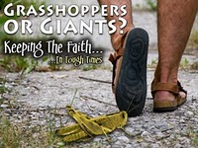
This is the mentality that we often adopt in our lives
We see the challenges, obstacles (giants) in our lives
We Feel…
Small
Insignificant
Incapable
We look at our own abilities / strength…
…we feel like grasshoppers.
But this is not how God sees us…
…it's not how He wants us to see ourselves.

Slide 7
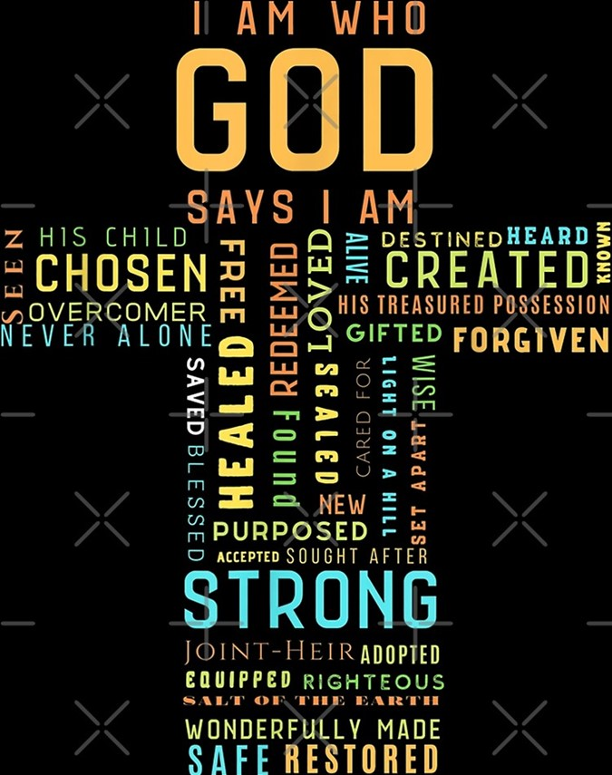
Understand Our Perception of Ourselves Matters.
How We See Ourselves Affects How We…
Behave
Interact w- Others
Face Challenges
If we see ourselves as grasshoppers…
…we will act like grasshoppers
We shy away from challenges,
feel overwhelmed by obstacles…
…doubt our ability to make a difference.

Slide 8

Small -inferiority complex-
Exoskeleton - strength only comes from outside sources-
Afraid Travel Alone -always groups
Beware- When a Group of Locust Come - they always bring destruction
Only Defense - leaping ability- never stay / fight
Caused a Distorted View
Inward -in our eyes
Outward -in their eyes too
Canaanites Saw 12 People They Had Never Seen Before..
…What Did They See?
Strange Sight –
2 Giants/ 10 Grasshoppers

Slide 9
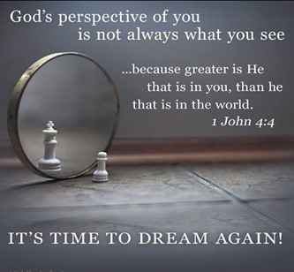
This Is How God Sees Us:
His Beloved Children
Heirs of His Kingdom
More Than Conquerors
We Will Act Accordingly
We Will Face Challenges With Courage
We Will Overcome Obstacles With Faith
And We Will Make a Difference In the World Around Us

Slide 10
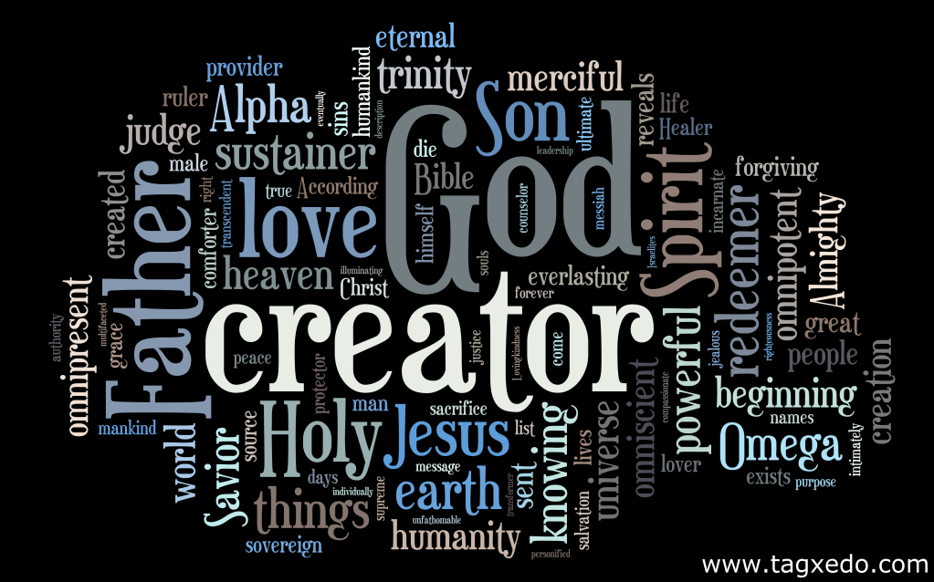
Understand Our Perception of God Matters
If We See God As …
Distant, Uncaring, Powerless
Then We Feel…
Alone, Unloved / Helpless
But if we see God as He truly is,
Loving Father
Mighty Savior
Ever-Present Help In Times Of Need,
Then We Will Feel
Loved, Cherished, And Empowered.

Slide 11
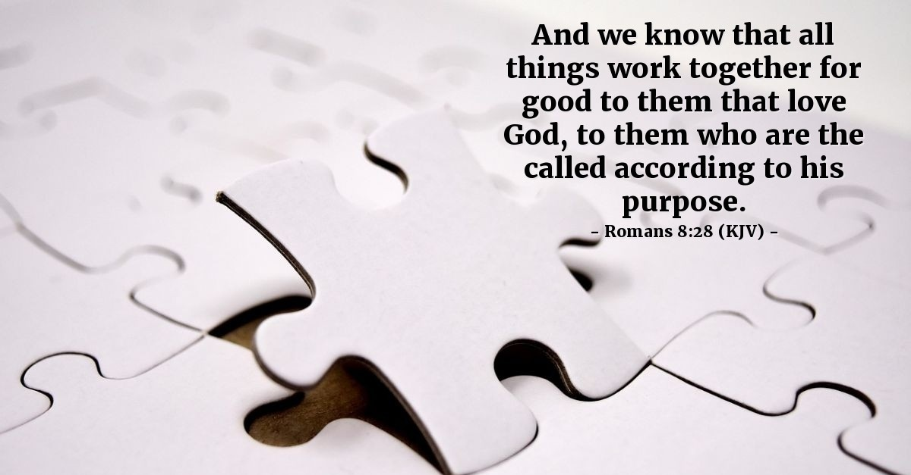
Our Perception of Our Circumstances Matters
If we see circumstances as insurmountable, hopeless, as giants,
then we will feel defeated, discouraged, and despairing.
But if we see our Circumstances through the Lens of…
God’s Promises…
as opportunities for growth, as stepping stones to victory,
then we will feel hopeful, encouraged, and triumphant.
Romans 8:28 Amp
And we know [with great confidence] that God [who is deeply concerned about us] causes all things to work together [as a plan] for good for those who love God, to those who are called according to His plan and purpose.

Slide 12
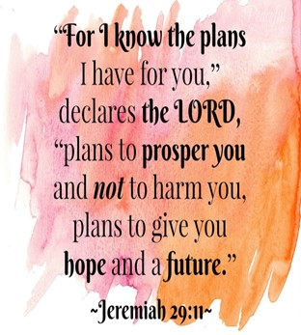
Understand Our Perception of Our Future Matters
If we see our future as uncertain, as bleak, as full of giants,
then we will feel anxious, fearful, and pessimistic.
But if we see our future as God sees it,
as full of promise,
as full of potential,
as full of victory, then we will feel confident, courageous, and optimistic.
I know what I’m doing.
I have it all planned out—
plans to take care of you,
not abandon you,
plans to give you
the future you hope for.

Slide 13
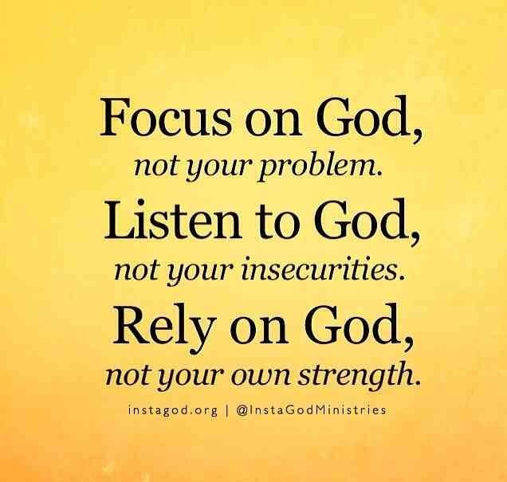
How Do We Change Our Perception?
How Do We Reject The Grasshopper Mentality?
We do it by renewing our minds with the Word of God
We Do It By…
Meditating On His Promises
verses
Focusing On The Your Problems

Slide 14

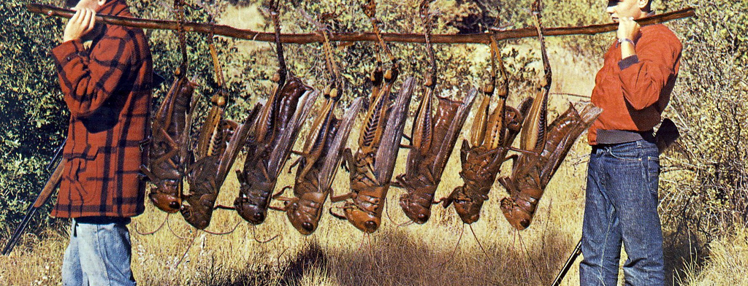
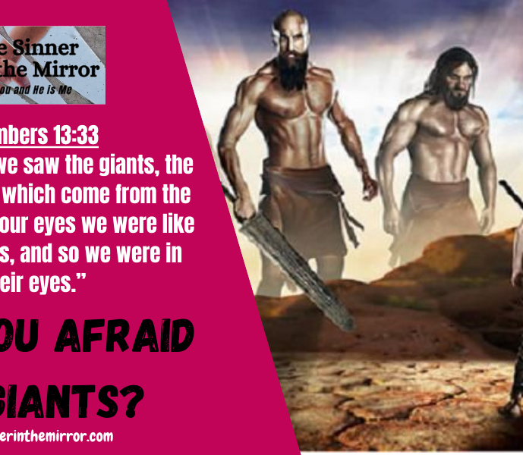
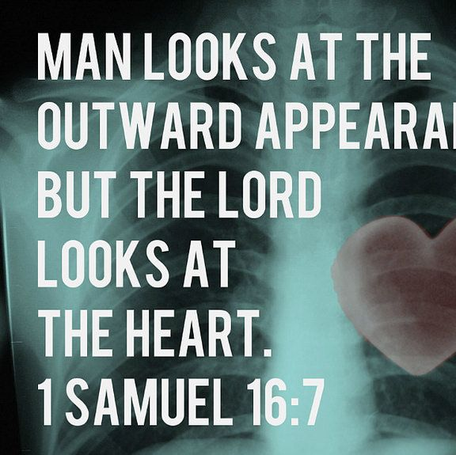
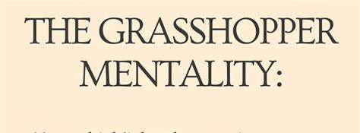
The Promise Reminds Us
We Are Not Limited
By the Boundaries of Our Circumstances
But
By the Boundlessness of God's Possibilities

Slide 15
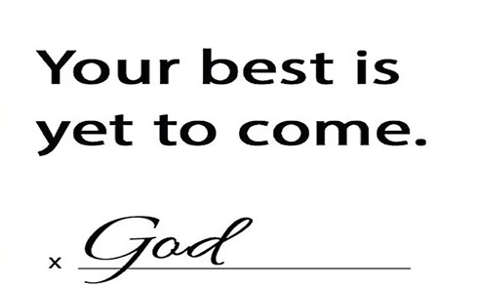
2024

Slide 16
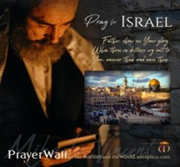

Psalm 17:7-9 -Complete Jewish Bible
⁷ Show how wonderful is your grace,
savior of those who seek at your right hand
refuge from their foes.
⁸ Protect them like the pupil of your eye,
hide them in the shadow of your wings
⁹ from the wicked, who are assailing them,
from their deadly enemies, who are all around them.
And All of the Innocent Victims
on Both Sides

Slide 17
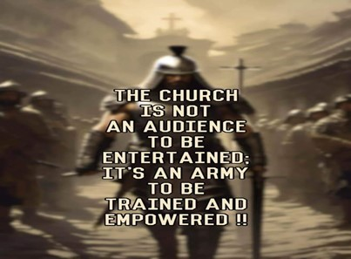
Repeat
These are the 2 Most Important Hours of My Week – Help Me to Cherish Them
I Am Here Today to Worship
Not to Be Entertained
I Am Singing to An Audience of One
Accept My Worship Oh Lord!

Slide 18
A man paid a visit to his local psychologist. When the doctor asked him what had prompted the visit, the man said, “I’m suffering from an inferiority complex.” Over the next few weeks, the psychologist put his new patient through an extensive battery of tests.
Next came the long wait while the test results were being evaluated. Finally, the doctor called him in for another consultation about the test results. The doctor began, “I have some interesting news for you.” The man asked, “What’s that?” The doctor responded, “You don’t have a complex … you are inferior.”

