Slide 1
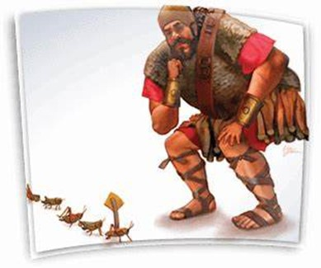
Courageous Living
“Land of the Giants”
Pt 4
March 24, 2024
Edward Church
Rejecting the Grasshopper Mentality
Numbers 13:33

Slide 2
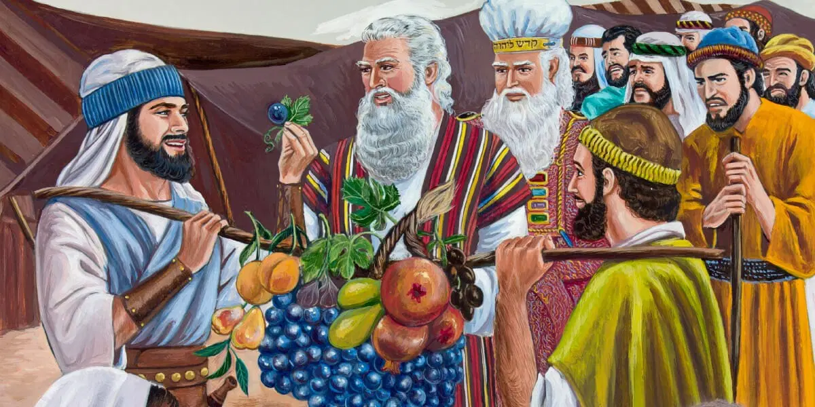
God’s Best was About to Come (1, 27)
Divine Mission
God Sent the Best of the Best (2b, 17)
Divine Commission
They Became the Worst of the Worst (28-33)
Human Omission

Slide 3
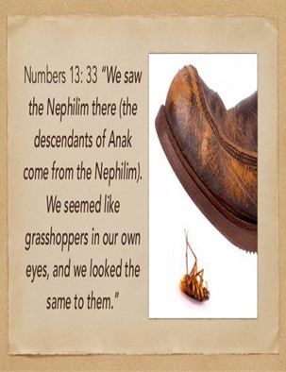
Grasshopper Mentality
Self-Defeating
Self-Limiting
Perception
We Carry of Ourselves and Abilities

Slide 4
Israel is Standing on the Brink of the Promised Land.
Delivered from the Bondage of Egypt…
...Led through the Red Sea,
Approaching the Promised land Flowing W- Milk / Honey
But instead of Stepping Forward In Faith…
…They Hesitated
Why?
Because They Saw Giants In The Land…
…Considered Themselves As Grasshoppers

Slide 5
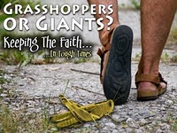
This is the Mentality that We Often Adopt In Our Lives
We see the Challenges, Obstacles (giants) in our lives
We Feel…
Small
Insignificant
Incapable
We Look At Our Own Abilities / Strength…
…We Feel Like Grasshoppers.
But This Is Not How God Sees Us…
…It's Not How He Wants Us to See Ourselves.

Slide 6
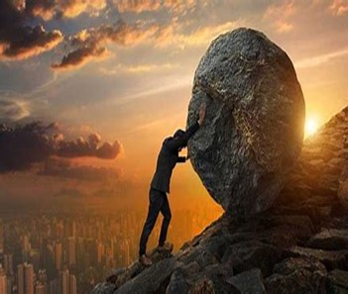

God Left Giants in Promised Land On Purpose..to Produce Struggle
God Knows a Lack of Struggle Produces:
    Spiritual Weakness
    Loss of Spiritual Edge
    Thanklessness
    Spiritual Laziness

Slide 7
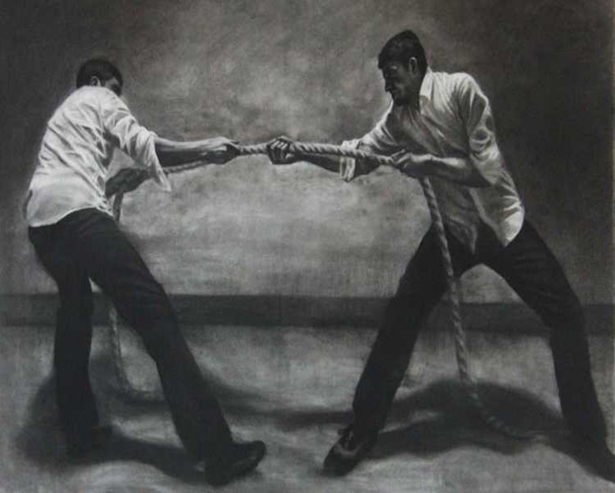
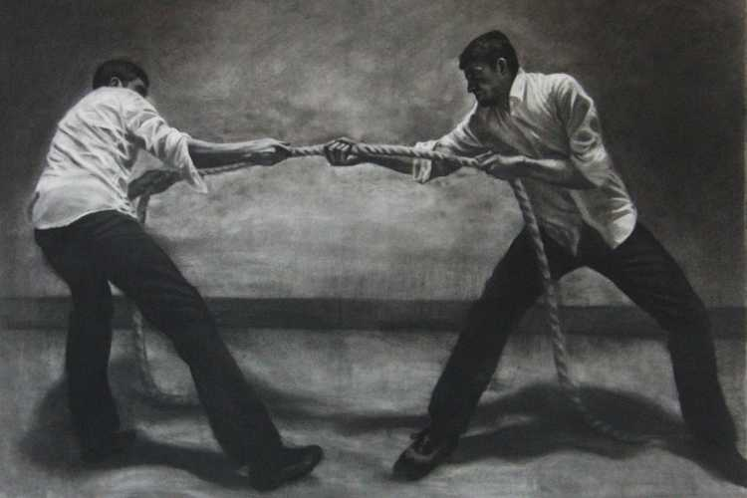
God Left Giants in Promised Land On Purpose..
…to Produce Struggle
#1- Because They Needed to Learn How to Fight
We Are at War!
Eph 6:10-12, ¹⁰ Finally, my brethren, be strong in the Lord, / in the power of his might.¹¹ Put on the whole armour of God, that ye may be able to stand against the wiles of the devil. ¹² For we wrestle not against flesh and blood, but against principalities, against powers, against the rulers of the darkness of this world, against spiritual wickedness in high places.
This War is…
    Daily -Attacks can come at any hour
    Powerful -all your strength not enough
    All Inclusive -No One is Excluded

Slide 8
God Left Giants in Promised Land On Purpose..
…to Produce Struggle
#1- Because They Needed to Learn How to Fight
Psalms 18:34 (KJV)
³⁴ He teacheth my hands to war, so that
a bow of steel is broken by mine arms.
  Speaks of the Ordinary Doing the Extra-Ordinary
      Dependant on God for…
            Guidance -teaches
            Strategy -to war
            Purpose -bow of steel broken
            Strength -broken by mine arms

Slide 9
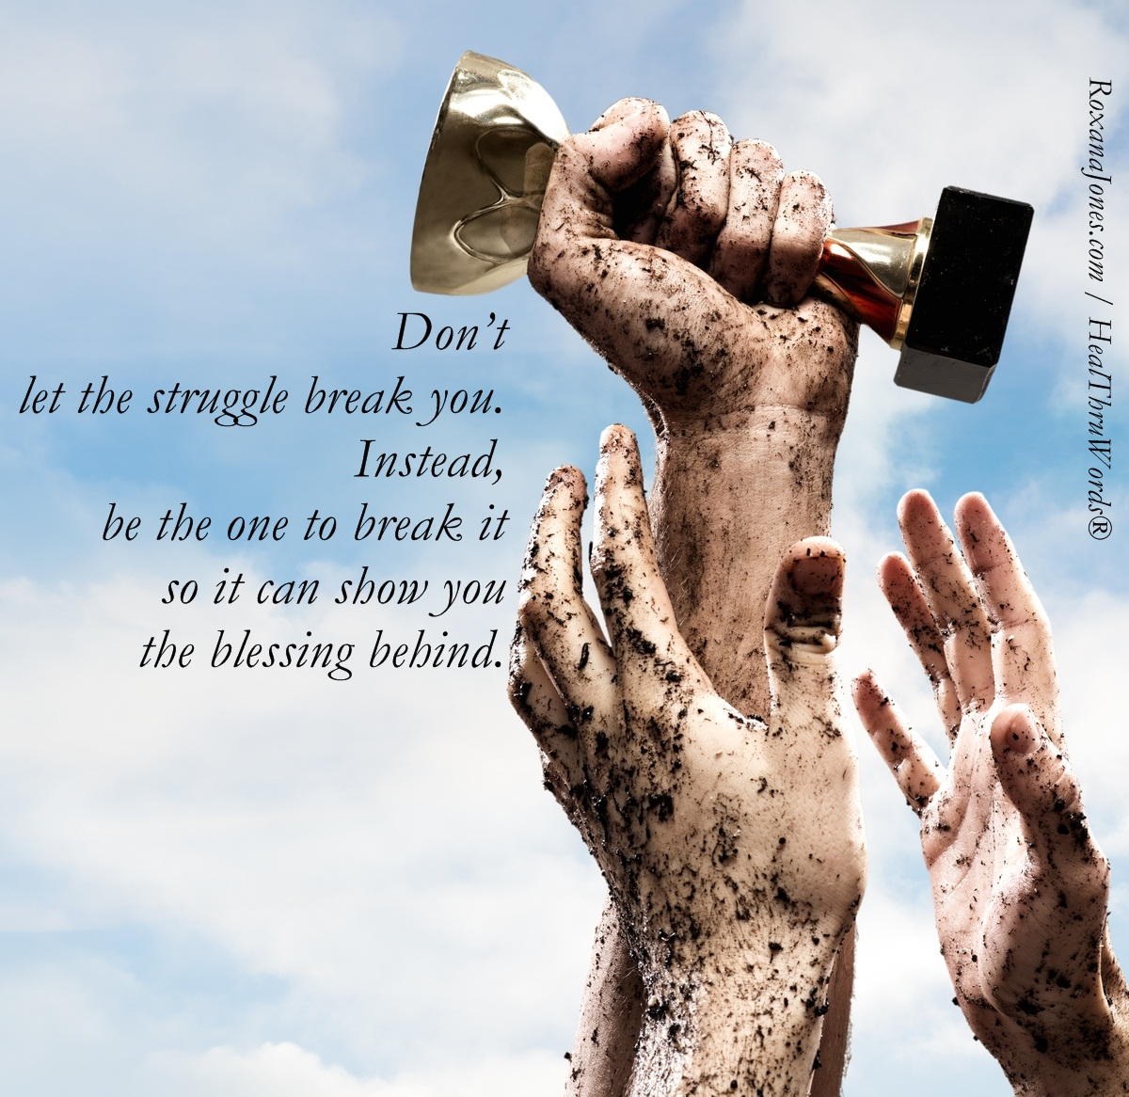
God Left Giants in Promised Land On Purpose..
…to Produce Struggle
#2- Because Giants Distinguish the Difference …
…Between Professors and Possessors
  It’s one thing to confess the promises of God, it’s another thing to strap on your sword / go toe to toe with your giants and possess your promises.
#3- Giants Expose the Grasshoppers in the Crowd
(When giants show up grasshoppers speak up).
Grasshoppers usu Blend into Their Environments …
…But Giants Uncover Them

Slide 10
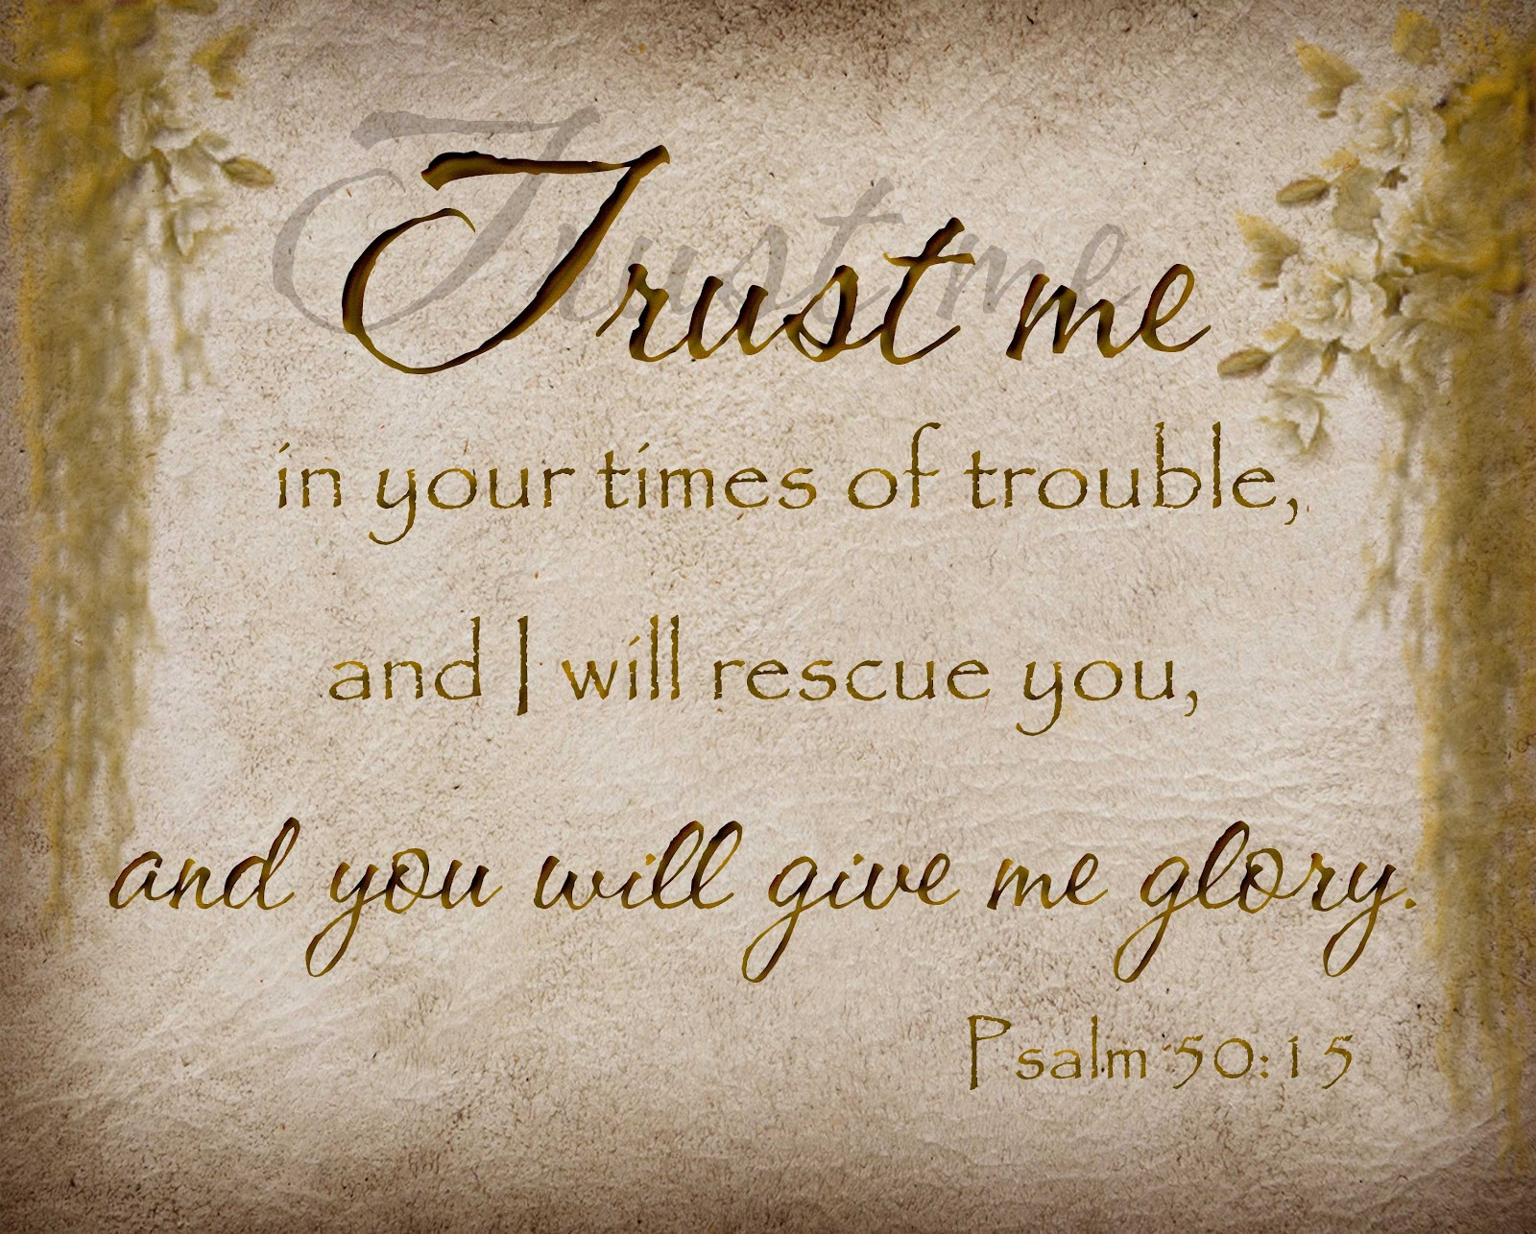

The Struggle
#4- You Get to Know Yourself in the Struggle
(the real you comes out under pressure)
#5- You Get to Know Your God
…You Realize that God is Your Only Help
…You Realize that He is More Than Enough!
#6- Struggles Test Your Level of Commitment
The Only Way To Truly Gauge Your Level Of Commitment Is Through The Struggle

Slide 11
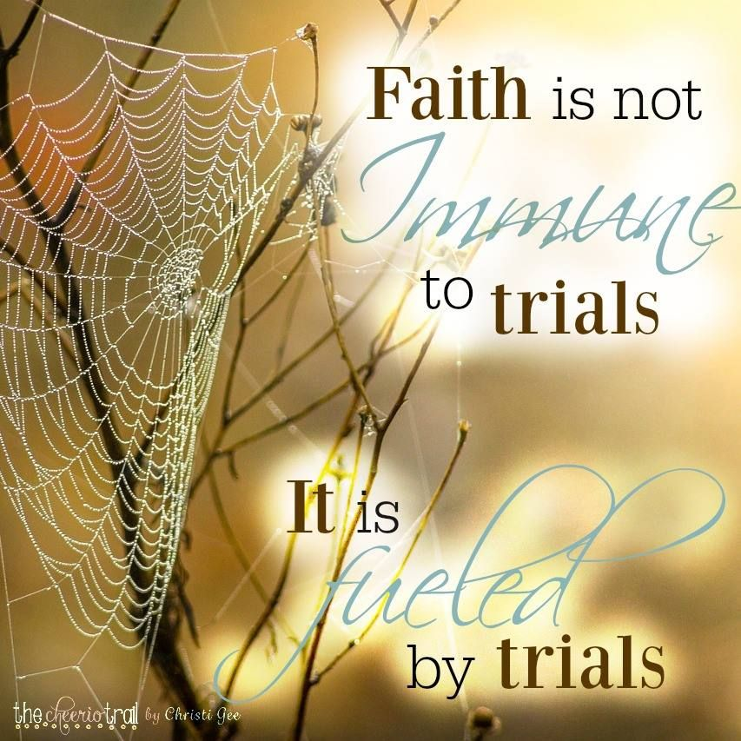
#7- The Struggle Qualifies You for the Reward:
David heard them speak of a reward…
…but he knew the reward was only for the person
…who would fight and KILL Goliath.
1 Sam 17:25 And the men of Israel said, Have ye seen this man that is come up? surely to defy Israel is he come up: and it shall be, that the man who killeth him, the king will enrich him with great riches, and will give him his daughter, and make his father’s house free in Israel.

Slide 12
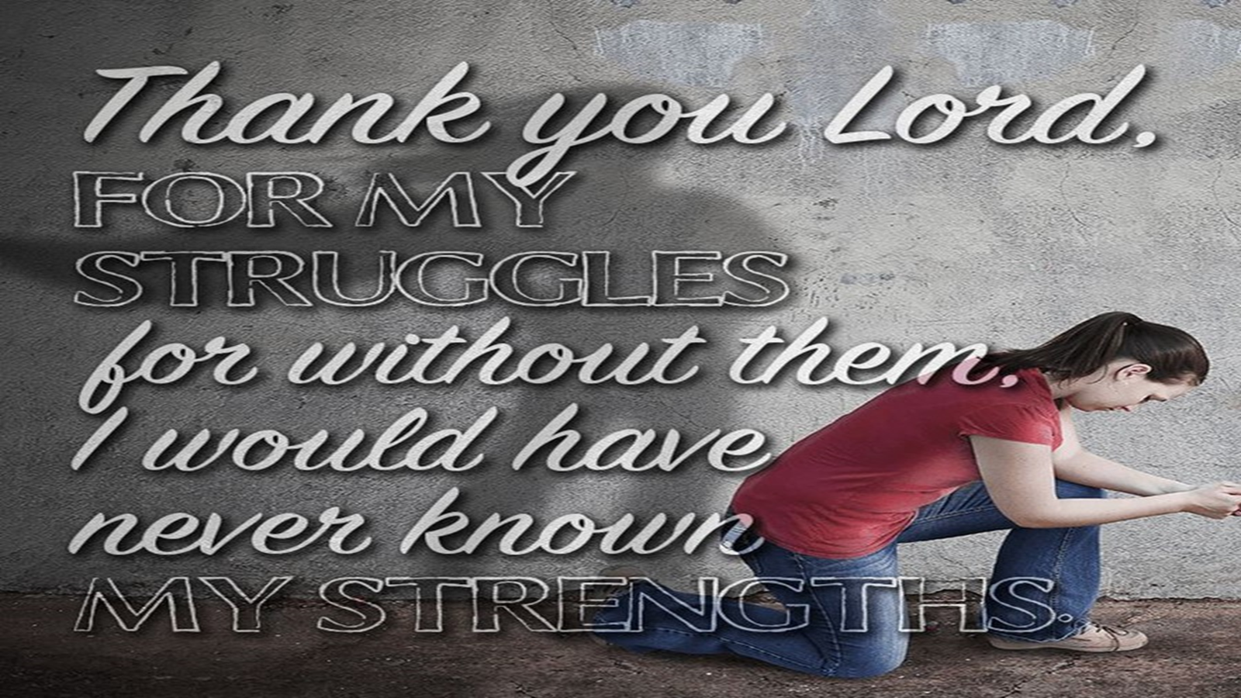
Giants Have Been in the Land a Long Time…
…They Won't Leave Without a Fight (28)
These Giants had been in Canaan for Generations
  Negative
  Destructive
  Stubborn
You Must…
  Hold on to the Vision
  Refuse to Quit the Struggle
  Trust God for Strength / Results
Don't Get Discouraged When Everything Doesn't Change Overnight
  War Takes Longer and Costs More Than We Expect
  But Victory is Certain Through the Grace of God

Slide 14
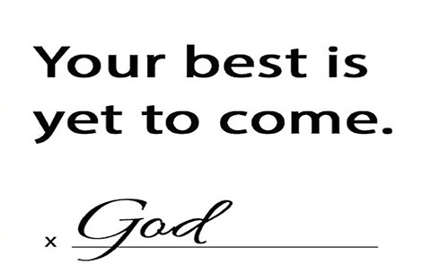
2024

Slide 15
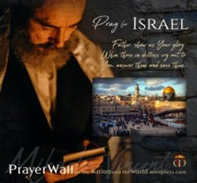

Psalm 17:7-9 -Complete Jewish Bible
⁷ Show how wonderful is your grace,
savior of those who seek at your right hand
refuge from their foes.
⁸ Protect them like the pupil of your eye,
hide them in the shadow of your wings
⁹ from the wicked, who are assailing them,
from their deadly enemies, who are all around them.
And All of the Innocent Victims
on Both Sides

Slide 16
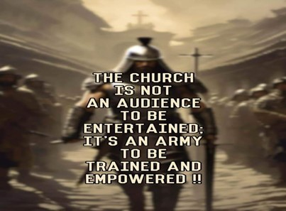
Repeat
These are the 2 Most Important Hours of My Week – Help Me to Cherish Them
I Am Here Today to Worship
Not to Be Entertained
I Am Singing to An Audience of One
Accept My Worship Oh Lord!

Slide 17
At a nursing home in Florida, a resident group was discussing the giant ailments in their lives.
"My arms are so weak I can hardly lift this cup of coffee."
"Yes, I know my cataracts are so bad I can’t even see my coffee."
"I can’t turn my head because of the arthritis in my neck!"
"My Blood pressure pills make me dizzy."
"Well, I guess that’s just the price we pay for getting old."
Everyone agreed, except one woman who said, "Well, it’s not that bad! Thank God, we can all still drive!"

