Slide 2
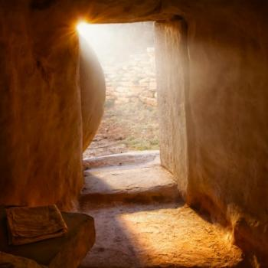
John 20:1-18
Edward Church
April 25, 2022
“Finding Hope”
First Seven Sayings...
of the
...Resurrected Jesus

Slide 3
Video
Passion words from Cross

Slide 4
Video
resurrection

Slide 5
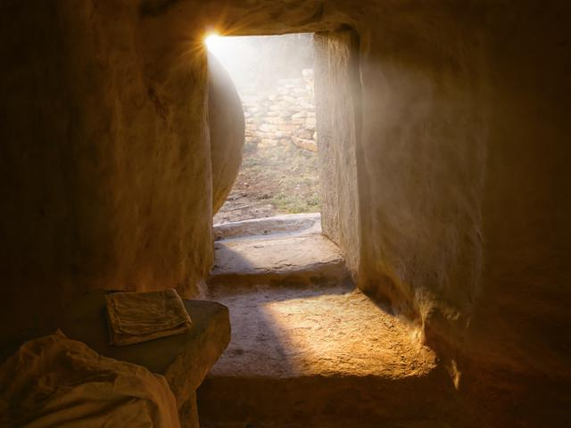
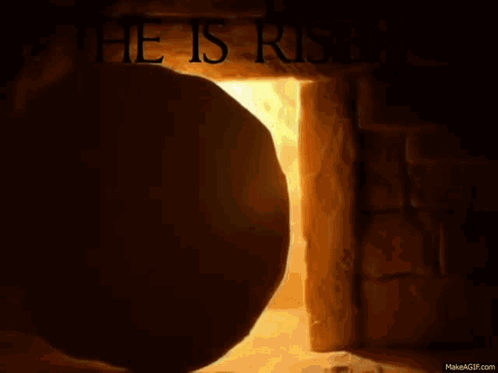
Christ’s Resurrection Greatest Event in History
Seven Words of the Cross
is a Message from God to All the World
1st Seven Words of the Risen Christ
is a Message from God to Church
The Resurrection of Christ was the Miracle of Miracles
Without it --- No Savior
No Sure Word of God
No Salvation
No Hope Beyond the Grave

Slide 6

Message of “COMFORT”
Two Gardens
First Garden- Genesis 3
Woman Questioned
Death Entered the World
Left with a Promise and Weeping
Second Garden-
Woman Questioned “Why weepest…?”
Death was Defeated
Standing with the Promise and Joy

Slide 7

“Woman Why Weepest Thou” (15)
Message of “COMFORT”
New Garden
Rev. 21:4
"And God shall wipe away all tears from their eyes”
Tears Ended Forever!!

Slide 8
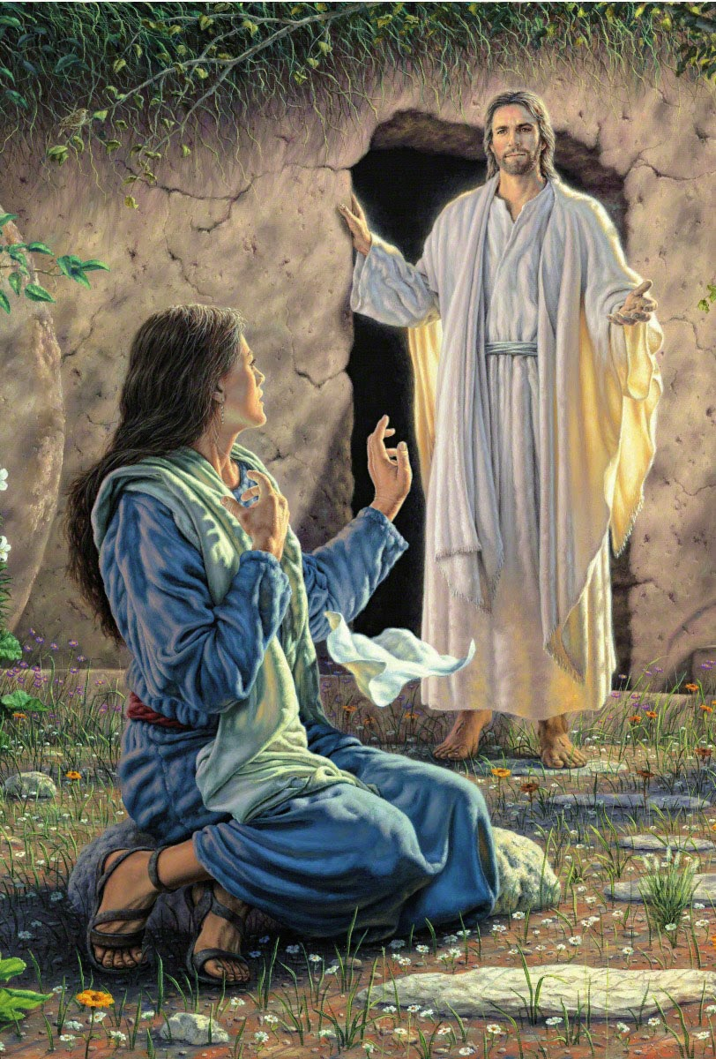
“Mary….”
Message of “INTIMACY”
Jesus Called Mary by Name
Jesus Knows…
His Disciples
Their Needs
How to Address Them
He Called
Thomas by Name (29)
He asked for Peter by Name.
Mark 16:7 (NKJV) But go, tell His disciples--and Peter--that He is going before you into Galilee; there you will see Him, as He said to you."

Slide 9

Message of “HOPE”
She Had the Message of the Resurrection.
A Message to Tell to the World
Sin Had Been Paid At The Cross
We Have A Hope Beyond the Grave
One Day and a Great Reunion Day
All Preaching Across the Centuries is Useless…
…Without the Resurrection

Slide 10

“Peace Be with You” (19-21)
Message of “PEACE”
God’s Promise of Peace.
Doors Shut -Fear Destroys Peace
Stood Midst -His Presence Destroys Fear
Be (present tense) - Now!!!
Absolute Peace
Peace = To Set At One Again
…Bind that which was Separated
Peace with God (salvation)
…Peace of God (self)
…Peace Through God (situations)

Slide 11

“Peace Be with You” (19-21)
Message of “PEACE”
Peace Not Blame
Peace Not Fault-Finding
Peace Not Rebuke were the…
…First Words
He is the Prince of Peace!!!

Slide 12
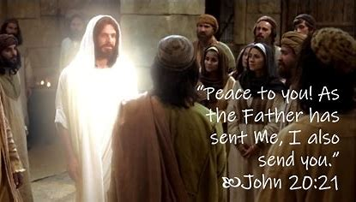
“I Send You…Receive Ye Holy Ghost” (21-23)
Message of “POWER”
Here is the Call to Service…
…the Power to Serve.
There is a Job to be Done for the Lord
We are Powerless without Him
The Cross gives us the Message
The Resurrection gives us the Power

Slide 13
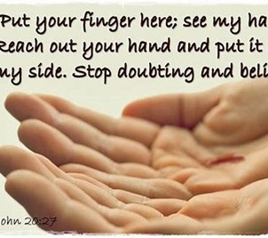
“Reach…Be Not Faithless…Believe” (27)
Message of “CHALLENGE”
Stages to Dealing with Doubt
Give Doubt to Jesus-
Stage 1 -Jesus Came to Him
Powerless Stage
Stage 2 -Take a Hold of What You Do Know
Personal Power Stage
Stage 3 -It Will Enable You to Believe What You Could Not
God Enabled Stage

Slide 14
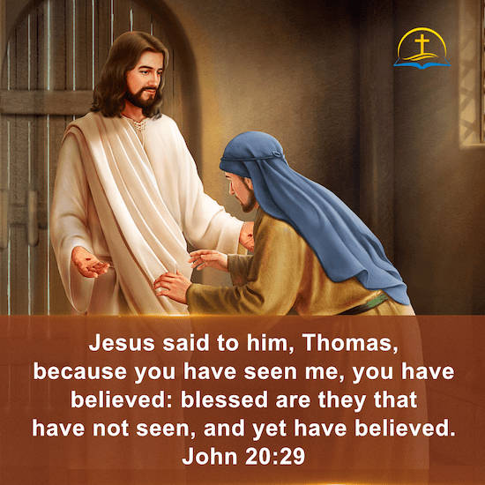
“Blessed…Have Not Seen and Believe” (29)
Message of “PROMISE”
A Word to Us Today…
We are Saved by Faith - Eph.2:8-9
Inner Grace …
…Affecting Spirit
…Affecting Self
We Are to Walk by Faith - Rom.3:24
Outward Grace…
…Affecting Life
…Investing in Others

Slide 15

“Blessed…Have Not Seen and Believe” (29)
Message of “PROMISE”
Faith Brings Blessing
in Time and for Eternity!
Mary lost the Lord (13)
…but she found Him Because of
…the Resurrection and His Love

Slide 16
Video
Video

Slide 17
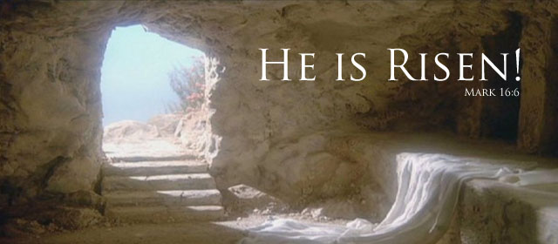
He Took Our Fear of
Death
Life
Conquered Them At Cross
On the Third Day
He Arose

Slide 18

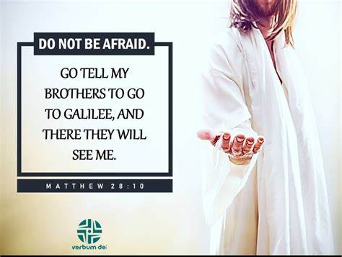

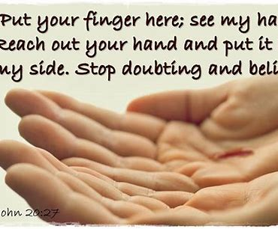

Slide 19
Painting the church
A cheating painting contractor had been skimping by thinning his paint excessively. Nevertheless, he landed a big job painting a church. He was almost done when a major storm blew up. It washed all the paint off.
Amid the thunder and lightening, there came a loud voice… “REPAINT,” it boomed. “REPAINT, AND THIN NO MORE!”

